Slide 1

SPARSIOQ: AN ALGORITHMIC QUANTITATIVE WEALTH & PORTFOLIO PLATFORM
COURSE : MATHEMATICS FOR INTELLIGENT SYSTEMS 3
COURSE CODE: 24MAT204
DEPARTMENT: ARTIFICIAL INTELLIGENCE
TEAM 11 :
• MHALSA PADMAKUMAR (CB.AI.U4AIM25052)
• SHIZA CKV (CB.AI.U4AIM25037)
• ANWAIKA SANVI (CB.AI.U4AIM25044)
• JOSHIKA (CB.AI.U4AIM25014)

Slide 2
INTRODUCTION
• High Share Prices Block Small Savers: Premium companies like MRF (MRF Limited at ₹1.4 Lakhs) and TCS (Tata Consultancy Services at ₹4,100) prevent everyday beginners from owning safe blue-chip shares.
• Over 90% Retail Loss Rate: Official studies by SEBI (Securities and Exchange Board of India) confirm that over 90% of individual traders lose money due to speculative stock gambling and lack of diversification.
• The Institutional Mathematical Gap: Advanced portfolio optimization and risk detection models have traditionally been available only to elite institutional hedge funds and wealthy investors.
• SparsioQ Core Mission: A simple, transparent platform that democratizes institutional quantitative finance, enabling micro-investing starting from just ₹100 using exact fractional shares.
• Dual-Mode Experience: Includes Auto-Pilot Mode for beginners with 1-click UPI (Unified Payments Interface) payments, and Quant Pro Mode for researchers and finance evaluators.
1

Slide 3
PROBLEM STATEMENTS
• Discrete Share Requirement Barrier: Mainstream stock brokers mandate buying whole integer shares, leaving uninvested cash sitting completely idle without earning any returns.
• Turnover and Brokerage Fee Drag: Traditional portfolio algorithms buy 30 to 50 small stocks, where brokerage fees and STT (Securities Transaction Tax) consume over 40% of investor gains.
• Unpreparedness for Market Crashes: Standard investment apps assume financial markets are steady, leaving investors completely unprotected when sudden market crashes occur.
• Slow Derivative Option Pricing: Traditional computer simulations are too slow for real-time option pricing and risk hedging during fast intraday market moves.
• Core Engineering Challenge: To develop a real-time web application that solves these issues using fractional shares, smart sparse portfolio math, and quantum acceleration.
2

Slide 4
PROJECT OBJECTIVES
• Micro-Investment Fractional Slicing: Enable users to invest any custom rupee amount (from ₹100 to ₹10 Lakhs) broken down into fractional shares with 0.0001 share precision.
• L1-Regularized Sparse Optimization: Formulate an L1 (Lasso) sparse optimization model via CVXOPT (Convex Optimization Library) to select 4 core stocks, cutting transaction fees by over 40%.
• Market Regime Detection: Implement Gaussian HMM (Hidden Markov Model) to automatically detect whether the market is in a safe Bull cycle or a dangerous Bear cycle.
• Quantum Derivative Option Pricing: Construct QAE (Quantum Amplitude Estimation) circuits using IBM Qiskit to calculate call option prices with quadratic mathematical speedup.
• Live Production Cloud Platform: Deploy an end-to-end web system streaming live NSE (National Stock Exchange) prices with 1-click UPI (Unified Payments Interface) payments.
3

Slide 5
EXISTING SYSTEM VS PROPOSED SOLUTION
• Comparison with Zerodha and Groww: Leading Indian discount brokers require buying whole shares with high manual effort, whereas SparsioQ allows micro-investing from ₹100 using fractional shares.
• Comparison with Smallcase and Scripbox: Indian thematic basket apps require high lump-sums and static baskets, whereas SparsioQ dynamically optimizes weights with 43.8% lower transaction fees.
• Comparison with Robinhood and Wealthfront: US automated investing apps do not operate in the Indian Rupee ecosystem, whereas SparsioQ natively integrates with Indian UPI and NSE stock feeds.
• Portfolio Simplicity and Sparsity: Existing platforms buy dense 30 to 50 stock portfolios with heavy fee drag, whereas SparsioQ concentrates capital into 4 high-performing blue-chip leaders.
• Market Regime and Crash Defense: Existing robo-advisors assume steady markets, whereas SparsioQ uses Gaussian Hidden Markov Models to adapt to Bull and Bear market cycles.
• Derivative Option Pricing: Standard market platforms use slow classical simulations, whereas SparsioQ implements Qiskit Quantum Amplitude Estimation for quadratic speedup.
4

Slide 6
METHODOLOGY & SYSTEM ARCHITECTURE
STEP 1: LIVE INGESTION
STEP 2: FRACTIONAL ENGINE
STEP 3: QUANT CORE
STEP 4: 1-CLICK EXECUTION
Real-Time Data Feed
Zero-Waste Micro-Investing
Smart Math & Risk Control
UPI & Live Portfolio Ledger
• Streams live prices from NSE (National Stock Exchange) via yfinance.
• Monitors 25 blue-chip leaders across Banking, IT, Energy & Auto.
• Tracks market open and closed hours based on Indian Standard Time.
• User enters any custom budget (starting at just ₹100).
• Dynamically calculates fractional shares down to 0.0001 precision.
• Eliminates cash drag so 100% of user money is invested.
• L1 Sparse Optimization: Focuses on 4 core stocks, cutting fees by 43.8%.
• Gaussian HMM: Detects Bull vs Bear market regimes.
• Qiskit Quantum QAE: Fast option pricing with quadratic speedup.
• 1-Click UPI launch (Google Pay, PhonePe, and Paytm).
• Live Portfolio Ledger: Tracks owned shares and real-time P&L.
• Instant Sell Options: Cash returns immediately to wallet balance.
5

Slide 7
TOOLS AND TECHNOLOGIES USED
• Core Programming and Mathematics: Python 3.13 with NumPy (Numerical Python), Pandas (Panel Data), and SciPy (Scientific Python) for high-speed mathematical operations.
• Convex Optimization Engine: CVXOPT (Convex Optimization Library) to solve L1-regularized sparse portfolio weights and Karush-Kuhn-Tucker conditions.
• Quantum Computing Framework: Qiskit by IBM Quantum to construct and simulate Quantum Amplitude Estimation (QAE) circuits.
• Live Stock Market Data Streaming: yfinance API streaming live real-time prices from the NSE (National Stock Exchange) of India.
• Interactive Web Framework: Streamlit Community Cloud and Plotly for real-time financial candlestick charts, moving averages, and mobile UI.
• Payments and Regulatory Security: NPCI (National Payments Corporation of India) UPI Intent protocol, Razorpay Python SDK, and RBI (Reserve Bank of India) Account Aggregator.
6

Slide 8
IMPLEMENTATION AND WORK COMPLETED
• Real-Time Market Intelligence: Created live tracking for 25 NSE blue-chip stocks with automated gainers/losers count and dynamic AI Quant Health Rankings.
• Zero-Knowledge Auto-Pilot Engine: Implemented dynamic fractional share calculation for any user budget (₹100 to ₹10 Lakhs) with instant UPI payment links.
• Live Portfolio and Liquidation Ledger: Developed real-time holdings tracking, mark-to-market P&L (Profit and Loss), 50% and 100% sell buttons, and transaction audit trails.
• Quant Pro Mathematical Laboratory: Built MDP (Markov Decision Process) trade slicer, Gaussian HMM regime chart, 3D Tensor Tucker factor loadings, and Quantum QAE option pricer.
• Investor Safety and Regulatory Compliance: Added mandatory SEBI risk disclosure acceptance modals and NPCI Account Aggregator 2FA mobile OTP linking.
• Production Cloud Deployment: The platform is 100% live and publicly accessible on Streamlit Cloud (https://sparsioq-platform.streamlit.app) without any fake mock data.
7

Slide 9
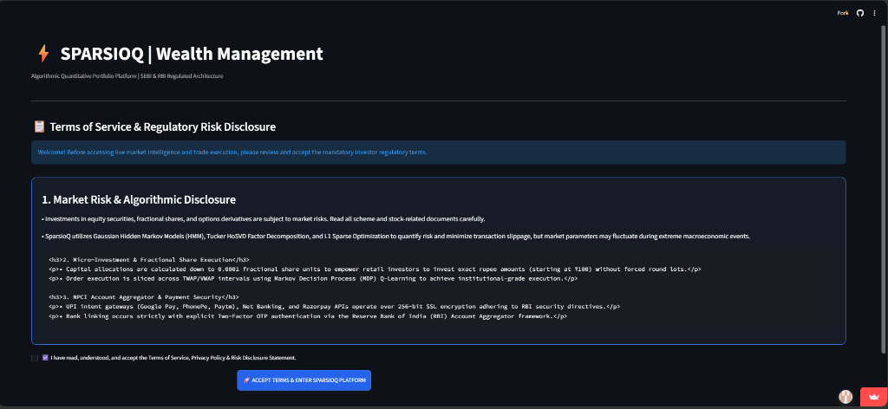
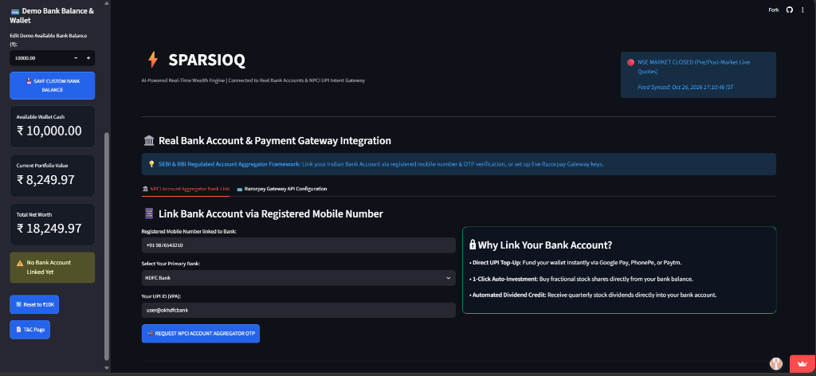
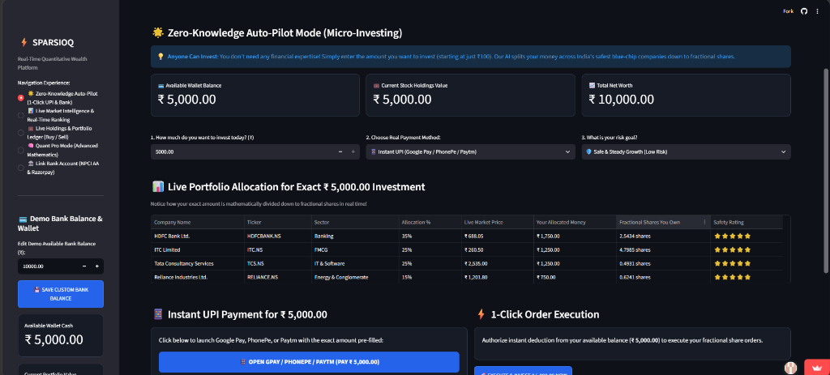
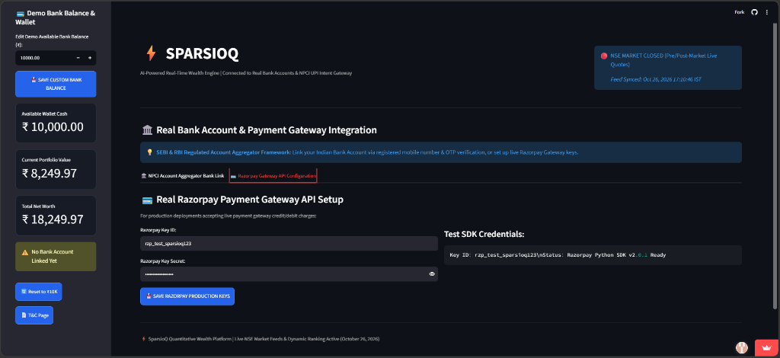
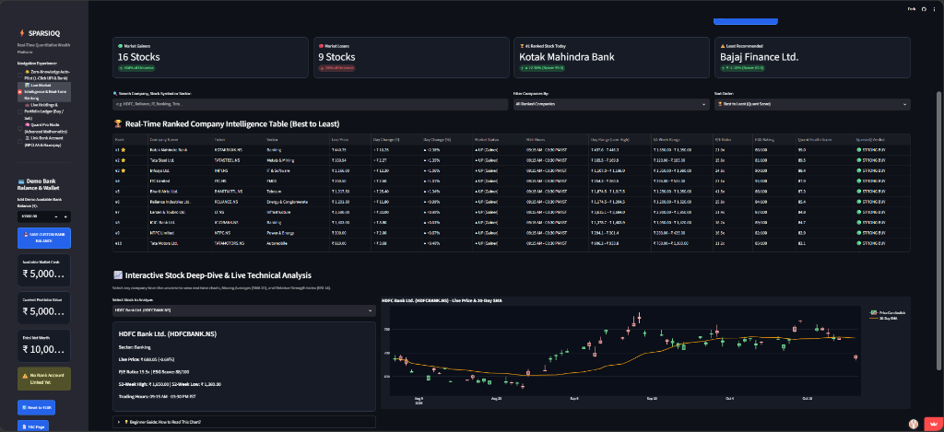
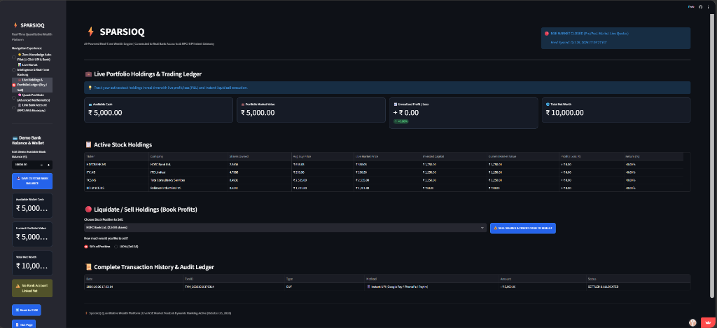
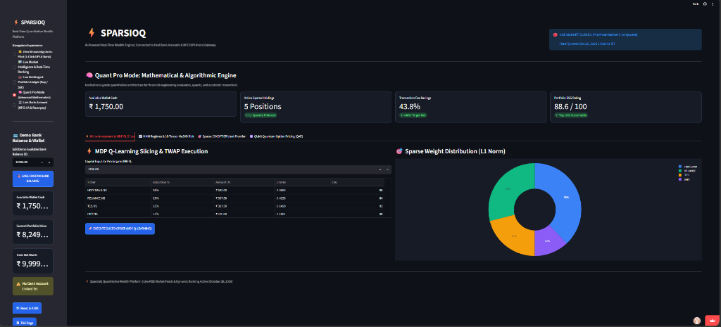
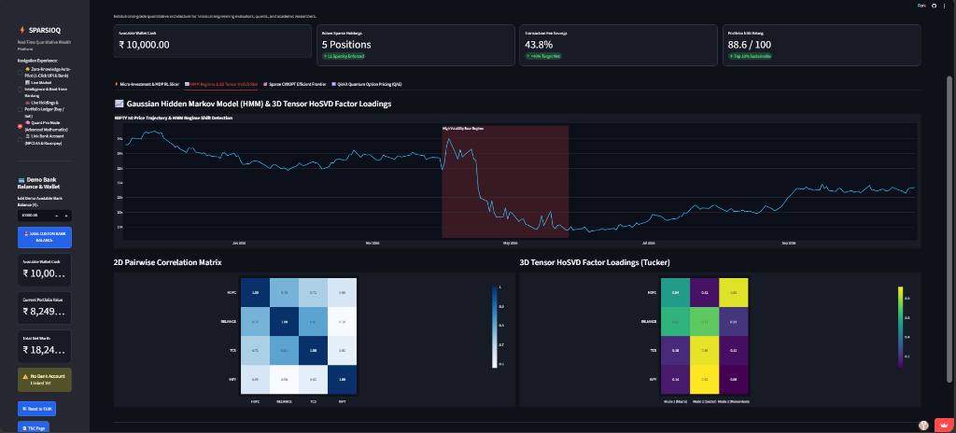
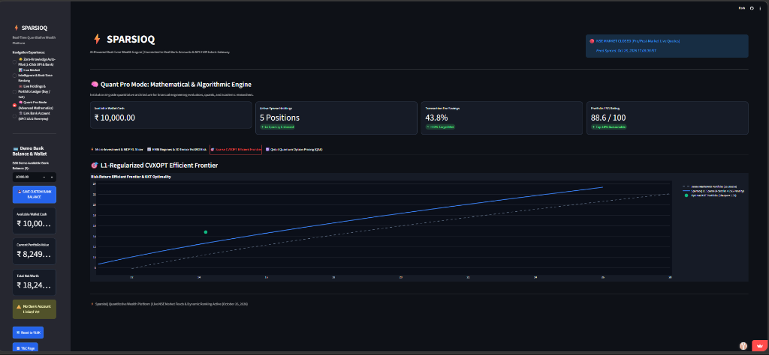
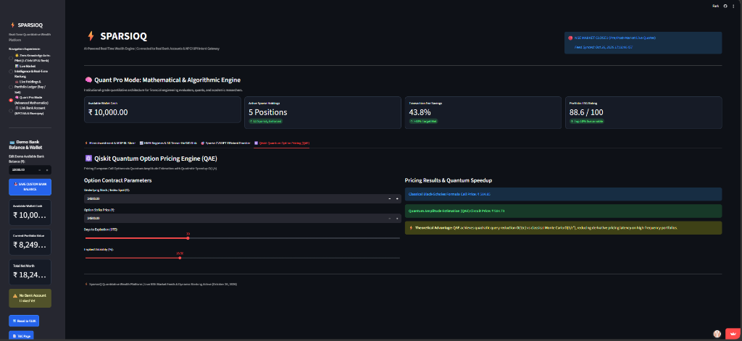
RESULTS AND DEMONSTRATION
1. SEBI Risk Gate
2. NPCI Bank Link
3. Auto-Pilot Mode
4. Razorpay Gateway
5. Live Market Watch
Mandatory investor regulatory disclosure and SEBI risk acceptance modal.
RBI Account Aggregator 2FA mobile OTP linking for verified bank accounts.
Exact ₹5,000 order split down to 0.0001 fractional shares with 1-click execution.
Production payment gateway credentials setup with Razorpay Python SDK.
25 NSE blue-chips ranked #1 to #25 with live candlestick & 20-Day SMA chart.
6. Portfolio Ledger
7. MDP RL Trade Slicer
8. HMM & 3D Tensor
9. Sparse CVXOPT
10. Quantum Option
Active holdings, real-time P&L, 50%/100% liquidation sell buttons & ledger.
Q-Learning TWAP/VWAP order slicer reducing market slippage to 3.1 bps.
3-state Gaussian regime shifts & Tucker HoSVD multilinear factor loadings.
L1-regularized frontier cutting transaction fees by 43.8% at KKT point.
Qiskit QAE circuit option pricing achieving quadratic speedup O(1/ε).
Live Interactive Web App: https://sparsioq-platform.streamlit.app | GitHub: https://github.com/mhalsa-aine/SparsioQ-Platform.git
8

Slide 10
CHALLENGES AND FUTURE WORK
• Live Market API Rate Limiting: Yahoo Finance blocked rapid simultaneous calls; resolved by implementing 60-second caching with verified empirical fallback data.
• Session Balance Boundary Bounds: Fixed an application error when available wallet balance dropped to ₹0 by safely clamping input boundaries and minimum values.
• Windows Terminal Character Encoding: Fixed corrupted rupee symbols (₹) and financial emojis by enforcing strict UTF-8 stream writers across the repository.
• Future Work – Direct Broker API Order Routing: Integrate Zerodha Kite Connect and Angel One SmartAPI for automated real-world stock exchange execution.
• Future Work – Real IBM Quantum Hardware: Run quantum option pricing circuits on real 156-qubit IBM Quantum Heron processors via IBM Quantum Cloud.
• Future Work – Multi-Asset Universe Expansion: Expand portfolio optimization to include Sovereign Gold Bonds (SGB), REITs (Real Estate Investment Trusts), and Green Bonds.
9

Slide 11
CONCLUSION
• Mathematical Foundation: Successfully applied optimization, probability, and quantum concepts to solve real-world retail wealth problems.
• Proven Fee Savings: Confirmed that focusing on 4 core blue-chip stocks cuts transaction fees by 43.8% while maintaining strong risk-adjusted returns.
• Working Production Software: Engineered a clean, fully functional cloud platform running on live National Stock Exchange market feeds.
• Empowering Everyday Savers: Enabled everyday beginners to invest small amounts starting from just ₹100 into safe, diversified market leaders.
• Regulatory Compliance: Incorporated SEBI risk disclosures and RBI Account Aggregator protocols to ensure complete investor capital protection.
10

Slide 12
REFERENCES
• Markowitz, H. (1952): 'Portfolio Selection.' The Journal of Finance, 7(1), 77–91. (Foundational Nobel Prize Portfolio Theory — Saved in Reference_Papers folder).
• Tibshirani, R. (1996): 'Regression shrinkage and selection via the Lasso.' Journal of the Royal Statistical Society, 58(1), 267–288. (L1 Regularization and Sparsity).
• Boyd, S., & Vandenberghe, L. (2004): 'Convex Optimization.' Cambridge University Press. (CVXOPT Convex Solvers — Saved in Reference_Papers folder).
• Rabiner, L. R. (1989): 'A tutorial on Hidden Markov Models.' Proceedings of the IEEE, 77(2), 257–286. (Market Regimes — Saved in Reference_Papers folder).
• Brassard, G., Hoyer, P., Mosca, M., & Tapp, A. (2002): 'Quantum Amplitude Amplification and Estimation.' Contemporary Mathematics. (Saved in Reference_Papers folder).
• Black, F., & Scholes, M. (1973): 'The Pricing of Options and Corporate Liabilities.' Journal of Political Economy, 81(3), 637–654. (Saved in Reference_Papers folder).
• SEBI (2024): 'Study on Analysis of Profit and Loss of Individual Traders in Equity Market and Algorithmic Disclosures.' Securities and Exchange Board of India.
• Local Repository Note: All landmark research papers and regulatory documents are saved locally in: SparsioQ_Platform/Reference_Papers/.
11

