Slide 1
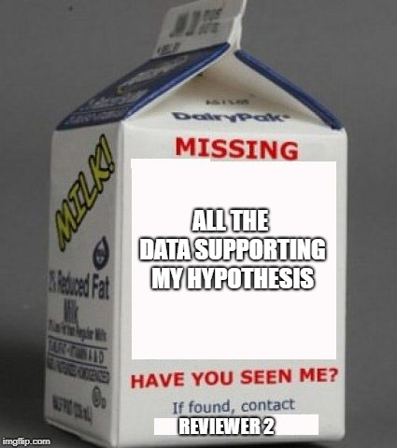
Finding Yourself in Missing Data UW Psychology Summer 2018
Max Halvorson, MA

Slide 2
https://www.youtube.com/watch?v=z2GvJtzn41E

Slide 3
Why should we worry about missing data?
Loss of power
Mo’ data, mo’ power, mo’ pubs, mo’ money, no problems
Makes data analysis painful
Different n’s for different models
Even reporting demographics gets annoying
Software warnings and errors ☹
Potential for bias (stay tuned)

Slide 4
Deleting cases: tempting but inefficient
Listwise deletion
Cases with missing data on ANY variable in the relevant analysis are dropped
Casewise (pairwise) deletion
Cases with missing data on ALL variables in the relevant analysis are dropped

Slide 5
Deleting cases is not only inefficient but can lead to bias
MLE slides 2-6

Slide 6
MLE slide 17

Slide 7
Agenda
Why should we care about missing data?
What should we do about missing data?
“Dumb” approaches and a smarter idea
Missing data theory: am I allowed to do that?
“Smart” approaches
Multiple Imputation
Full Information Maximum Likelihood
OK, but how do we actually do that?
Practical Concerns
R examples
BLIMP examples

Slide 8
Some historical options insert a readily available value
Drinks
0
3
NA
4
2
NA
1
NA
0
4
NA
0
“Dumb” Imputation

Slide 9
Some historical options insert a readily available value
Drinks | Mean
0 | 0
3 | 3
NA | 1.71
4 | 4
2 | 2
NA | 1.71
1 | 1
NA | 1.71
0 | 0
4 | 4
NA | 1.71
0 | 0
“Dumb” Imputation
Mean imputation
Insert the mean of the available data

Slide 10
Some historical options insert a readily available value
Drinks | Mean | Single
0 | 0 | 0
3 | 3 | 3
NA | 1.71 | 2
4 | 4 | 4
2 | 2 | 2
NA | 1.71 | 2
1 | 1 | 1
NA | 1.71 | 2
0 | 0 | 0
4 | 4 | 4
NA | 1.71 | 2
0 | 0 | 0
“Dumb” Imputation
Mean imputation
Single (value) imputation
Insert a value you’ve chosen based on theory or rationale

Slide 11
Some historical options insert a readily available value
Drinks | Mean | Single | Zero
0 | 0 | 0 | 0
3 | 3 | 3 | 3
NA | 1.71 | 2 | 0
4 | 4 | 4 | 4
2 | 2 | 2 | 2
NA | 1.71 | 2 | 0
1 | 1 | 1 | 1
NA | 1.71 | 2 | 0
0 | 0 | 0 | 0
4 | 4 | 4 | 4
NA | 1.71 | 2 | 0
0 | 0 | 0 | 0
“Dumb” Imputation
Mean imputation
Single (value) imputation
Zero imputation
Insert a zero

Slide 12
Some historical options insert a readily available value
Drinks | Mean | Single | Zero | LOCF
0 | 0 | 0 | 0 | 0
3 | 3 | 3 | 3 | 3
NA | 1.71 | 2 | 0 | 1
4 | 4 | 4 | 4 | 4
2 | 2 | 2 | 2 | 2
NA | 1.71 | 2 | 0 | 3
1 | 1 | 1 | 1 | 1
NA | 1.71 | 2 | 0 | 2
0 | 0 | 0 | 0 | 0
4 | 4 | 4 | 4 | 4
NA | 1.71 | 2 | 0 | 0
0 | 0 | 0 | 0 | 0
“Dumb” Imputation
Mean imputation
Single (value) imputation
Zero imputation
Last Observation Carried Forward
In multiple timepoint research, carry forward the most recent observation that was captured

Slide 13
Have appeal, but not ideal…why?
Mean Imputation
What if the sample is biased?
Single Value Imputation
Why 2 and not 3?
What if the sample is not similar to prior samples?
Zero Imputation
What if there are multiple or unforeseen reasons for non-response?
Last Observation Carried Forward (LOCF)
Why measure something repeatedly if we expect it not to change?

Slide 14
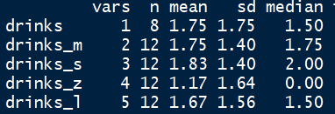
Descriptive statistics on the imputed variable will vary based on approach…how do we know which is “right?”
This is only for one variable. What happens when we start thinking about other predictors?

Slide 15
Let’s think about drinks (Y) and a related predictor, number of exams thus far in the quarter (X)
Drinks (Y) | Exams (X)
0 | 2
3 | 11
NA | 2
4 | 17
2 | 8
NA | 6
1 | 6
NA | 9
0 | 4
4 | 15
NA | 1
0 | 0
In this case, X is fully observed

Slide 16
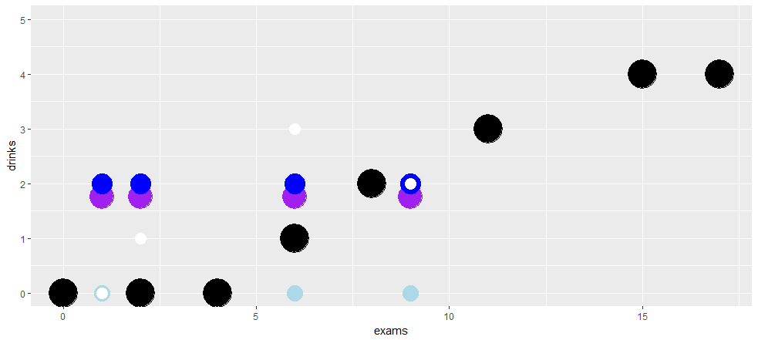
Let’s take a closer look at our example data, plotted against a predictor
Black = real data, Other colors = imputed data

Slide 17
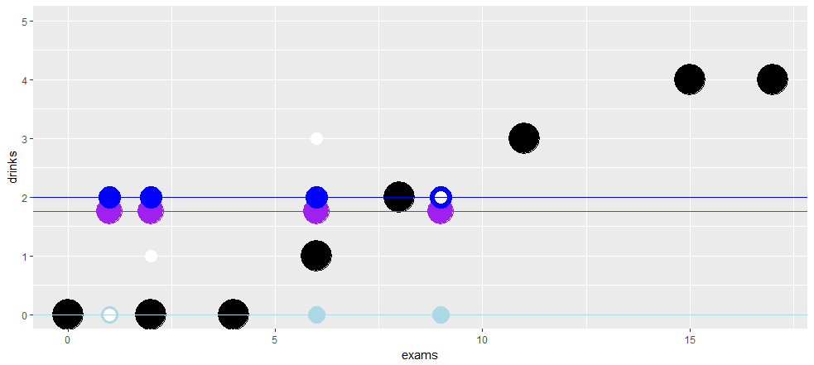
These methods ignore X’s, effectively assuming there is NO relation between Y and X’s
But the whole point is to measure relations among variables!

Slide 18
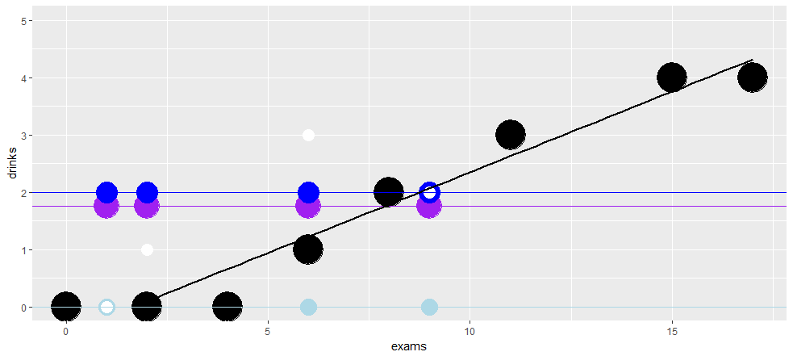
Why not use existing relations between X’s and Y’s in our data to estimate missing Y values?
This is the basic idea behind multiple imputation!

Slide 19
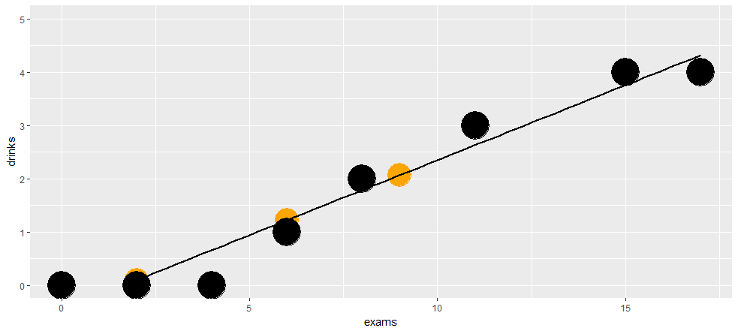
We use our existing data to generate a best guess for each missing Y for which we have X data

Slide 20
What if we impute data using relations from the data that are present?
Drinks (Y) | Exams (X)
0 | 2
3 | 11
NA | 2
4 | 17
2 | 8
NA | 6
1 | 6
NA | 9
NA | 4
4 | 15
NA | 1
0 | 0
1) In our complete data, what is the
relation between X and Y?
Y = -.46 + .28X
2) For each data point, plug in X values
Y = -.46 + .28*2

Slide 21
What if we impute data using relations from the data that are present?
Drinks (Y) | Exams (X)
0 | 2
3 | 11
.10 | 2
4 | 17
2 | 8
NA | 6
1 | 6
NA | 9
NA | 4
4 | 15
NA | 1
0 | 0
1) In our complete data, what is the
relation between X and Y?
Y = -.46 + .28X
2) For each data point, plug in X values
Y = -.46 + .28*2
= .10

Slide 22
What if we impute data using relations from the data that are present?
Drinks (Y) | Exams (X)
0 | 2
3 | 11
.10 | 2
4 | 17
2 | 8
NA | 6
1 | 6
NA | 9
NA | 4
4 | 15
NA | 1
0 | 0
1) In our complete data, what is the
relation between X and Y?
Y = -.46 + .28X
2) For each data point, plug in X values
Y = -.46 + .28*6

Slide 23
What if we impute data using relations from the data that are present?
Drinks (Y) | Exams (X)
0 | 2
3 | 11
.10 | 2
4 | 17
2 | 8
1.22 | 6
1 | 6
NA | 9
NA | 4
4 | 15
NA | 1
0 | 0
1) In our complete data, what is the
relation between X and Y?
Y = -.46 + .28X
2) For each data point, plug in X values
Y = -.46 + .28*6
= 1.22

Slide 24
What if we impute data using relations from the data that are present?
Drinks (Y) | Exams (X)
0 | 2
3 | 11
.10 | 2
4 | 17
2 | 8
1.22 | 6
1 | 6
2.06 | 9
.66 | 4
4 | 15
-.18 | 1
0 | 0
1) In our complete data, what is the
relation between X and Y?
Y = -.46 + .28X
2) For each data point, plug in X values
…but what if we’re missing X variables?

Slide 25
Regression-based imputation repeats the same procedure for each variable in turn, substituting each “X” variable into the “Y” slot
Y ~ X₁ + X₂ + X₃
X₁ ~ Y + X₂ + X₃
X₂ ~ Y + X₁ + X₃
X₃ ~ Y + X₁ + X₂
If we continue doing this, eventually we’ll fill in a value for each record that isn’t totally missing

Slide 26
This is single (vs. multiple) imputation. We’re halfway there...
But before we proceed, let’s talk about the assumptions we make when we use this regression-based approach

Slide 27
Agenda
Why should we care about missing data?
What should we do about missing data?
“Dumb” approaches and a smarter idea
Missing data theory: am I allowed to do that?
“Smart” approaches
Multiple Imputation
Full Information Maximum Likelihood
OK, but how do we actually do that?
Practical Concerns
R examples
BLIMP examples

Slide 28
Quick note on notation: we’ll talk about Y’s and X’s here, but this distinction is just for clarity. Y is whatever variable you’re trying to impute at the moment

Slide 29
Let’s think about ways in which our data might be missing – these are called missing data mechanisms
Missing Completely at Random (MCAR)
Y’s missingness is UNRELATED to underlying Y values and X values
Missing At Random (MAR)
Y’s missingness is UNRELATED to underlying Y values (can be related to X values)
Not Missing at Random (NMAR)
Y’s missingness is RELATED to underlying Y values
Flashback to MLE slide 3

Slide 30
What are some examples?
Missing Completely at Random (MCAR)
A spotty internet connection made me lose data for a few P’s
I randomly presented 50% of items in a scale to each P
Missing At Random (MAR)
20% of P’s skipped a self-esteem item, but skipping the item has nothing to do with Ps’ self-esteem
Not Missing at Random (NMAR)
I don’t have data on offensiveness of an inappropriate joke because those who found them offensive quit the study

Slide 31
Come up with your own example for each (3min discuss with neighbor)
Missing Completely at Random (MCAR)
A spotty internet connection made me lose data for a few P’s
I randomly presented 50% of items in a scale to each P
Missing At Random (MAR)
20% of P’s skipped a self-esteem item, but skipping the item has nothing to do with Ps’ self-esteem
Not Missing at Random (NMAR)
I don’t have data on offensiveness of an inappropriate joke because those who found them offensive quit the study

Slide 32
menti.com
Give an example of data missing completely at random (MCAR).
Give an example of data missing not at random (MNAR).

Slide 33
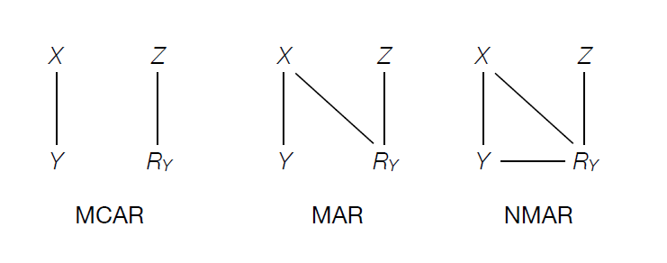
Some visual intuition about missing data mechanisms
Z are auxiliary variables (not in analysis model)
X are predictors
Y is variable to impute
R is missingness of Y (1 if missing, 0 if not)
Diagram from Enders

Slide 34
Some important nuance about the missing data mechanisms: these are all CONDITIONAL relations
So if we use other variables to explain away a connection between Y values and missingness on Y, what looks like an NMAR mechanism might actually be an MAR mechanism
These variables should be related to X, related to Y, and related to M_{Y}

Slide 35
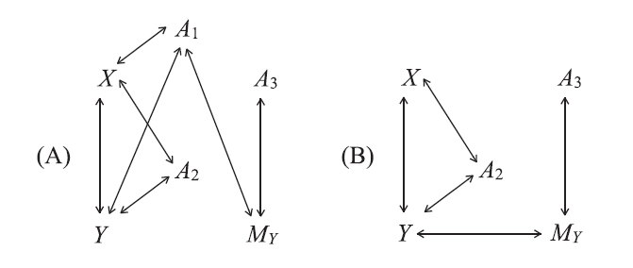
What variables are worth including in a multiple imputation model?
NMAR
MAR
A₁, A₂, A3 are auxiliary variables
Y is the variable to impute
X represents the predictor(s)
M_{y} is 1 if Y is missing, 0 if observed
Enders, 2016

Slide 36
So how do we actually deal?
Testing MCAR is all we can do, statistics-wise
Create a missing data indicator, M_{Y}, for Y
1 if missing, 0 if not
Compare mean X values for MY = 0 vs. MY = 1 (t tests)
If MCAR is true, all X’s should be unrelated to missingness on Y
But this is not widely accepted
TBH, this is a pretty unrealistic assumption in many cases AND only allows for disproving MCAR, not proving it
Practically, we should think carefully about potential bias

Slide 37
menti.com
Name the missing data mechanism (MCAR, MAR, MNAR)
After controlling for political affiliation, missingness on a bias measure is unrelated to its underlying levels.
A computer error caused 3 seconds of missing data on an EEG sensor.
Whenever a baby became overaroused by a stimulus, his/her eye tracking data were missing due to too much movement.

Slide 38
Agenda
Why should we care about missing data?
What should we do about missing data?
“Dumb” approaches and a smarter idea
Missing data theory: am I allowed to do that?
“Smart” approaches
Multiple Imputation
Full Information Maximum Likelihood
OK, but how do we actually do that?
Practical Concerns
R examples
BLIMP examples

Slide 39
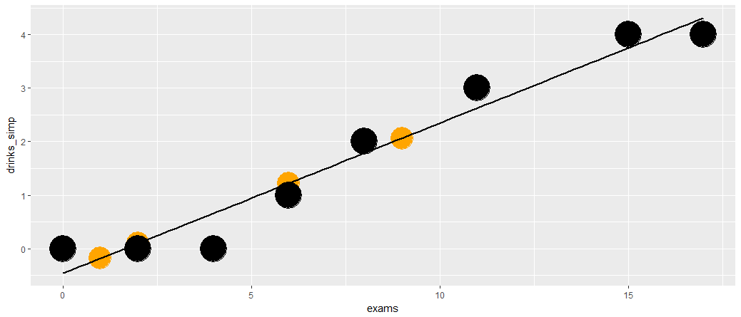
There’s one big issue with regression-based single imputation as we’ve described it so far
We’re introducing certainty where it isn’t fair to do so. Whatever our observed data told us, we’re ASSUMING that’s true for unobserved data as well
How can we maintain the level of noise that should exist in the full data?

Slide 40
We solve this problem by letting existing uncertainty propagate into imputations, and repeating the imputation process several times
MLE slides 58-62

Slide 41
Six Steps to Success (in Multiple Imputation)
Perform a “dumb” imputation, like mean imputation, as a placeholder
Placeholder imputations for I (the variable we are currently imputing) are set to missing
I is regressed on all other variables in the model
Predictions from the model (including a random draw of residual error) in 3 entered for cases missing on I
Repeat 2-4 for each variable in the imputation model
Rinse and repeat many times

Slide 42

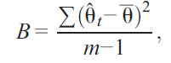

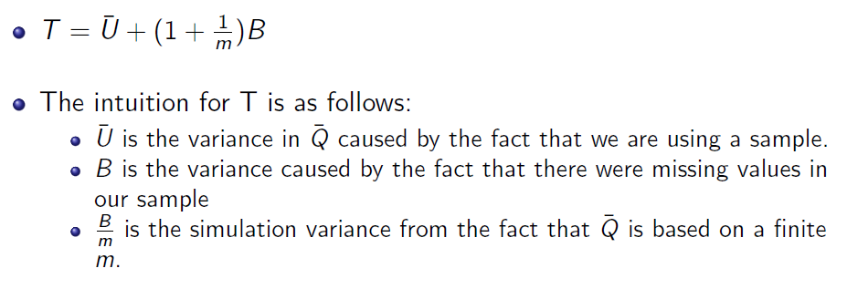
After imputing, we pool estimates
For coefficient estimates, we simply take the mean
For standard errors, we pool together the estimated standard errors from each model (within-imputation variance) with the variance from imputation to imputation (between-imputation variance)
Baraldi & Enders,
2010
Molstad, Vats,
Zhong, 2013

Slide 43
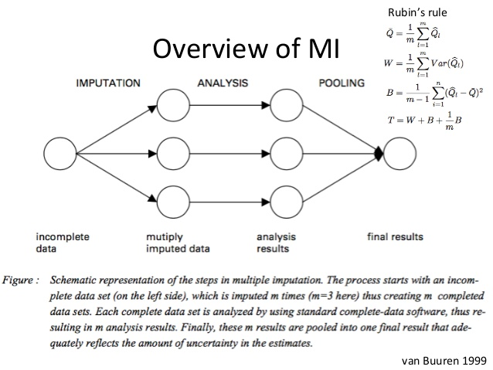

Slide 44
I’ll show an example of the pooling process later

Slide 45
Agenda
Why should we care about missing data?
What should we do about missing data?
“Dumb” approaches and a smarter idea
Missing data theory: am I allowed to do that?
“Smart” approaches
Multiple Imputation
Full Information Maximum Likelihood
OK, but how do we actually do that?
Practical Concerns
R examples
BLIMP examples

Slide 46
Maximum Likelihood in a nutshell
There is a set of parameters (B₀, B_{1,} etc.) that maximizes the likelihood of having observed all of your Y’s and X’s together
Given scores of [9,8,10]…there’s a greater probability of observing these if the population mean is 9 than if it’s 8
Given a set of parameters, your data have a calculable joint probability of all being what they are!
That is, you could calculate the probability of getting a 9, 8, and 10 given a population mean of 9 (with some SD)

Slide 47
We want the set of parameters that maximizes the joint probability of our data having been generated
For mathematical reasons, we maximize the log-likelihood function, which is proportional to the aforementioned joint probability
Unfortunately, these equations are not readily solvable

Slide 48
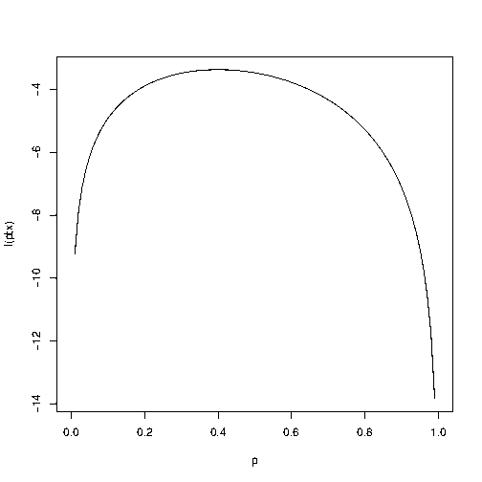
So, we select a starting point and jitter around our parameters until we stop increasing our log-likelihood.

Slide 49
So, we select a starting point and jitter around our parameters until we stop increasing our log-likelihood.

Slide 50
So, we select a starting point and jitter around our parameters until we stop increasing our log-likelihood.

Slide 51
So, we select a starting point and jitter around our parameters until we stop increasing our log-likelihood.

Slide 52
So, we select a starting point and jitter around our parameters until we stop increasing our log-likelihood.

Slide 53
So, we select a starting point and jitter around our parameters until we stop increasing our log-likelihood.

Slide 54
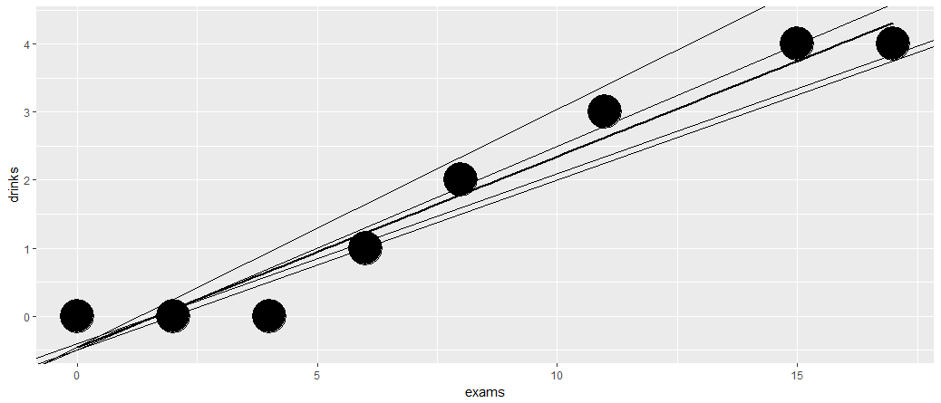
In regression, the MLEs define a regression line (OLS estimates)
There are lots of regression lines that COULD have generated our data
MLE simply jitters around parameters until they have maximized the probability of generating the data in hand

Slide 55
In contrast to normal MLE, FIML directly maximizes the likelihood function using all available data
This is in contrast to a gradient-based algorithm
For example, in a dataset with X₁ – X₆…
An observation with all 6 variables will use all that information to calculate the likelihood
An observation with only 5 will use information from those 5 to calculate the likelihood, integrating across possible unknown values

Slide 56
So, FIML uses all of the available information in a dataset to estimate parameters
AND it’s often one line of code in an analysis

Slide 57
FIML assumptions == MI assumptions
Data are multivariate normal
Independent sampling
Missing data are MAR or MCAR

Slide 58
I’ve heard about FIML – why don’t I just use that?
Do you have nominal or ordinal variables?
FIML won’t handle these nicely
MI can avoid imputing “out of bounds” values
Do your data have a multilevel structure?
FIML won’t handle appropriately (without complex extensions)
MI can accommodate these structures
Are you running an analysis that’s not specified as an SEM?
FIML requires some additional complexity and complicates your models
MI lets you run that exact analysis
If you can use FIML, by all means, go ahead! Less headache is a good thing

Slide 59
Software Options
Blimp (flexible, multilevel imputation available, can impute nominal/ordinal)
R
Amelia
MICE
Mplus (FIML)
SPSS
Stata
My pipeline
R → Blimp → R → Mplus (if necessary)

Slide 60
Agenda
Why should we care about missing data?
What should we do about missing data?
“Dumb” approaches and a smarter idea
Missing data theory: am I allowed to do that?
“Smart” approaches
Multiple Imputation
Full Information Maximum Likelihood
OK, but how do we actually do that?
Practical Concerns
R examples
BLIMP examples

Slide 61
An example with real data (small dataset)
Show NBA data

Slide 62
An example with my own data (large dataset)
Show Impulsivity ML CFA – Pittsburgh data

Slide 63
Agenda
Why should we care about missing data?
What should we do about missing data?
“Dumb” approaches and a smarter idea
Missing data theory: am I allowed to do that?
“Smart” approaches
Multiple Imputation
Full Information Maximum Likelihood
OK, but how do we actually do that?
Practical Concerns
R examples
BLIMP examples

Slide 64
An example for you to try

Slide 65
PHEW.
There’s so much more to explore here, though!
Dealing with non-convergence
Specific software questions from folks
How do I know it worked?
Beyond intuition
Mathematical underpinnings – MVN sampling vs. FCS
Variation in software
And a theme of grad school…more research is needed!

Slide 66
This slide is called, “things Max screwed up the first time”
Eating the first marshmallow
Think carefully about models BEFORE imputing
The Kitchen Sink approach
Start with your analysis model(s), and build out from there
Caveat: auxiliary variables help as long as they don’t mess with convergence
Getting it done so you can show your advisor
Let your inner obsessive compulsive tendencies shine through

Slide 67
How do I know imputation worked?
Convergence
We at least need this (draw picture)
Similarity to original data
Lack of impossible data points
Honestly, though…we don’t exactly. We just know that we’ve done the best job we can given our study design and what we know about the data

Slide 68
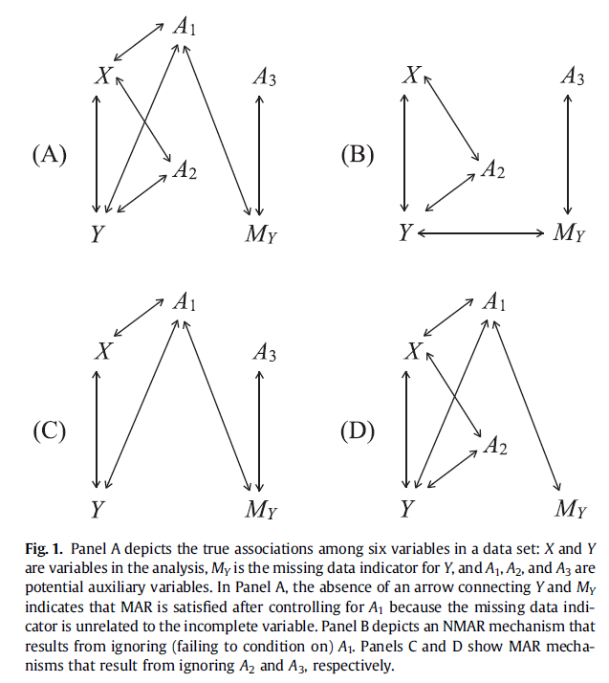
How do I select auxiliary variables?

Slide 69
Impute at the scale level or item level?
This is a “more research is needed” problem
Will you want to look at scale scores eventually?
Does MI converge when you impute at the item level?
Graham (2009) suggests scale-level is OK if…
At least half of items observed
High Cronbach’s α for scales
Item-total correlations are similar

Slide 70
Do all multiple imputation softwares use chained equations?
No, Amelia (among others) uses a multivariate normal sampling method to simultaneously estimate parameters

Slide 71
How do we know when we’re done?
At a higher level, we’re really doing a two-step
Imputation step: use observed relations to generate a best guess of each Y and X (with uncertainty) for missing observations
Estimation step: Estimate a new set of relations based on this dataset since relations have now shifted around
Rinse and repeat until estimates stop changing (“converge”)

