Slide 1


faculty of Computers and information.
DISEASE DIAGNOSING BASED ON INTERNET OF THINGS

Slide 2

Project supervisor:
Prof : Mohamed Hassan Hagag.
Presented by:
Waleed Mohamed Mohamed.
Mahmoud Hussein Soliman.
Mohamed Aboelkassem sayed.
Mahmoud Aldeen Tareq.
Sara Alaa Alkurdy.
Aisha Hamdy Mahmoud.

Slide 3

Disease detect
Overview:
At this time some patients do not discover some of their diseases early to be treated before it becomes serious and pay a lot of money and do a great effort and go to the doctor’s and spend much money in buying useless medicine due to the wrong diagnosis for some patients and here comes the seriousness of this problem so, some countries and large companies begin to think about how to solve this problem and provide all the money and effort for helping people and treating the disease early ,too.

Slide 4

problem statement
Patients and countries want to save the huge expenses which they spend on some wrong diagnoses or treatments for some of health state and also the discovery of serious diseases in the early stages and hence comes the importance of the project and its usefulness to the community in general and especially patients.
The patient can take care of himself from his home when he knows his state early, he can avoid some foods or something that may Affect on his health .

Slide 5
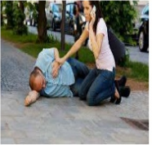
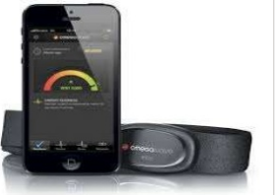
motivation
The patient is able to save the effort and the costs of treatment and the discovery of serious diseases in the early stages to facilitate the treatment quickly in short time
Daily follow-up of vital signs of the human body can reduce the risk of disease relatively
making someone else follow your health also helps the patient to follow his health regularly.

Slide 6
objectives
To provide fast, easy to use, and portable medical care to raise the level of medical care and rescue people who suffers from heart disease, diabetes, and stress
To Facilitate treatment and health care and more efficient treatment
To Avoid wrong treatment expenses or mis-diagnosis of cases
To Alert the patient to go to the hospital
To send a request to get help from a friend

Slide 7
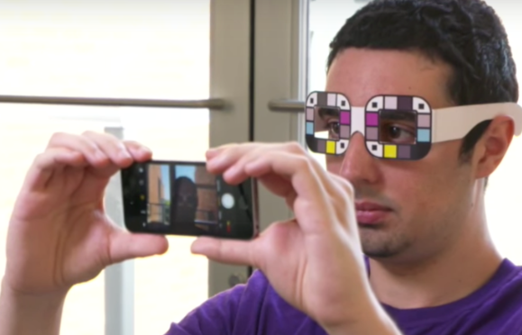
similar systems
Jaundice Detection
Jaundice a yellowing of the skin and eyes is a common concern for new parents.
The patient takes a selfie, then the app’s computer-visualization and machine-learning algorithms detect yellow pigment in the person’s sclera (the part of the outer eye that’s ordinarily white)

Slide 8
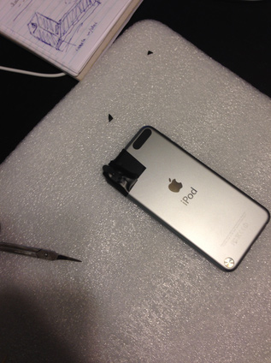
similar systems
Blood diagnosis app (Athelas):
It built a low-cost lens attachment to the smartphone camera that images blood at high magnification. The attachment magnifies/focuses on the sample by means of a 1mm ball lens.
It is implemented using computer vision to algorithmically count and identify cells in the bloodstream to automatically diagnose disease.

Slide 9
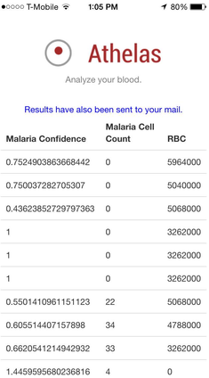
similar systems
Blood diagnosis app (Athelas):
Then the result is :

Slide 10
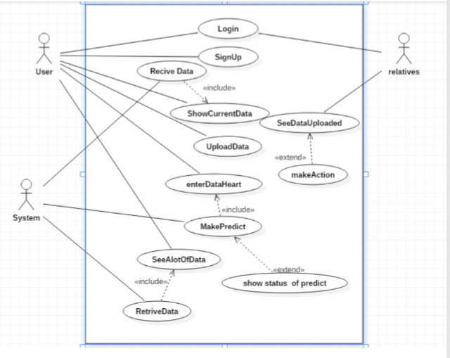
UML Diagrams
Usecase Diagram :

Slide 11
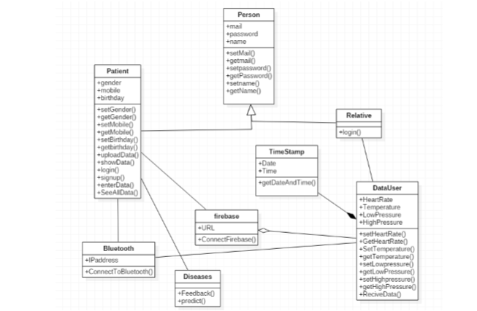
UML Diagrams
Class Diagram :

Slide 12
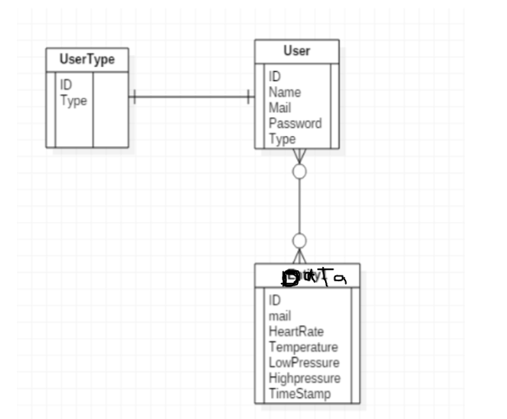
UML Diagrams
Relational database (ERD) :

Slide 13
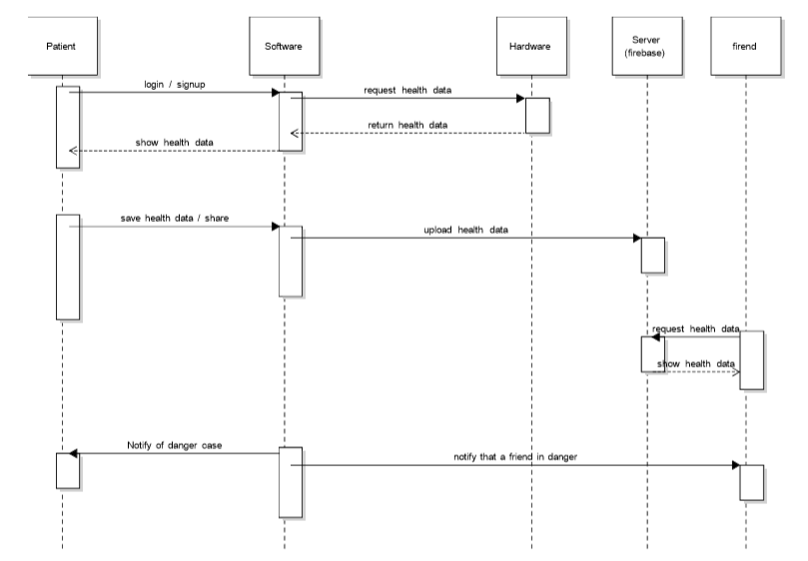
UML Diagrams
System Sequence Diagram :

Slide 14
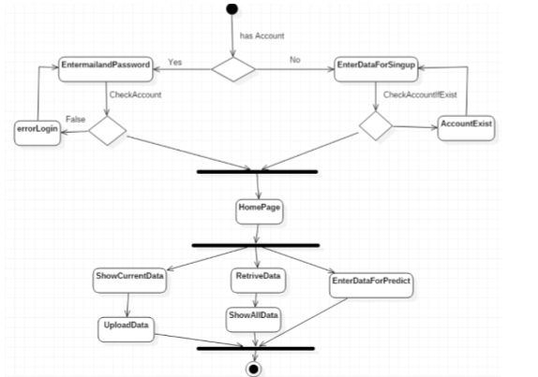
UML Diagrams
Activity Diagram :
User Activity

Slide 15
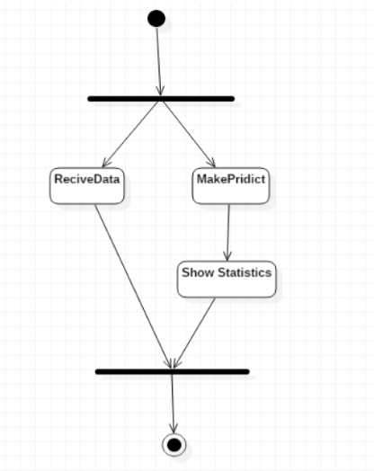
UML Diagrams
Activity Diagram :
System Activity

Slide 16
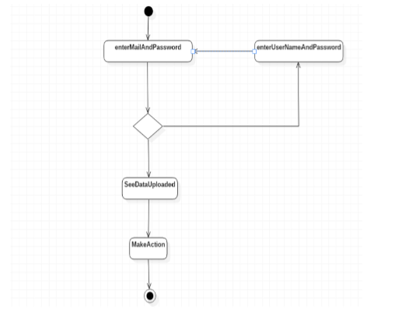
UML Diagrams
Activity Diagram :
Relative Activity

Slide 17
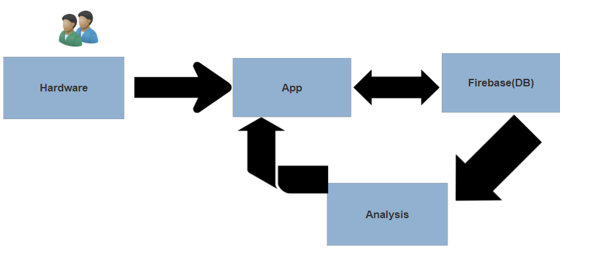
High level diagram

Slide 18
Hardware
Arduino board (Nano Atmega 328).
Bluetooth chip (HC-05).
Heart rate sensor.
Temperature sensor (lm35).

Slide 19
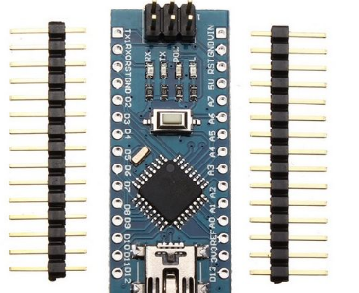
Arduino board
Description :
Arduino Nano is a surface mount breadboard embedded version with integrated USB. It is a smallest, complete, and breadboard friendly. It has everything that Diecimila/Duemilanove has (electrically) with more analog input pins and onboard 5V AREF jumper.
Physically, it is missing power jack. The Nano is automatically sense and switch to the higher potential source of power.

Slide 20
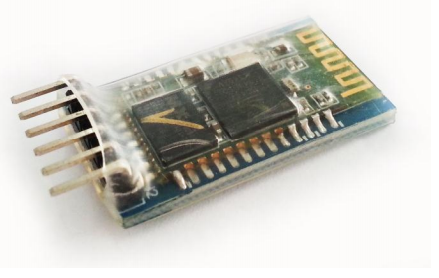
Bluetooth chip
Description :
HC-05 Bluetooth Module is an easy to use Bluetooth SPP (Serial Port Protocol) module, designed for transparent wireless serial connection setup. Its communication is via serial communication which makes an easy way to interface with controller or PC.
HC-05 Bluetooth module provides switching mode between master and slave mode which means it able to use neither receiving nor transmitting data.

Slide 21
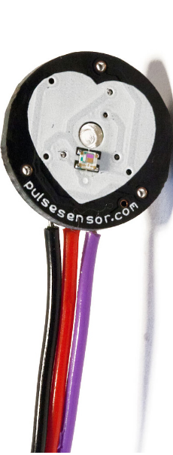
Heart rate sensor
Description :
Pulse Sensor Amped is a plug-and-play heart-rate sensor for Arduino and Arduino compatibles. It can be used by students, artists, athletes, makers, and game & mobile developers who want to easily incorporate live heart-rate data into their projects.
Pulse Sensor adds amplification and noise cancellation circuitry to the hardware. It's noticeably faster and easier to get reliable pulse readings. Pulse Sensor Amped works with either a 3V or 5V Arduino.

Slide 22
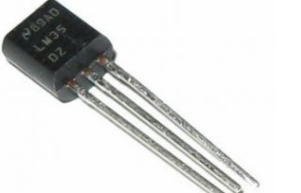
Temperature sensor
Description :
Temperature sensor is a thermocouple or a resistance temperature detector (RTD) that gathers the temperature from a specific source and alters the collected information into understandable type for an apparatus or an observer.
Temperature sensors are used in several applications namely HV system and AC system environmental controls, medical devices, food processing units, chemical handling, controlling systems, automotive under the hood monitoring

Slide 23
App
Introduction :
The App is developed by using Android platform because the Android platform is built for mobile devices, a typical Android app is designed for smartphones or tablets PC which runs on the Android OS.
The data is sent from the hardware via the Sensors when the person wears the watch, the data automatically is sent to the application so, the patient can see it

Slide 24
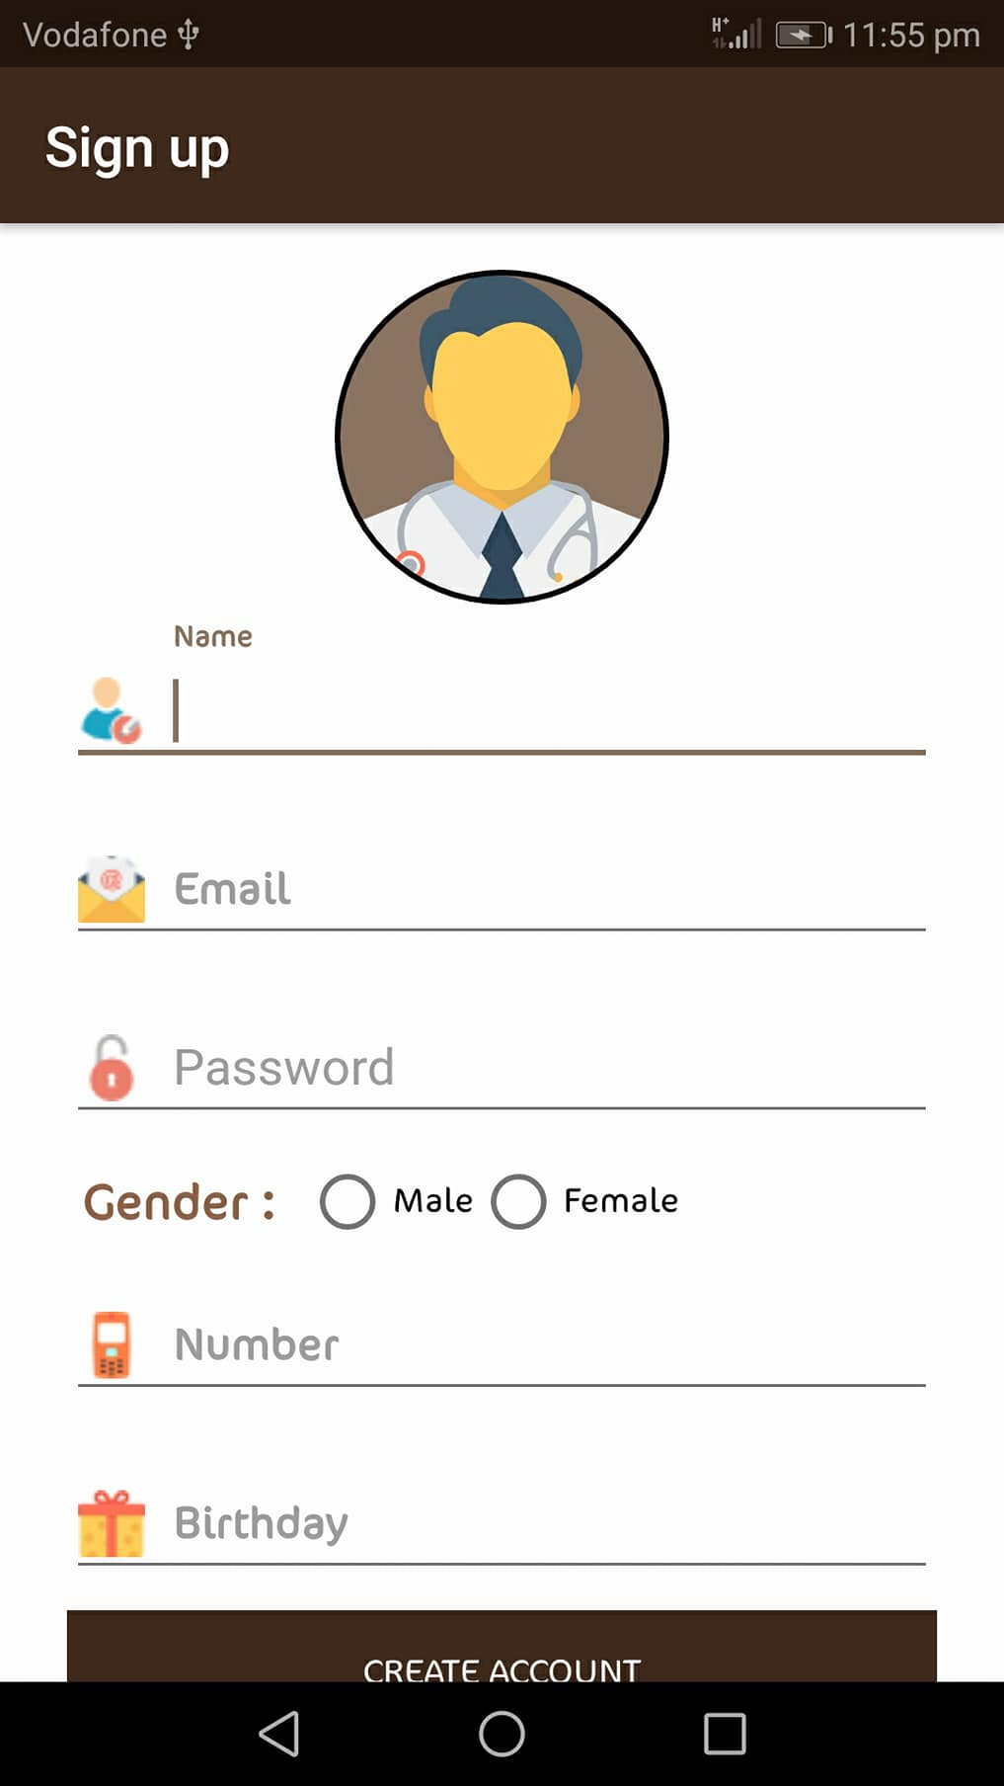
App content :
Sign Up :
Description :
Make the user has account in application to use system.

Slide 25
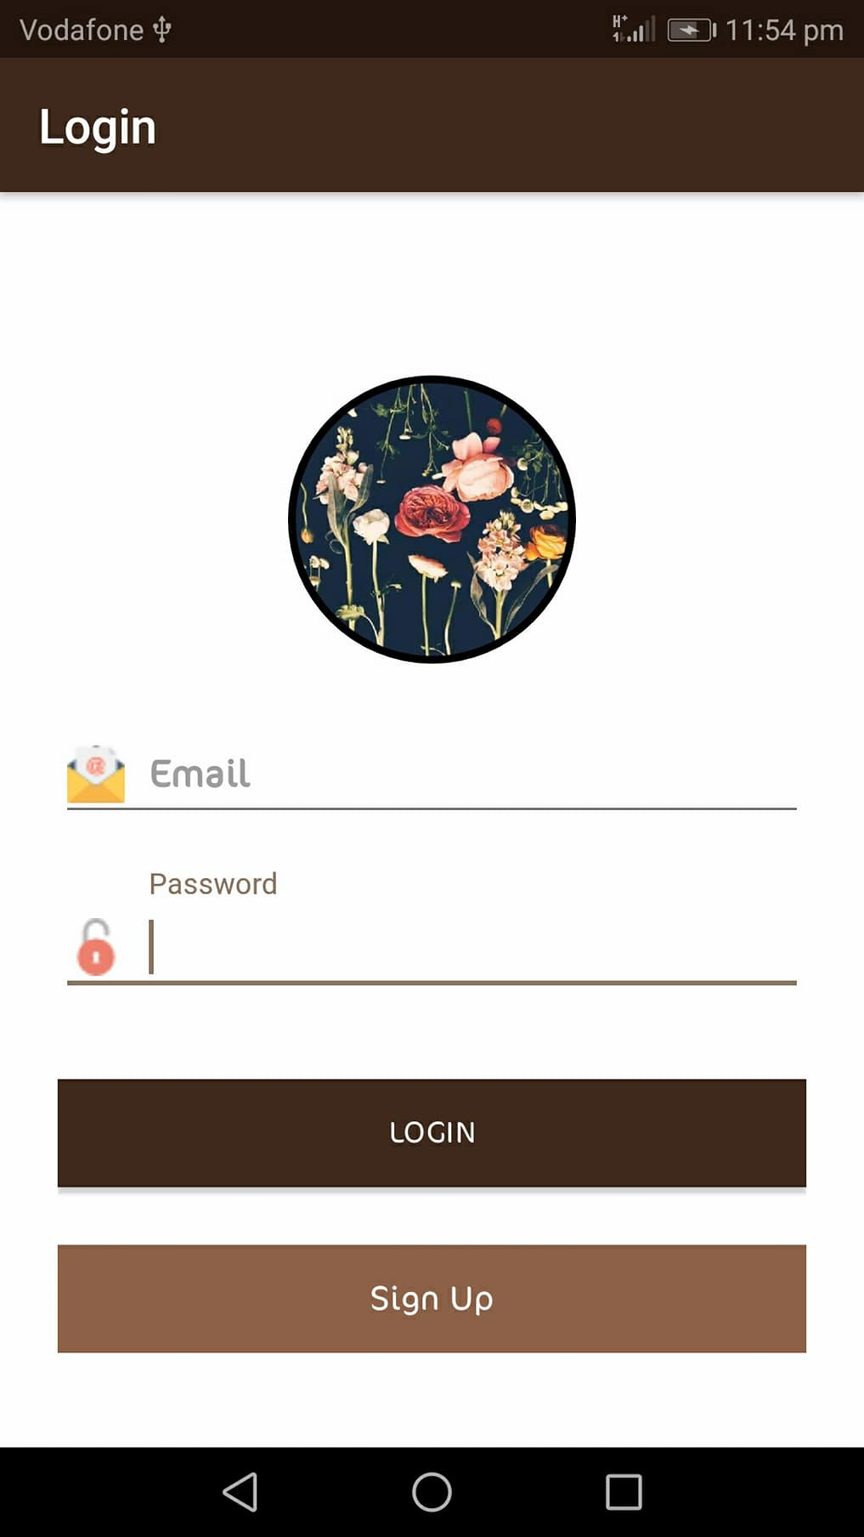
App content :
Login :
Description :
Make the user enter the system and can receive data or the profile of his profile or anything else.

Slide 26
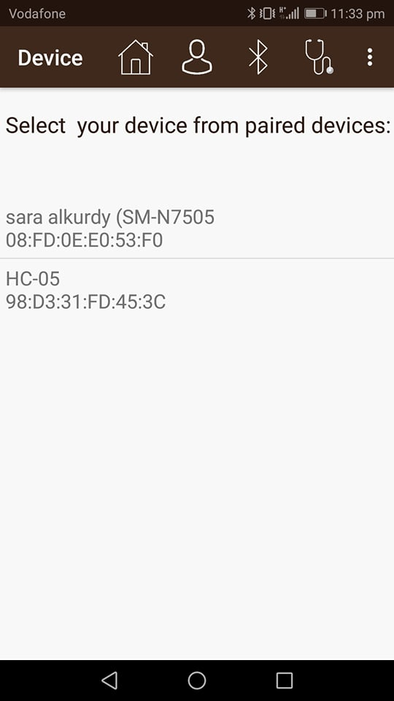
App content :
Bluetooth :
Description :
Make the user choose Bluetooth for each transmittal of his vital signs and see them in the application.

Slide 27
App content :
Received Data :
Description :
Make the user see his vital signs received from Bluetooth.

Slide 28
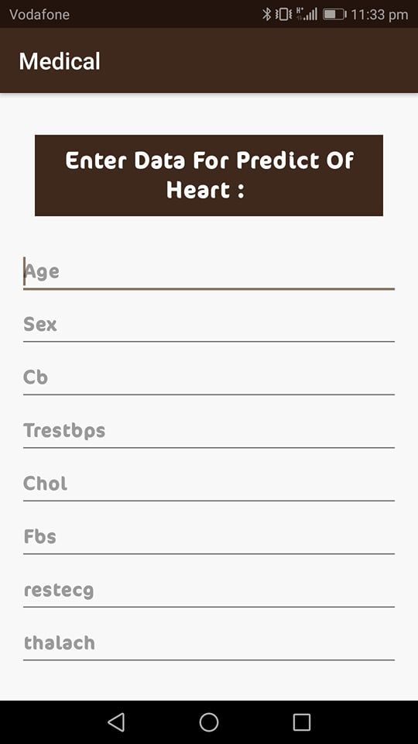
App content :
Heart Data :
Description :
Make the user enter data of heart.

Slide 29
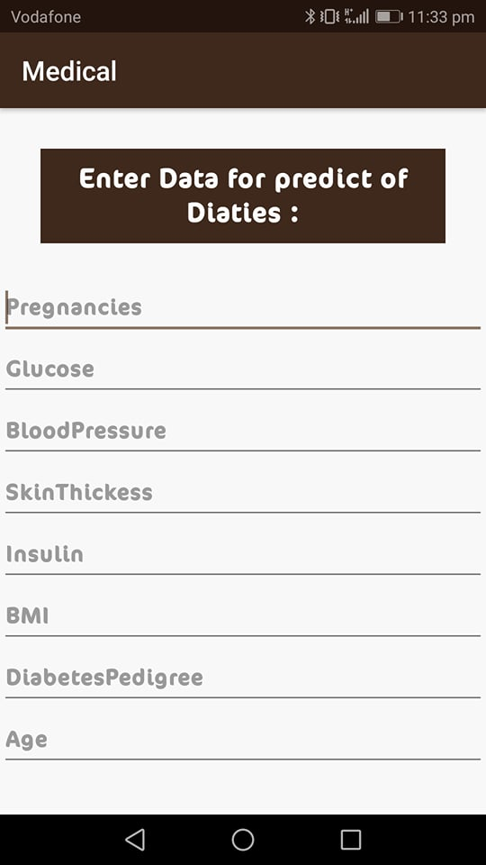
App content :
Diabetic Data :
Description :
Make the user enter data of diabetic.

Slide 30
Firebase
Introduction:
Firebase is platform which allows to build web and mobile applications without server side programming language. You can store users data on it’s real-time database which sync data among users data in no time.
Firebase is not a structure database.
There are two types of storing in firebase Realtime or firestore. In our application we use Realtime.

Slide 31
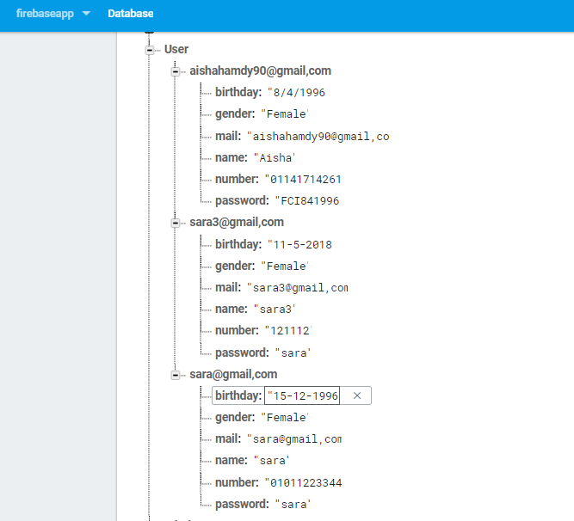
Firebase
In firebase database we has three document :
Users : it contains all data of patients that use our system.

Slide 32
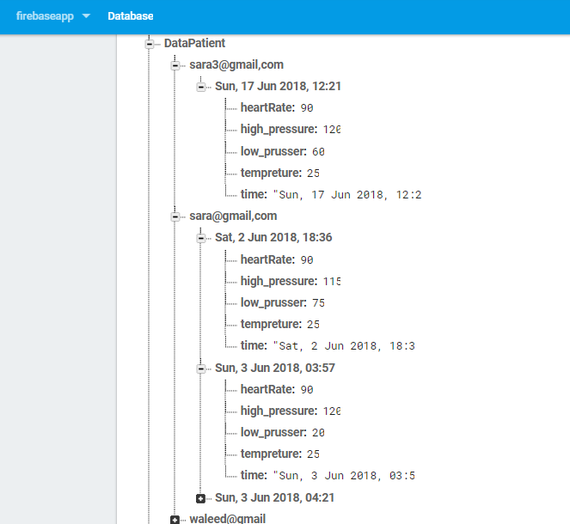
Firebase
Patient Data : it contains all reading of sensors for our patients.

Slide 33
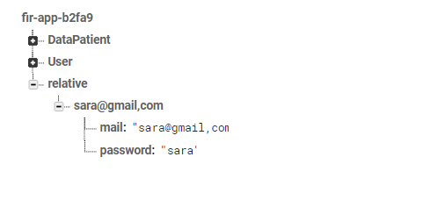
Firebase
Relative : it contain all data of relative that monitor patient to help him if he is sick.

Slide 34
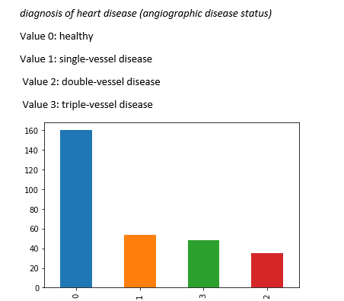
Analysis
introduction :

Slide 35

Analysis
intuation :
We have used several machine learning algorithms to get the highest accuracy in classification of coronary artery disease
1st algorithm:
Logistic Regression: is one of the most common classification algorithms.
And these were the training and the test accuracy:

Slide 36


Analysis
2nd algorithm:
Support Vector Machine: Its is usually used with small dataset.
And these were the training and the test accuracy:
It is obviously works with high training accuracy but too low in testing accuracy.
SVM with scaling.

Slide 37


Analysis
3rd algorithm:
Multi-layer Perceptron: is a supervised learning algorithm, It is different from logistic regression, in that between the input and the output layer there can be one or more non-linear layers called hidden layers.
Both Accuracy are too low because we haven’t applied the scaling yet.
MLP with scaling.
High training accuracy and the highest test accuracy yet.

Slide 38


Analysis
with 1000 iteration
Almost the same but a bit higher in training accuracy due to iterations.
4th algorithm:
Decision Trees: are a non-parametric supervised learning method used for classification and regression . The goal is to create a model that predicts the value of a target variable by learning simple decision rules inferred from the data features.
The accuracy on the training set is 100%, while the test set accuracy is much worse. This is an indicative that the tree is overfitting.

Slide 39

Analysis
Decision Trees(2): We will set max_depth=3, limiting the depth of the tree as
it decreases overfitting.
Actually not that good
The sklearn ensemble module includes two averaging algorithms based on randomized
decision training: the RandomForest algorithm and the Extra-Trees method and we will use the 5th algorithm:

Slide 40


Analysis
RandomForest algorithm: In random forests each tree in the ensemble is built from a sample drawn with replacement from the training set.
The same what happened in decision trees there is overfitting
RandomForest algorithm(2):
As we made in decision trees We will set max_depth=3 to decrease overfitting.
Now the overfitting is much decreased with adequate training accuracy and the highest test accuracy.
And this the highest test accuracy we have reached after experimenting several algorithms,
So we applied this model as a trained model in our application.

Slide 41
datasets
Introduction :
According to a report of the American heart association statistics (2016), heart diseases are the leading cause of death for both men and women and responsible
for 1 of 4 people deaths ,even modest improvements in prognostic models of heart even and complications could save literally hundreds of lives and help to
significantly reduce the cost of health care services , medication and lost of productivity
The number of people with diabetes is steadily increasing, as a study by the International Diabetes Federation demonstrated. In 2013 the total number of diabetes patients was 382 million and in 2035 that number will be expected to be 595 million

Slide 42
datasets
Heart Dataset Information :
This directory contains 4 databases concerning heart disease diagnosis.
All attributes are numeric-valued. The data was collected from the four following locations:
Cleveland Clinic Foundation (Cleveland Data)
Hungarian Institute of Cardiology, Budapest (Hungarian data).
V.A. Medical Center, Long Beach, CA (long-beach-va data).
University Hospital, Zurich, Switzerland (Switzerland data).

Slide 43
datasets
Heart Dataset Information :
This database contains 76 attributes, but all published experiments refer to using a subset of 14 of them. In particular, the Cleveland database is the only one that has been used by ML researchers to this date.
The "goal" field refers to the presence of heart disease in the patient. It is integer valued from 0 (no presence) to 4. Experiments with the Cleveland database have concentrated on simply attempting to distinguish presence (values 1,2,3,4) from absence (value 0).

Slide 44
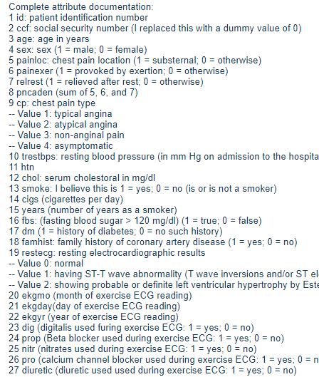
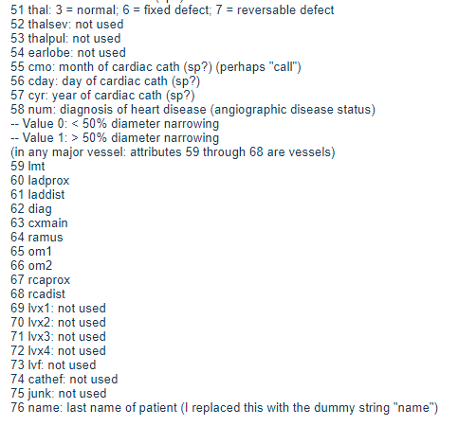
datasets
Heart Dataset Information :
Attribute Meaning :

Slide 45
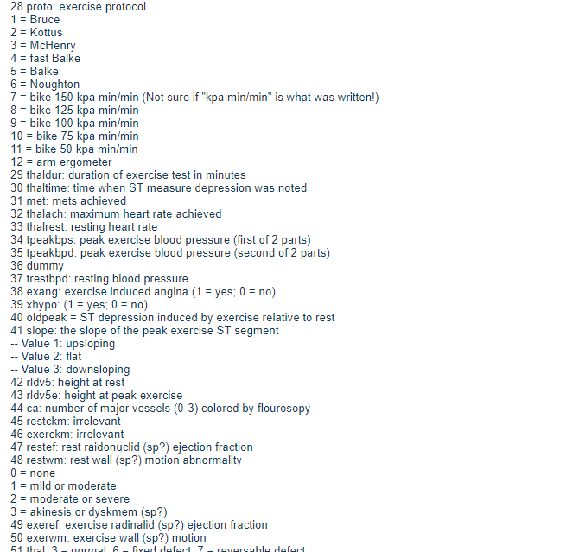
datasets
Heart Dataset Information :
Attribute Meaning :

Slide 46
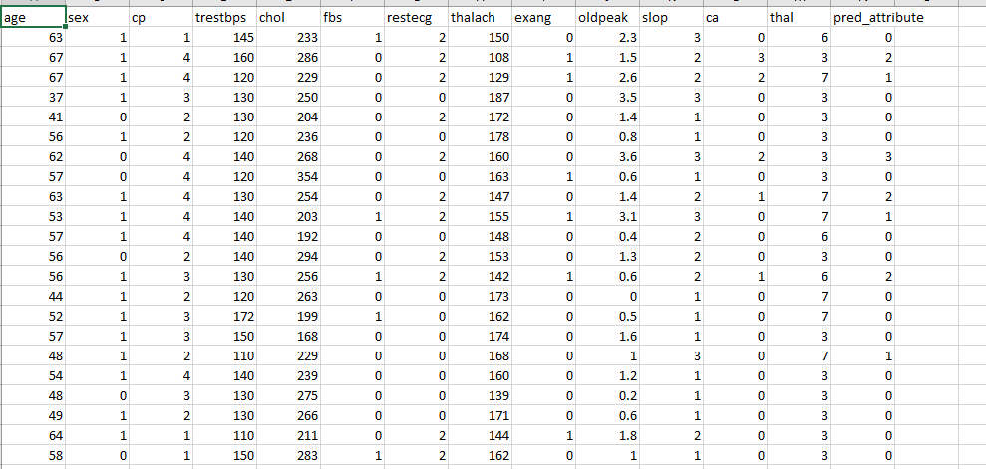
datasets
Heart Dataset Information :
Dataset Content :
dataset : http://archive.ics.uci.edu/ml/machine-learning-databases/heart-disease/heart-disease.names

Slide 47
datasets
diabetes Dataset Information:
The dataset contain 8 attribute and 769 instance The eight features were chosen in order to form the basis for forecasting the onset of diabetes within five years in Pima Indian women. Those variables were chosen because they have been found to be significant risk factors for diabetes among Pimas or other populations.

Slide 48
datasets
Data meaning:
1-Pregnancies : Number of times pregnant (F1 feature)
2-Glucose : Plasma glucose concentration a 2 hours in an oral glucose tolerance test(F2)
3-BloodPressure: Diastolic blood pressure, expressed in mm Hg (F3 feature)
4-SkinThickness: Triceps skin fold thickness, expressed in mm (F4 feature)
5-Insulin: 2-Hour serum insulin, expressed in mu U/ml(F5 feature)
6-BMI: Body mass index, expressed in weight in kg/(height in m)2 (F6 feature)
7-DiabetesPedigreeFunction: Diabetes pedigree function (F7 feature)
8-Age: Age, expressed in years (F8 feature)

Slide 49
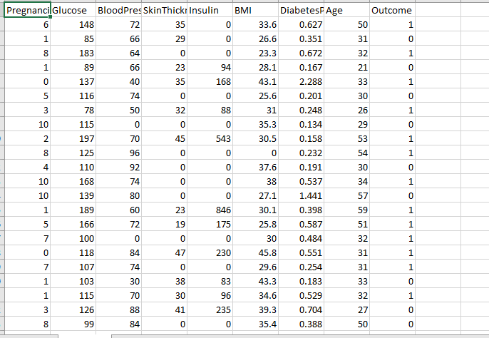
datasets
Data content:
https://github.com/susanli2016/Machine-Learning-with-Python/blob/master/diabetes.csv

Slide 50
Result

Slide 51
constraints
1- Scarcity of component in Egypt
2- Scarcity of dataset in hospitals in Egypt
3- Scarcity of features in dataset

