Slide 1
Robot Control Backend
A cloud API for recording robot-control sessions and events
Khaled Mohamed Ahmed El-Sayed El-Masry, Electrical Power Quality Department
Notes:
Replace everything in [brackets]. Delete all grey guidance text before you present. 5 slides after this one, 5 minutes in total. Every member speaks.

Slide 2
SLIDE 1 | PROJECT NEED
The problem
PROJECT CONTEXT
PROBLEM STATEMENT
One control session can produce button inputs, device status, telemetry and command results.
The backend needs to link these records to an authenticated operator and active session.
That history should be easy to review.
The project needs one secure API that accepts validated session events and stores a consistent history for later review.
The service prepares this data layer for a future connection to the existing control website.
2
Notes:
Source: project README and execution report at https://github.com/mhamedelmasery654-sys/robot-control-backend. The project provides a recording backend for future website integration.

Slide 3
SLIDE 2 | SYSTEM ARCHITECTURE
System architecture
The current service path has a planned client, a protected API, and two data stores
1
2
3
CLIENT
API
DATA STORES
Planned client: the existing control website. It is not connected to this backend yet.
Node.js and Express handle REST and authenticated WebSocket traffic. JWT identifies the operator; Zod validates requests.
PostgreSQL stores users and sessions. MongoDB stores session event history.
Current scope: store and review events. The API does not send robot or motor commands.
3
Notes:
Sources: project README and API documentation. This diagram distinguishes the current API and database path from the planned website integration. The service does not issue hardware commands. https://github.com/mhamedelmasery654-sys/robot-control-backend

Slide 4
SLIDE 3 | VERIFICATION EVIDENCE
Implementation evidence
Local checks recorded in the project report; live API checks run on 24 October 2026
1
2
3
11
44
200
Automated tests passed; repositories are mocked, with a local WebSocket test.
JavaScript files parsed by npm run check.
Live readiness returned HTTP 200. PostgreSQL and MongoDB both reported up.
Postman lint reported 0 errors and 0 warnings. PostgreSQL migration and smoke checks passed.
4
Notes:
Sources: https://github.com/mhamedelmasery654-sys/robot-control-backend/blob/main/README.md and https://github.com/mhamedelmasery654-sys/robot-control-backend/blob/main/README-execution-report.md. I also sent read-only GET requests to /api/v1/health/live and /api/v1/health/ready on 24 October 2026; both returned HTTP 200, and readiness reported PostgreSQL and MongoDB up. No market survey figures were provided, so this slide uses project verification evidence.

Slide 5
SLIDE 4 | API DESIGN
How the backend works
REQUEST FLOW
DATA AND SAFEGUARDS
Node.js and Express provide the REST API and authenticated WebSocket event intake.
1. The operator signs in and receives a JWT.
2. The API starts a control session.
3. It validates, stores and acknowledges session events.
Routes cover authentication, sessions, event history and admin audits.
PostgreSQL with TypeORM stores users, roles, sessions and admin audit records.
MongoDB with Mongoose stores controller inputs, device and robot status, voice status, telemetry and command results.
Zod rejects unknown fields; duplicate event IDs are acknowledged safely.
Raw audio and transcripts are not accepted. Events expire after 90 days by default.
5
Notes:
Source: public README and API overview. The WebSocket endpoint records authenticated events and acknowledges them after MongoDB accepts the event. It does not transmit motor commands. https://github.com/mhamedelmasery654-sys/robot-control-backend

Slide 6
SLIDE 5 | API ROUTES AND DATA
API routes and event records
REST AND WEBSOCKET ROUTES
SYNTHETIC EVENT AND VALIDATION
Authentication
/auth/register / /auth/login
/auth/me
Sessions
/sessions
/sessions/:sessionId/events
/sessions/:sessionId/close
Admin and live events
/admin/users / /admin/audit
WebSocket: /api/v1/ws
Example fields
source: system
category: device_status
eventName: test.rest.persistence
data: connected=true, statusCode=TEST_ONLY
The API validates each event and ties it to its session. It safely acknowledges duplicate event IDs and rejects unknown fields. Event records expire after 90 days.
6
Notes:
Source: public OpenAPI specification and API overview. Example values are synthetic and contain no account identifiers, tokens, real device telemetry or command payloads. https://github.com/mhamedelmasery654-sys/robot-control-backend/blob/main/postman/specs/openapi.yaml

Slide 7
SLIDE 6 | DEPLOYMENT AND ACCESS
Deployment and access
WHO USES IT
HOW THEY ACCESS IT
WHAT IT NEEDS
Control application operators and project administrators.
A public HTTPS API with authenticated REST and WebSocket routes.
Render web service, PostgreSQL, MongoDB, GitHub source, and protected host settings.
CURRENT PROJECT STATUS
Render service
Data stores
Robot connection
Live
Both up
Not linked
7
Notes:
Source: project README, current deployment section, and live readiness endpoint. The service is a Docker web service on Render. Current commercial pricing has not been set. The service-level health-check field still needs to be configured to /api/v1/health/ready.

Slide 8
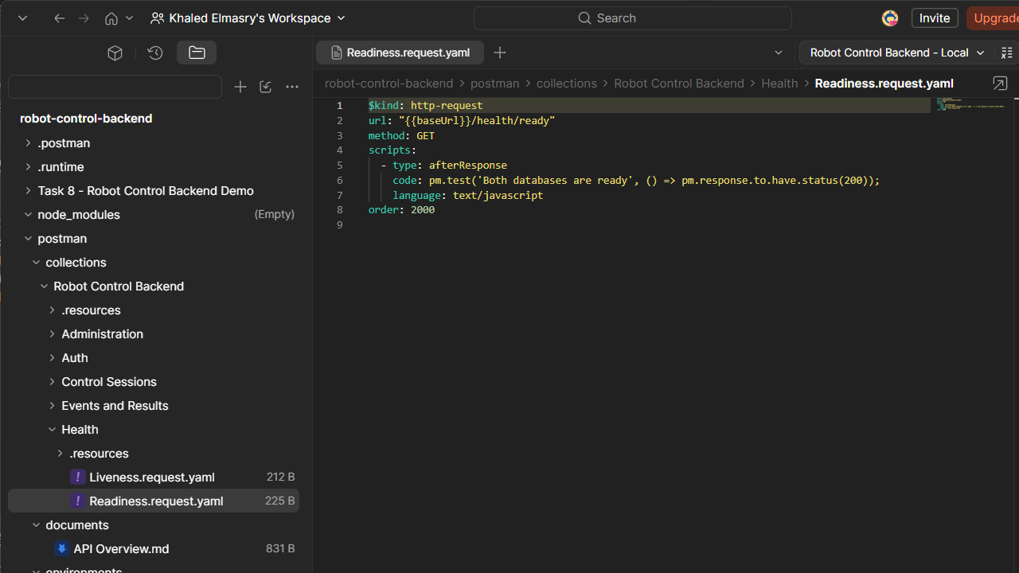
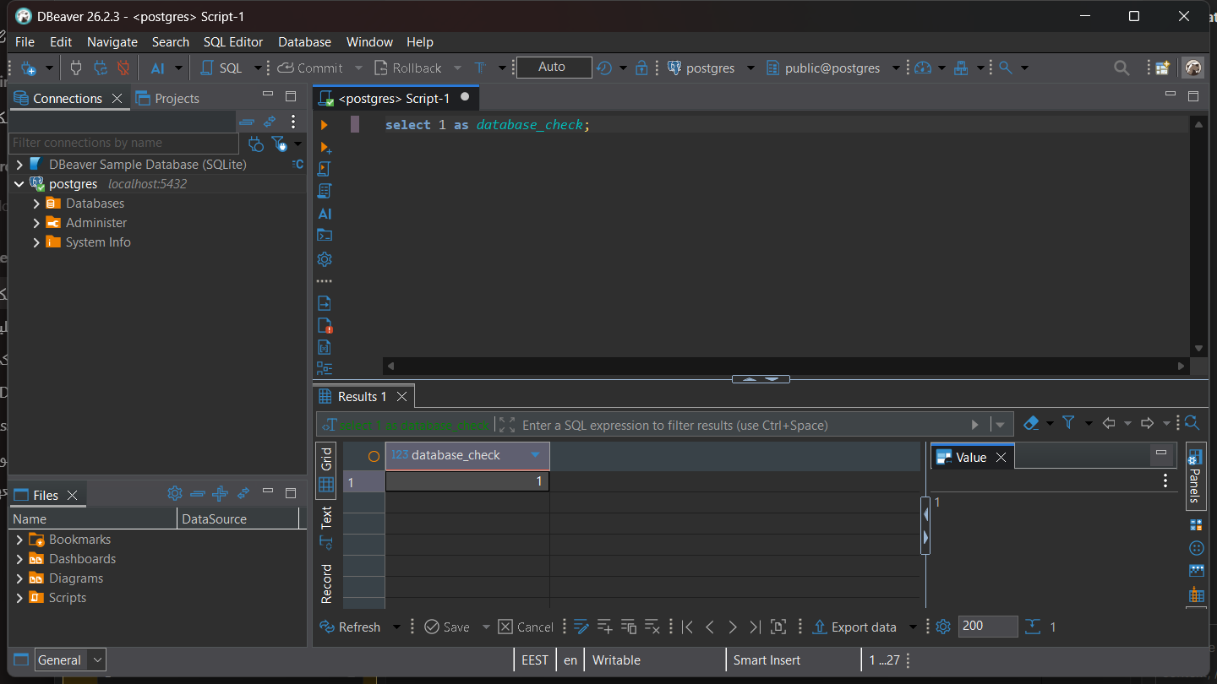
SLIDE 7 | DEVELOPER TOOL EVIDENCE
Local development tools
POSTMAN LOCAL MODE
POSTGRESQL IN DBEAVER
DBeaver shows a successful read-only SELECT 1 result on the local PostgreSQL connection.
The Postman workspace contains the Robot Control Backend health requests and local environment.
8
Notes:
Evidence screenshots captured from the open Postman and DBeaver applications on 24 October 2026. The Postman screenshot shows the local readiness request definition; it is not a live Postman response. The DBeaver screenshot shows a read-only SELECT 1 result from the local PostgreSQL connection.

Slide 9
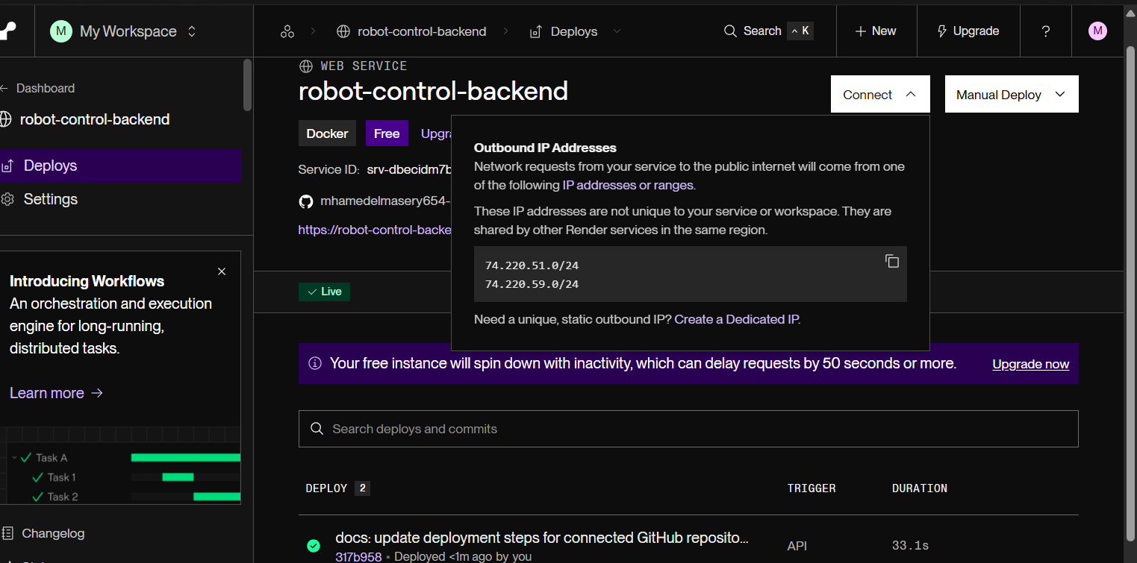
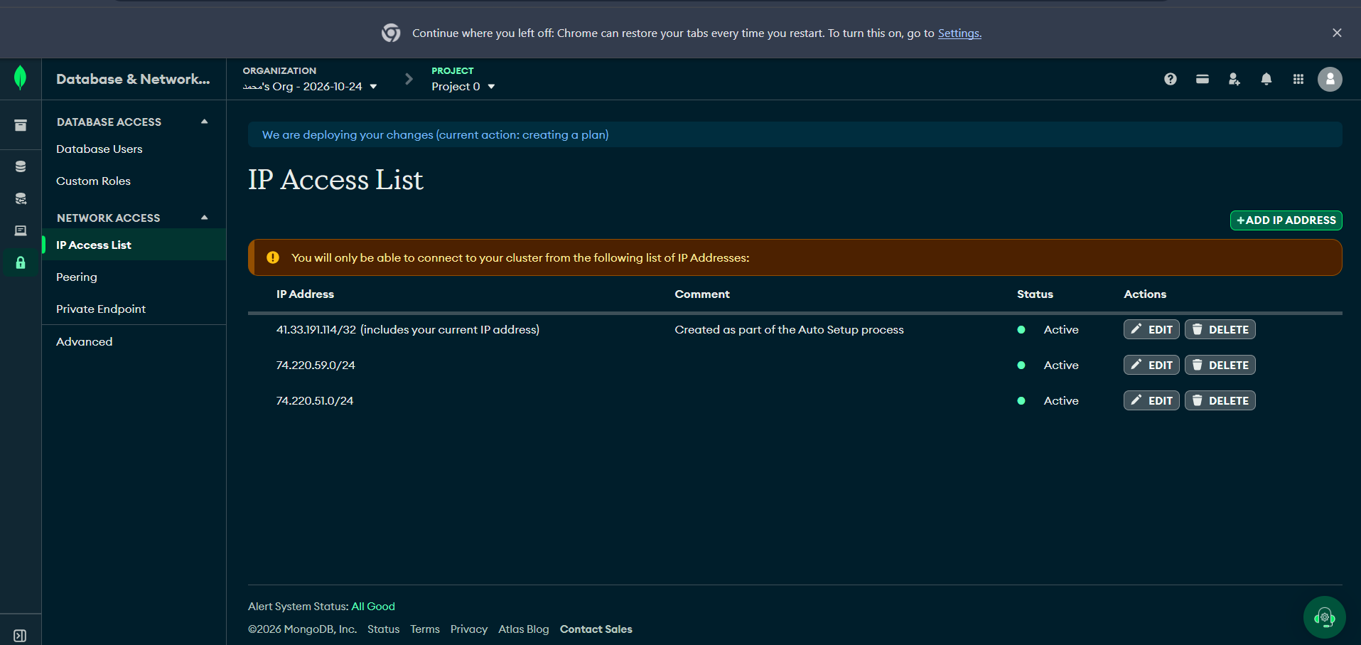
SLIDE 8 | CLOUD DEPLOYMENT EVIDENCE
Live cloud deployment
RENDER WEB SERVICE
MONGODB ATLAS NETWORK ACCESS
Render shows robot-control-backend as Live. Frankfurt outbound ranges: 74.220.51.0/24 and 74.220.59.0/24.
Atlas shows the laptop entry and both Render ranges as Active.
9
Notes:
The supplied Atlas IP Access List screenshot included the laptop public IP. The embedded evidence image replaces that address with a redaction. Render outbound ranges remain visible. Source image supplied by the project owner.

Slide 10
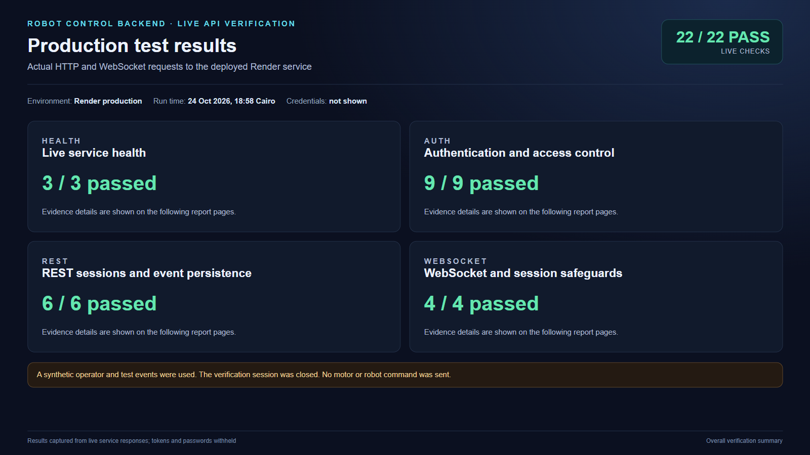
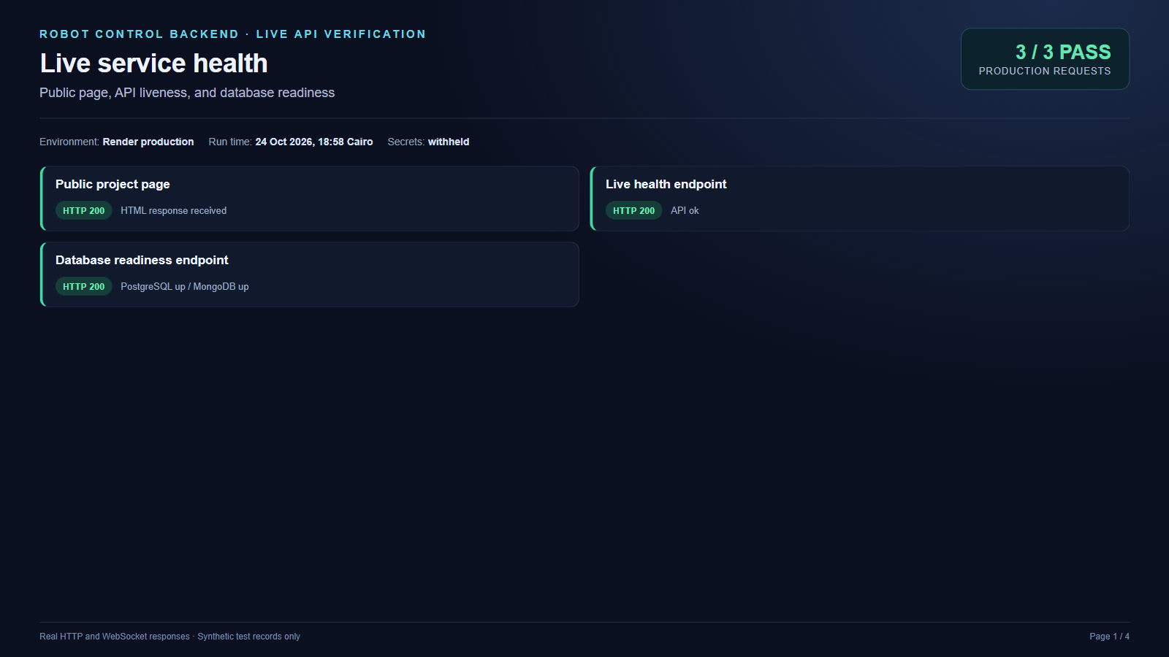
SLIDE 9 | LIVE API RESULTS
Production test results
OVERALL LIVE RUN
SERVICE HEALTH
Public page, liveness, and readiness returned HTTP 200. Readiness reported PostgreSQL and MongoDB up.
22 of 22 live checks passed against the Render production service. Synthetic test records were used; the session was closed.
10
Notes:
Actual HTTP requests were sent to the published Render service on 24 October 2026 at 18:58 Cairo. Overall verification: 22 passed, 0 failed. Health group: 3 of 3. All credentials and tokens were withheld from screenshots. No robot or motor command was sent.

Slide 11
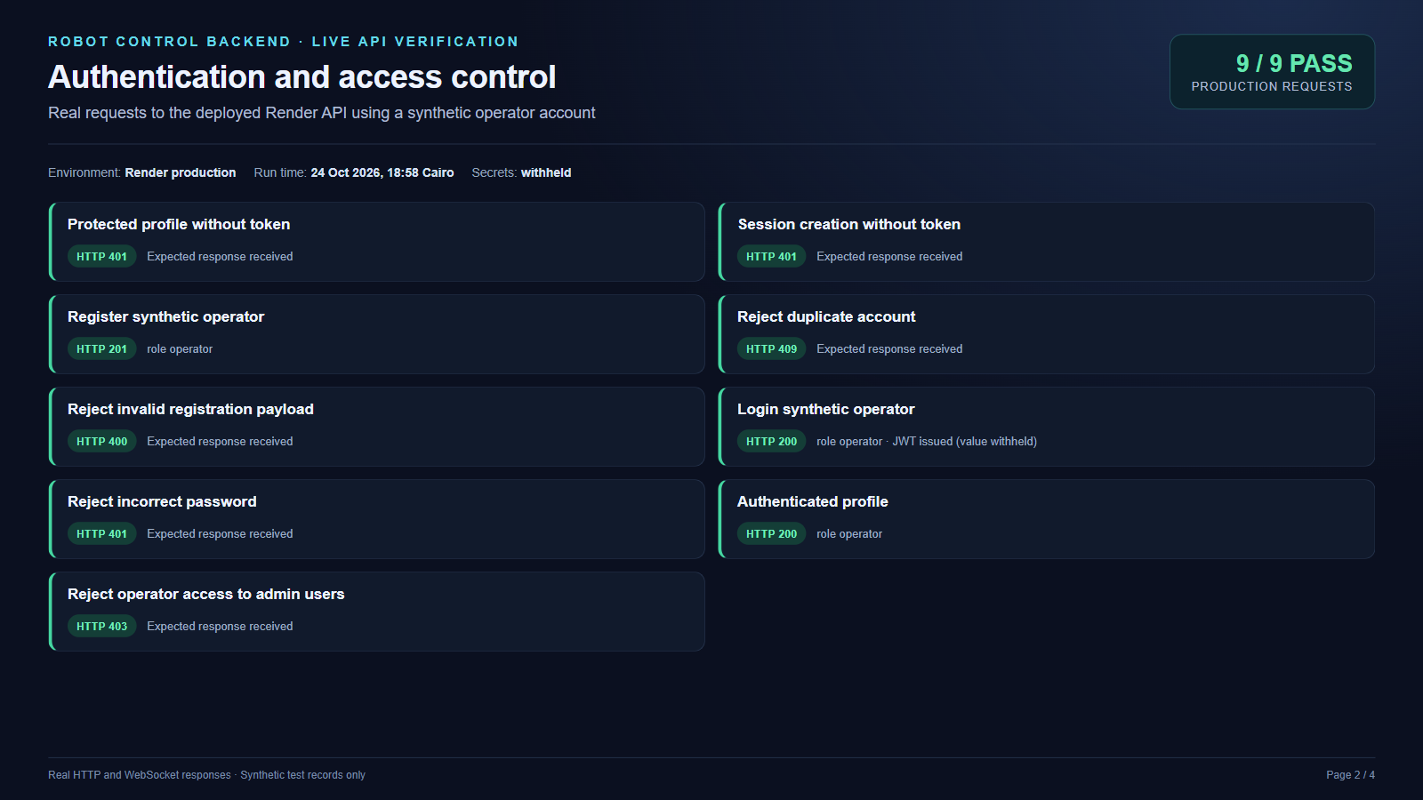
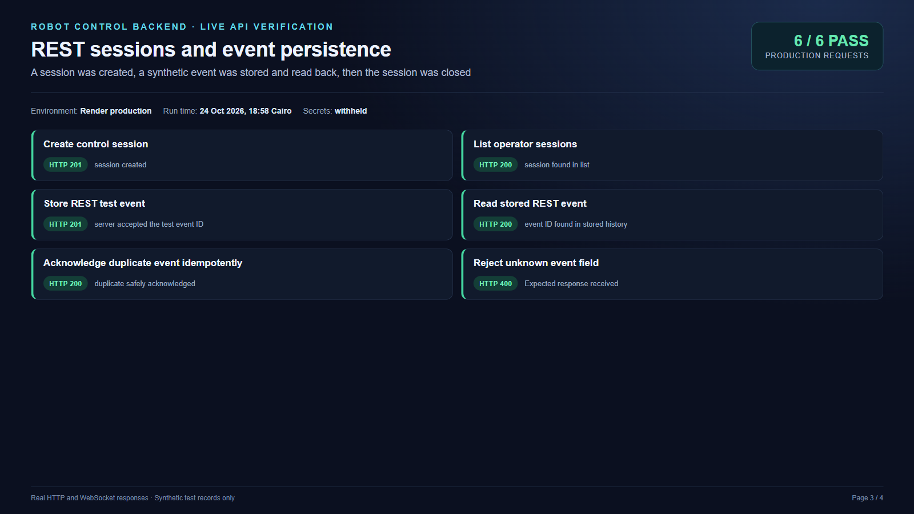
SLIDE 10 | AUTH AND REST
Authentication and event history
AUTHENTICATION AND ACCESS
SESSION AND EVENT API
6 of 6 REST checks passed for session creation, event storage and history, duplicate handling, and schema rejection.
9 of 9 live authentication and access checks passed using a synthetic operator account. Password and JWT were withheld.
11
Notes:
The checks used a synthetic operator account and synthetic events on the production service. The account remains in production for now; its random password was not saved. The test session was closed. No real user data was used.

Slide 12
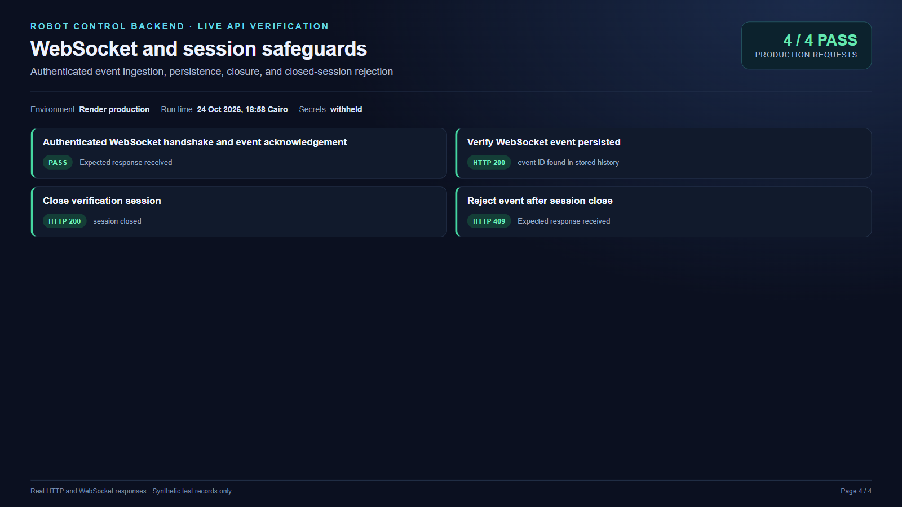
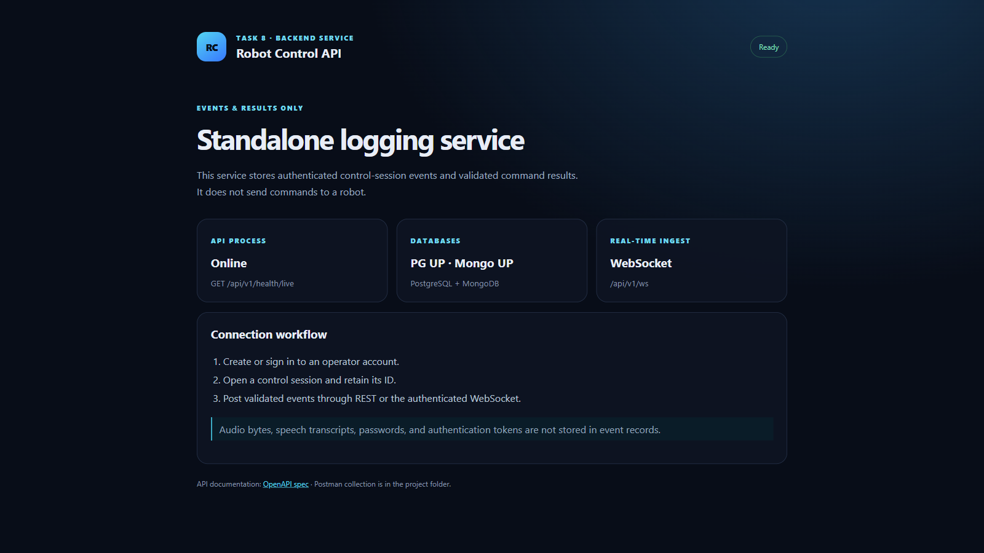
SLIDE 11 | WEBSOCKET AND SESSION
WebSocket and session safeguards
LIVE WEBSOCKET CHECKS
PUBLISHED SERVICE PAGE
Chrome shows the live API online, both databases up, and WebSocket ingestion available. The page states that it does not send robot commands.
4 of 4 live checks passed: authenticated handshake, event acknowledgement, persisted event, and rejection after session close.
12
Notes:
Actual authenticated WebSocket connection and event acknowledgement were verified against production; a REST history read found the same event. The verification session then closed, and the API rejected another event for that closed session with HTTP 409. Synthetic test records were used only.

Slide 13
SLIDE 12 | PROJECT OWNER AND NEXT STEP
Project owner and next step
PROJECT OWNER
NEXT STEP
Khaled Mohamed Ahmed El-Sayed El-Masry
Third-year student, Faculty of Engineering
Electrical Power Quality Department
Connect the existing control website to the authenticated session and event API.
Before production use, replace the current Atlas runtime user with a least-privilege database user and set Render's health check to /api/v1/health/ready.
Remove the temporary synthetic test account after review.
Scope today: event recording only. The physical robot is not connected to this backend.
PROJECT LINKS
GitHub repository and README
Execution report
OpenAPI specification
Live project page
API base URL
API readiness
API liveness
Project owner profile
Render dashboard (login required)
13
Notes:
The live checks used a synthetic operator account that remains in the production database until explicitly removed. No password or token was retained in the evidence bundle. The backend has no robot actuation path.

