Slide 1

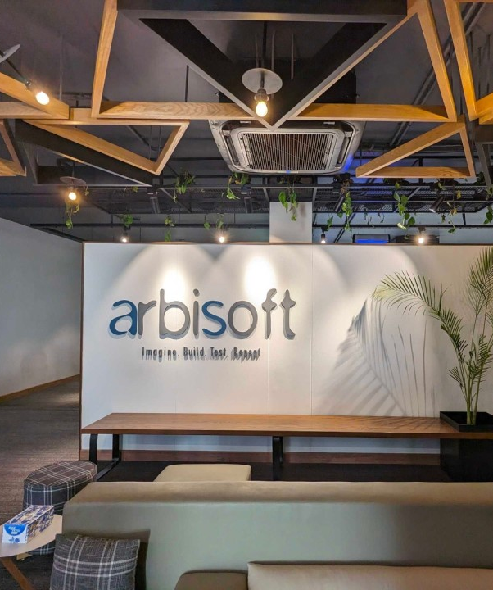

FELLOWSHIP
PRESENTATION
MUHAMMAD HAMMAD SANI

Slide 2
OVERVIEW
01
02
03
Enjoyable Things
Challenging Areas
My Learning
04
05
PROJECT DEMO
My Suggestions

Slide 3
Learning

Slide 4
Learning
Python Docs

Slide 5
Learning
Python Docs
Two Tasks

Slide 6
Learning
Python Docs
Two Tasks
Weatherman

Slide 7
Learning
Python Docs
Two Tasks
Weatherman
COVID Analyzer

Slide 8
Learning
Python Docs
Two Tasks
Weatherman
COVID Analyzer
Clean Code (PEP 8)

Slide 9
Learning
Scrapy

Slide 10
Learning
Scrapy
Two Scrappers

Slide 11
Learning
Scrapy
Two Scrappers
Educative Blogs

Slide 12
Learning
Scrapy
Two Scrappers
Educative Blogs
Codedamn Course Video Link

Slide 13
Learning
Scrapy
Two Scrappers
Educative Blogs
Codedamn Course Video Link
Git and GitHub

Slide 14
Learning
Django

Slide 15
Learning
Django
Basic CRUD Operation Project

Slide 16
Learning
Django
Basic CRUD Operation Project
Research on Final Project

Slide 17
Learning
Django
Basic CRUD Operation Project
Research on my Final Project
Requirement Document

Slide 18
Learning
Django
Basic CRUD Operation Project
Research on my Final Project
Requirement Document
Entity Relation Diagram Design

Slide 19
Learning
Django
Basic CRUD Operation Project
Research on my Final Project
Requirement Document
Entity Relation Diagram Design
Project Implementation

Slide 20
Learning
Django
Basic CRUD Operation Project
Research on my Final Project
Requirement Document
Entity Relation Diagram Design
Project Implementation
Deployment (AWS EC2)

Slide 21
2. Enjoyable Things
Working in Industry

Slide 22
2. Enjoyable Things
Working in Industry
Mentor guiding you

Slide 23
2. Enjoyable Things
Working in Industry
Mentor guiding you
Doing some real software engineer stuff

Slide 24
2. Enjoyable Things
Working in Industry
Mentor guiding you
Doing some real software engineer stuff
Flexible Schedule (Remote/Office)

Slide 25
2. Enjoyable Things
Working in Industry
Mentor guiding you
Doing some real software engineer stuff
Flexible Schedule (Remote/Office)
IT Department helping you

Slide 26
2. Enjoyable Things
Working in Industry
Mentor guiding you
Doing some real software engineer stuff
Flexible Schedule (Remote/Office)
IT Department helping you
Free Lunch :-)

Slide 27
3. Challenging Areas
Transition in way of consuming knowledge

Slide 28
3. Challenging Areas
Transition in way of consuming knowledge
Books / Videos to Documentation

Slide 29
3. Challenging Areas
Transition in way of consuming knowledge
Books / Videos to Documentation
University and Fellowship Work

Slide 30
4. Fellowship Project
Project Motivation

Slide 31
4. Fellowship Project
Project Motivation
Project Demo

Slide 32
5. Some Suggestions
Monthly Feedback

Slide 33
5. Some Suggestions
Monthly Feedback
Fellowship Procedure

Slide 34
5. Some Suggestions
Monthly Feedback
Fellowship Procedure
Test Conduction in University

Slide 35
Thanks for Listening, Any Questions!

