Slide 1
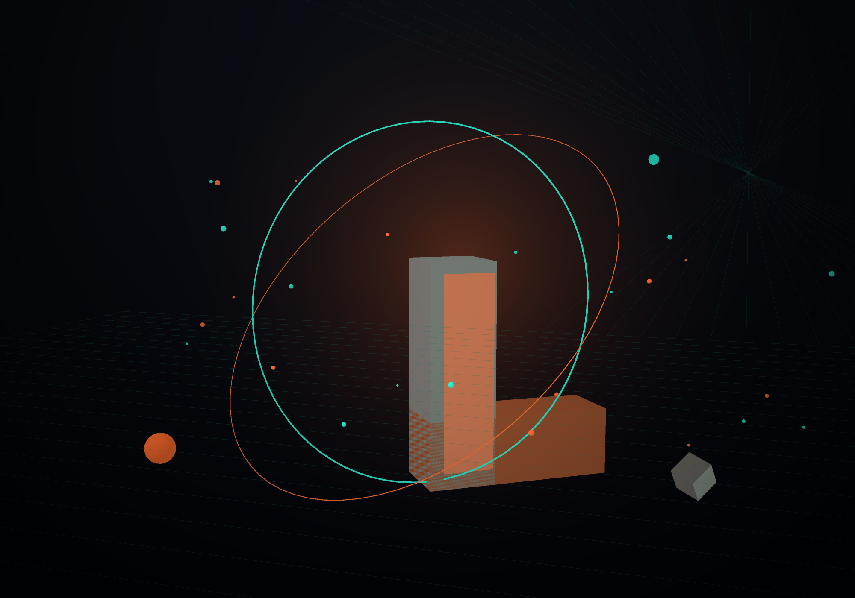
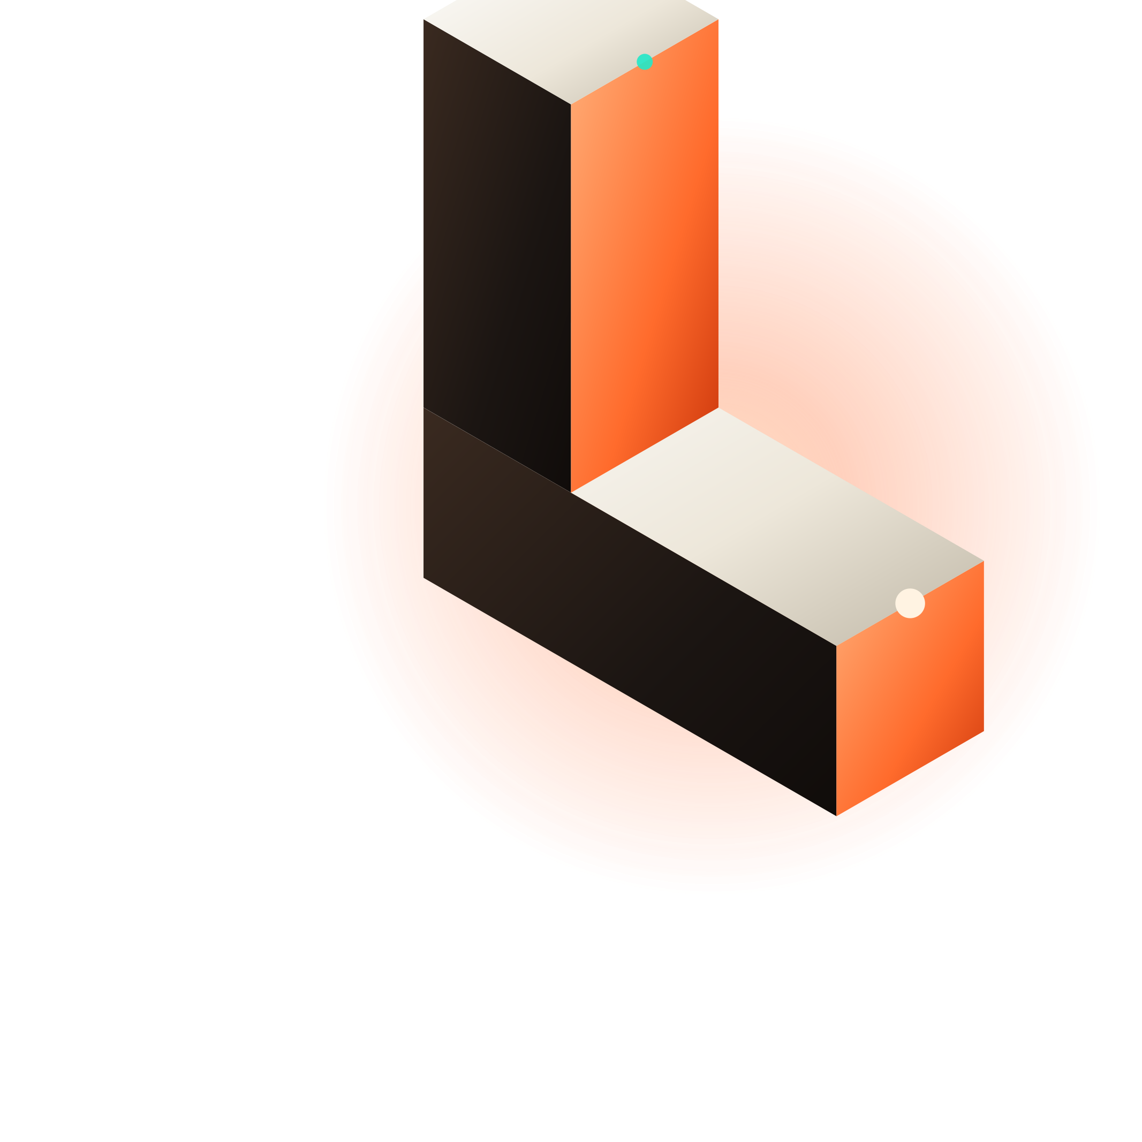
LUMENFORGE
WEBSITES YOU CAN WALK THROUGH
An interactive 3D studio building launch-ready 3D commerce, real-estate and product sites with Blender (bpy), Three.js and React.
Pitch deck · 2026 · forge@lumenforge.studio

Slide 2
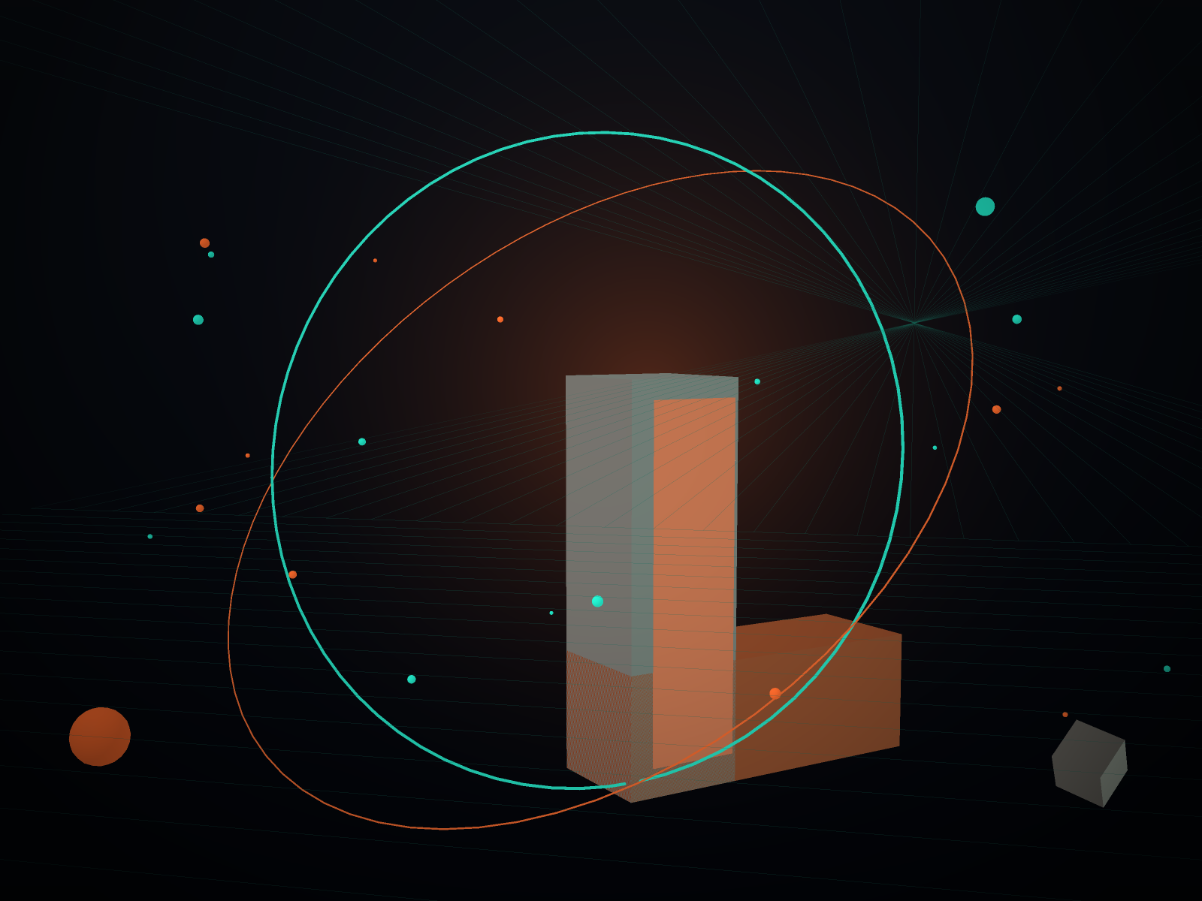
THE PROBLEM
The web is still flat, and flat is expensive.
01
Visitors cannot imagine scale
Static product shots force customers to guess size, material and finish. Guessing is where carts die.
02
Video is a dead end
A 4 MB hero video looks expensive, costs LCP, and cannot be explored. It is a billboard, not a room.
03
WebGL got a bad name
Most 3D sites are 40 MB showreels built by studios who never had to ship on a mid-range Android.

Slide 3
THE OFFER
One studio, three ways in.
SPARK
FORGE
FOUNDRY
$4,800
$12,500
$3,900 / mo
One hero scene, art-directed stills, mobile fallback. Two weeks.
Full 3D site: up to five rooms or products, CMS, analytics, launch kit.
Retainer: new scenes each sprint, perf monitoring, asset library upkeep.
All tiers include a written first-load budget, a Lighthouse gate in CI, and WebGL fallbacks for low-tier phones.

Slide 4
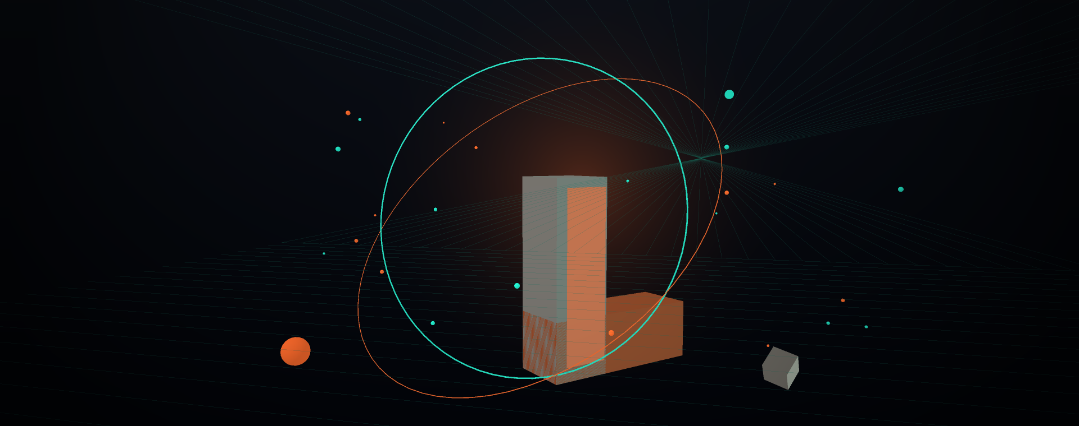
THE FORGE
Blockout → Forge → Budget → Wire → Harden
01
02
03
04
05
Blockout
Forge
Budget
Wire
Harden
Camera path, scale and light locked in Blender before any texture exists.
bpy scripts build hero assets, bake lightmaps, export GLTF with LODs.
Draco + KTX2 compression against a signed-off first-load ceiling.
React Three Fiber scenes, scroll timelines, CMS so marketing can edit copy.
GPU tiers, fallbacks, SEO-safe HTML and a perf gate in CI.

Slide 5
CASE 01 · 3D COMMERCE
Atelier Nova
A flagship store where every piece is a real object: rotate, place, buy.
1.9 MB FIRST LOAD
+38% ADD-TO-CART
BPY ASSET PIPELINE
THREE.JS + R3F

Slide 6
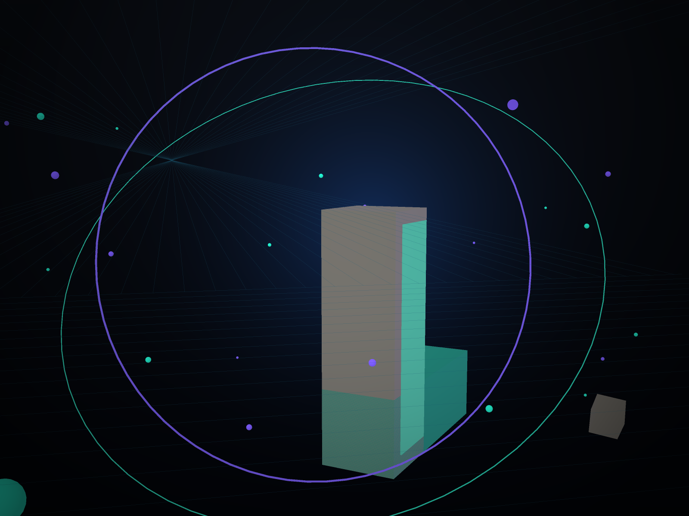
CASE 02 · REAL ESTATE
Meridian Towers
48 unit interiors and sun studies computed in Blender, walkable on a phone.
3.1× LONGER SESSIONS
KTX2 + DRACO
SUN STUDY IN BPY
WEBGL 2 FALLBACK

Slide 7
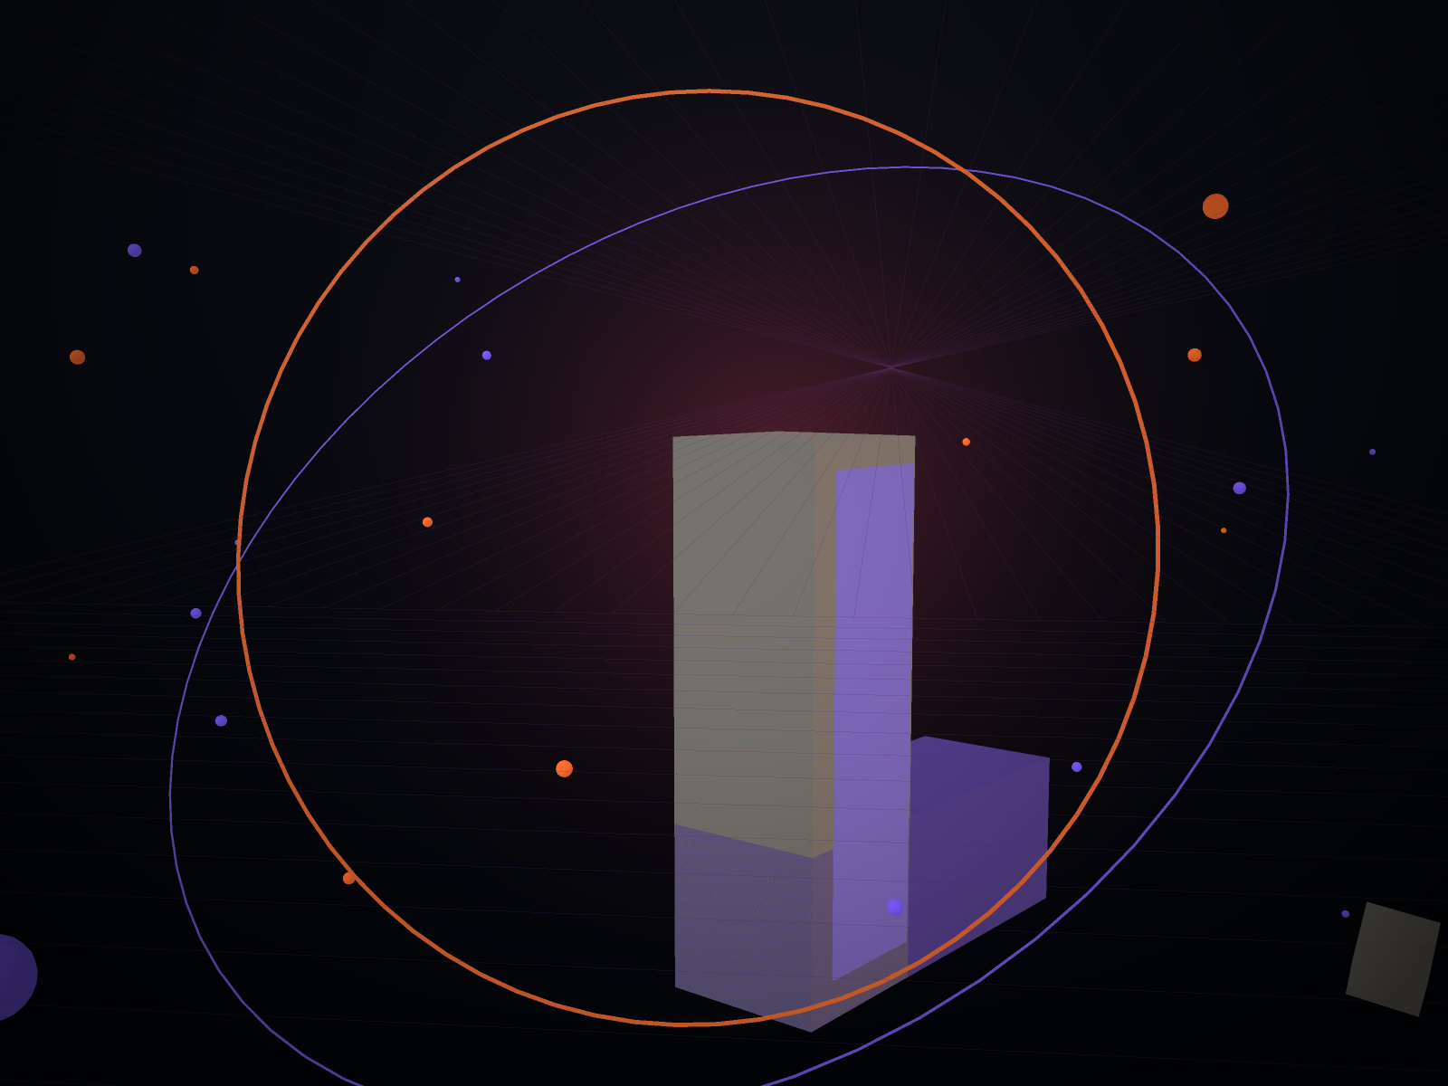
CASE 03 · PRODUCT LAUNCH
Kinetic Labs
A scroll-driven reveal that turns a spec sheet into a launch moment.
2.4M CAMPAIGN VIEWS
GLTF + DRACO
GSAP + R3F
LAUNCH AD KIT

Slide 8
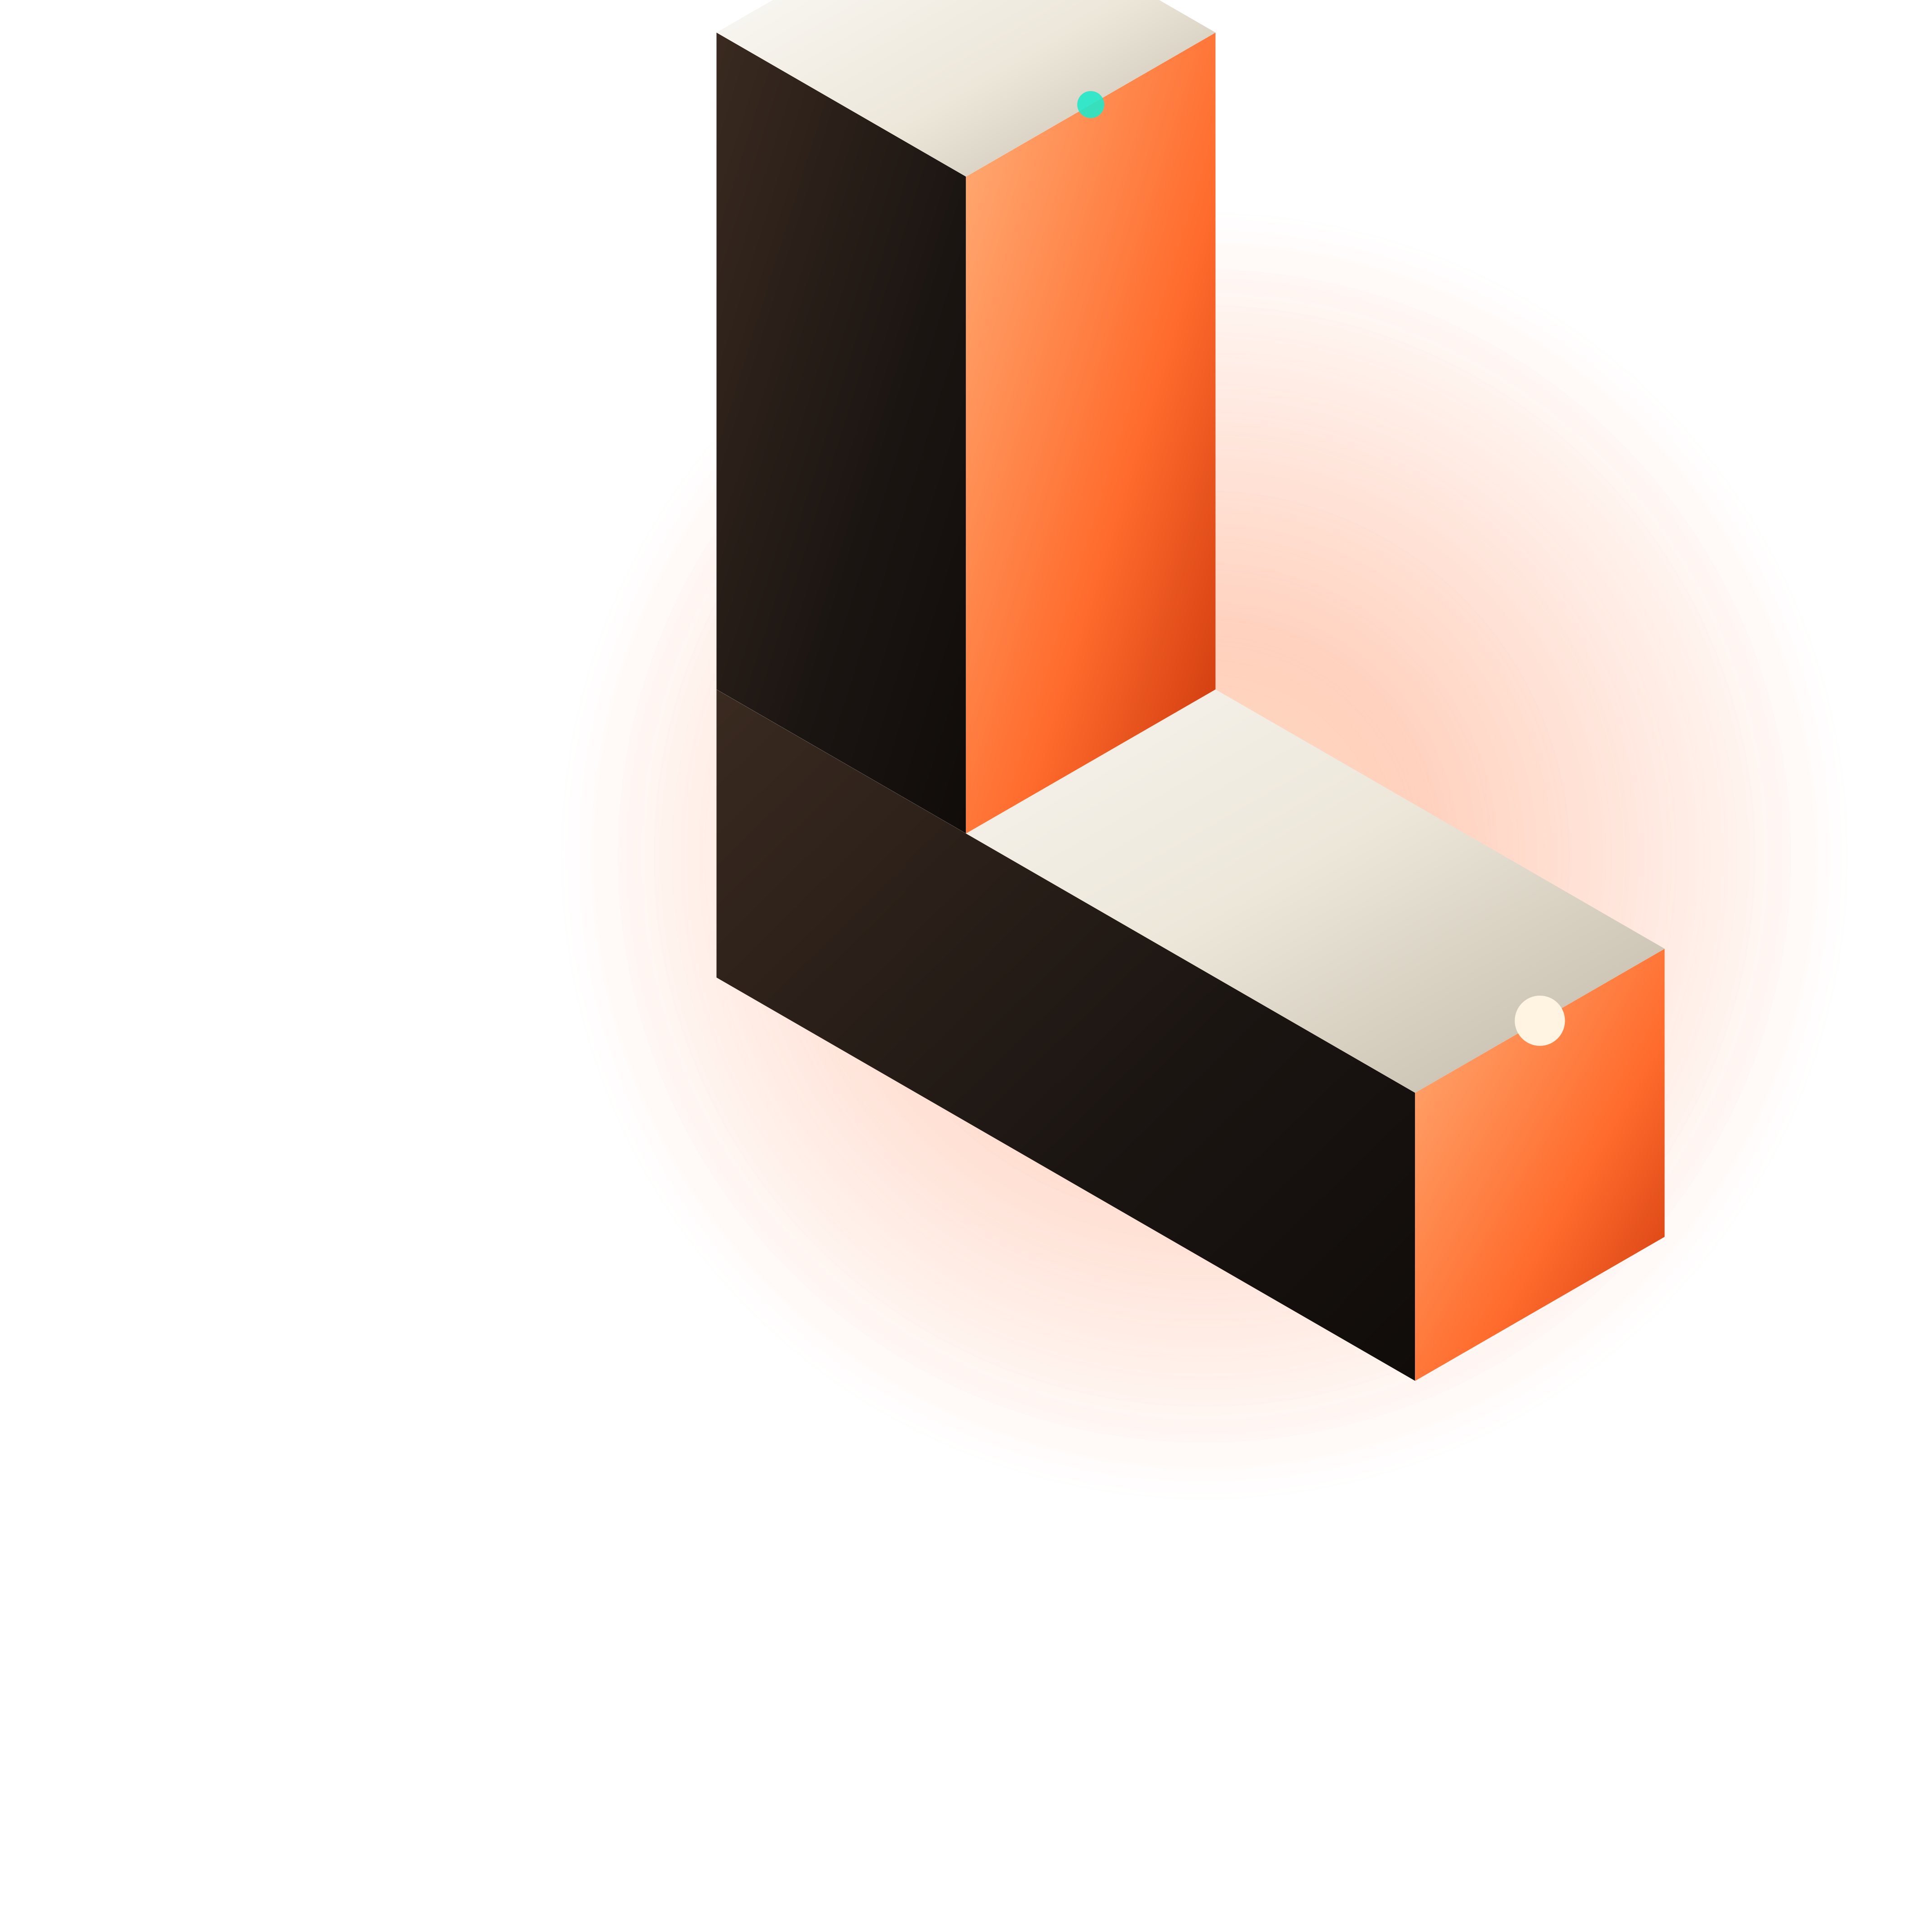
ENGINEERING
Beauty that survives a mid-range phone.
< 2.0 MB
60 fps
first load, including fonts and JS
on a Pixel 6a / iPhone 12 tier GPU
95+
≤ 8
Lighthouse performance gate in CI
draw calls in the hero scene

Slide 9
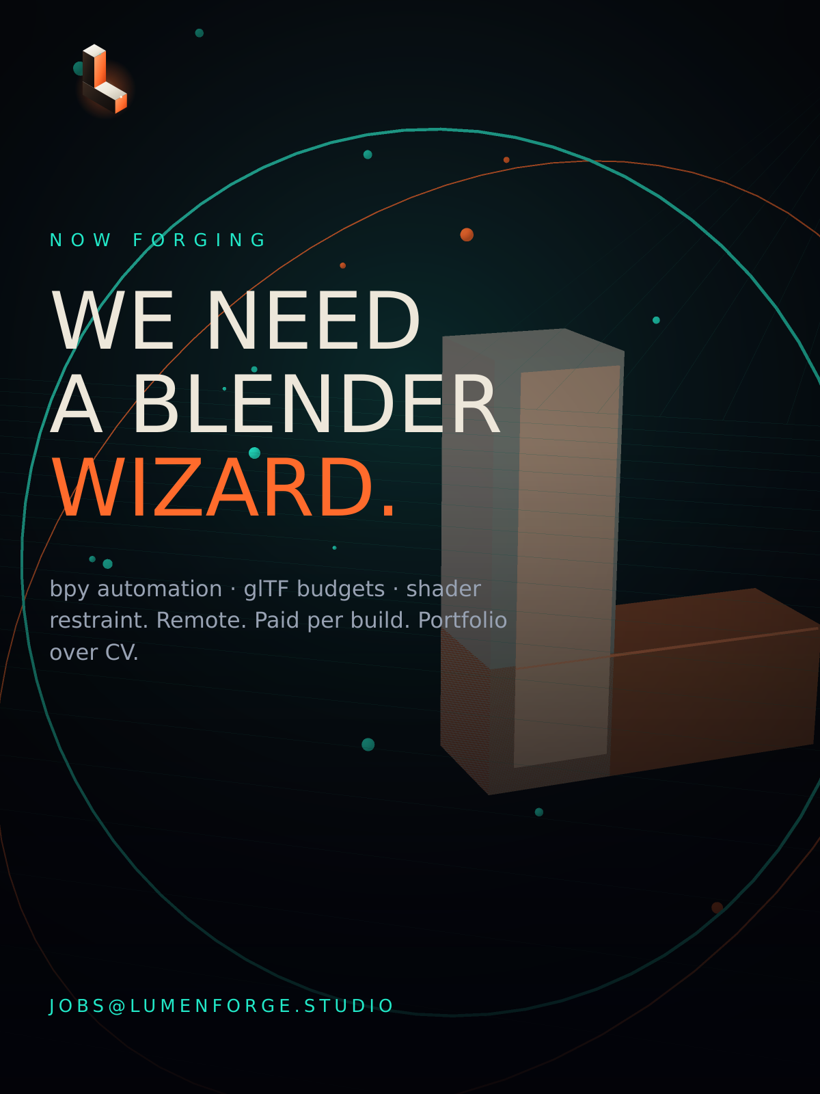
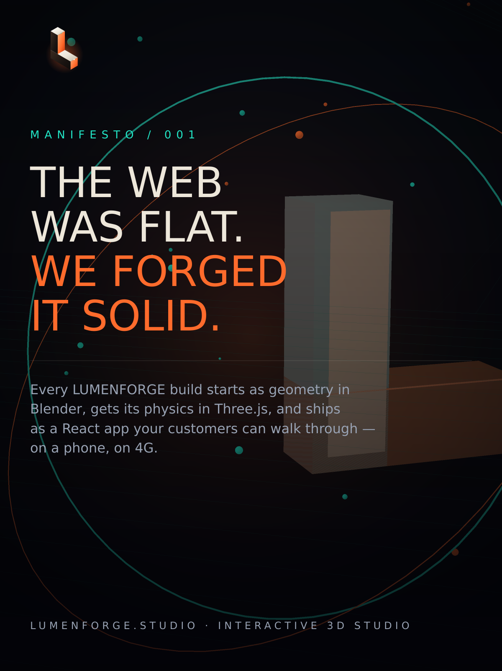
THE STUDIO
Blender hands, browser discipline.
LUMENFORGE is a small, senior team: an asset pipeline engineer writing bpy automation, a creative developer owning the WebGL layer, and a motion designer who ships the launch campaign with every build.
BLENDER
BPY
THREE.JS
REACT THREE FIBER
REACT / NEXT
GSAP
DRACO
KTX2
PLAYWRIGHT
FIGMA

Slide 10
COMMERCIALS
Fixed scope, fixed number, fixed date.
 | Spark | Forge | Foundry
Price | $4,800 | $12,500 | $3,900 / mo
Scenes | 1 | up to 5 | 2 per sprint
bpy pipeline | — | included | included
CMS + analytics | — | included | included
Launch ad kit | stills | stills + video | monthly
Delivery | 2 weeks | 3–5 weeks | rolling

Slide 11
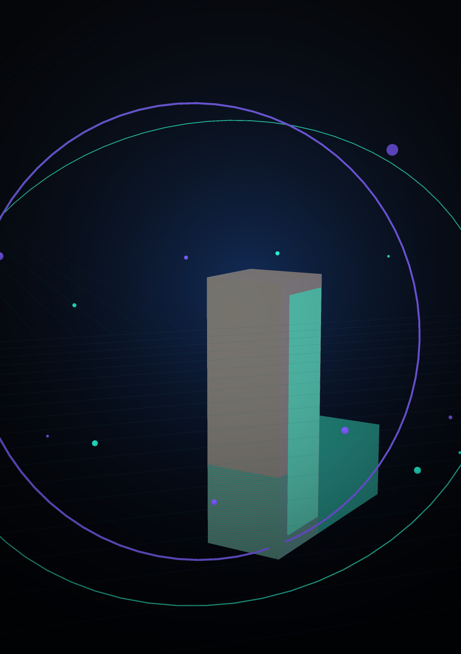
NEXT STEP
Send us your product.
We send back a room.
Within 48 hours you get a fixed price, a camera path and a load budget. No retainer to start, no discovery invoice.
forge@lumenforge.studio
lumenforge.studio · live showroom at /showroom

