Slide 1
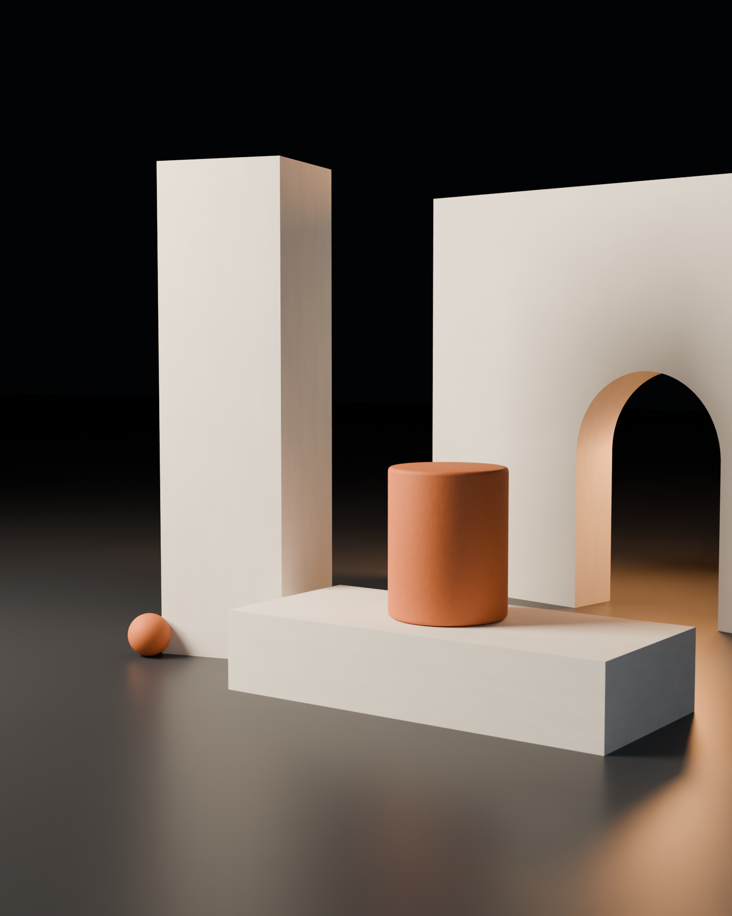
KILN
Rooms,
not pages.
An interactive architecture studio. We model the space in Blender, light it with bpy and ship it in React — under two megabytes, sixty frames on a phone.
PITCH DECK · 2026 · STUDIO@KILN.STUDIO

Slide 2
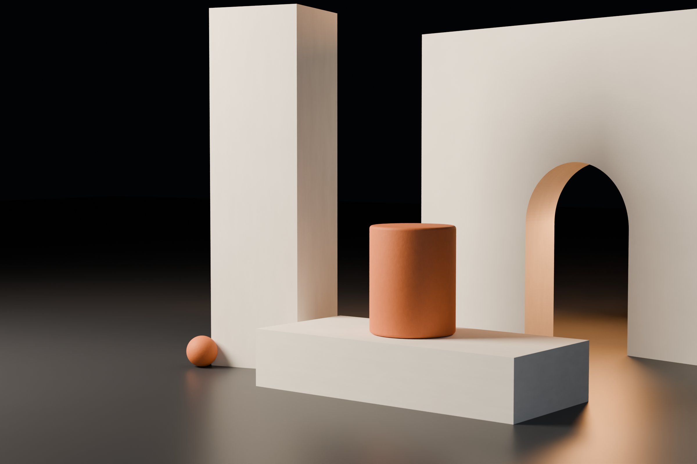
THE PROBLEM
A page is a photograph
of a place.
Customers are asked to judge size, material and finish from a flat image — then guess wrong at the moment they would have bought. Video does not help: it cannot be explored. And most “3D websites” are forty-megabyte showreels that melt a phone on 4G.
No sense of scale · No sense of material · No sense of light
THE ARGUMENT

Slide 3
THE WORK
Three rooms, three trades.
COMMERCE
PROPERTY
LAUNCH
A gallery you can shop
Every unit walkable
A moment, not a page
WHAT WE BUILD

Slide 4
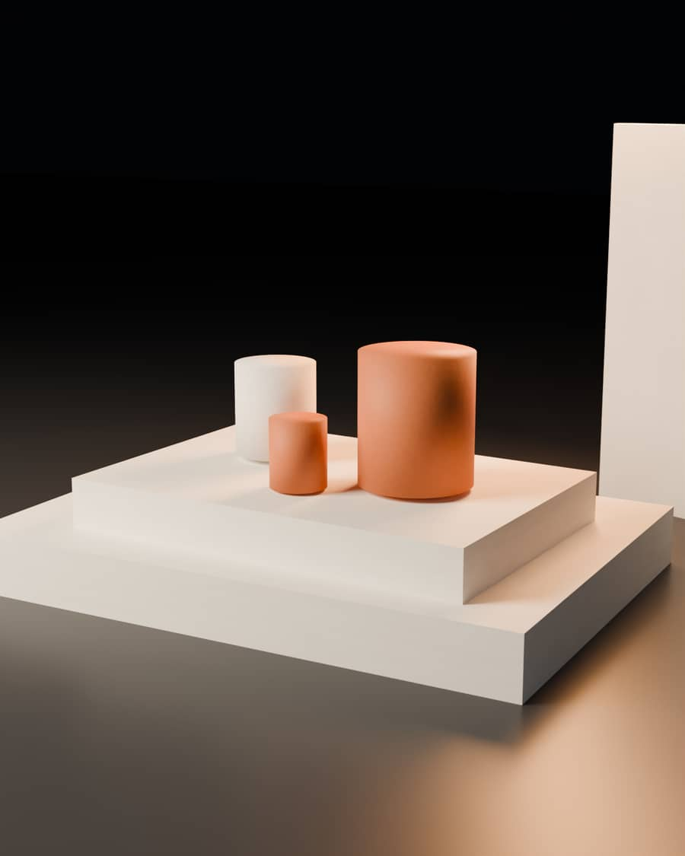
CASE 01 · COMMERCE
Atelier Nova
A flagship where every piece is a real object you turn, place and buy.
+38% add-to-cart
1.9 MB first load
7 draw calls
RENDERED IN BLENDER · SHIPPED IN REACT

Slide 5
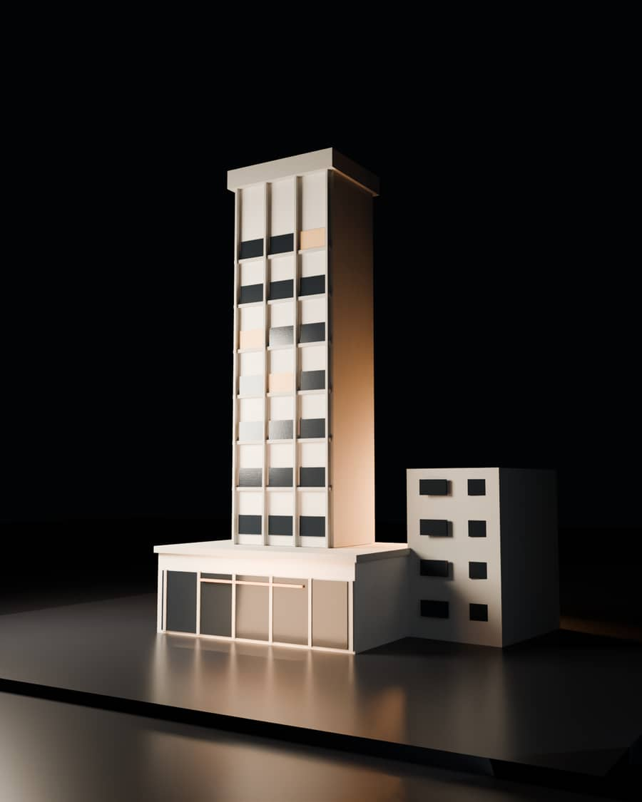
CASE 02 · PROPERTY
Meridian Towers
Forty-eight apartments, each lit for its real orientation. Sun studies computed in Blender and baked to a lightmap.
3.1× session length
48 units walkable
0 render farm
RENDERED IN BLENDER · SHIPPED IN REACT

Slide 6
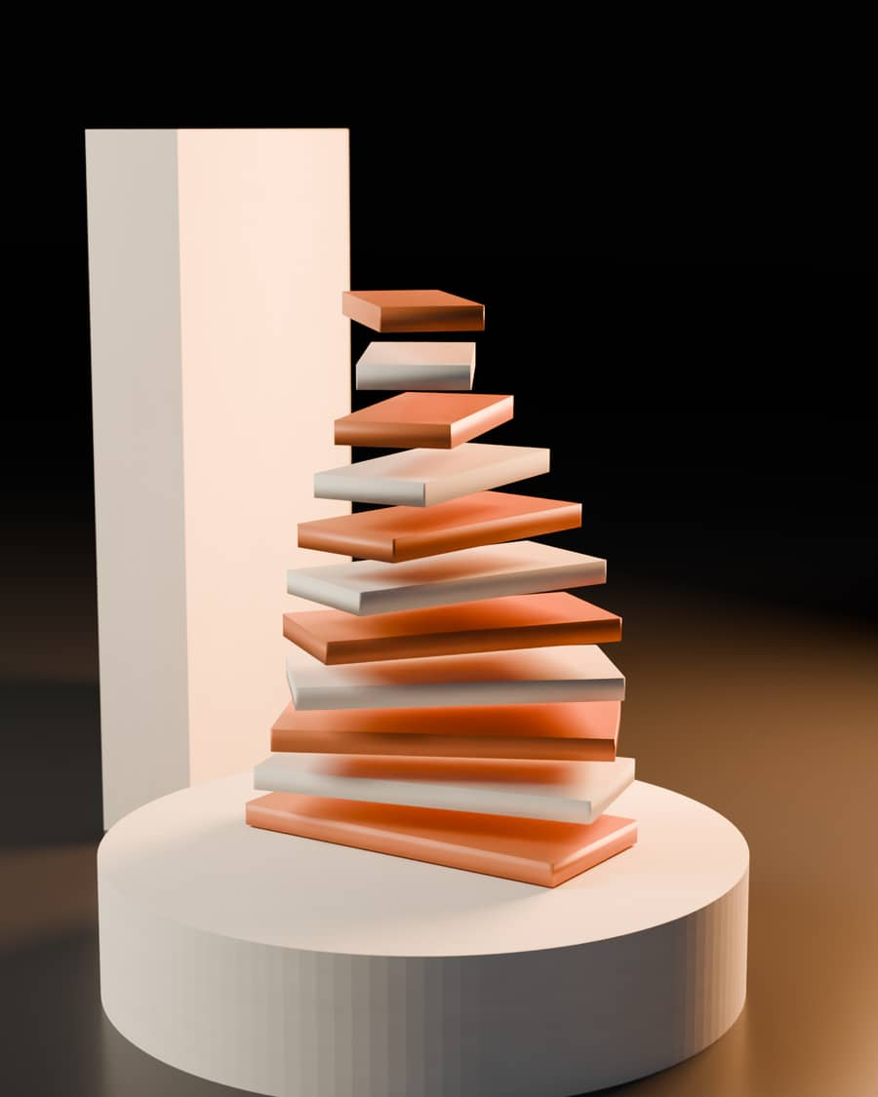
CASE 03 · LAUNCH
Kinetic Labs
A scroll-driven reveal built from one turned form. The launch film is rendered from the same geometry.
2.4M campaign views
1 asset set
6 wks to launch
RENDERED IN BLENDER · SHIPPED IN REACT

Slide 7
METHOD
Blockout · Forge · Budget · Wire · Harden
01
02
03
04
05
Blockout
Forge
Budget
Wire
Harden
Camera path, scale and light locked before a texture exists.
bpy builds the hero geometry, bakes lightmaps, exports glTF with LODs.
Draco and KTX2 measured against a ceiling signed off up front.
React Three Fiber scenes, scroll timelines, CMS bindings.
GPU tiers, fallbacks, SEO-safe HTML, a Lighthouse gate in CI.
THE METHOD

Slide 8
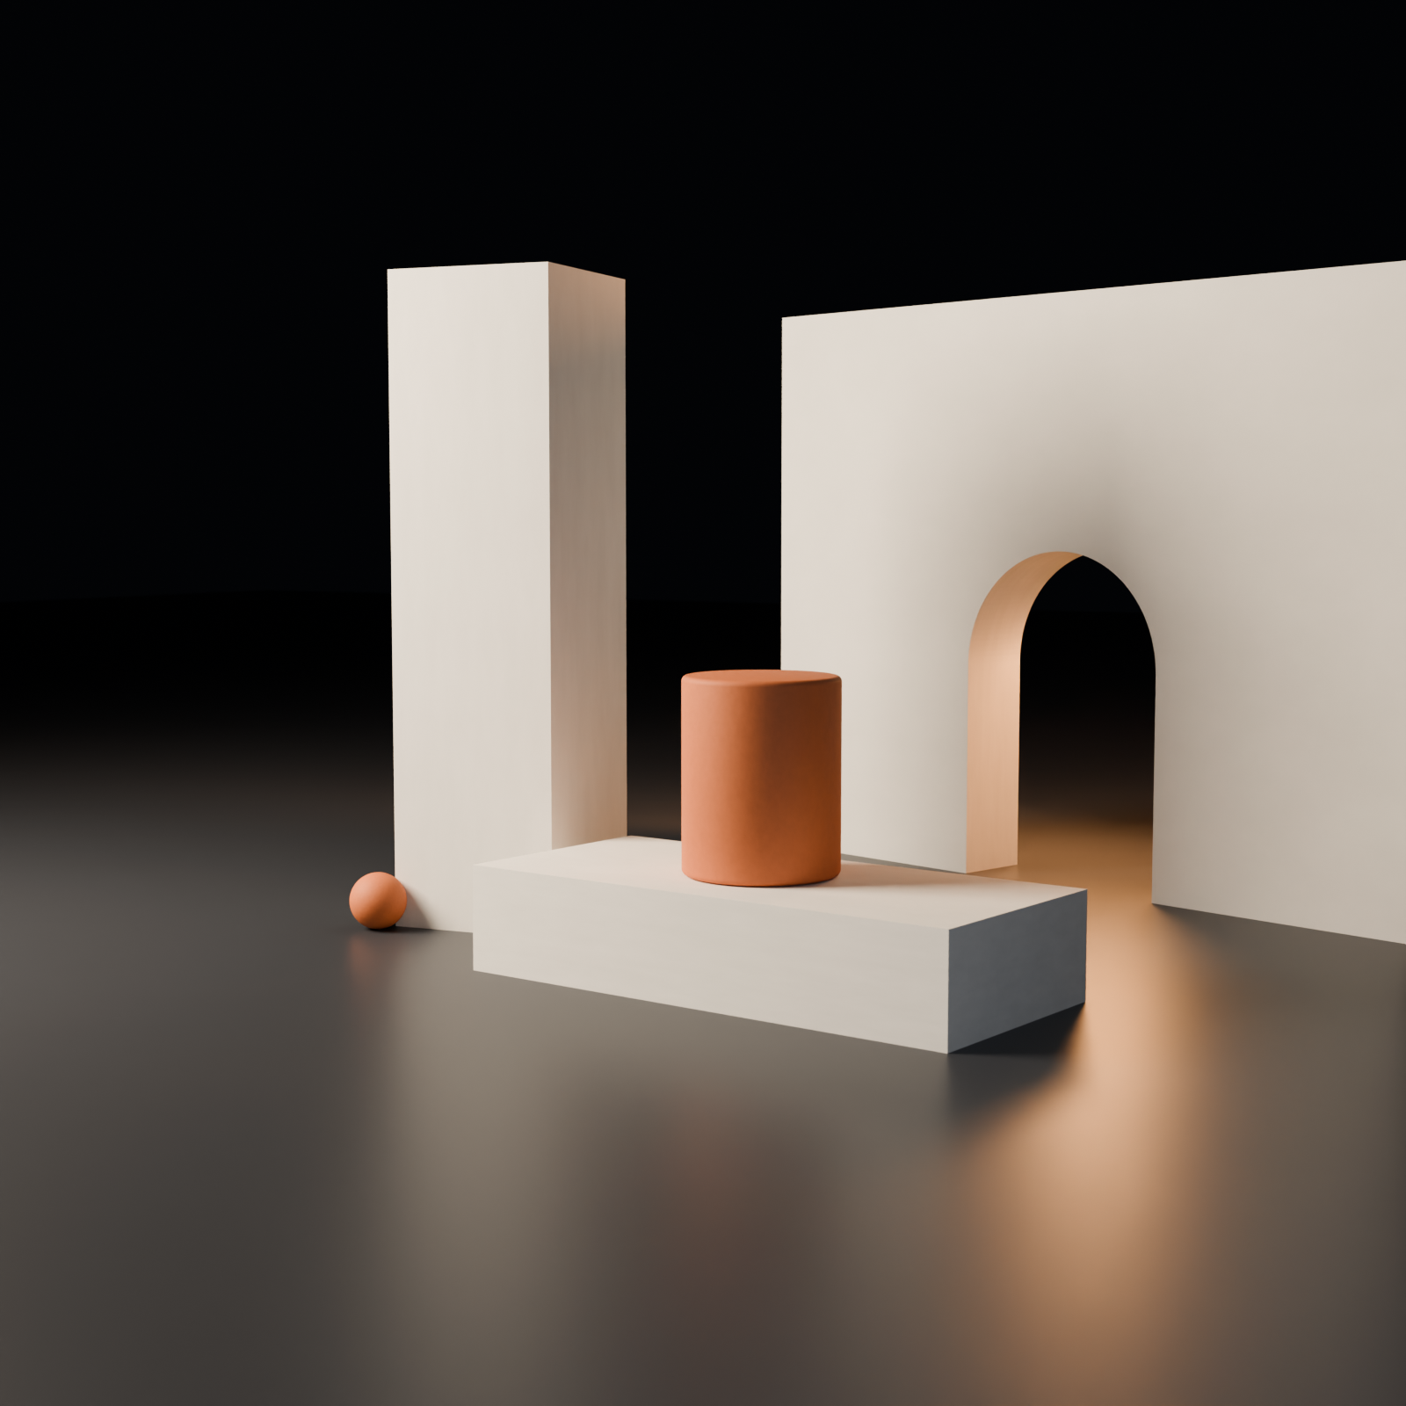
ENGINEERING
Beauty that survives
a mid-range phone.
< 2.0 MB
60 fps
first load, fonts and JS included
on a Pixel 6a / iPhone 12 tier GPU
≤ 8
95+
draw calls in the hero scene
Lighthouse, gated in CI
THE BUDGET IS THE DESIGN

Slide 9
THE STUDIO
Blender hands,
browser discipline.
KILN is three people on purpose: an asset engineer writing bpy automation, a creative developer owning the WebGL layer, and a motion designer who ships the campaign with every build.
Blender · bpy · Cycles · Three.js · R3F · gsap · Draco · KTX2 · Playwright
THE STUDIO

Slide 10
RATES
Fixed scope. Fixed number.
SPAR
KILN
FIRING
$4,800
$12,500
$3,900 / mo
2 weeks
3–5 weeks
rolling
One walkthrough scene, three art-directed stills, source handover.
Up to five rooms, bpy pipeline, CMS, launch kit, thirty days of support.
Two scenes per sprint, performance monitoring, monthly ad creative.
RATES

Slide 11
WHY IT HOLDS TOGETHER
One set,
many pictures.
Every KILN build starts as a real Blender scene. That single decision pays three times: the site is lit correctly, the launch film is rendered from the same geometry, and the ad stills are photographs rather than illustrations. One asset, one invoice, three channels.
PROVENANCE

Slide 12
NEXT STEP
Send the product.
We send the room.
Within two working days: a fixed price, a camera path and a load budget. No discovery invoice, no retainer to start.
studio@kiln.studio
kiln.studio · +44 20 7946 0812 · showroom at /showroom
KILN · 2026

