Slide 1
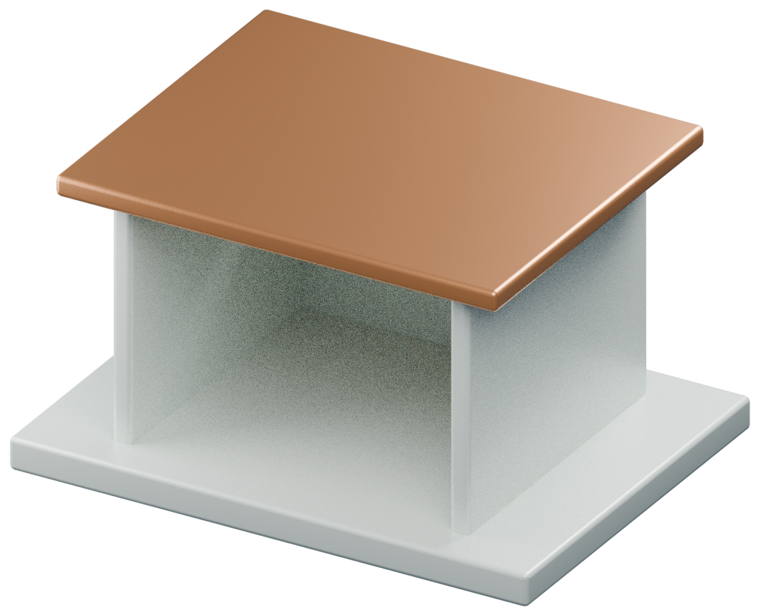
A PAVILION FOR PAUSE
Make room
for stillness.
A conceptual pavilion study organized
around arrival, shelter and a framed
view.
Concept model; not a construction document
01 / HERO
Notes:
A conceptual pavilion study organized around arrival, shelter and a framed view.
Source: Original conceptual pavilion study; design intent only, not a built project or engineering certification.
Source detail: A conceptual pavilion study organized around arrival, shelter and a framed view.
Asset: {"path": "assets/studio3d/architecture/view-01.png", "license": "Original procedural geometry", "source": "studio/blender_scene.py; assets/studio3d/architecture.json", "alt": "Concept pavilion with plinth, load-bearing walls and roof"}

Slide 2
A PAVILION FOR PAUSE
The space unfolds in three moments.
01
02
03
A compressed
threshold.
An open sheltered
room.
A framed view outward.
02 / MECHANISM
Notes:
Sequence directs attention before any material or ornament is added.
Source: Original conceptual pavilion study; design intent only, not a built project or engineering certification.
Source detail: Sequence directs attention before any material or ornament is added.

Slide 3
A PAVILION FOR PAUSE
Structure and enclosure play different roles.
Primary structure
Secondary enclosure
Define a legible load path and a
restrained set of supporting
elements.
Filter light and frame views without
obscuring the spatial organization.
03 / COMPARISON
Notes:
This distinction is conceptual; structural design requires project-specific engineering.
Source: Original conceptual pavilion study; design intent only, not a built project or engineering certification.
Source detail: This distinction is conceptual; structural design requires project-specific engineering.

Slide 4
A PAVILION FOR PAUSE
Light is a material
that changes.
Study the opening across different sun angles
before fixing its proportions.
04 / STATEMENT
Notes:
Study the opening across different sun angles before fixing its proportions.
Source: Original conceptual pavilion study; design intent only, not a built project or engineering certification.
Source detail: Study the opening across different sun angles before fixing its proportions.

Slide 5
A PAVILION FOR PAUSE
Test the space,
not just the image.
Next studies: circulation, accessibility, climate
response and a physical or digital section model.
05 / CLOSING
Notes:
Next studies: circulation, accessibility, climate response and a physical or digital section model.
Source: Original conceptual pavilion study; design intent only, not a built project or engineering certification.
Source detail: Next studies: circulation, accessibility, climate response and a physical or digital section model.

