Slide 1
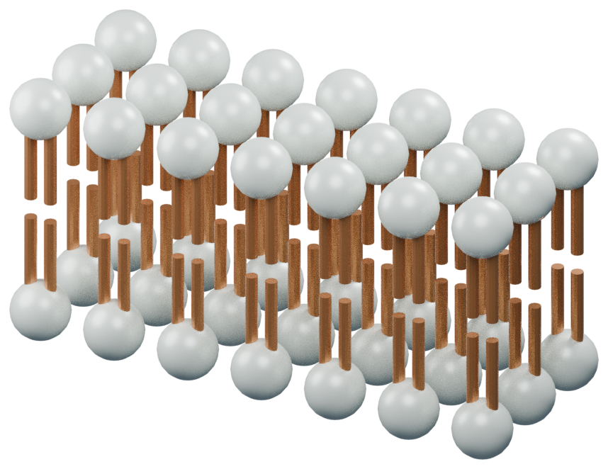
ACROSS THE CELL MEMBRANE
A boundary.
Not a barrier.
The cell membrane regulates
exchange between a cell and its
surroundings.
Molecular schematic; not to scale
01 / HERO
Notes:
The cell membrane regulates exchange between a cell and its surroundings.
Source: OpenStax Biology 2e, sections 5.2–5.3: https://openstax.org/books/biology-2e/pages/5-2-passive-transport
Source detail: The cell membrane regulates exchange between a cell and its surroundings.
Asset: {"path": "assets/studio3d/membrane/view-01.png", "license": "Original procedural geometry", "source": "studio/blender_scene.py; assets/studio3d/membrane.json", "alt": "Stylized phospholipid bilayer: polar heads face outward, tails point inward"}

Slide 2
ACROSS THE CELL MEMBRANE
Diffusion follows a concentration gradient.
01
02
03
Particles move
randomly.
More particles leave the
crowded side.
Net movement declines
toward equilibrium.
02 / MECHANISM
Notes:
Net movement follows the gradient; individual particles continue to move in both directions.
Source: OpenStax Biology 2e, sections 5.2–5.3: https://openstax.org/books/biology-2e/pages/5-2-passive-transport
Source detail: Net movement follows the gradient; individual particles continue to move in both directions.

Slide 3
ACROSS THE CELL MEMBRANE
Not every molecule crosses the same way.
Simple diffusion
Facilitated diffusion
Small nonpolar molecules can pass
through the lipid bilayer.
Transport proteins help selected
solutes move down their gradients.
03 / COMPARISON
Notes:
Permeability depends on the molecule and the membrane.
Source: OpenStax Biology 2e, sections 5.2–5.3: https://openstax.org/books/biology-2e/pages/5-2-passive-transport
Source detail: Permeability depends on the molecule and the membrane.

Slide 4
ACROSS THE CELL MEMBRANE
Against the gradient?
Energy is required.
Active transport couples movement to an energy
source. It is not simply faster diffusion.
04 / STATEMENT
Notes:
Active transport couples movement to an energy source. It is not simply faster diffusion.
Source: OpenStax Biology 2e, sections 5.2–5.3: https://openstax.org/books/biology-2e/pages/5-2-passive-transport
Source detail: Active transport couples movement to an energy source. It is not simply faster diffusion.

Slide 5
ACROSS THE CELL MEMBRANE
Ask what drives
the movement.
Identify the solute, the membrane pathway and the
direction of the concentration gradient.
05 / CLOSING
Notes:
Identify the solute, the membrane pathway and the direction of the concentration gradient.
Source: OpenStax Biology 2e, sections 5.2–5.3: https://openstax.org/books/biology-2e/pages/5-2-passive-transport
Source detail: Identify the solute, the membrane pathway and the direction of the concentration gradient.

