Slide 1
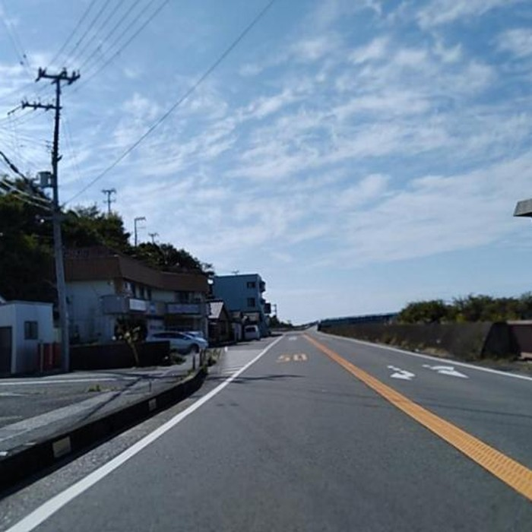
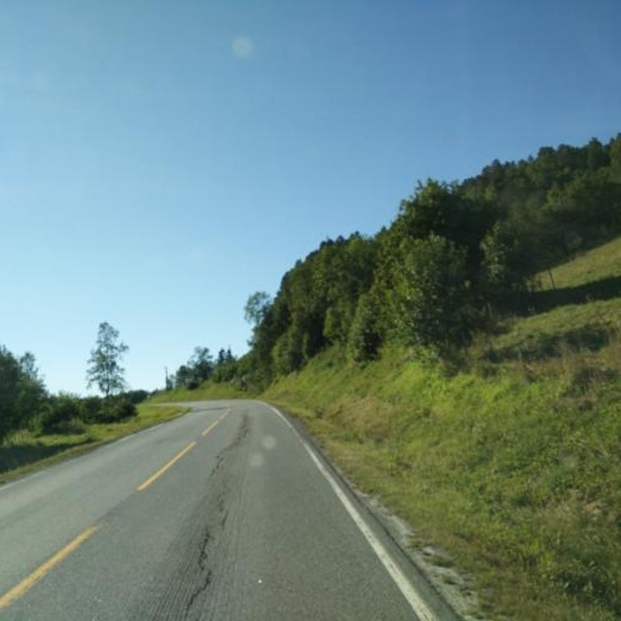
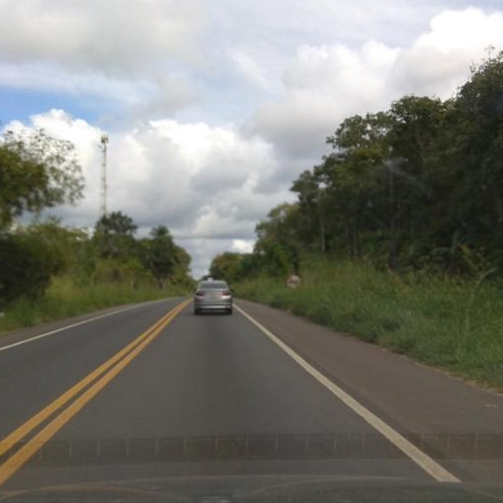
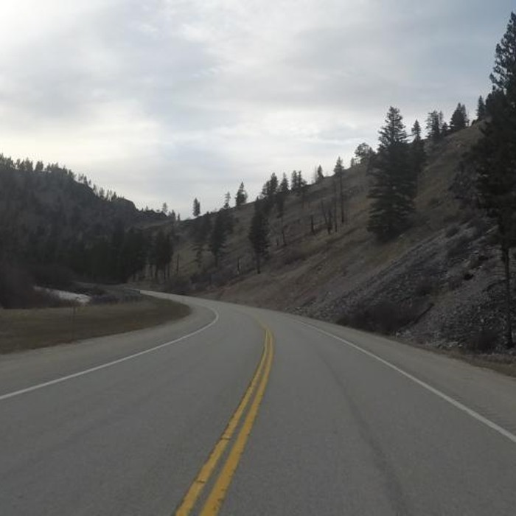
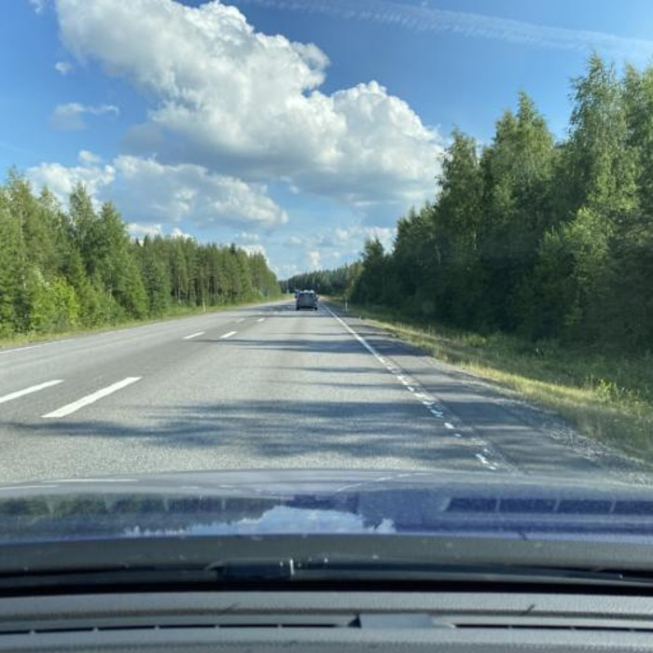
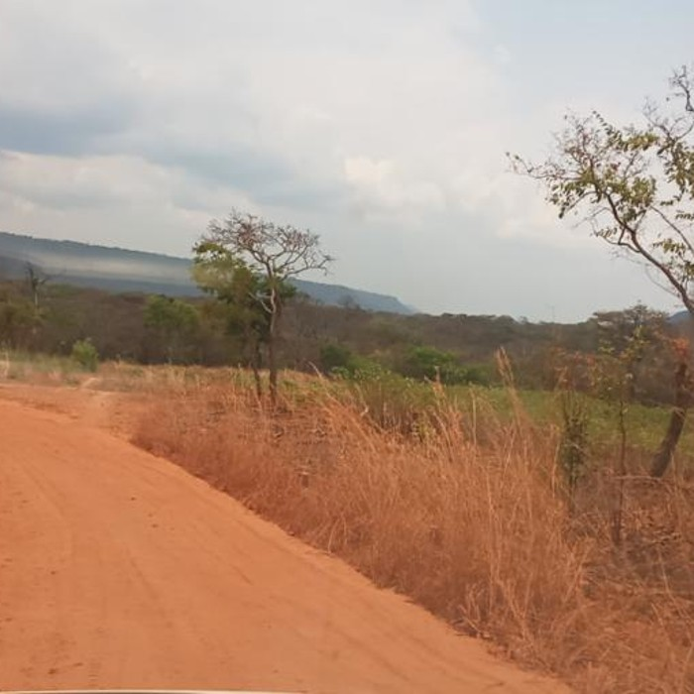
Phase I midpoint | Team OpenSI | AI and Visualisation
Can AI play GeoGuessr?
Japan > Japan
Norway > Norway
Brazil > Brazil
How StreetCLIP guesses the country of a street photo, and where it goes wrong
AI-aided pair
Manuel Lisa, Umut Tanriverdi
Human-only pair
Maximilian Hammer, Florian Weigelt
USA > Canada
Finland > Sweden
Zambia > Angola
Real test photos: true country > StreetCLIP's guess
Notes:
Hi, we are team OpenSI. Our question is: can AI play GeoGuessr? On the right are real test photos, with the true country and the model's guess. The top row is right. The bottom row is wrong, but the guess is always a neighbour. So where does the model fail, and why?

Slide 2
Our setup: one street photo in, one country out
1
Model
StreetCLIP: a CLIP model (ViT-L/14) fine-tuned on street-level photos for geolocation. It works zero-shot: it compares the photo with one text prompt per country and picks the best match.
Prompt for every country:
"A Street View photo in Japan, Eastern Asia."
2
Dataset
OpenStreetView-5M test set: about 210,000 Mapillary photos from almost every country, with labels like climate, land cover and urban or rural.
3
Phase I
Black box: we only look at inputs and outputs, not inside the model. Overall, StreetCLIP gets 49 % of the photos right (197 candidate countries).
Notes:
Our model is StreetCLIP, an image and text model trained on street photos. This is how it guesses. For every country there is one sentence, like "A Street View photo in Japan". The model picks the sentence that fits the photo best. Here it says Japan, with 91 percent. Our data is the OpenStreetView-5M test set: about 210,000 photos from almost every country. The model gets 49 percent of them right. In Phase I we do not look inside the model. We only study inputs and outputs.

Slide 3
Four shared questions, two pairs working separately
Q1
Q2
Q3
Q4
Errors
Which countries get confused, and what do the pairs have in common?
Confidence
When is the model confidently wrong? Can we see the training countries?
Visual clues
What happens when we hide road, vegetation, sky, text, ...?
Environment
Do climate, land cover or urban vs. rural change the accuracy?
AI-aided pair
Human-only pair
Manuel and Umut
Used Claude for planning, code, plots and reading results. Logged every important prompt.
Maximilian and Florian
Own code and own reasoning. Only light autocomplete and docs search.
Same model, same data, same questions. In Phase II the pairs swap roles.
Notes:
We asked four questions. Where do the wrong guesses go? When is the model wrong but very sure? Which parts of the photo does it use? And does the environment matter? Manuel and I worked with AI, Maximilian and Florian without.

Slide 4
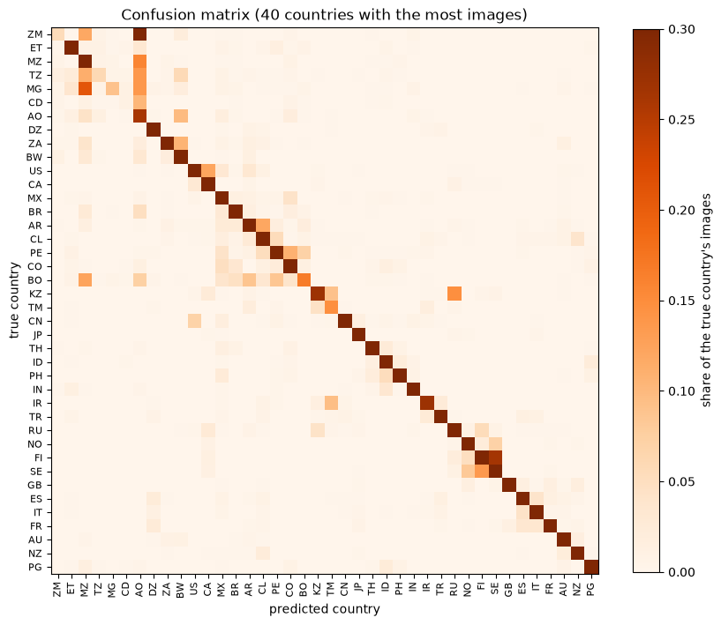
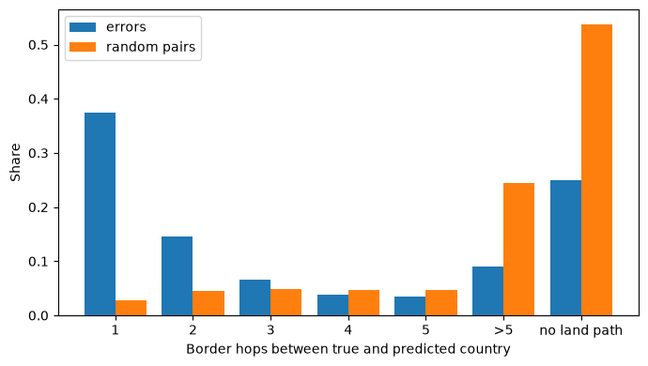
Q1: Errors stay close to home
Human-only pair
AI-aided pair
13x more often a direct neighbour than random pairs
Both pairs: some countries attract wrong guesses (Angola, Canada, North Korea 26x)
Confusion blocks inside regions: Africa, South America, Nordic countries
Notes:
Question one: where do the wrong guesses go? On the left is Florian's confusion matrix. The dark diagonal shows correct guesses. The coloured squares next to it are mistakes, and they form blocks of countries from the same region. On the right, we counted the borders between the true and the guessed country. Blue are real mistakes, orange are random pairs. Most mistakes are only one border away: 13 times more often than in random pairs.

Slide 5
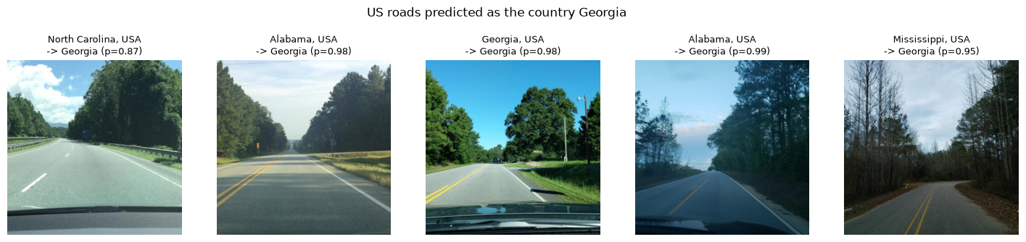
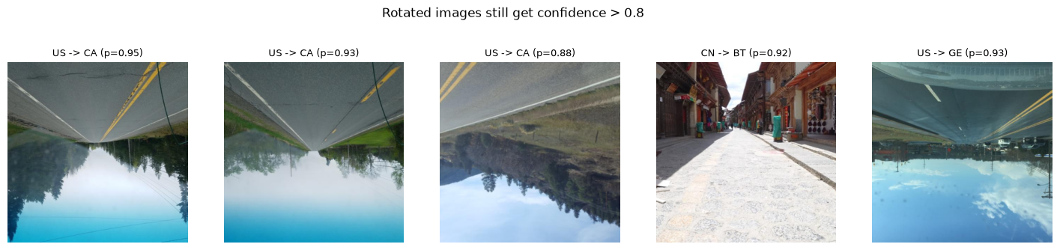
Q2: The worst confident errors come from one word
Human-only pair
US roads guessed as the country Georgia
96 %
of all "Georgia" guesses were US photos (paper's prompt). The model read the US state.
Fix: add the subregion
"..., Georgia, Western Asia." Only 62 US photos are still guessed as Georgia.
Human-only pair
Second cause: rotated photos, still over 80 % sure
But real Georgia: 1 of 290 right
The prompt fixed the US confusion, not the recognition of Georgia.
Notes:
Question two: when is the model wrong but very sure? The top row shows US roads. The model said "Georgia", the country, with up to 99 percent. The reason: Georgia is also a US state. 96 percent of all Georgia guesses were US photos. When we wrote "Georgia, Western Asia", these mistakes almost disappeared. The bottom row shows a second cause, found by the human pair: upside-down photos, where the model is still over 80 percent sure.

Slide 6
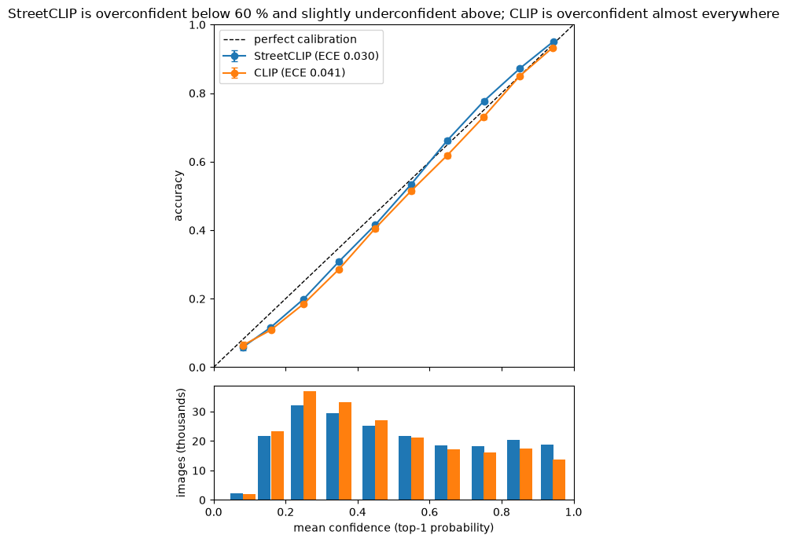
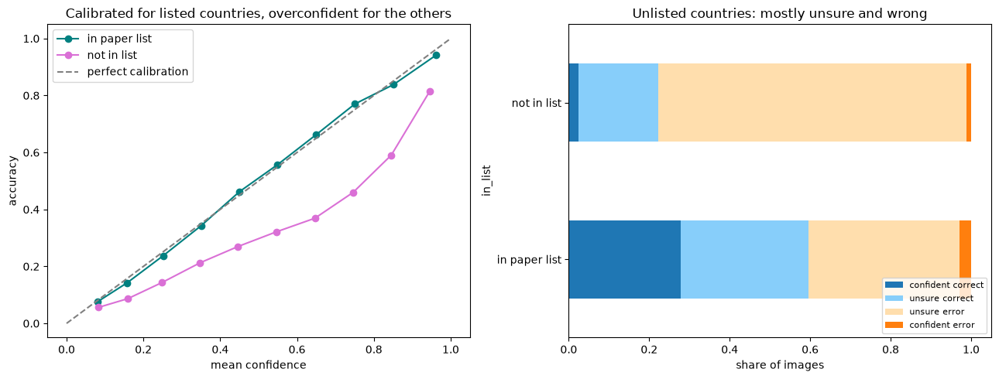
Q2: Confidence is mostly honest, but not for every country
AI-aided pair
Human-only pair
Well calibrated overall
Calibration error (ECE) 0.030, better than the original CLIP (0.041). Fine-tuning made it more honest.
Overconfident for countries outside the training list
AI pair: most of the accuracy gap (16 of 18 points) already exists in the original CLIP.
Notes:
Can we trust its confidence in general? If it says 70 percent, it should be right 70 percent of the time. On the left, that is the dashed line, and StreetCLIP is close to it. On the right, Maximilian split the countries. For countries in the training data, the green line is perfect. For the others, the pink line is lower: the model is too sure.

Slide 7
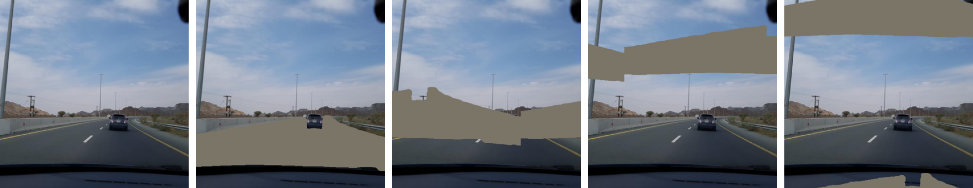
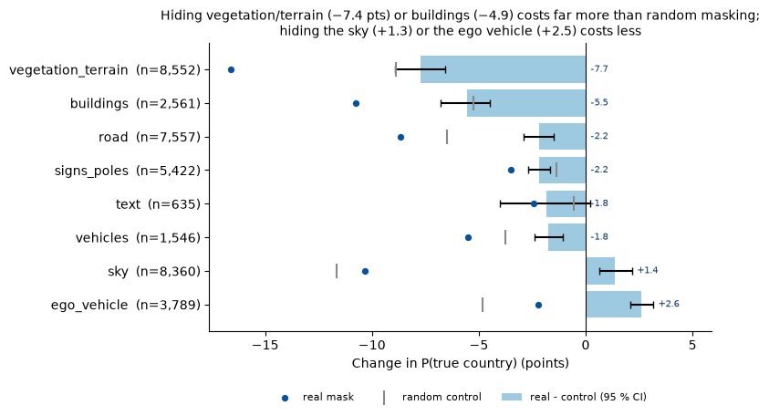
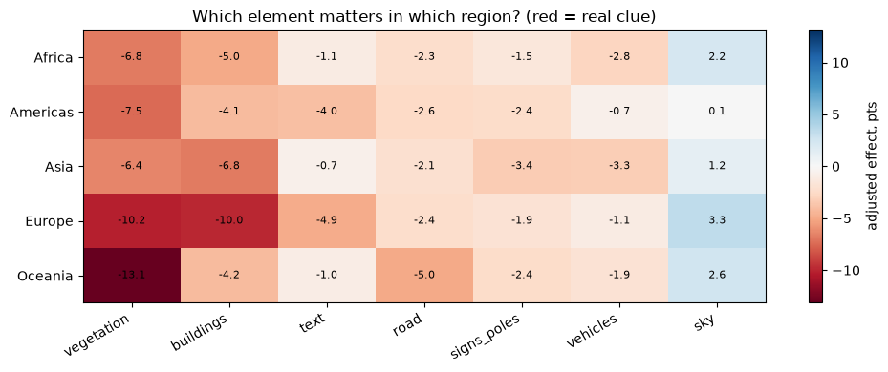
Q3: Hiding the landscape hurts the most
Method
Hide one element with a gray mask, then compare with random masks of the same size.
Original
Road hidden
Random mask
Random mask
Random mask
AI-aided pair | 12,154 photos
Human-only pair | 3,660 photos
Notes:
Question three: which parts of the photo does it use? At the top is our method. We cover one part, here the road, with a gray mask, and compare it with random masks of the same size. If the real mask hurts more, this part is a real clue. Bottom left: hiding vegetation hurts the most, then buildings. The sky is no clue. Bottom right, the human pair found the same result, split by region. Red means a strong clue.

Slide 8
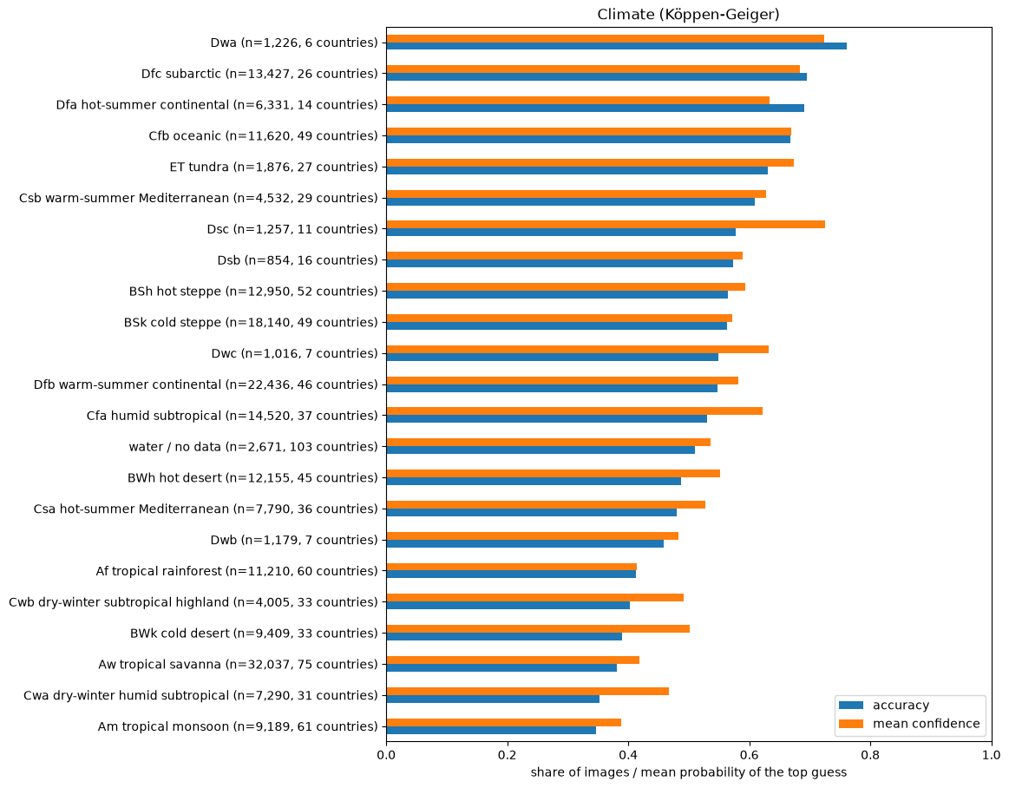
Q4: Climate looks important, but it is mostly the country mix
Human-only pair | raw accuracy
AI-aided pair | vs. country mix
Same height = no real climate effect.
Only built-up areas stay clearly better, also within the same country (+7.2 points).
From about 35 % (tropical) to 70 % (cold climates)
Notes:
Question four: does the environment matter? On the left, Florian's results: 35 percent right in tropical climates, about 70 percent in cold ones. But each climate has a different mix of countries. So on the right, we calculated the accuracy we expect from the countries alone. Orange is real, grey is expected. The bars are almost the same. So the climate itself does not matter. The countries do.

Slide 9
What changed with AI?
5x
more code
4,500 vs. 840 lines
34 vs. 19
plots
interactive vs. static
14 of 37
log entries
AI suggestions we had to reject or fix
AI-aided pair
Human-only pair
More breadth: 4 questions, dashboard, masking of cue parts
More controls: random baselines, within-country checks
But AI mistakes often looked correct, so checking took time
More depth on single causes
Found rotated photos and a better Georgia prompt
Fewer, simpler plots, but every line understood
Same main results in both pairs. Next: Phase II, we swap roles and open the black box.
Notes:
So, what changed with AI? We wrote five times more code and made almost twice as many plots. But 14 of our 37 logged AI suggestions were wrong, and they looked correct at first. With AI we covered more questions. The human pair went deeper into single causes. Both pairs found the same main results. In Phase II, we swap roles and look inside the model. Thanks for watching!

