Slide 1
Smart Hospital Bed
M. Hamza (BSCS17004)
Ammar Bin Asim (BSCS17005)
Aoun Ahmed (BSCS17008)
M. Junaid Ahmad (BSCS17012)
Warda Ahmer (BSCS17027)
Meram Zia (BSCS17038)

Slide 2
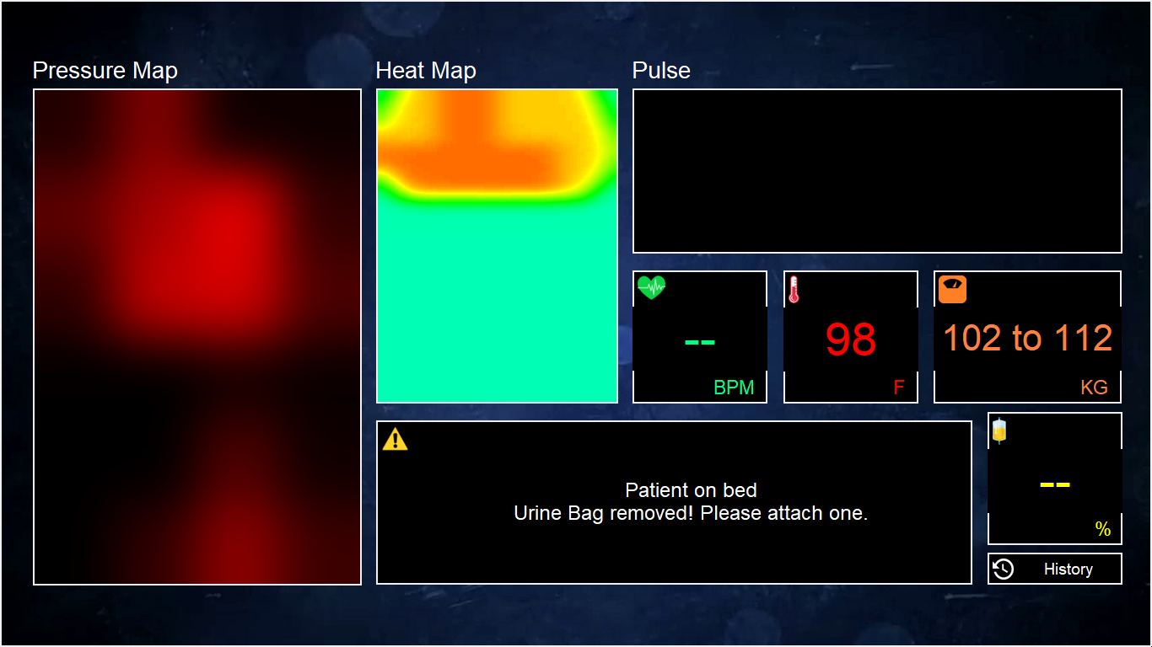
Introduction
Our smart hospital bed estimates a patient's temperature, posture, and weight without the use of any tethering or intrusive equipment
Cheap components resulted in cost of Rs.50000 only, whereas international smart beds cost Rs.5 lac

Slide 3
Features
Detection of patient's presence on the bed
Visualization of patient's body contour and position
Patient's weight range estimation
Alert generation if a disabled or coma patient is not turned periodically
Patient’s turns pattern history graph
Urine bag's filled percentage detection
Alert generation if the patient has not urinated in 6 hours
Alert generation if urine bag is more than 80% full
Alert generation if urine bag has been removed
Patient’s urination pattern history graph
Patient’s body temperature prediction
Body's heat map display

Slide 4
Architecture

Slide 5
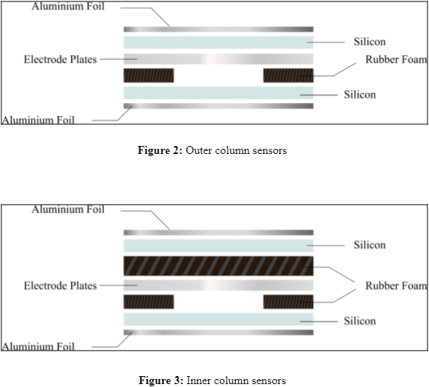
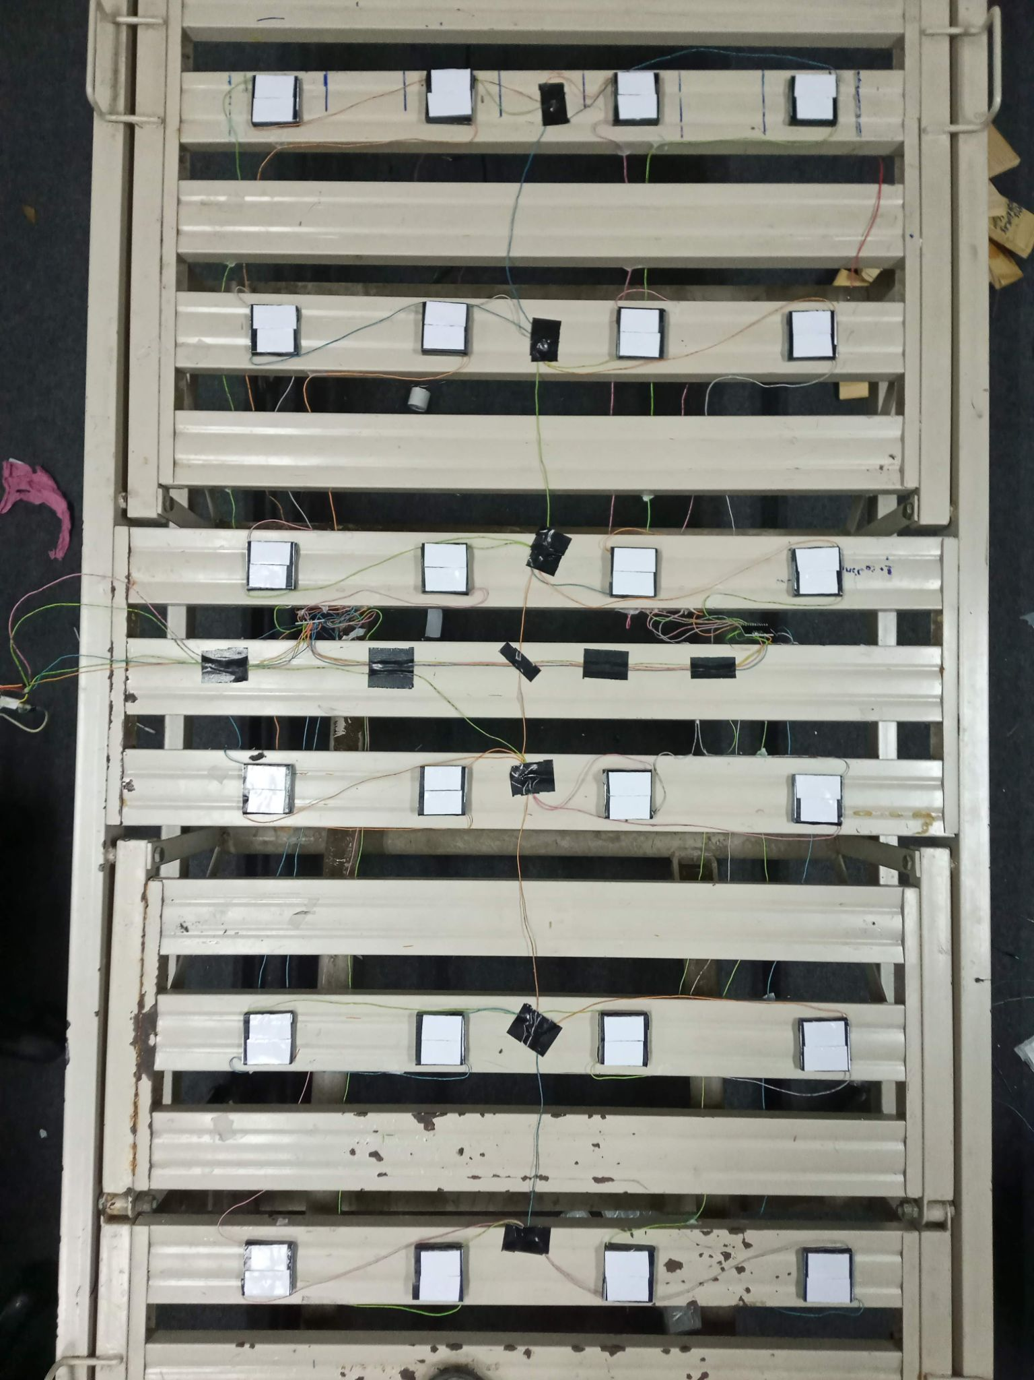
Pressure Sensors
Placed in a grid of 6x4
Connected to 2 MPR121s
MPR121s attached to STM32

Slide 6
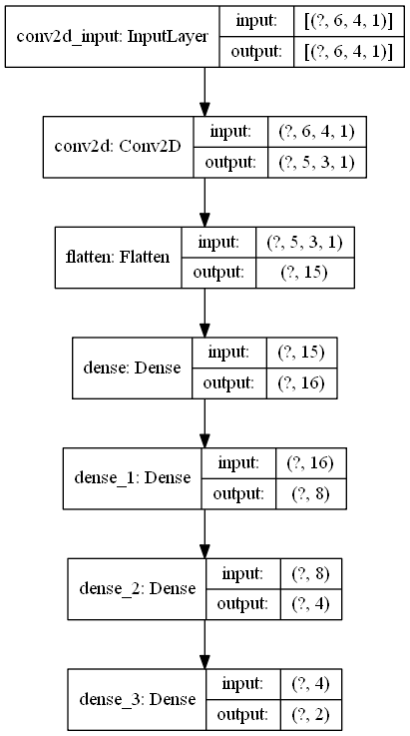
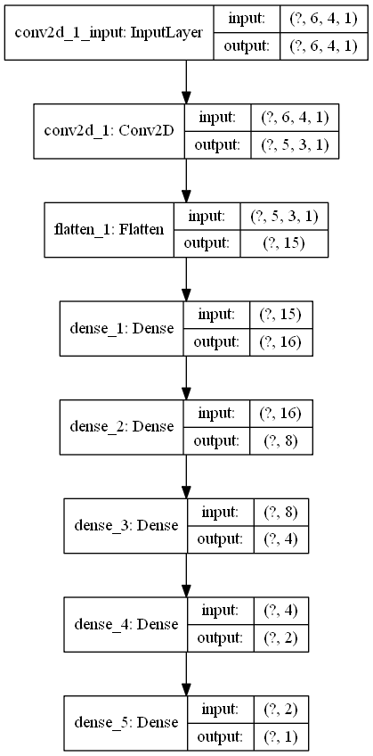
Neural Networks
Data from these is fed to the body detection neural network (left image)
If a body is detected, then this data is also fed to the weight estimator neural network (right image)

Slide 7
Dataset for Neural Networks
We collected the following dataset for use in both neural networks:
6 people with 28 lying poses per person
38 readings with unoccupied bed
A total of 206 capacitance differentials + weight pairs collected
95% of dataset used for training
5% of dataset used for validation

Slide 8
Neural Network Analysis
Body Detection
Epochs: 100
Training Loss: 0.0006
Training Accuracy: 100%
Validation Loss: 0.0006
Validation Accuracy: 100%
Weight Estimation
Epochs: 1000
Training Loss: 6.90
Training Accuracy: 100%
Validation Loss: 12.6
Validation Accuracy: 98%

Slide 9
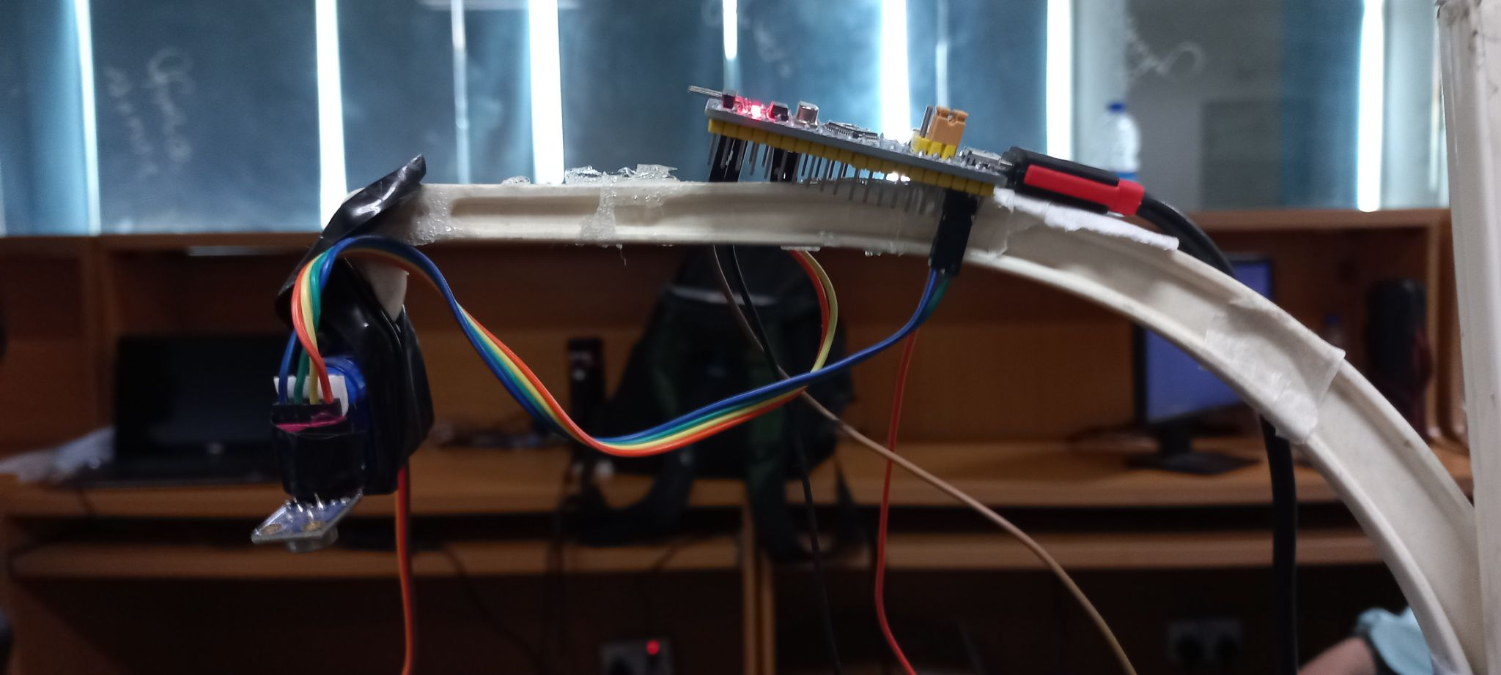
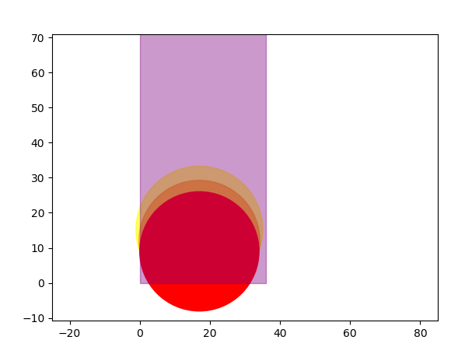
Temperature Module
Infrared sensor MLX90614 used to obtain body temperature
Mounted on a stand at the top of the bed
Gives an average temperature of area under 90 degree curvature
Fixed height, area already calculated and rotates on 3 angles
Body coverage conveyed from STM32 to temperature module via I2C

Slide 10
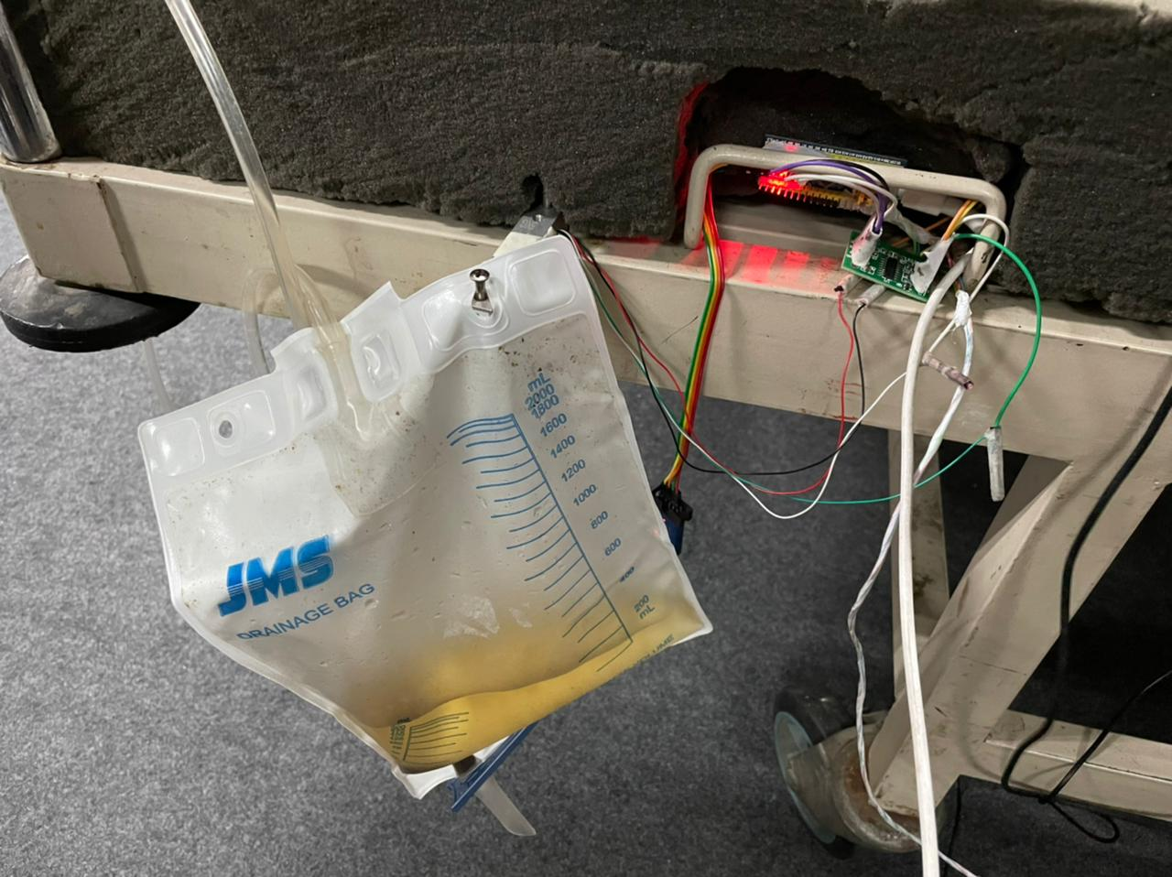
Urine Bag Module
A 50 kg load cell used with HX711 and STM32
Implemented in Arduino
The module starts when the bed gets occupied with a patient
Load cell readings are continuously taken
Readings being sent through I2C to central node

Slide 11
Central Node
All modules attached to Raspberry Pi 3B
Runs Linux
STM32s coded with C-language
Communication between modules using I2C
All STM32s attached to Raspberry Pi through serial ports
Also runs user interface and required backend servers

Slide 12
Implementation

Slide 13
User Interface
Implemented in Python using Tkinter library
Fetches data from all modules through serial ports
Displays:
Body contour and heat map
Pulse visualization
Heart rate (bpm)
Temperature (F)
Weight (kg)
Urine bag fill capacity (%)
Alerts from all the modules
History button for Grafana

Slide 14
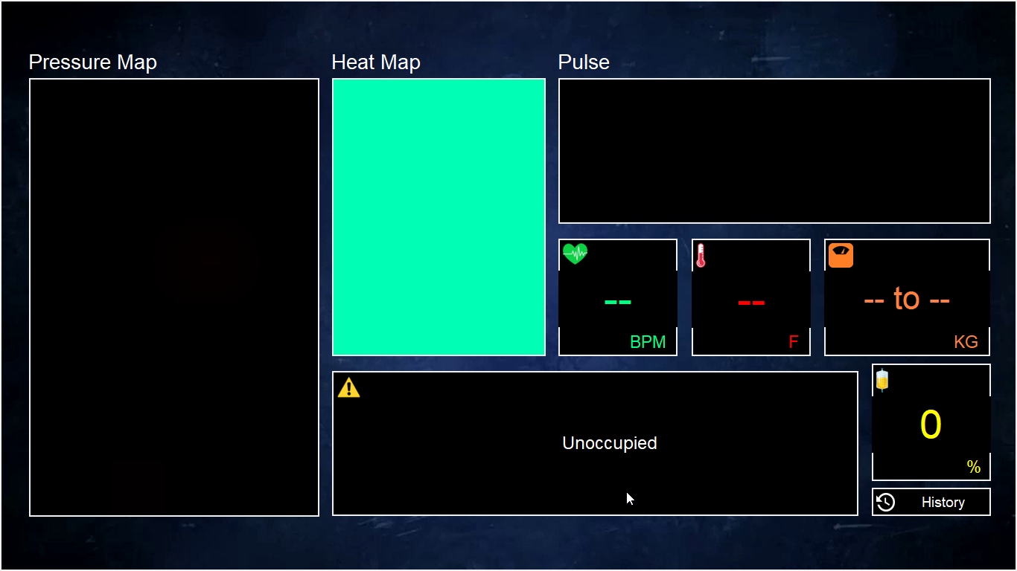
Body Detection Module
Bed unoccupied

Slide 15
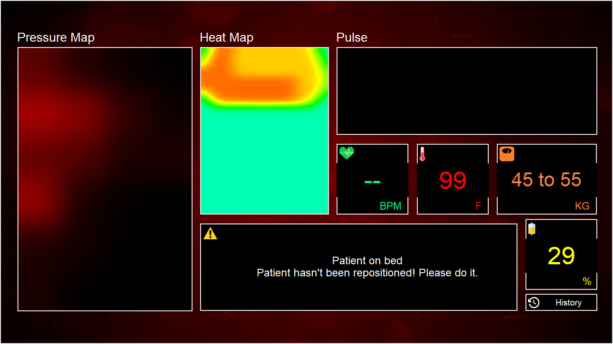
Turn Detection
Checks if the activated sensors shift from left to right or vice versa
If shifted activations are greater than the threshold, a turn is detected
If not detected for a certain period of time, an alert is generated

Slide 16

Temperature Module
Body temperature is calculated as a ratio of previous ambient temperature without patient and temperature measured with patient on bed w.r.t. percentage area covered by body out of total sensors’ coverage
Following relation was found with experiments:
Where

Slide 17
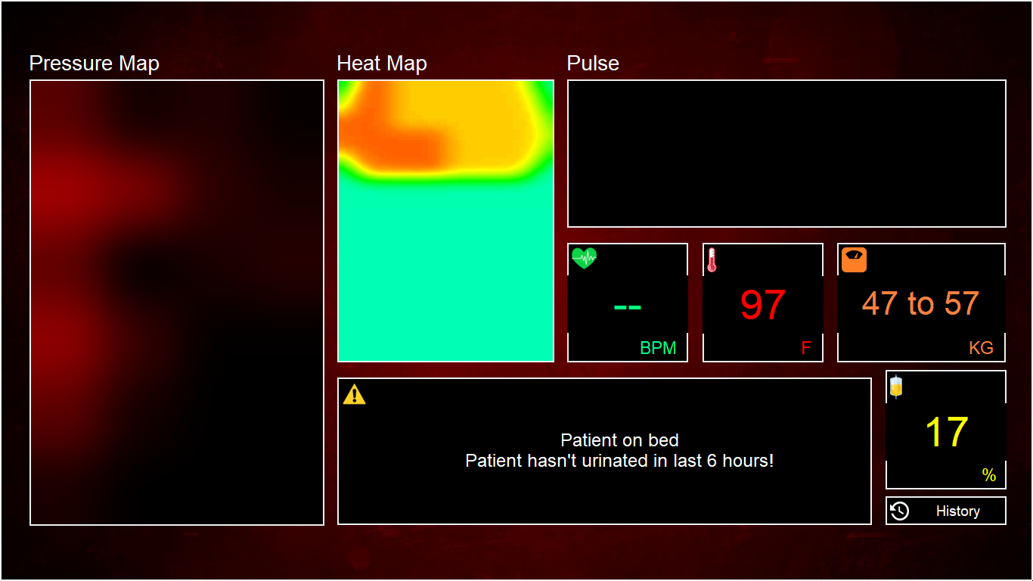
Urine Bag Module
If the patient has not urinated for a specified period, an alert is generated
If the urine bag has reached a specified capacity threshold, it needs to be changed. A relevant message is displayed accordingly
If the urine bag gets removed, either for replacement or by mistake, a relevant message is displayed accordingly
If the urine bag gets changed after being removed, a relevant message is displayed accordingly

Slide 18
Pulse Detection Experiments

Slide 19
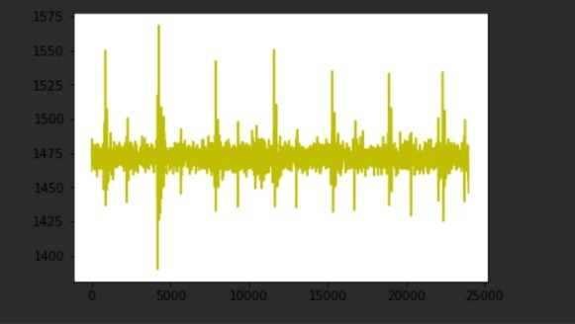
Experiment 1
Used MAX9814 mic array with STM32
Captured 8000 samples per second
1 mic placed directly above heart and 2 other mics recorded environmental noise
This noise cancelled from main beat signal
Applied butter filter, FFT and inverse FFT for further noise reduction
Failed to detect heartbeat from back side of the body

Slide 20
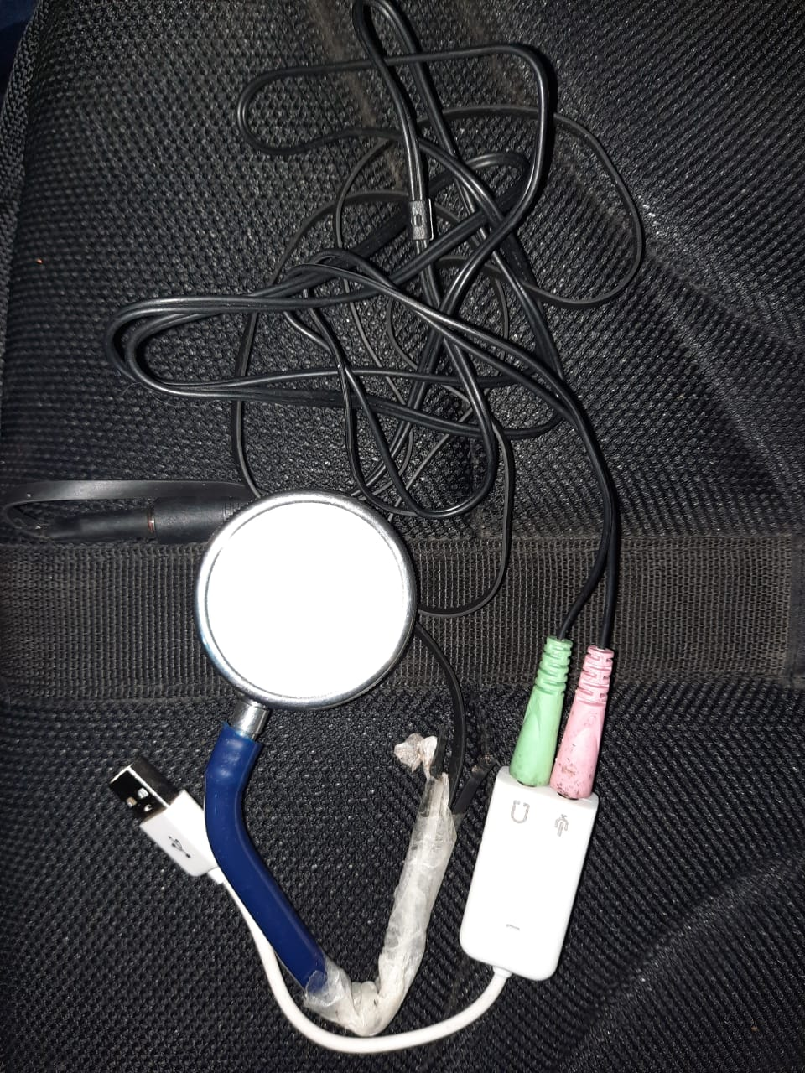
Experiment 2
Used standard 4 mm mic connected to Raspberry Pi 3B via ADC
Mic was embedded into the stethoscope chest-piece
Signal enhanced by Audacity by removing any ambient noise in the original signal
Able to detect clear heartbeats from front side without any noise reduction / cancellation
Able to detect some heartbeats from back side, but they were never consecutive, and the beats in between were missed

Slide 21
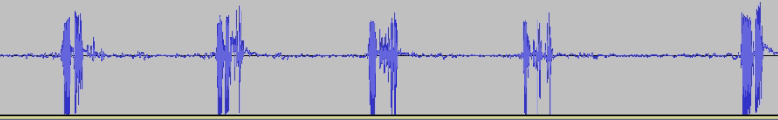
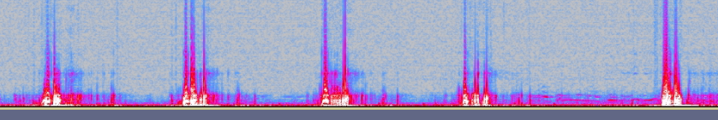
Experiment 2
Waveform
Spectrogram

Slide 22
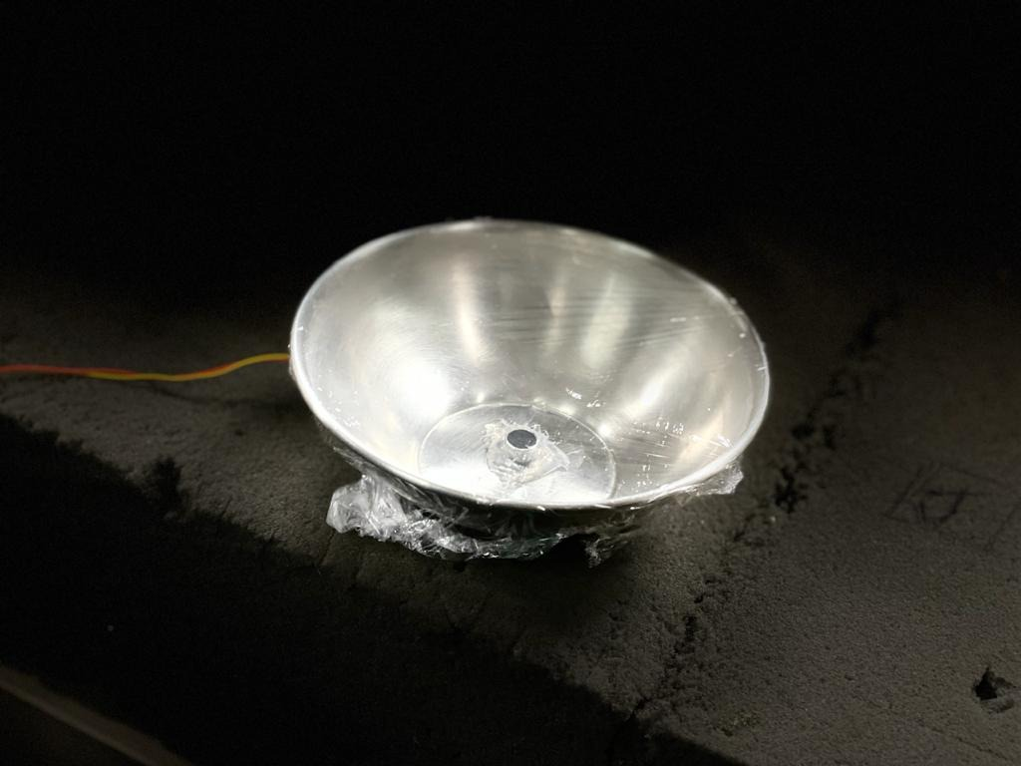
Experiment 3
Used MAX90614 mic (60 dB) with amplifier (10 dB each x 4)
Custom stethoscope chest-piece was designed with thin styrofoam sheet
This was able to detect clear heartbeats from front side without any noise reduction / cancellation
Could even detect people walking in other rooms when placed on floor
But still couldn't detect heartbeat from back side

Slide 23
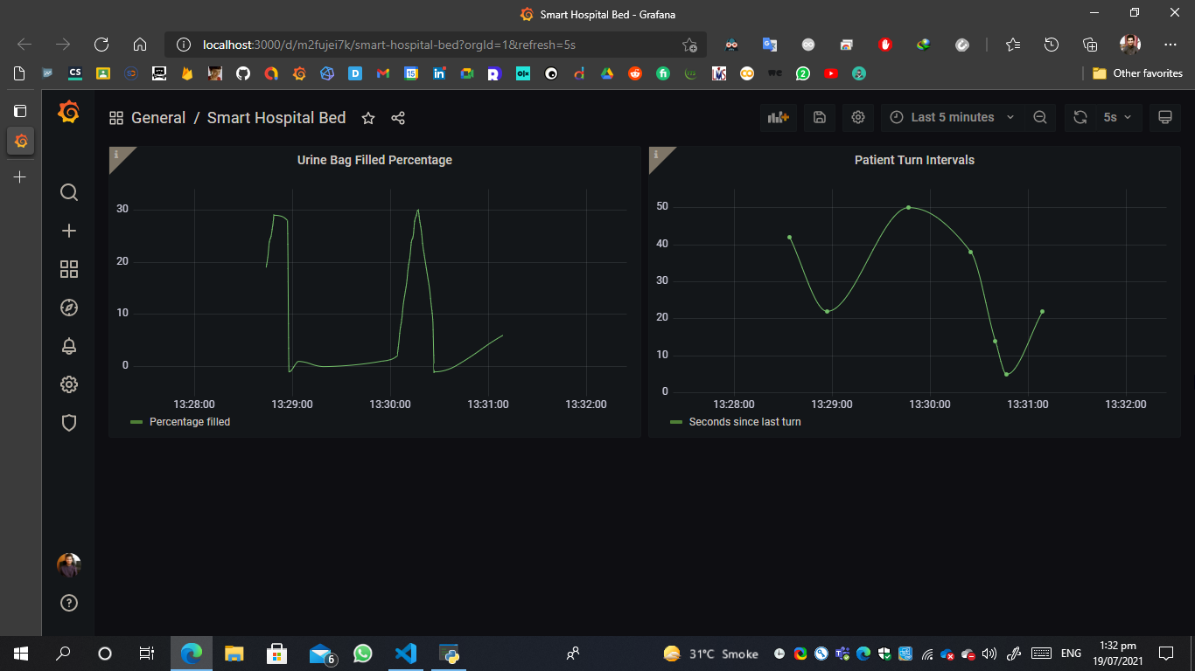
Grafana History
Patient turn intervals graph
Urine bag filled percentage graph

Slide 24
Thank you!

