Slide 1

Monitoring of Medication in Primary Care
BELMATT

Slide 2
Types of drug monitoring
Regular reviews
Physical health check
Blood test
Other investigations (ECG, urinalysis etc.)

Slide 3
Importance of monitoring
Assess response towards the diagnosis
Surveillance of undesirable effects on body
Seeking a therapeutic drug level (avoiding subtherapeutic/ toxic levels)

Slide 4
What is a high-risk Drug?
Narrow therapeutic index
Regular monitoring required as per licensed indication
Frequently linked to drug related preventable serious harm
Frequently linked to prescribing errors

Slide 5
High risk drugs/ drug groups and their monitoring (Examples)
DMARDs
Lithium
Amiodarone
Warfarin
NOACs
ACE inh and ARB II antagonists
Diuretics
Oral atypical antipsychotics
SGLT2 inhibitors
Mirabegron
Long term Nitrofurantoin
Spironolactone
NSAIDs

Slide 6
High risk drugs/ drug groups and their monitoring (Continued)
Examples of drugs requiring therapeutic levels monitoring:
Digoxin
Theophylline
Sodium valproate
Lithium
Carbamazepine

Slide 7

Some examples of real patients’ blood tests

Slide 8
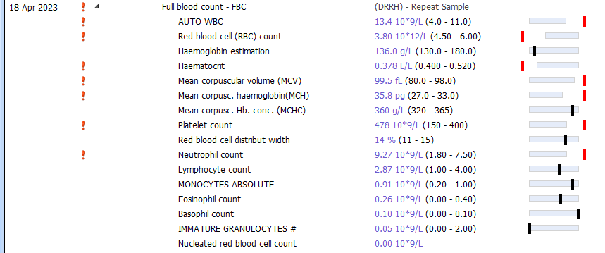

Slide 9


Slide 10
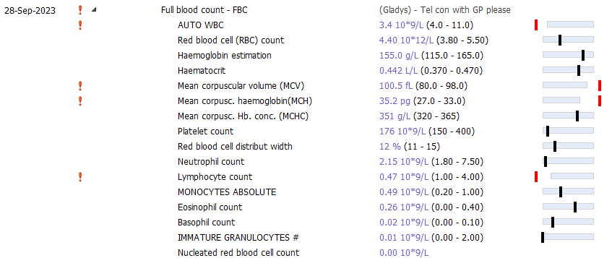

Slide 11
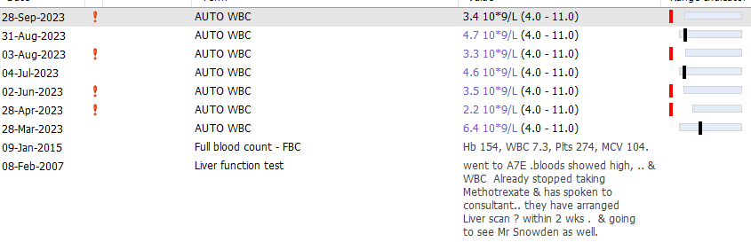

Slide 12
High risk drugs/ drug groups and their monitoring (Continued)
Drugs requiring agreement of treatment plan and patient tailored approach:
Hypnotics and Z-drugs
Schedule 2,3 Controlled drugs
Valproate prescribing in females of child baring-age

Slide 13
Ground facts
What helps GP practices monitor medication requiring blood tests and other investigations?
Common challenges
Prescribing support software aided safety checks
Audits for particular Drug/ Drug-groups (DMARDs, Lithium, Warfarin, NOACs etc.)
A good prescribing policy
Non-compliance from patients towards request for blood tests
Lack of robust monitoring
Non-adherence to prescribing policy

Slide 14
Monitoring of medication requiring regular reviews
What works well?
Common Challenges
Clinician’s expertise in prescribing
A good prescribing policy
Non-compliance from patients towards request for review
Lack of robust monitoring
Non-adherence to prescribing policy

Slide 15
Let’s improve prescribing safety
Up-skill non-clinical patient facing team members
Revise the prescribing policy
Delegate audit for high risk drugs monitoring to team member(s) who can ensure timely action in event of patient non-compliance or other scenarios
Present your findings and actions at regular practice meeting
Update messages regarding Blood test/ Review request regularly

Slide 16
Let’s improve prescribing safety (continued)
Ensure to update patient records where a review has taken place at secondary care
Post-hospital discharge medication reconciliation
Take patient-centred approach
Timely action on CAS alerts (DHSC, MHRA, NPSA etc.)
Medication and regime reviews (multi-step check)

Slide 17
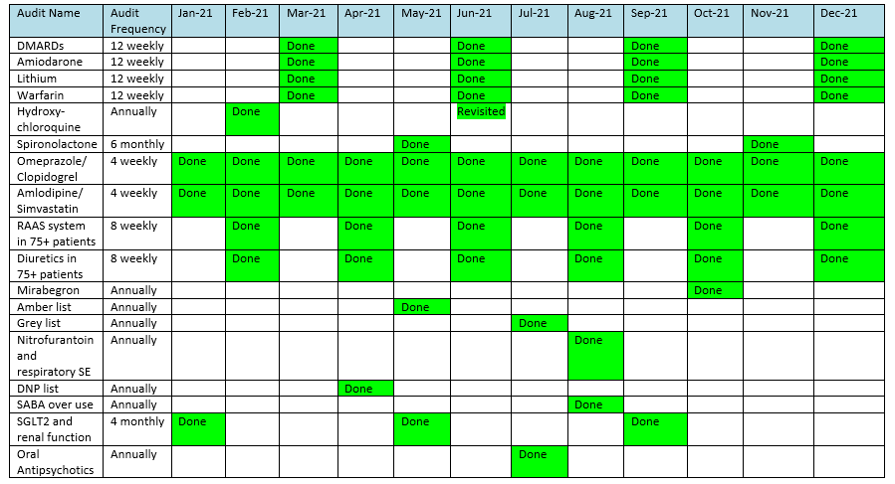
Good practice examples:

Slide 18
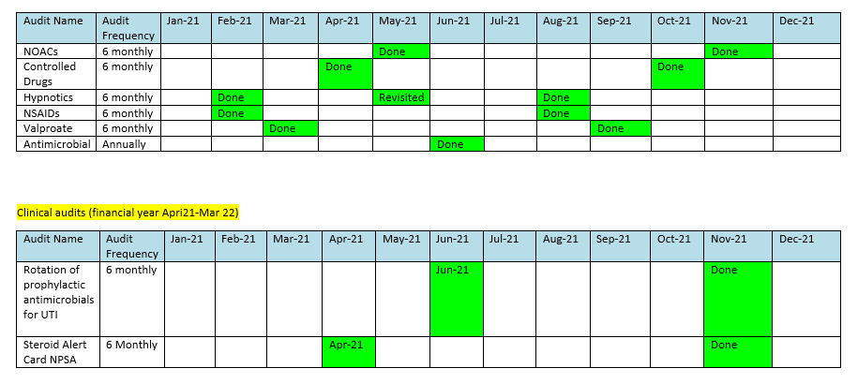
Good practice examples (continued):

Slide 19
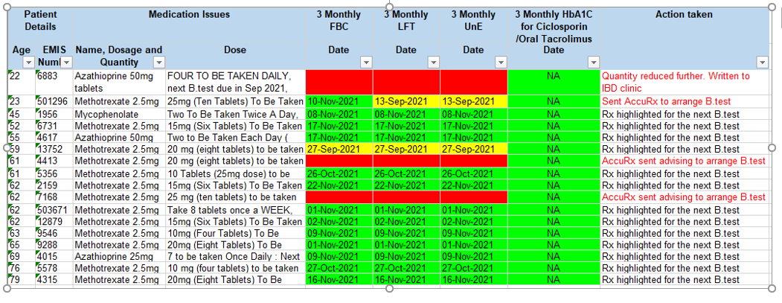
Good practice examples (continued):

Slide 20
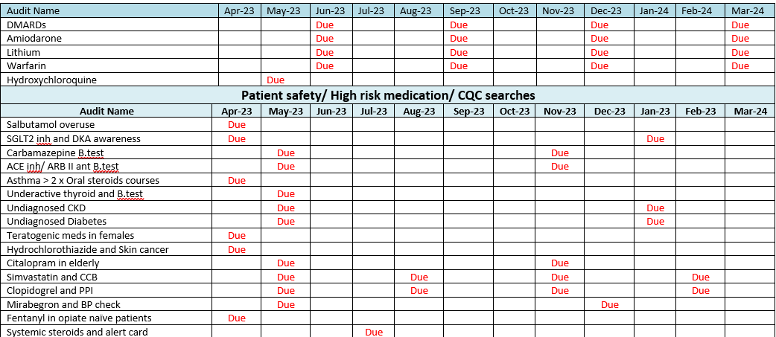

Slide 21
References
https://www.gmc-uk.org/-/media/documents/preventable-patient-harm-across-health-care-services_pdf-73538295.pdf
https://mm.wirral.nhs.uk/document_uploads/formulary/Therapeuticdrugmonitoring.pdf
https://bnf.nice.org.uk/
https://gmmmg.nhs.uk/shared-care/gmmmg-approved-shared-care-protocols/
https://pharmaceutical-journal.com/article/ld/the-top-ten-prescribing-errors-in-practice-and-how-to-avoid-them
https://www.ncbi.nlm.nih.gov/pmc/articles/PMC2723197/

Slide 22

Any questions

Slide 23
CONTACT INFO
+44 207 692 8709
admin@belmatt.co.uk
info@belmatt.co.uk
www.belmatt.co.uk
Suite 570, 405 Kings Road
Chelsea
SW10 0BB

