Slide 1
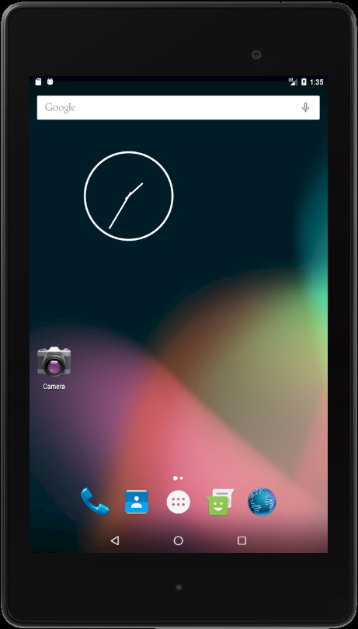
Developed : Android platform
Version : 3.2.1
Running Device : Nexus 7 API 23
Application Introduction : The application that used to record ideas

Slide 2
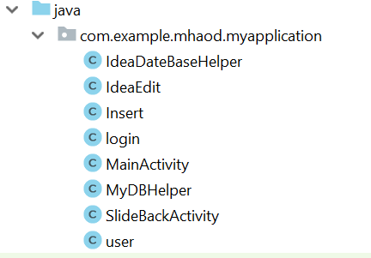
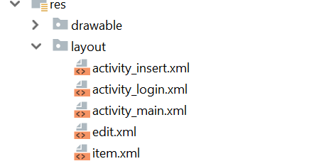
Login
MainPage
Add/Edit Idea
DeleteIdea
Register

Slide 3
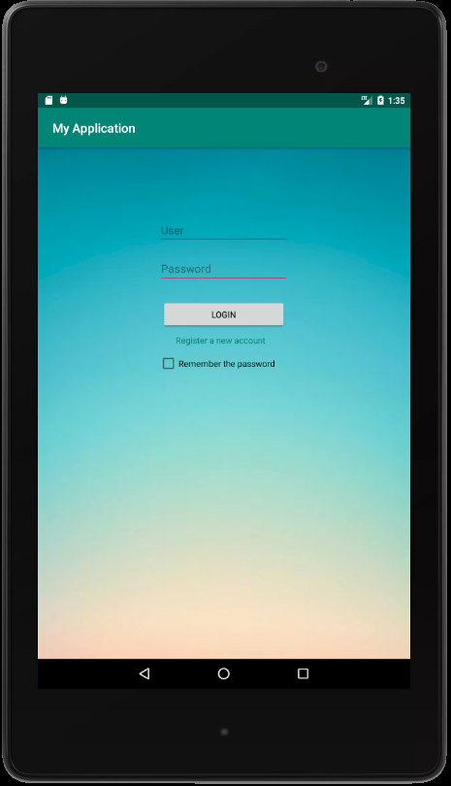



Log in First
Register button
Remember checkbox
Some notice:

Slide 4
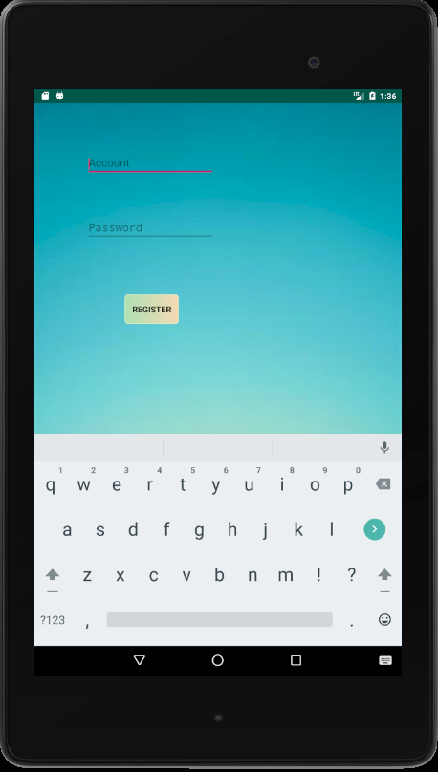
Username
Password
Then creating the new account by clicking the button

Slide 5
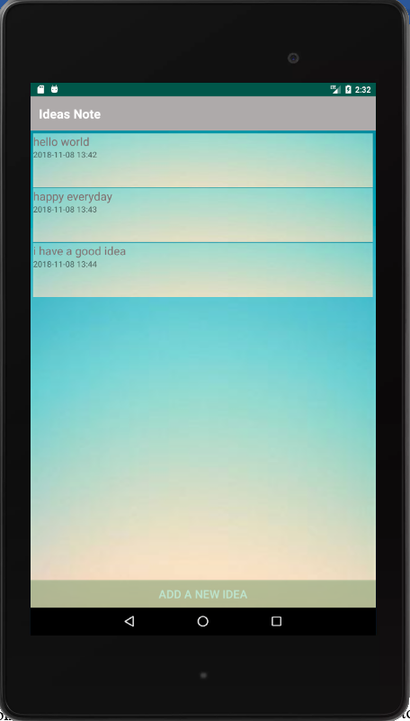
The main page
Users can add, edit and delete ideas
Add a new idea

Slide 6
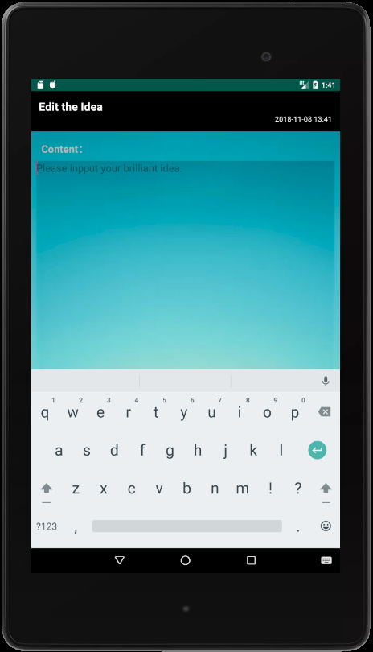
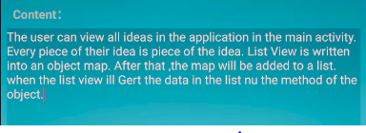

The date
Write the idea in the text area

Slide 7
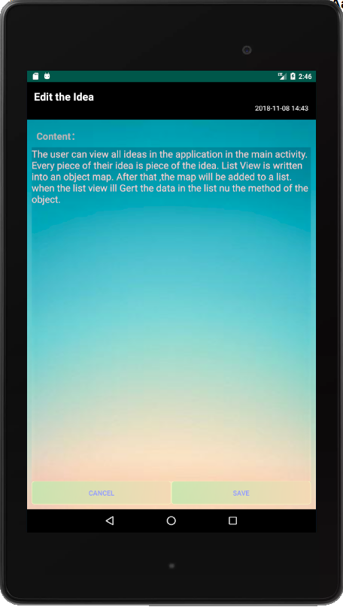
Modify the existed idea by click the item in main page.
Then save it!

Slide 8
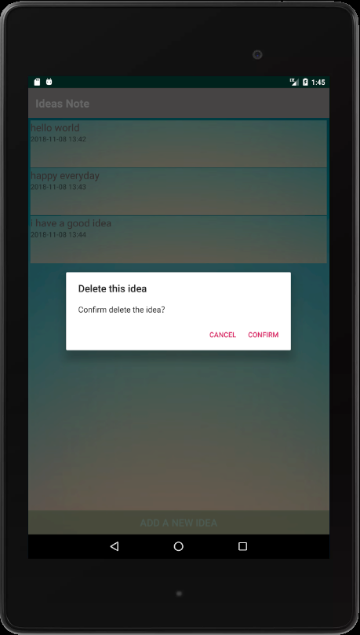
Delete the idea by click on the item long, long, long time.
Confirm: delete
Cancel : return the main page

Slide 9
Question?

