Slide 1
Diamond
Price Prediction
A Machine Learning Project
Done by: Asala Shawabkeh, Mustapha Haouili, Rana Wahid, Anas Alyan

Slide 2
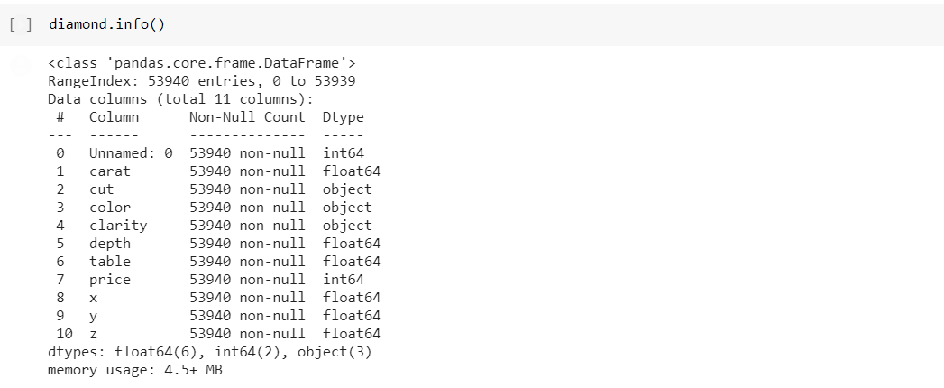
Step 1: Understanding The Data
Using diamond.info command we are able to get a summarized view of the data

Slide 3
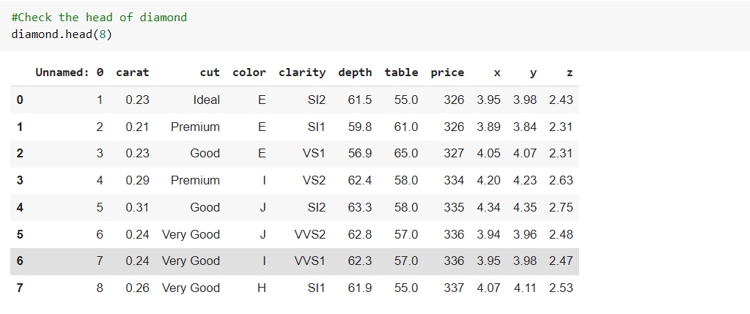
Step 1: Understanding The Data
The diamond.head command gives us a more in-depth look into the data

Slide 4
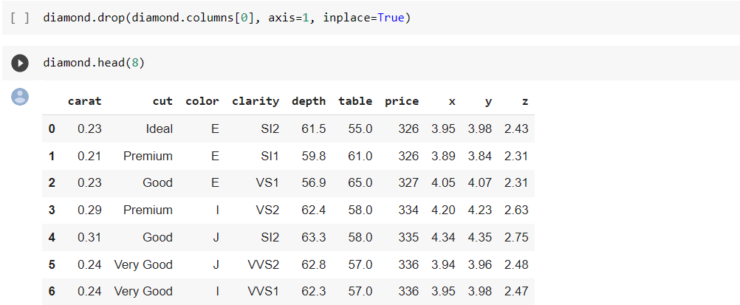
Step 2: Cleaning The Data
Since the first column (“Unnamed: 0”) is an unnecessary index column we are going to remove it

Slide 5
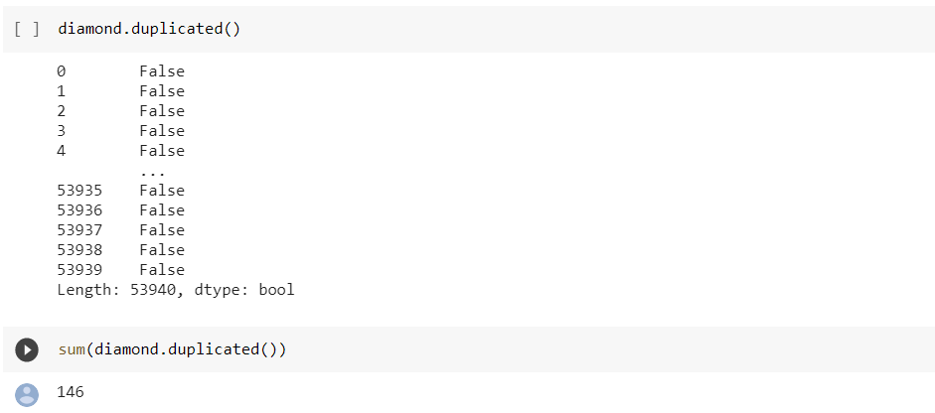
Step 2: Cleaning The Data
Next we are going to find the duplicates in the data and remove it, so the model can better generalize to the full dataset

Slide 6
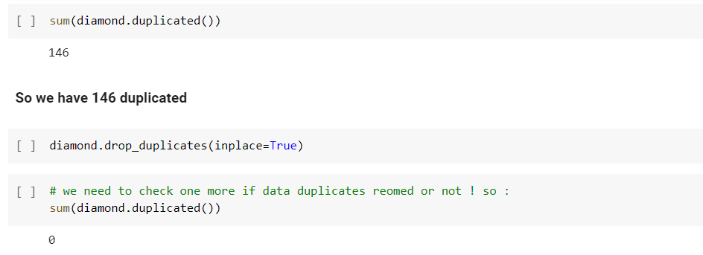
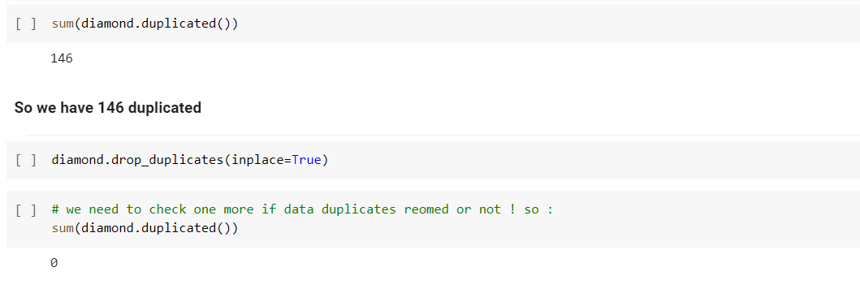
Step 2: Cleaning The Data
Using the diamond.drop_duplicates command to drop the duplicated data, and using the sum function to check if all the duplicated data is removed

Slide 7
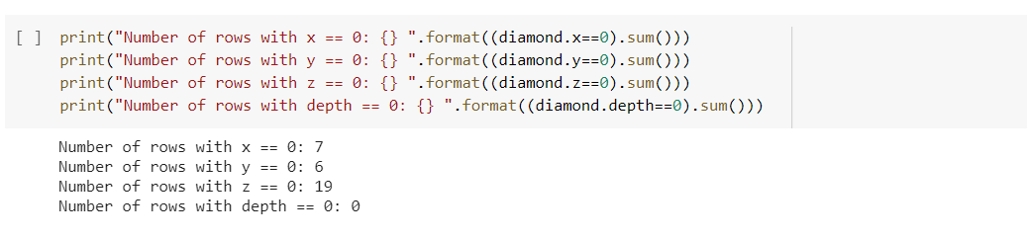
Step 2: Cleaning The Data
According to the data description the x,y and z parameters are the length, width and depth respectively, and hence they can’t be equal to zero.

Slide 8
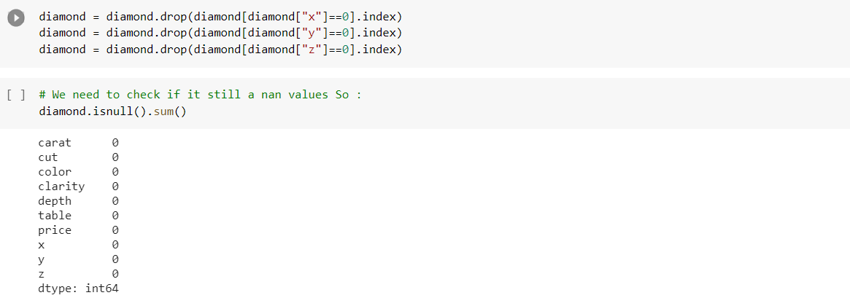
Step 2: Cleaning The Data
Using the .drop command to drop the rows that contain the missing parameters

Slide 9
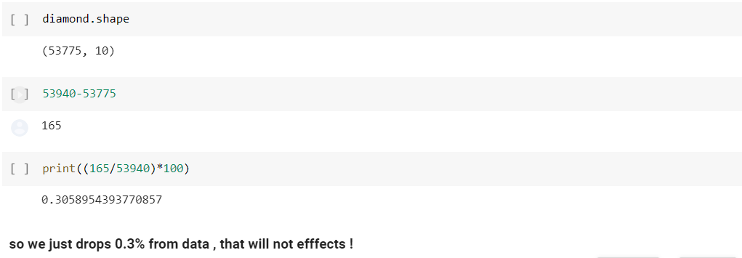
Step 2: Cleaning The Data
The dropped data percent was just 0.3% from the original, which won’t affect our
Model training!

Slide 10
Step 2: Cleaning The Data
Now we need to check for outliers in the data, Outliers badly affect mean and standard deviation of the dataset. These may statistically give erroneous results. Most machine learning algorithms do not work well in the presence of outlier. So it is desirable to detect and remove outliers. Best way is by using the Boxplot.

Slide 11
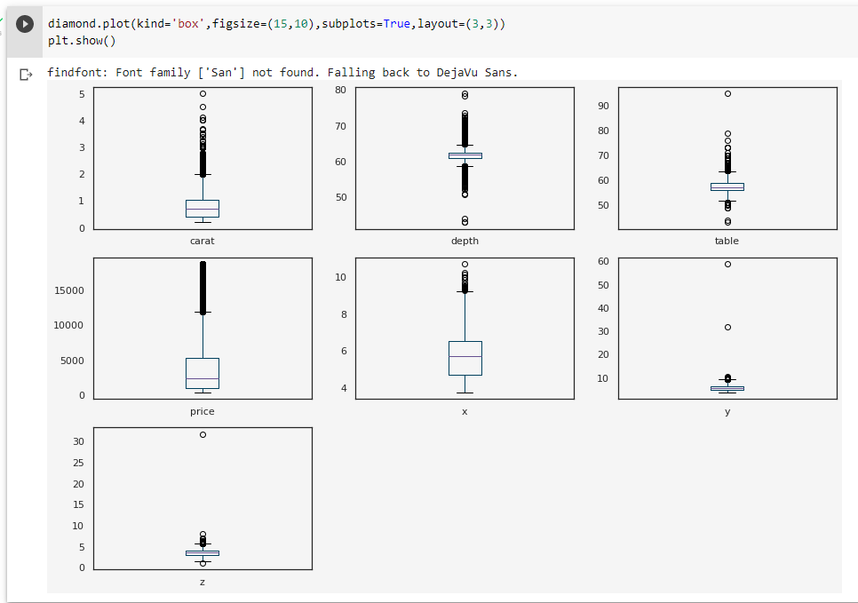
Step 2: Cleaning The Data
It is obvious that there are outliers in the data, and so it is better to remove them to further improve our model.

Slide 12
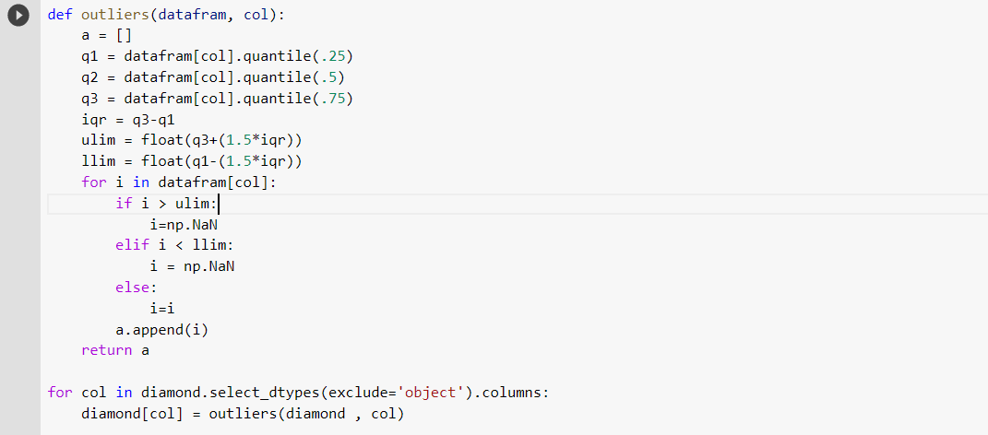
Step 2: Cleaning The Data
Defining a function to remove outliers, using the IQR values.

Slide 13
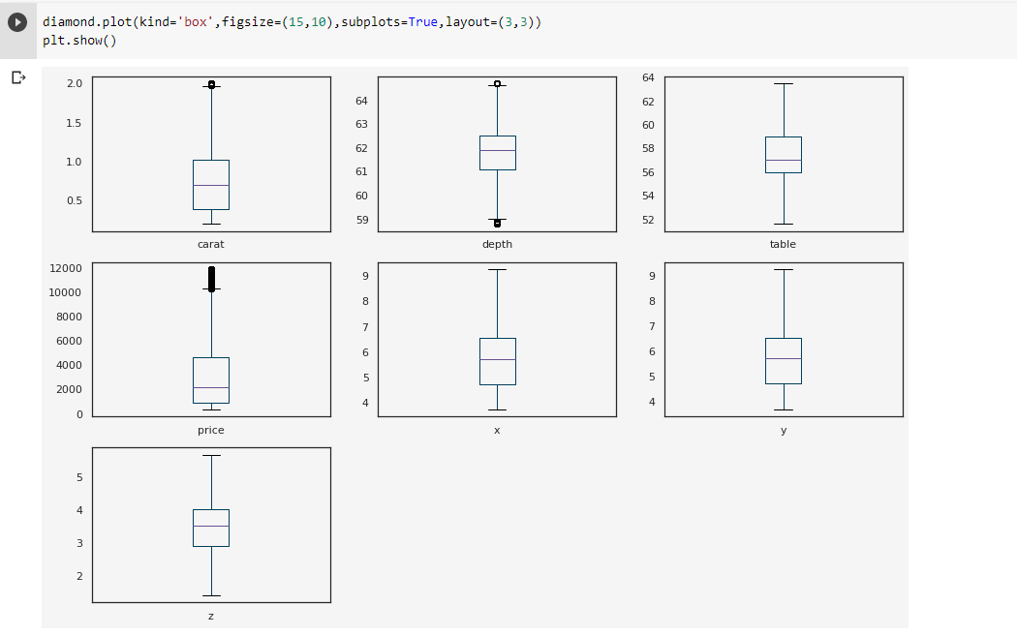
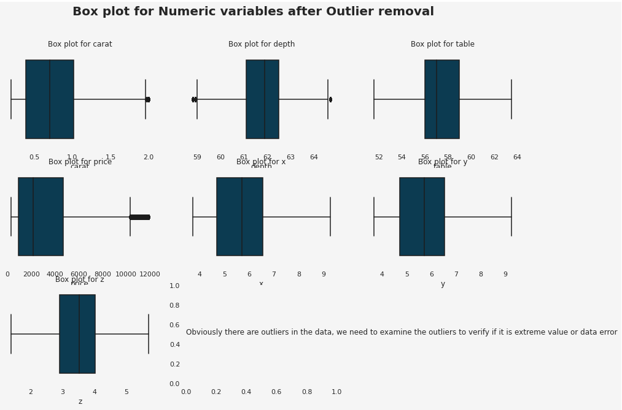
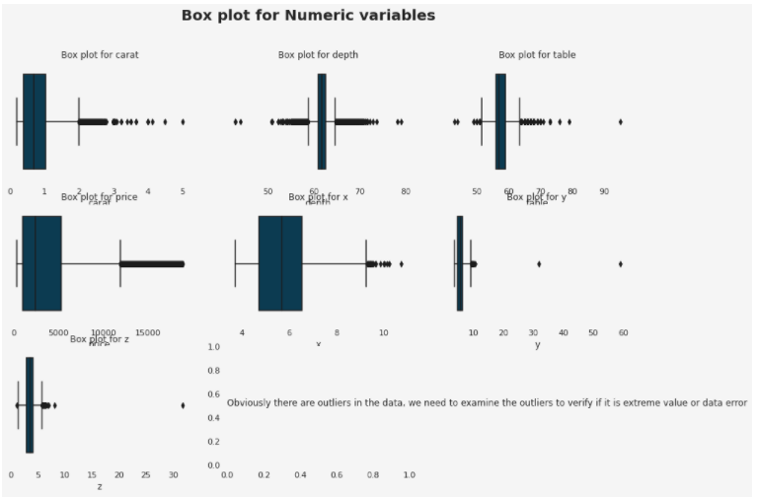
Step 2: Cleaning The Data
The Boxplot shows the dataset after removing the outliers

Slide 14
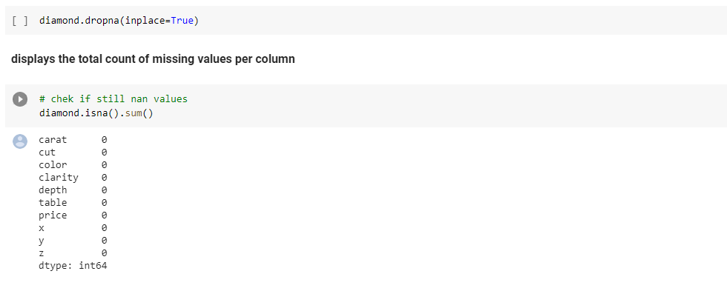
Step 2: Cleaning The Data
Dropping the NaN values that were placed instead of the outlier values

Slide 15
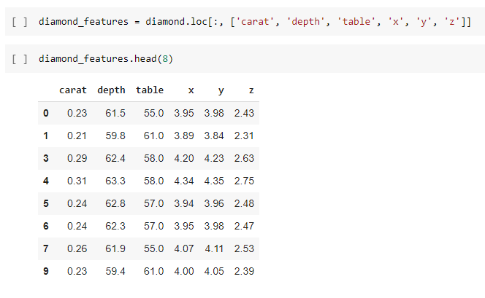
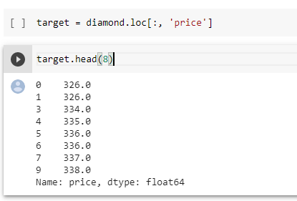
Step 2: Cleaning The Data
Since the predicting price is our goal, we separate the Price parameter from the dataset to visualize the correlation between it and the other parameters.

Slide 16
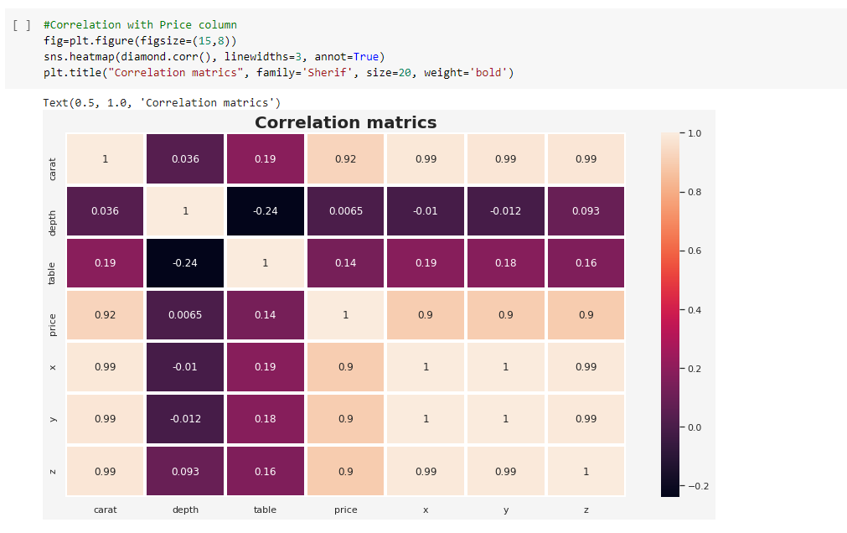
Step 2: Cleaning The Data
Creating the Correlation matrices.
Points to notice:
"x", "y" and "z" show a high correlation to the target column.
"depth", "cut" and "table" show low correlation. We could consider dropping but let's keep it.

Slide 17
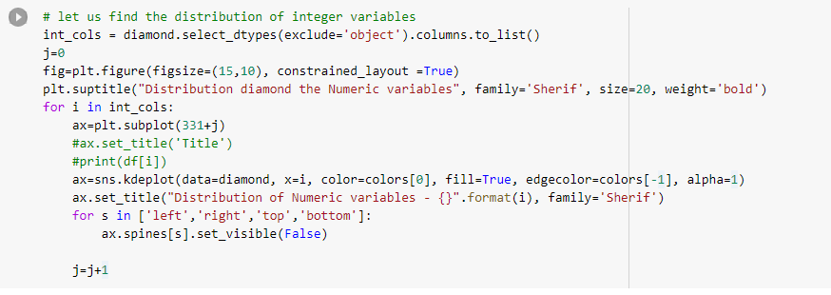
Step 2: Cleaning The Data
Visualizing the distribution of the numeric values

Slide 18
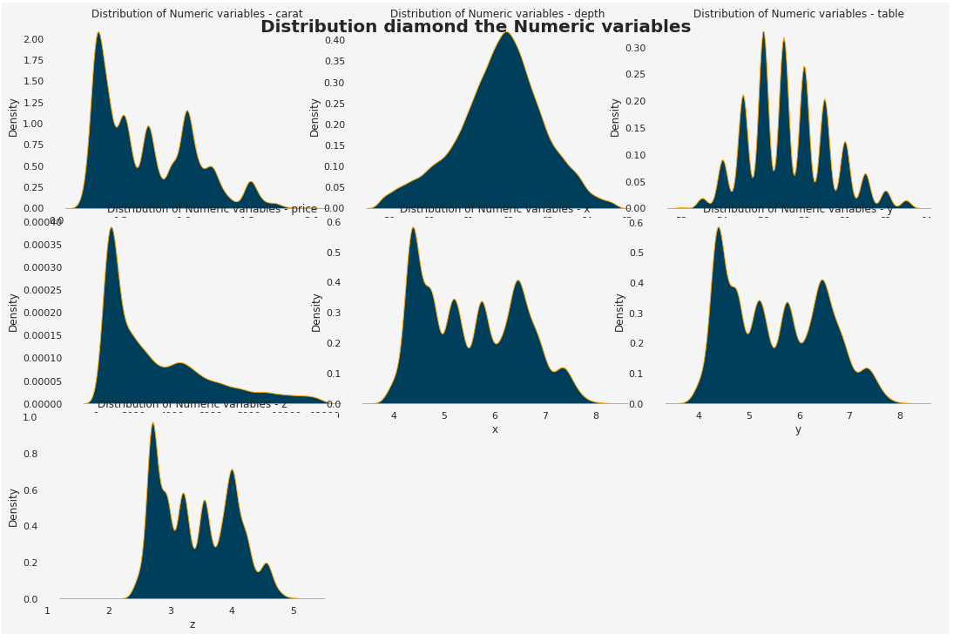
Step 2: Cleaning The Data
Visualizing the distribution of the numeric attributes

Slide 19
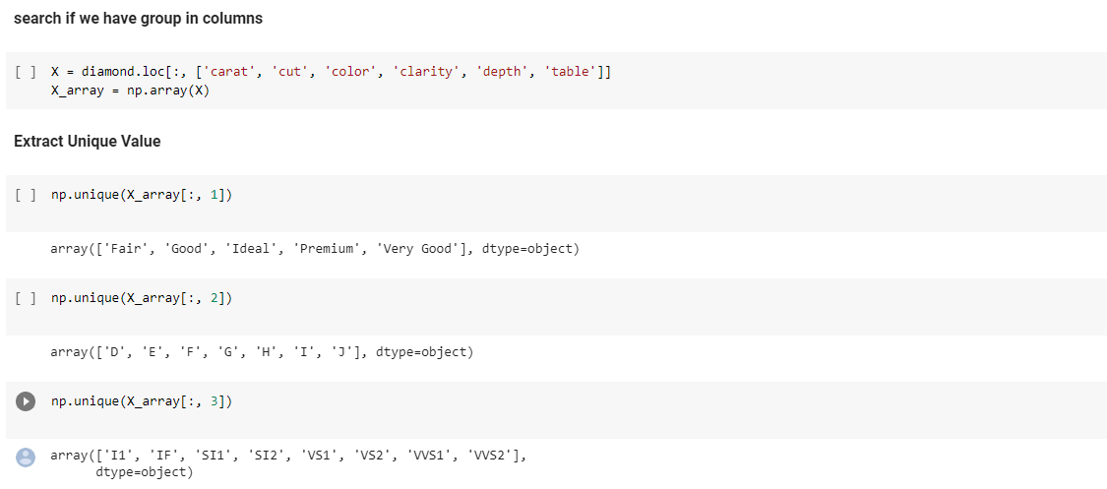
Step 2: Cleaning The Data
Locating the Categorical attributes from the dataset

Slide 20
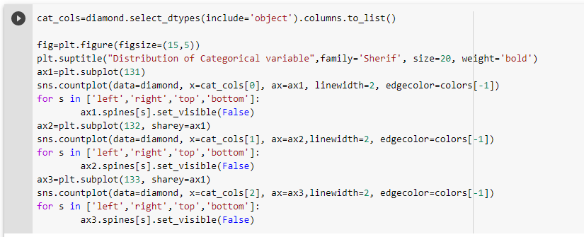
Step 2: Cleaning The Data
Visualizing the distribution of the categorical attributes

Slide 21
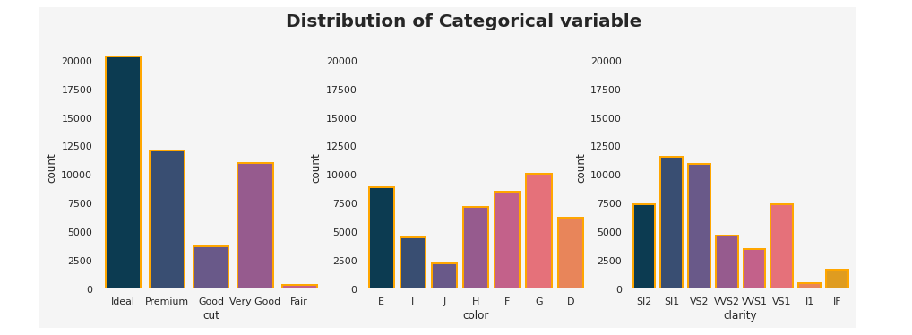
Step 2: Cleaning The Data
Visualizing the distribution of the categorical attributes

Slide 22
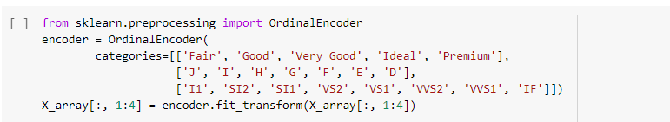
Step 2: Cleaning The Data
Using OrdinalEncoder to encode the categorical into numerical attributes

Slide 23
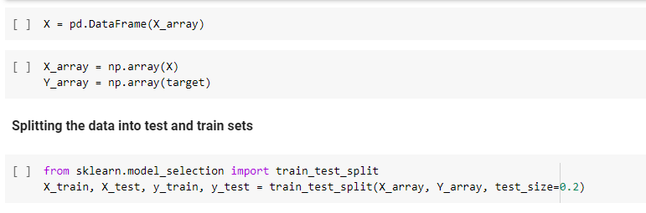
Step 3: Training The Model
First we prepare the arrays, and split the dataset into Testing and Training sets.

Slide 24
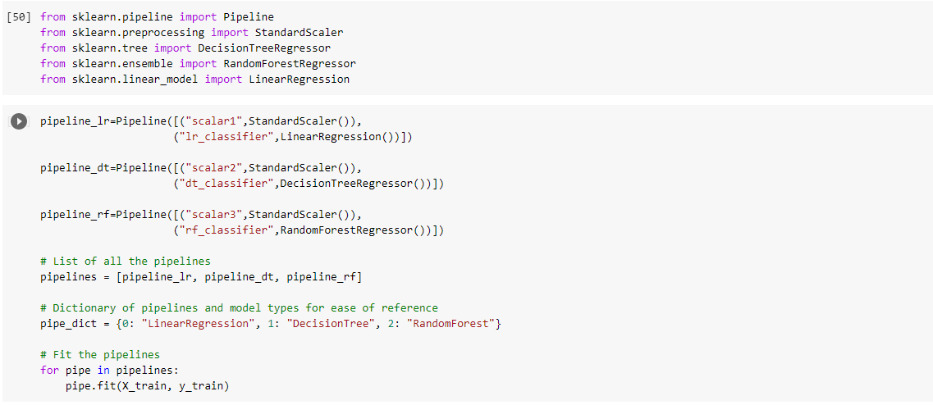
Step 3: Training The Model
Next we prepare our Pipelines for various model regressors.

Slide 25
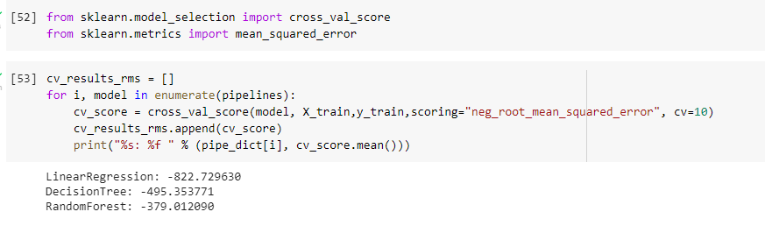
Step 3: Training The Model
Using cross_val_score and mean_squared_error, we print each regression score, and decide which regressor is best for our model.
Since the RandomForest has the lowest score, it is the best regression for our model

Slide 26
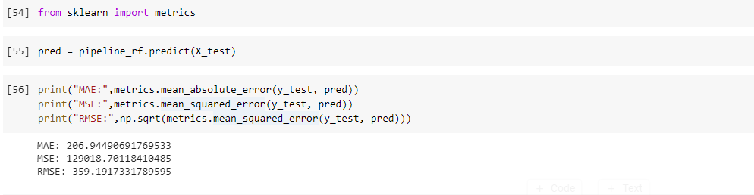
Step 4: Testing The Model
Using the Random Forest Regressor we test our data on the dataset.
Finding the values of the MAE, MSE, AND RMSE we see that they are reasonable

Slide 27
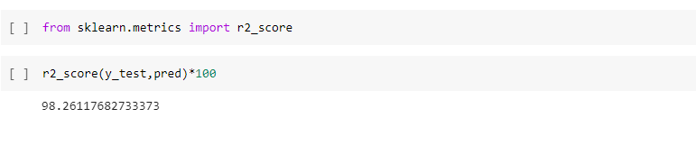
Step 4: Testing The Model
Using r2_score, we find our model accuracy
98.3% accuracy means that our model is doing a good job at predicting diamond prices!

