Slide 1

Berbagi
Oleh
Muhammad Haqi Yusuf (1515061030)
Nofa Alfionita (1515061030)
Sri Lestari (1515061030)

Slide 2
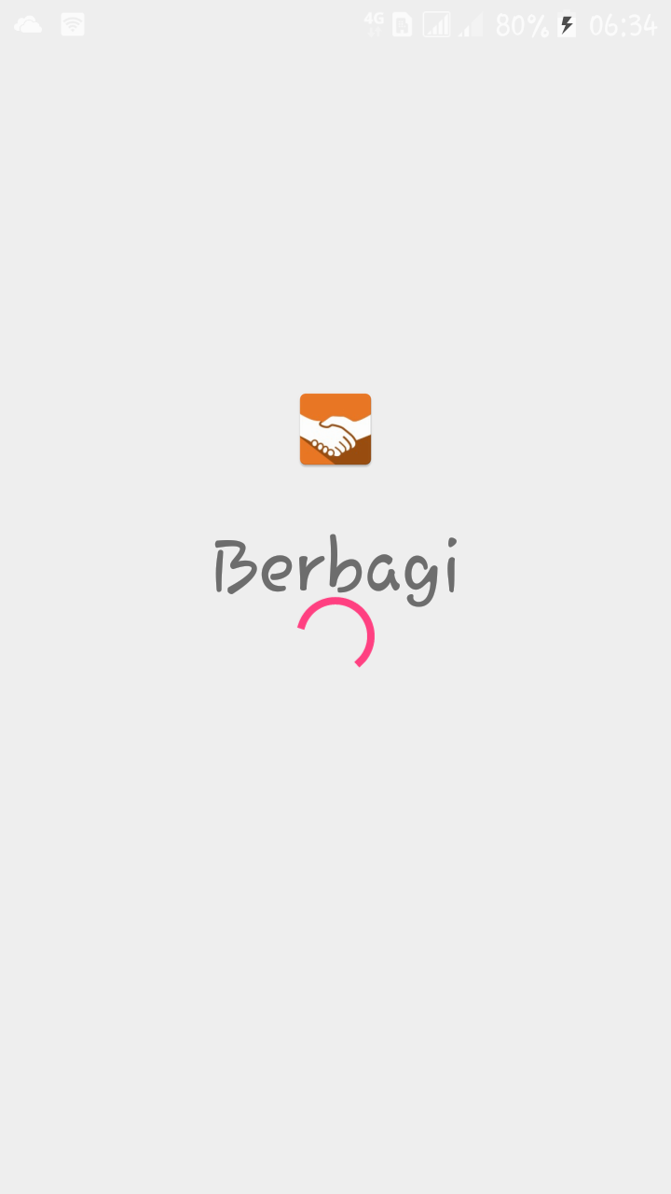
Place your screenshot here
Berbagi
is an app for people who want to share with others in need.

Slide 3
STAGES OF PROGRAM DEVELOPMENT
Requirement Analyze
UI Design
Database Design
Implementation
Testing
Coding

Slide 4
TOOLS AND DATABASE
Tools :
Android Studio IDE v3.0.1
Android SDK 19
Android Query Library v0.23.16
Database :
MySQL

Slide 5
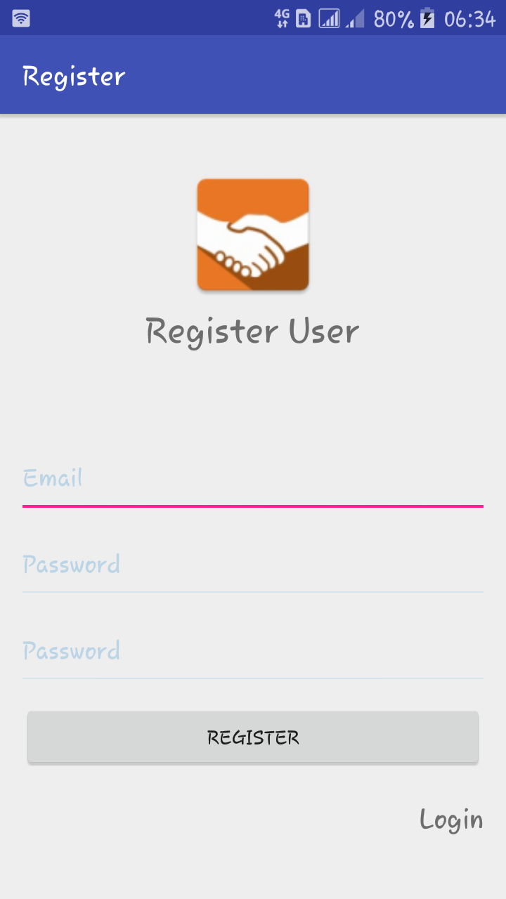
Place your screenshot here
Register
is a form to register for new users by input valid email and password

Slide 6
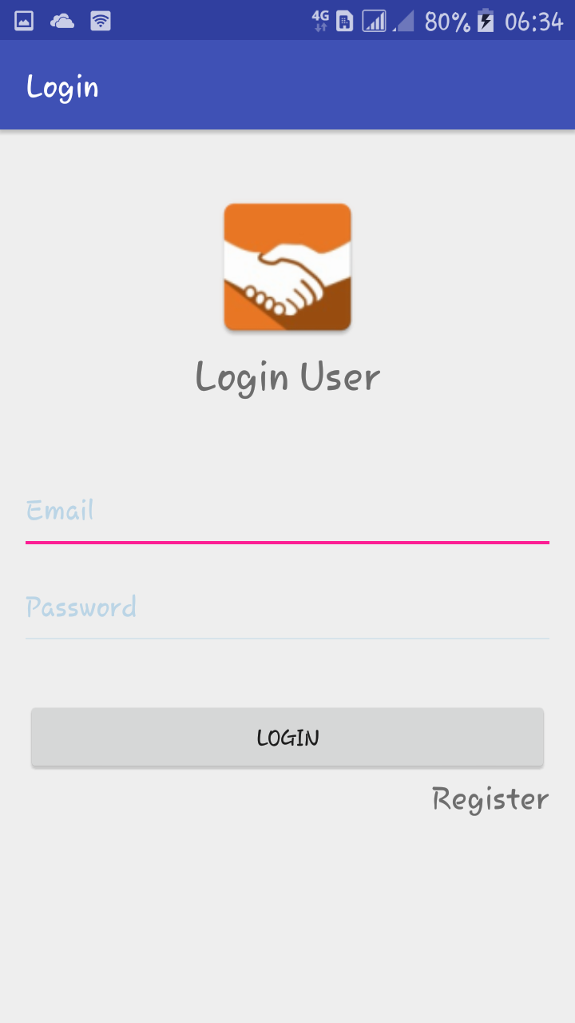
Place your screenshot here
Login
before using the application, the user must login first by input email and password that has been registered

Slide 7
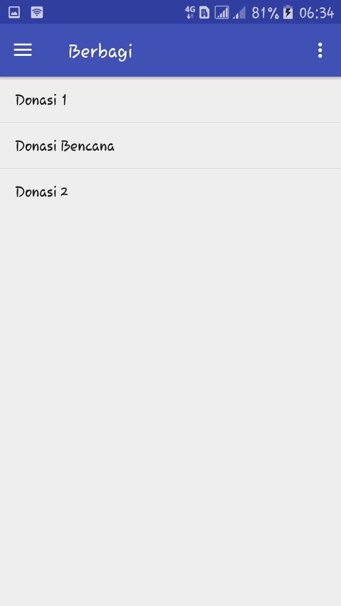
Place your screenshot here
List of Campaign
content that displays the campaign list.

Slide 8
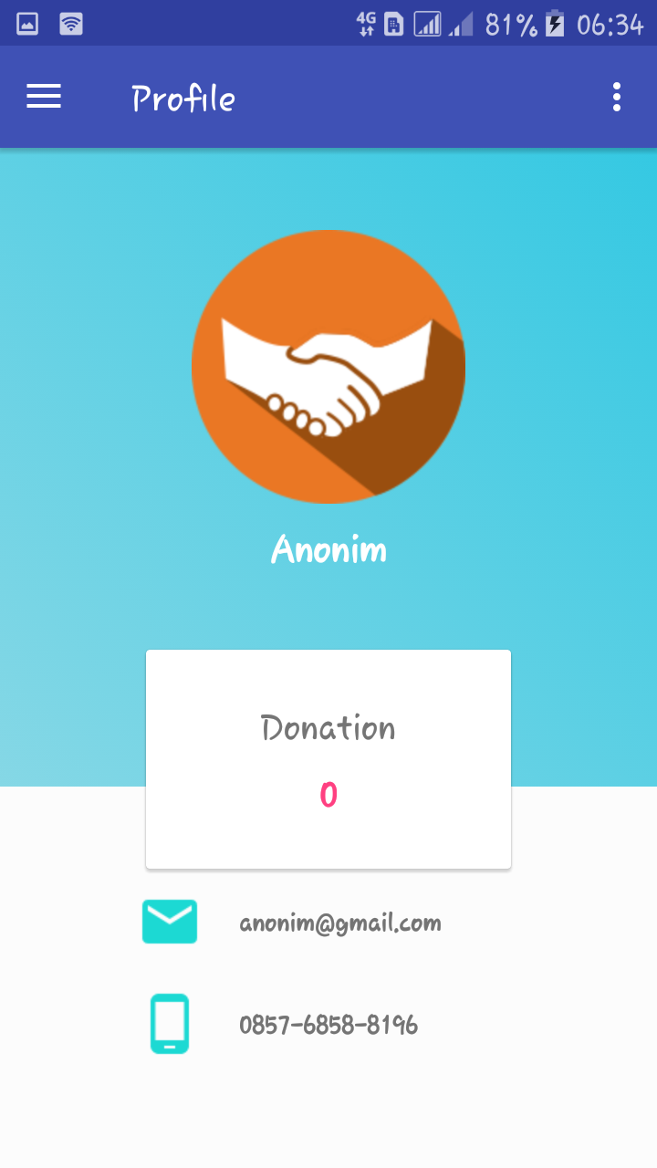
Place your screenshot here
User Profile
is a layout that contains information about the user.

Slide 9
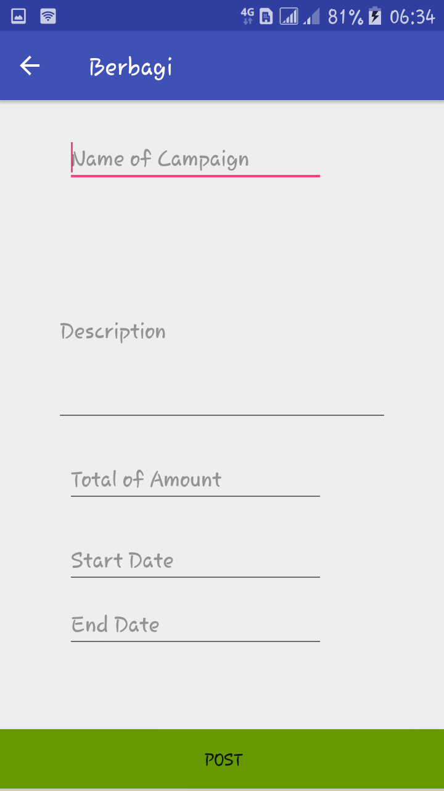
Place your screenshot here
Add Campaign
is a form to create a new campaign and will be displayed in the list (home)

Slide 10
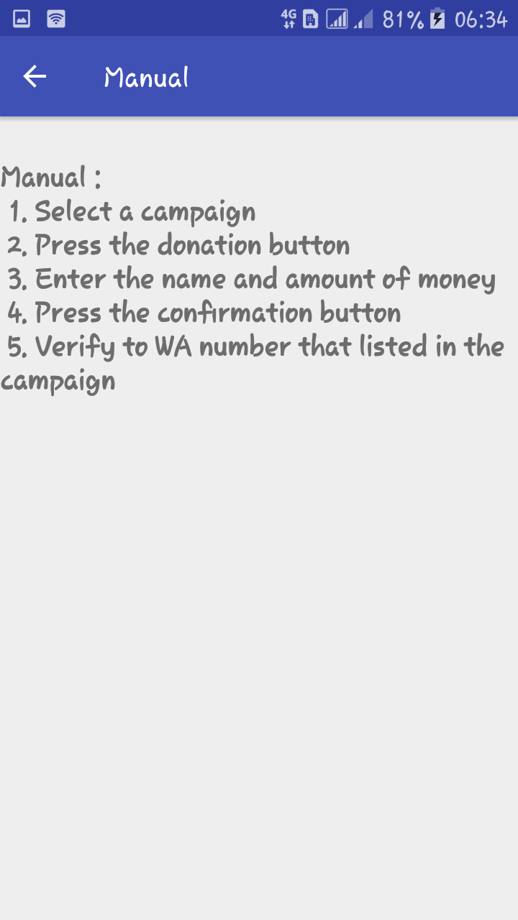
Place your screenshot here
Manual
is a guide how to donate online

Slide 11
THANKS!

