Slide 1
Macroeconomic factors and loan quality
An analysis of Lending Club’s portfolio

Slide 2
The Problem
Unsecured personal loans are risky – companies need to price their loans to compensate for the default risks that they face.
Lending companies use sophisticated models to evaluate borrowers’ loan default likelihood based on their credit profiles.
Some overlooked factors outside of an individual borrower’s credit portfolio are likely to impact default likelihood – how do macroeconomic factors, like stock market fluctuations or the unemployment rate, impact lending risk?

Slide 3
The Data
Lending Club is a company that originates unsecured personal loans. Data on their loans is publically published and will be the basis for this exploration.
FRED – Federal Reserve Economic Data – is a US government-maintained database of economic data. Daily S&P 500 closing stock prices and monthly unemployment rates are sourced from FRED.
Epiq Global maintains statistics on the number of personal bankruptcies filed each month in the US, which is a potential macroeconomic variable of interest.

Slide 4
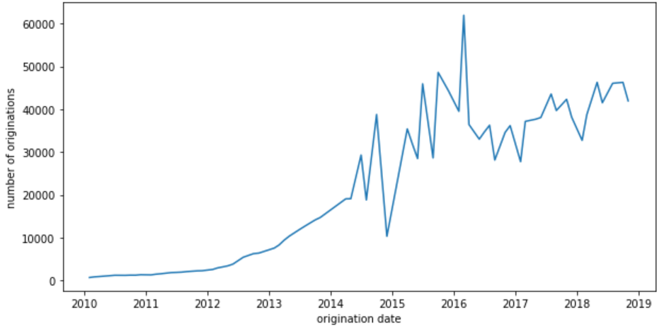
Exploring the Data – Loan Originations
Lending Club has originated tens of thousands of loans per month in recent years, with a trend of increased originations over time.

Slide 5
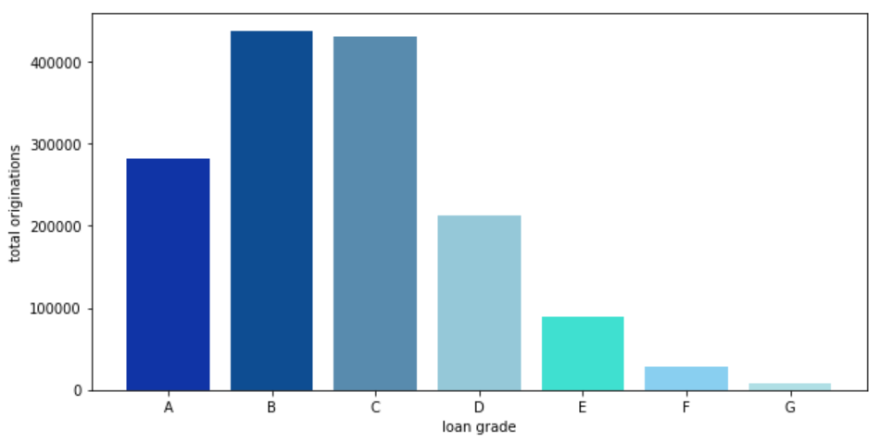
Exploring the Data – Grades
Lending Club loans are graded A through G, with grade A loans being lower-risk and lower-interest rate, and grade G loans being the highest-risk, highest-rate loans. Total originations for each grade are shown in the bar graph above – the large majority are grades A, B, or C.

Slide 6
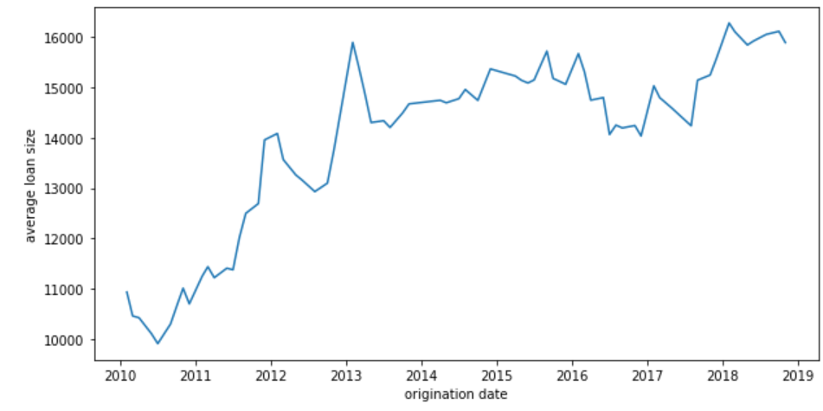
Exploring the Data – Loan Size
Loans range in size from $5,000 to $40,000. Since 2014, they have averaged roughly $14,000 - $16,000 per loan.

Slide 7
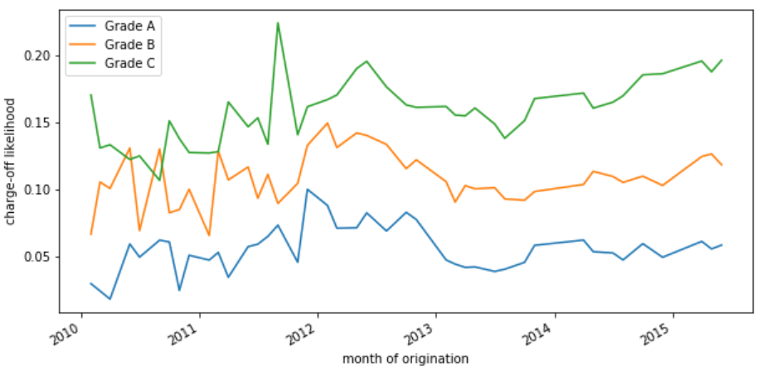
Exploring the Data – Charge-Offs
Charge-offs are the variable of interest – a loan is “charged off” if the borrower did not make all payments required.
The graph above shows that the loan “grading” by Lending Club is accurate in a relative sense – Grade C loans are significantly more likely to charge off than Grade A loans.

Slide 8
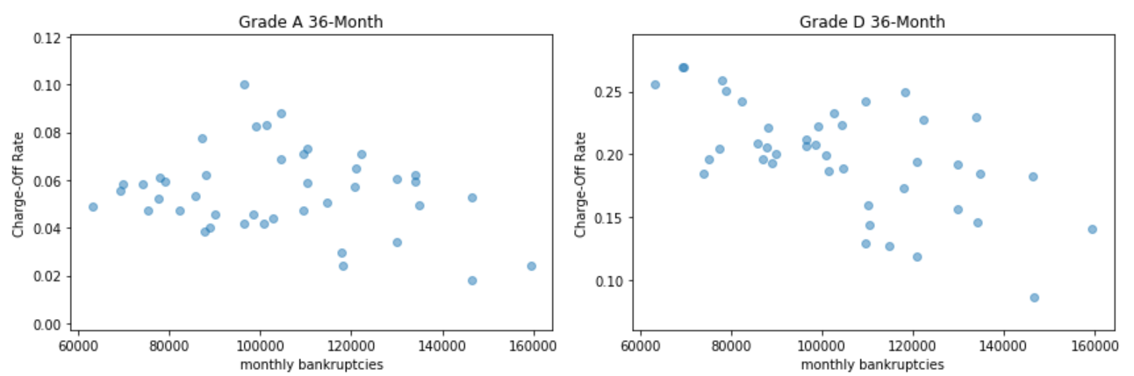
Macroeconomic Factors - Bankruptcies
It might be expected that higher national bankruptcy rates when loans are originated would predict higher charge-off rates throughout the life of the loan.
This prediction does not appear to be borne out in the data, where the opposite trend is observed. The graphs above show that higher bankruptcies are correlated with lower charge-off rates.

Slide 9
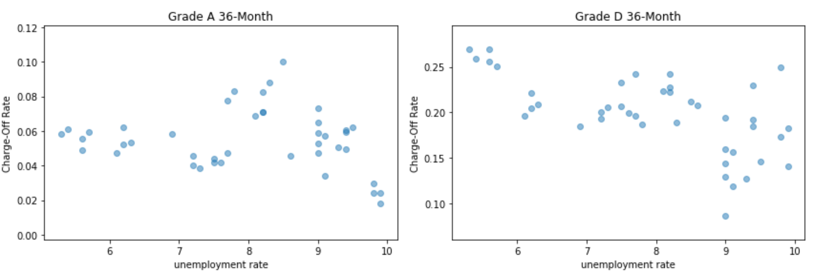
Macroeconomic Factors - Unemployment
One would expect a higher unemployment rate to predict a higher charge-off likelihood
This does not appear to be the case in the data. Higher unemployment rates at origination appear to be associated with higher charge-off rates.

Slide 10
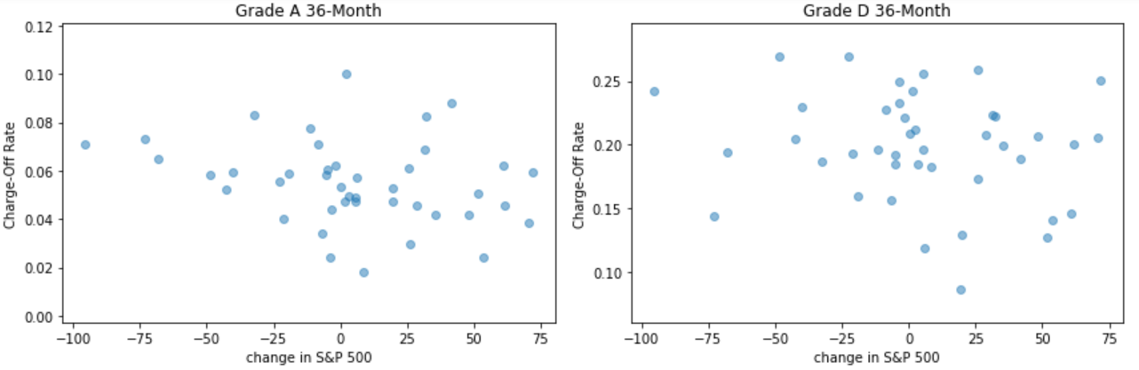
Macroeconomic Factors – S&P 500
Decreases in the S&P 500 might represent economic deterioration that would predict higher default likelihood. The x-axis of the plots above shows the monthly change in the S&P 500 stock index.
There is not a clear relationship between changes in the S&P 500 and default rates.

Slide 11
Conclusions
Relationships between macroeconomic variables and loan default rates appear to be weak.
To more rigorously evaluate these relationships, statistical tests must be used.

