Slide 1
vtp
Vlan trunking protocol

Slide 2
introduction
VTP is CISCO proprietary protocol
CISCO switches to exchange VLAN information
Propagates VLAN information (such as VLAN ID & VLAN Name) over whole LAN
A VTP domain is the set of trucked switches with same settings ( domain name, password and VTP version)
Three- VTP versions available V1, V2 & V3
Four- VTP modes ( server, transparent, client & mode off)

Slide 3
Vtp modes (1/3)
VTP Server: A switch in this mode can add, delete and rename VLANs
Propagates VLANs changes
Default mode for all CISCO switches
Changes made in server mode are advertise to the entire VTP domain

Slide 4
Vtp modes (2/3)
VTP Client mode: A switch in this mode cannot change VLANs configuration
Require server switch to inform about VLANs changes
Cannot create , delete or rename a VLANs
Received updates , processed and forwarded

Slide 5
Vtp modes (3/3)
VTP Transparent mode: A switch in this mode cannot share its database
It forwards VTP received VTP advertisements
Can create, delete and rename VLANs
But changes cannot be sent to other switches
VTP mode off: Similar to VTP transparent mode
Difference will not forward received VTP updates
Supported only in V3

Slide 6
Requirments
For VTP message exchange following five requirements must be met;
A switch must be configured as either a VTP server or VTP client
VTP domain name must be the same on both switches
If present, the VTP domain password must be the same
VTP versions must match
Link between the switches must be a trunk link

Slide 7
Configuration Revision number
32- bit number indicates level of revision
To keep track of the most recent information
When changes made on server mode, revision number increments before VTP advertisement send
Listening switches receive VTP Advertisement and if the revision number is higher than the one locally stored, the advertisement overwrites any stored VLAN information

Slide 8
Vtp advertisements (1/2)
Three types of VTP advertisements
Summary Advertisement: VTP Servers send summary advertisements every 300 seconds and every time a VLAN database change occurs. This advertisement carries information like VTP version, domain name, revision number, number of subset advertisements to follow
Subset Advertisement: VTP Servers send subset advertisements after a VLAN configuration change occurs. These advertisements contain the specific changes that have been performed, like add or delete of a VLAN, change of name of a VLAN, status of a VLAN, etc

Slide 9
Vtp advertisements (2/2)
Advertisement Request From Clients: A VTP Client may request any VLAN information. This could be due to the Client switch might be reset and has lost VLAN information or it might hear a higher revision number than its locally stored. The Server switch responds to these Advertisement Requests with a summary advertisement followed by a subset advertisement to bring the Client up-to-date

Slide 10
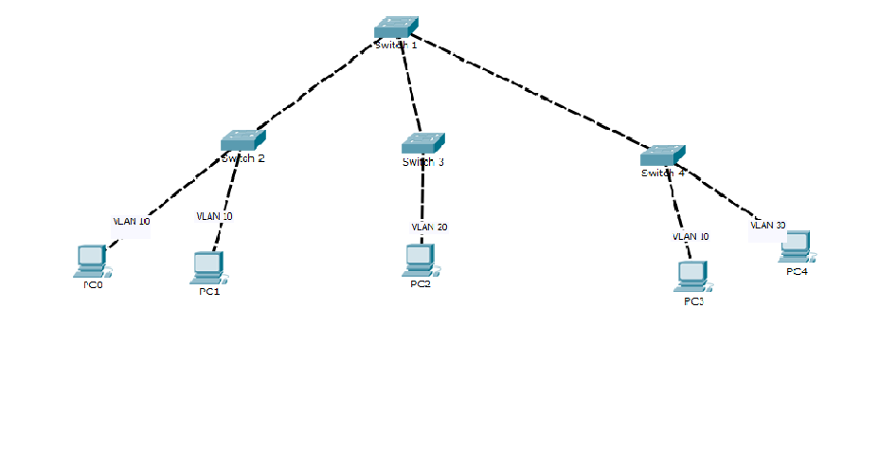
Vtp pruning
VTP pruning will make sure there is no unnecessary VLAN traffic on trunks when there’s nobody in a particular VLAN.
Depending on switch model VTP pruning is either turned on or off by default

Slide 11
Vtp messages (1/3)
VTP Version : 2
Configuration Revision : 0
Maximum VLANs supported locally : 255
Number of existing VLANs : 5
VTP Operating Mode : Server
VTP Domain Name :
VTP Pruning Mode : Disabled
VTP V2 Mode : Disabled
VTP Traps Generation : Disabled
MD5 digest : 0x57 0xCD 0x40 0x65 0x63 0x59 0x47 0xBD
Configuration last modified by 0.0.0.0 at 0-0-00 00:00:00
Local updater ID is 0.0.0.0 (no valid interface found)

Slide 12
Vtp messages (2/3)
VTP Version: Displays the VTP version the switch is running.
Configuration Revision: Current Revision number on this switch.
Maximum VLANs Supported Locally: Maximum number of VLANs supported locally.
Number of Existing VLANs: Number of existing VLANs.
VTP Operating Mode: Can be server, client, or transparent.
VTP Domain Name: Name that identifies the administrative domain for the switch.

Slide 13
Vtp messages (3/3)
VTP Pruning Mode: Displays whether pruning is enabled or disabled.
VTP V2 Mode: Displays if VTP version 2 mode is enabled. VTP version 2 is disabled by default.
VTP Traps Generation: Displays whether VTP traps are sent to a network management station.
MD5 Digest: A 16-byte checksum of the VTP configuration.
Configuration Last Modified: Date and time of the last configuration modification. Displays the IP address of the switch that caused the configuration change to the database.

