Slide 1

IoT Project • UT
Smart Water Tank
Monitoring & Overflow Prevention System
IoT-based Automated Water Management using ESP8266, Ultrasonic Sensors, MQTT & Servo Automation
ESP8266
MQTT
HC-SR04
Servo
Real-Time
PRESENTED BY
Muhammad Haris Irfan – Muhammad Zain

Slide 2
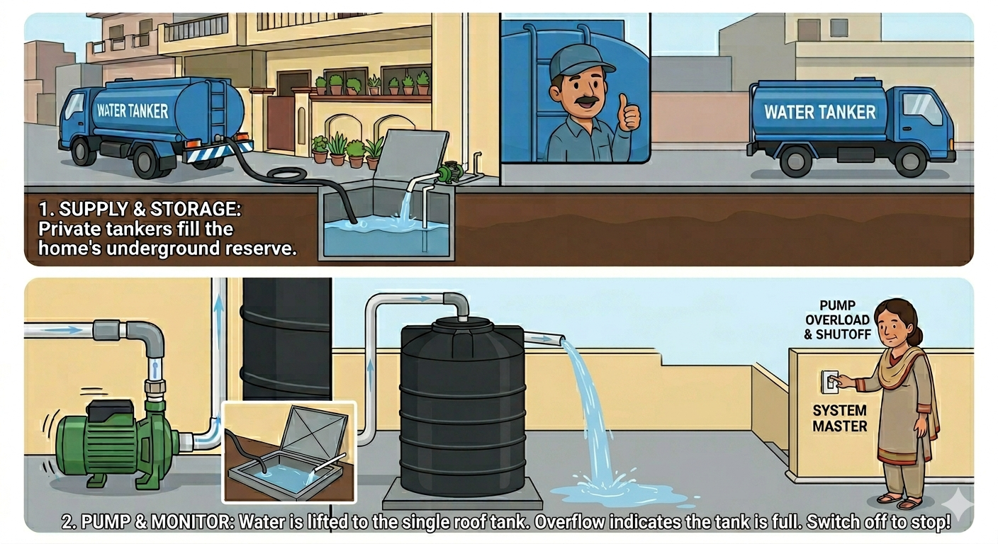





01 • CONTEXT
The Real-World Problem
Pakistan • Daily Water Routine
Water Wastage
Human Dependency
Tanker fills the underground tank. A person manually switches the motor ON, waits for water to reach the rooftop tank, and turns it OFF only after they see water overflowing from the pipe.
Overflow is the signal — water is already lost.
Someone must remember to start and stop the motor.
Forgotten Motors
Routine Overflow
Motor left running overnight is a common mistake.
Even ideal operation ends in overflow by design.
“Even in the best-case scenario, overflow water is already wasted water.”
Smart Water Tank Monitoring System
2 / 10

Slide 3









02 • SOLUTION
Automated Smart Water Tank System
Auto Motor ON
SYSTEM ARCHITECTURE
Triggers when water level falls low.
Underground Tank
Auto Motor OFF
Motor (Servo Sim.)
Stops once target level is reached.
Overflow Safety
Main Rooftop Tank
Independent sensor catches faults.
Sensors (Level + Overflow)
Live MQTT Feed
Status published in real-time.
ESP8266 Controller
Remote Monitoring
MQTT Broker
View tank from phone or laptop.
Mobile / Laptop UI
Smart Water Tank Monitoring System
3 / 10

Slide 4


03 • BUILD
Hardware Components
ESP8266 Wemos D1 Mini
HC-SR04 Ultrasonic Sensor
Water Sensor
Wi-Fi controller — runs the logic and talks to MQTT.
Measures live water level inside the tank.
Detects overflow as an independent safety trigger.
Servo Motor
Piezo Buzzer
Breadboard + Wiring
Simulates the motor switch — ON / OFF actuator.
Audible alert when tank is FULL or overflowing.
Prototyping platform for all sensor connections.
Smart Water Tank Monitoring System
4 / 10

Slide 5
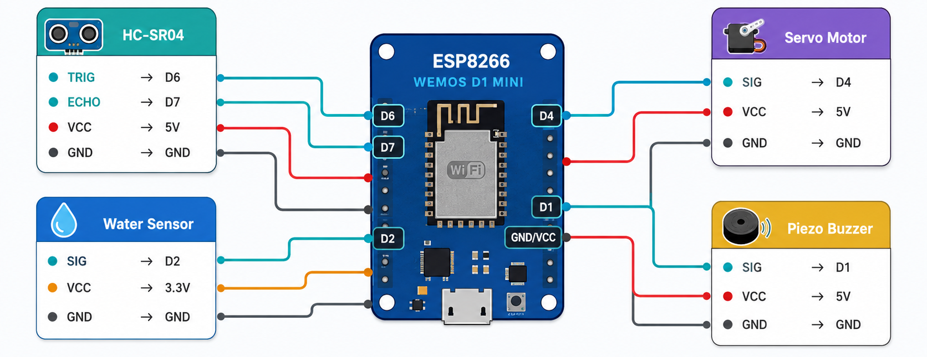
04 • WIRING
Circuit Diagram
Signal Line
5V Power
3.3V Power
Ground
Smart Water Tank Monitoring System
5 / 10

Slide 6

05 • ALGORITHM
System Logic Flow
01
02
03
Read Water Level
Low? Motor ON
Continuous Monitor
HC-SR04 measures distance to water surface.
If level below threshold, activate motor.
Keep reading level while motor runs.
04
05
06
Target Reached → OFF
Overflow Detected?
Publish to MQTT View on Dashboard
Stop motor when desired level is hit.
Independent water sensor fires buzzer alert.
Stream live status to broker each cycle.
Smart Water Tank Monitoring System
6 / 10

Slide 7



06 • CONNECTIVITY
Live MQTT Monitoring
Real-Time IoT Telemetry
mqtt://broker/tank/status
The ESP8266 publishes tank state to an MQTT broker. Any subscriber — phone, laptop, or dashboard — receives instant updates.
{
"water_level": 82,
"motor": "OFF",
"status": "FULL",
"overflow": false
}
ESP8266
MQTT
Dashboard
publisher
publish
broker
subscribe
subscriber
Updates streamed every cycle — under one second latency.
Sample payload published to the MQTT topic
Smart Water Tank Monitoring System
7 / 10

Slide 8

07 • DEMO
Live Demonstration
What you'll see in the live demo
Real-Time Water Level Detection
Automatic Motor Control
Ultrasonic sensor reports tank height as water fills.
Servo angle changes as motor switches ON / OFF.
Live dashboard
Serial Monitor Output
MQTT messages seen on dashboard refreshes with each new reading.
Diagnostic stream shows every decision the MCU makes.
Smart Water Tank Monitoring System
8 / 10

Slide 9




08 • ROADMAP
Future Improvements
Real Relay Control
Dedicated Mobile App
Cloud Database
Drive an actual AC motor in place of the servo.
Native iOS / Android control and history.
Persist tank readings for long-term analytics.
Push Notifications
Water Usage Analytics
Solar-Powered Node
Alerts when tank is full, leaking, or empty.
Trends, peak hours, leak detection patterns.
Off-grid deployment for rural installations.
Smart Water Tank Monitoring System
9 / 10

Slide 10


CONCLUSION
Small IoT systems,
real-world impact.
“This project demonstrates how simple, low-cost IoT systems can solve real water management problems faced daily in developing countries.”
Thank You
Muhammad Haris Irfan
Muhammad Zain
Smart Home Ready
Water Conservation
IoT Sustainability
Drop-in solution for any rooftop tank
Zero overflow, zero waste
Connected, scalable, low-power

