Slide 1
Introduction to Version control and Git
Madeline(Maddy) Harrop

Slide 2
What is Version Control?
Version control is a system that tracks changes to files over time.
It allows multiple people to collaborate on projects, keeps a history of changes, and makes it easy to manage and revert to previous versions.

Slide 3
Why use Version Control?
Collaboration: Multiple people can work on the same project simultaneously.
History Tracking: You can track changes and understand who made them.
Rollback: You can revert to a previous state of your project if something goes wrong.

Slide 4
What is Git?
Git is a distributed version control system that allows you to track changes to your codebase.

Slide 5
Installing Git
Follow Lloyds instructions for downloading git
Download Git: Git - Downloads (git-scm.com)
Install Git following the installation instructions for your operating system.

Slide 6
What is the Command Line
The command line is a text-based interface for interacting with your computer.
You can access it through the Terminal or Command Prompt (Windows).
Notes:
But we are going to use git bash

Slide 7
Using Git Bash (Windows)
Git Bash is a command-line tool that provides a Unix-like shell on Windows. It's useful for running Git commands and Unix utilities.
Notes:
Bash is a Unix shell and command language
Bash commands are part of the foundational knowledge in the world of programming and system administration. Knowing how to perform common tasks through the command line is a fundamental skill, especially when working with Unix-based systems (Linux, macOS) or even Windows through tools like Git Bash or Windows Subsystem for Linux (WSL).

Slide 8
Introduction command line

Slide 9
Basic Terminal/Command Line Commands
$ pwd :(Print Working Directory) Shows your current directory.
$ ls : (List) Lists files and directories in the current directory.
$ cd dir_name or .. : (Change Directory) Moves to another directory.
$ mkdir dir_name : (Make Directory) Creates a new directory.
$ touch <file> : Creates an empty file.
$ rm <file> : Removes a file.
$ cp <source> <destination> : Copies a file or directory.
$ mv <source> <destination> : Moves or renames a file or directory.
Notes:
Bash is a powerful tool for interacting with your system
It is crucial to avoid executing the wrong commands in Git Bash and to not rush because Git is a powerful and complex version control system that can have far-reaching consequences on your project and codebase. Making mistakes in Git can lead to data loss, code conflicts, and project instability.
Rushing through commits and merges can lead to code conflicts that are challenging to resolve. Incorrectly resolving conflicts can introduce bugs, inconsistencies, and errors into your project, causing headaches for you and your team.
If you are not checking the response, you may miss failures or errors in your command

Slide 10
Basic Command Line
Build 64-bit Windows apps with Unix-like tools
username@computername MINGW64 ~
$ pwd
c/Users/namehere
username@computername MINGW64 ~
$ ls
Print Working Directory
List (files and directories
Notes:
MinGW-w64 is a development environment for Windows that allows you to compile and build software for the Windows platform using the GNU Compiler Collection (GCC). It provides a way to develop and run software written in C, C++, and other languages on a Windows system.
Git Bash is a command-line interface for Git, and it provides a Unix-like environment on Windows. It includes many Unix utilities and tools, which makes it a convenient environment for software development, especially for those familiar with Unix-based systems. MinGW-w64 complements this environment by providing the ability to compile and build software natively on Windows.

Slide 11
Basic Command Line
username@computername MINGW64 ~
$ mkdir new_folder
username@computername MINGW64 ~
$ cd new_folder
username@computername MINGW64 ~/new_folder
$ touch new_file.txt
username@computername MINGW64 ~/new_folder
$ ls
new_file.txt
Make Directory
Change Directory
Creates an empty file
List files or directories

Slide 12
Basic Command Line
username@computername MINGW64 ~/new_folder
$ rm new_file.txt
username@computername MINGW64 ~/new_folder
$ ls
username@computername MINGW64 ~/
$ cd ..
username@computername MINGW64 ~/new_folder
$ rm new_folder
Remove file or folder
Nothing in the folder
Change Directory One UP
Remove file or folder

Slide 13
Task
Open a brand new gitbash terminal from the highest level of your PC
Navigate to your documents (inside Onedrive)
Create a new folder called my_folder
Create a txt file called my_txt.txt
Inside my_folder, create another new folder called another_folder
Inside of another_folder create a python file called main
Open it in visual studio code (code .)
Remove all folders (the ones we just made)

Slide 14
Introduction to gitbash

Slide 15
Repositories (Repos)
A repository is a central location where you store and manage your project's source code, files, and history.
It acts as a container for all the files and assets related to your project.
Repositories provide a way to organise, and version control your project.
They keep track of changes over time, enable collaboration among developers, and serve as a backup for your project.

Slide 16
Basic Git Commands
git init : Initializes a new Git repository.
git clone <repository URL> : Copies a repository from a remote server to your local machine.
git add <file> : Stages changes for commit.
git commit -m "message“ : Commits staged changes with a message.
git status : Shows the status of your working directory.
git log : Displays a history of commits.
git pull : Fetches changes from a remote repository.
git push : Pushes local changes to a remote repository.
Notes:
It is crucial to avoid executing the wrong commands in Git Bash and to not rush because Git is a powerful and complex version control system that can have far-reaching consequences on your project and codebase. Making mistakes in Git can lead to data loss, code conflicts, and project instability.
Rushing through commits and merges can lead to code conflicts that are challenging to resolve. Incorrectly resolving conflicts can introduce bugs, inconsistencies, and errors into your project, causing headaches for you and your team.
If you are not checking the response you may miss failures or errors in your command

Slide 17
Getting started with Git
username@computername MINGW64 ~c/user/me/documents
$ git init
Initialized empty Git repository in C:/Users/../..
username@computername MINGW64 ~c/user/me/documents
$ touch example.txt
username@computername MINGW64 ~c/user/me/documents
$ git status
Initialize a new git repository
Create a txt file
Show the status of changes as untracked, modified, or staged in your directory and staging area. To know current state of your Git repository.

Slide 18
Getting started with Git
username@computername MINGW64 ~c/user/me/documents
$ git add .
username@computername MINGW64 ~c/user/me/documents
$ git commit -m "Initial commit"
Stage your files(changes are preparing to commit
Commit the changes you've staged.
Creates a snapshot of the changes along with a commit message

Slide 19
Branching
username@computername MINGW64 ~c/user/me/documents
$ git checkout -b test
username@computername MINGW64 ~c/user/me/documents
$ git add .
username@computername MINGW64 ~c/user/me/documents
$ git commit -m "Add new content to example.txt“
Create and switch to a new branch
Make some changes to example.txt

Slide 20
branching
username@computername MINGW64 ~c/user/me/documents
$ git checkout main
username@computername MINGW64 ~c/user/me/documents
$ git merge test
Auto-merging example.txt
CONFLICT (content): Merge conflict in example.txt
Automatic merge failed; fix conflicts and then commit
the result.
Look at example.txt now
Time to fix the conflicts

Slide 21

Example.txt
<<<<<<< HEAD
Main text
=======
Testing branch text
>>>>>>> test
<<<<<<< HEAD: This marker indicates the beginning of the conflicting changes from the current branch (main in this case). Everything between this marker and the next marker (=======) represents the changes made in the current branch.
Main text: The content between <<<<<<< HEAD and ======= is the content that exists in the main branch.
=======: This marker indicates the end of the changes from the current branch and the beginning of the changes from the branch you are merging (test in this case).
Testing branch text: The content between ======= and >>>>>>> test is the content that exists in the test branch.
>>>>>>> test: This marker indicates the end of the conflicting changes from the branch you are merging.

Slide 22
branching
username@computername MINGW64 ~c/user/me/documents
$ git add .
username@computername MINGW64 ~c/user/me/documents
$ git merge --continue
Add the updated file
Will open a commit message for you, read it then close it.

Slide 23
Introduction to GitHub

Slide 24
Remote Repos
A remote is a link from your local Git repository to another repository.
It's often a repository hosted on a server, such as GitHub, GitLab, or Bitbucket.
Remotes allow you to interact with and exchange changes with a central repository.
Remotes facilitate collaboration.
By connecting your local repository to a remote repository, you can share your work with others, fetch changes made by collaborators, and contribute to shared projects.

Slide 25
What is GitHub?
GitHub is a web-based platform that provides hosting for Git repositories. It facilitates collaboration, code review, and project management.

Slide 26
Create an account
Create a GitHub account: GitHub Signup

Slide 27
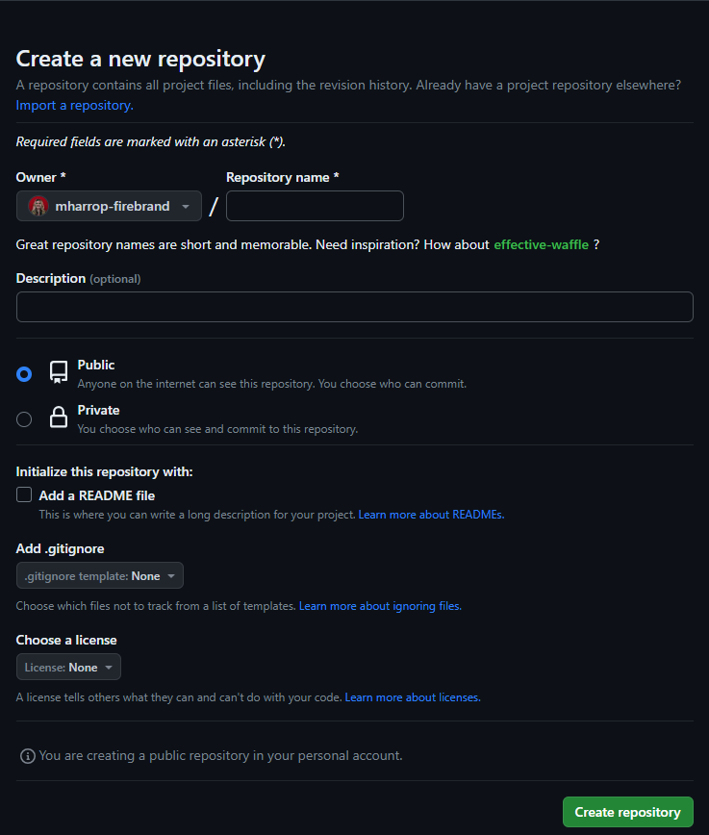
Getting started with GitHub
Create a name for the repo
If you want add a description
Keep it public for now
The readme is a description for you or others looking at your project
.gitignore is a file where you store file type to ignore when pushing to github
Licence you can ignore.

Slide 28
Collaborating with Others
Fork a repository: Create your copy of someone else's repository.
Clone a repository: Get a local copy of a repository from GitHub.
Create branches: Isolate your work from the main codebase.
Pull requests: Propose changes and merge them into the main codebase.

Slide 29
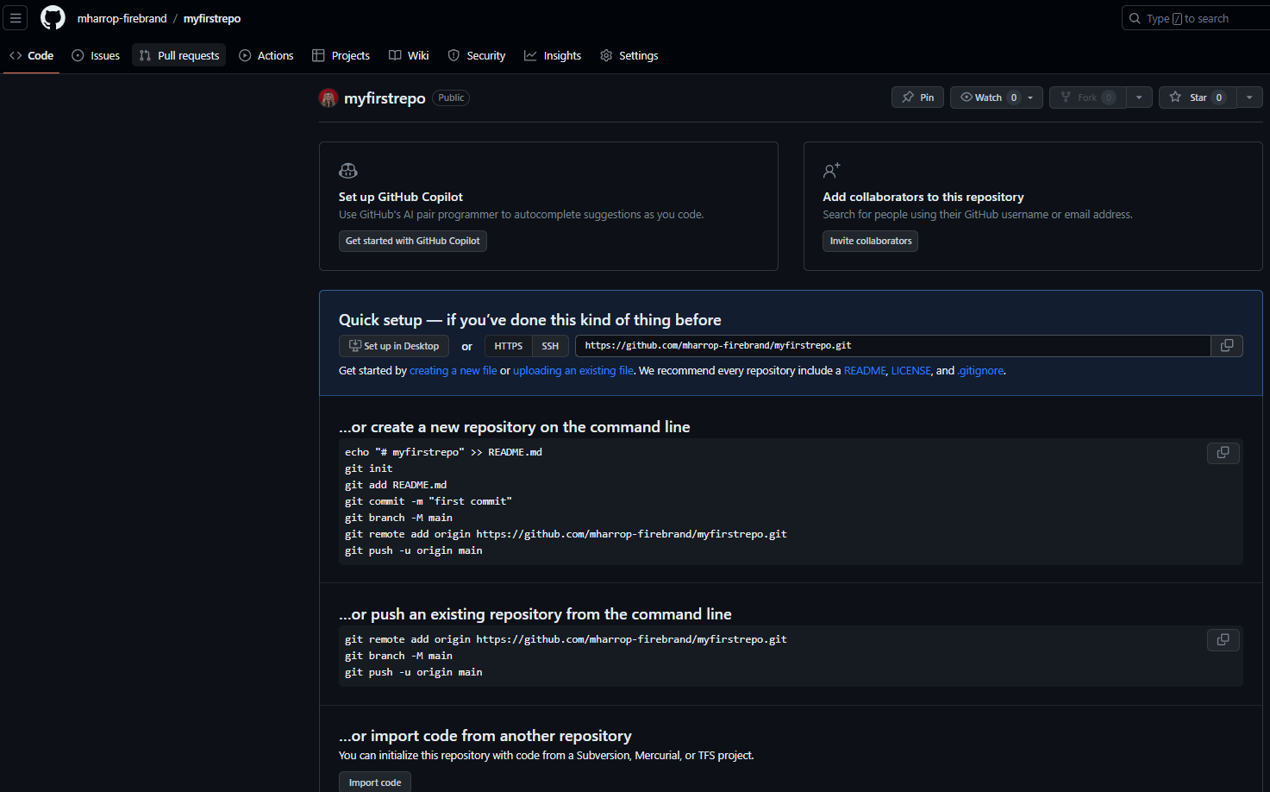
Repository's files and folder structure
Review, discuss, and merge changes proposed by contributors.
A project management board for organizing and prioritizing work
Include information on identified vulnerabilities, suggested fixes, and security policies
Options for general settings, collaborators, branches, webhooks, and more
For tracking tasks, bugs, enhancements, and other discussions
GitHub Actions automate workflows, such as building, testing, and deploying your code
A place for collaborative documentation
Analytics and visualisations related to the repository

Slide 31
Using GitHub
Clone the repository
Link your local Git repository to the remote GitHub repository
Push your local code to GitHub

Slide 32
Find a location
Find a location to place the repo

Slide 33
might not work
username@computername MINGW64 ~
$ git config --global user.name "Your Name"
username@computername MINGW64 ~
$ git config --global user.email "youremail@example.com"
Same as your Github account
The --global flag indicates that you want to set these configurations globally for your user account, which means they will apply to all Git repositories on your system.
Notes:
Configuring Git with your name and email address is essential for the following reasons:
Authorship Identification: When you make commits in a Git repository, each commit includes the name and email address of the author. This information helps identify who made the changes.
Collaboration: In collaborative projects, knowing the author of each commit is crucial for accountability and tracking contributions. It allows project maintainers and team members to understand who made specific changes.
Contact: Providing your email address allows others to contact you if they have questions or need clarification about your code contributions.
Git Services: When you use Git services like GitHub or GitLab, your name and email address are associated with your account. Configuring Git with the same information ensures that your commits are correctly linked to your account on these platforms.
Consistency: Configuring Git globally with your name and email address ensures consistency across all your Git repositories. You don't need to specify this information for each repository individually.
By configuring Git with your name and email address, you make your contributions to Git repositories more transparent and traceable, which is crucial for collaborative software development. It also helps maintain a clear and accurate history of commits.

Slide 34
Cloning
This creates a local copy of the repository on your computer
username@computername MINGW64 ~
$ git clone https://github.com/username/repository.git
username@computername MINGW64 ~
$ cd repofilename
username@computername MINGW64 ~
$ git init
Make the gitbash in the right location
Initialise git

Slide 35
Cloning
Create a README.md
Edit in VSc
username@computername MINGW64 ~
$ touch README.md
username@computername MINGW64 ~
$ git add .
username@computername MINGW64 ~
$ git commit –m “added files”
Make some changes and additions to the project

Slide 36
Cloning
This updates the code on GitHub with the latest changes
username@computername MINGW64 ~
$ git push -u origin main
Enumerating objects: 3, done.
Counting objects: 100% (3/3), done.
Writing objects: 100% (3/3), 237 bytes | 237.00 KiB/s, done.
Total 3 (delta 0), reused 0 (delta 0), pack-reused 0
To https://github.com/username/repository.git
* [new branch] main -> main
branch 'main' set up to track 'origin/main'.

Slide 37
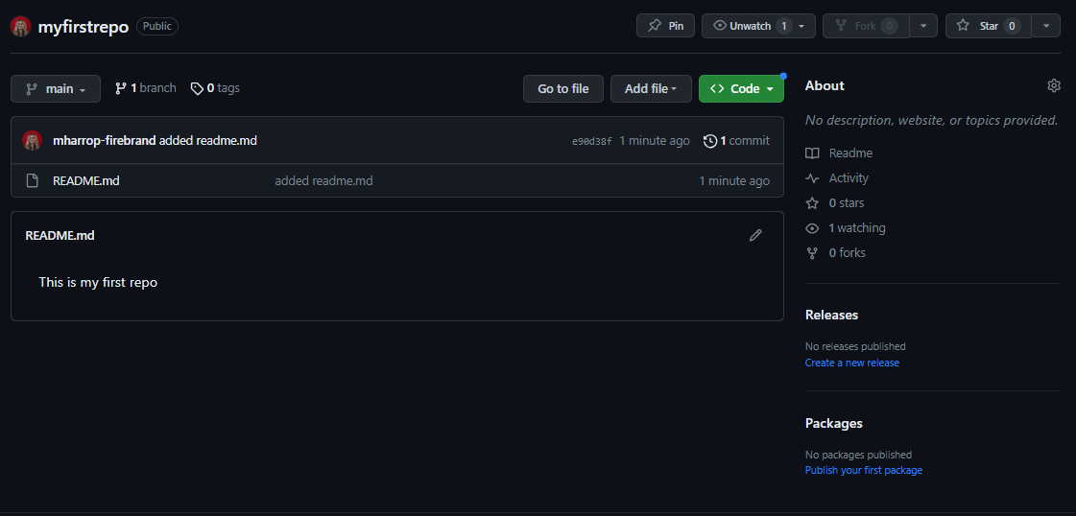
See your changes

Slide 38
Collaboration
username@computername MINGW64 ~
$ git pull origin master
To get the latest changes made by others, developers pull from the remote repository
This is when conflict may show.
Get in the habit of pulling regularly to keep updated with changes

Slide 39
REMEMBER
FOR EVERY CHANGE:
`git add .`: Stage your changes.
`git commit -m "Message"`: Commit changes locally.
`git push origin <branch>`: Push changes to GitHub.

Slide 40
COLLABORATION TIPS:
- Create a new branch for changes.
- Commit and push to your branch.
- Submit a pull request to merge changes.
- Review and discuss pull requests.

Slide 41
Branch Protection rules
Branch protection rules define whether collaborators can delete or force push to the branch and set requirements for any pushes to the branch, such as passing status checks or a linear commit history.
Rules may include:
Require pull request reviews
Require code owner reviews
Require status checks
Require signed commits
Branch Deletion Protection

Slide 42
Pull Requests/ Merge requests
Commit:
As the developer works on the changes, they commit their changes to their branch.
Pull Request:
When the developer is ready to share their changes with the rest of the team, they create a pull request.
In the pull request, they describe the purpose of the changes, what the changes do, and any relevant context.
Review changes:
The pull request is then opened for review.
Team members, collaborators, or contributors can review the changes, provide feedback, and discusss code modifications.

Slide 43
Additional Resources
GitHub Guides: Official GitHub guides for various topics.
Pro Git Book: Comprehensive guide to Git.
Git Cheat Sheet: Handy reference for Git commands.

