Slide 1
Capstone Project:
Loan Default Prediction
Presentation
Practical Data Science
October 19, 2023
Presented By: Mariah Haris

Slide 2
EXECUTIVE SUMMARY

Slide 3
Project Key Question?
Would the Applicant Default?
Which features (like income, job type, debt-to-income ratio) are most indicative of a potential loan default?
Are there any patterns or trends in the data that can provide deeper insights into the characteristics of defaulters?
How can the bank improve its loan approval process based on the insights from the data?

Slide 4
KEY TAKEAWAY
The primary goal of this analysis was to develop a model that accurately predicts loan defaulters to minimize the financial risk for the lender.
We tested different models including Decision Tree (accuracy: 0.89), Random Forest (accuracy: 0.93), and Logistic Regression (accuracy: 0.89), and optimized the Random Forest model using GridSearchCV to achieve the best performance.

Slide 5
THE BIG PICTURE
Accurate prediction of loan defaulters will save the company from potential financial loss.
The optimized Random Forest model with GridSearchCV showed the best performance with an accuracy of 0.90, precision of 0.70, and recall of 0.82.
This model has successfully balanced the trade-off between precision and recall, making it a suitable solution for the business problem.

Slide 6
THE IMPORTANT FINDINGS
The optimized Random Forest model with GridSearchCV is the most suitable model for predicting loan defaulters, with a high accuracy of 0.90, ensuring reliable predictions.
This model will help in identifying clients who are at risk of defaulting on their loans, allowing the lender to take proactive measures.

Slide 7
NEXT STEPS & RECOMMENDATIONS
MODEL RECOMMENDATION
Further fine-tune the model parameters to see if the performance can be improved even more, aiming for an accuracy above 0.90.
Test the model with additional data to validate its performance in real-world scenarios and ensure its reliability.
BUSINESS RECOMMENDATION
Review the model's performance metrics, including the high recall of 0.82, which is crucial for identifying loan defaulters.
Make informed decisions based on the model's predictions to mitigate financial risks and potentially save the company from significant losses.
Monitor the model's performance over time and update it as necessary to maintain its high accuracy and reliability in predicting loan defaulters.

Slide 8
PROBLEM
&
SOLUTION SUMMARY

Slide 9
Understanding the problem
Defaulting on loans is a significant concern for banks as bad loans (NPA) can severely impact their profits. By identifying potential defaulters before loan approval, banks can mitigate financial risks and ensure a stable revenue stream
A bank's consumer credit department aims to simplify the decision-making process for home equity loans of credit to be accepted.
The model will be based on the
data obtained via the existing loan underwriting process from recent applicants who have been given credit.
The model will be built from predictive modeling techniques, but the model created must be interpretable enough to provide a justification for any adverse behavior (rejections)
They will adopt the
Equal Credit Opportunity Act's guidelines to establish an empirically derived and statistically sound model for credit scoring.

Slide 10
PROCESS
Data Preprocessing
2. Exploratory Data Analysis
Model Building
Hyperparameter Tuning
Data Context
Data Inspection
Handling Missing Values
Data Transformation
Convert Categorical Variables
Data Splitting
Univariate Analysis
Bivariate Analysis
Multivariate Analysis
Outlier Detection
Logistic Regression
Decision Tree
Random Forest
Classification
GridsearchCV
Evaluation
Interpretation
Recommendation

Slide 11
Data Preprocessing (5960 Rows , 13 Columns)
Missing Values
Missing in all columns other than BAD (default or not ) and LOAN (amount approved)
Percentage of Missing Values (approx):
Debt-to-income ratio 21%
Number of major derogatory reports 12%
existing mortgage 9%,
Years Present job 9%,
Recent credit enquiries 9%
Because the columns are very important and % high, missing values were imputed using Median for Numerical and Mode for Categorical.
Dropped rows with more than 6 column values missing
Outliers:
all the values smaller than Lower_Whisker will be assigned value of Lower_whisker
all the values above upper_whisker will be assigned value of upper_Whisker
Conversion of Variables :
Converted the OBJECT type of the target variable for default or not for Model Prep.

Slide 12
Exploratory Data Analysis:
Univariate Analysis:
Numerical Columns: histograms or box plots
Categorical Columns: bar plots
Bivariate Analysis:
Numerical vs. Numerical:
Scatter plots to see relationships between two numerical columns.
Correlation matrices or heatmaps to identify correlated variables.
Categorical vs. Numerical: Box plots
Categorical vs. Categorical : Stacked bar plots or mosaic plots.
Multivariate Analysis:
scatter plot matrices to visualize relationships between more than two columns.

Slide 13
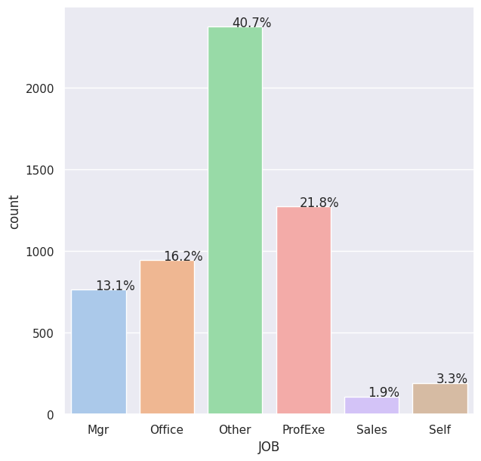
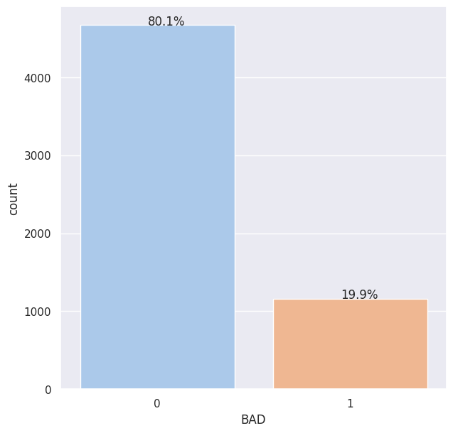
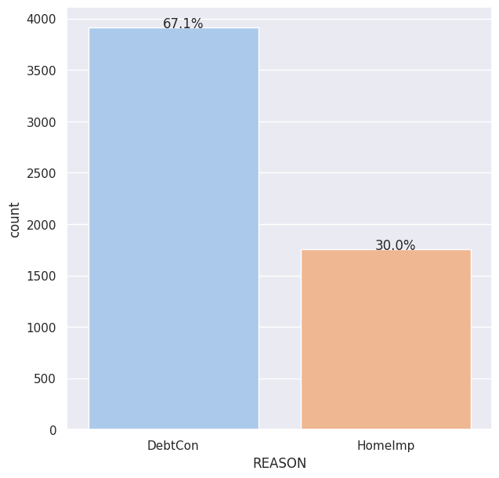
Exploratory Data Analysis:
From the bar plot, we can see that there are more customers who did not default on their loans than those did.
The highest Reason for loan request was Debt Consolidation(67%) followed by a approx 40% in home improvements.
Other Jobs are highest category 41% followed by professionals and least is sales at 1.9% that apply for loans

Slide 14
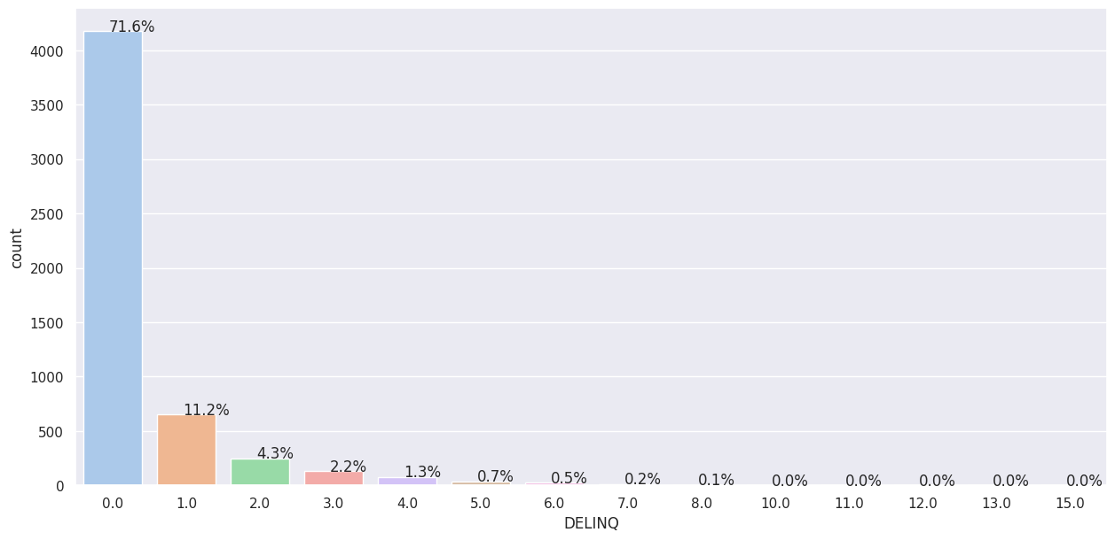
Exploratory Data Analysis:
72% applicants have 0 Deliquent ( unpaid ) credit lines with a sharp decrease of 1 line at 11%

Slide 15
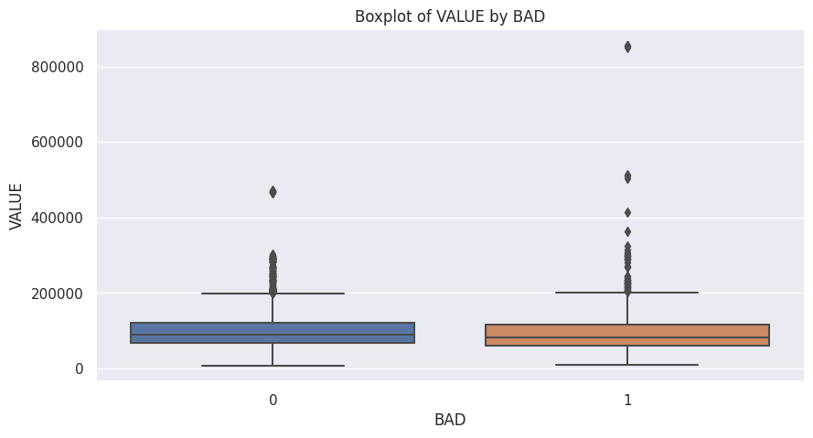
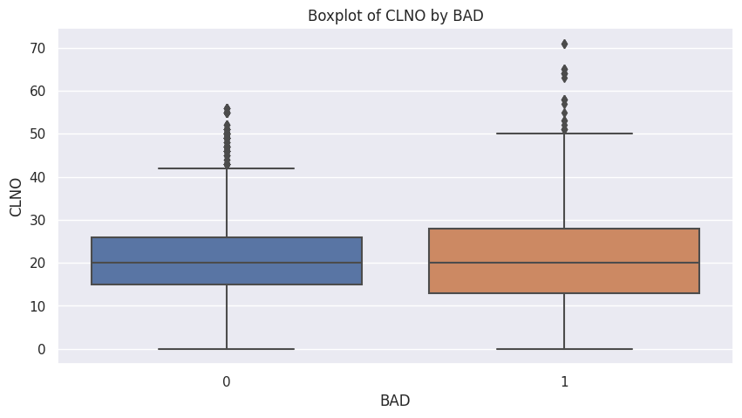
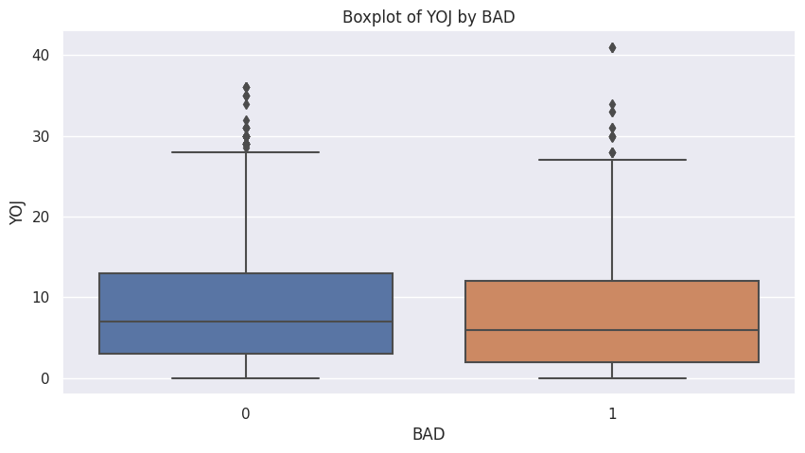
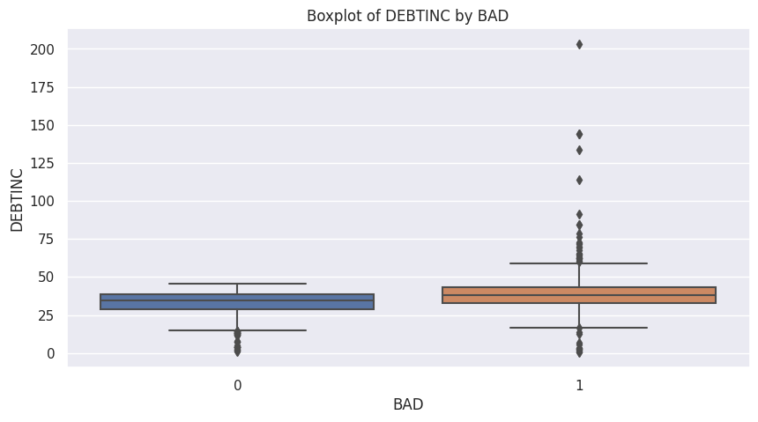
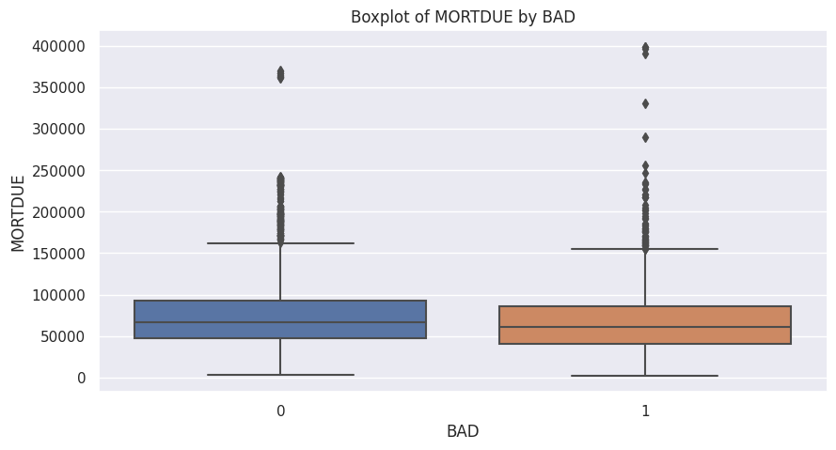
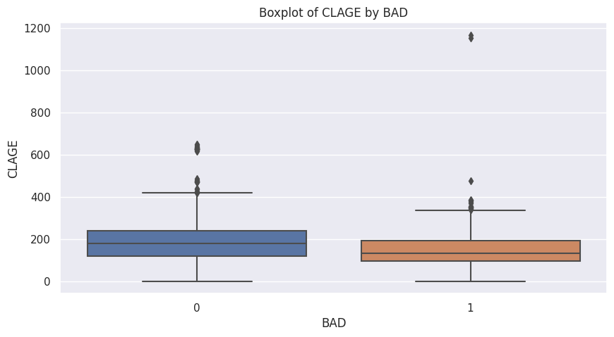
Exploratory Data Analysis:
Comparing the distribution of loan defaulters and non loan defaulters with other categories, don’t give a direct link to any variable

Slide 16
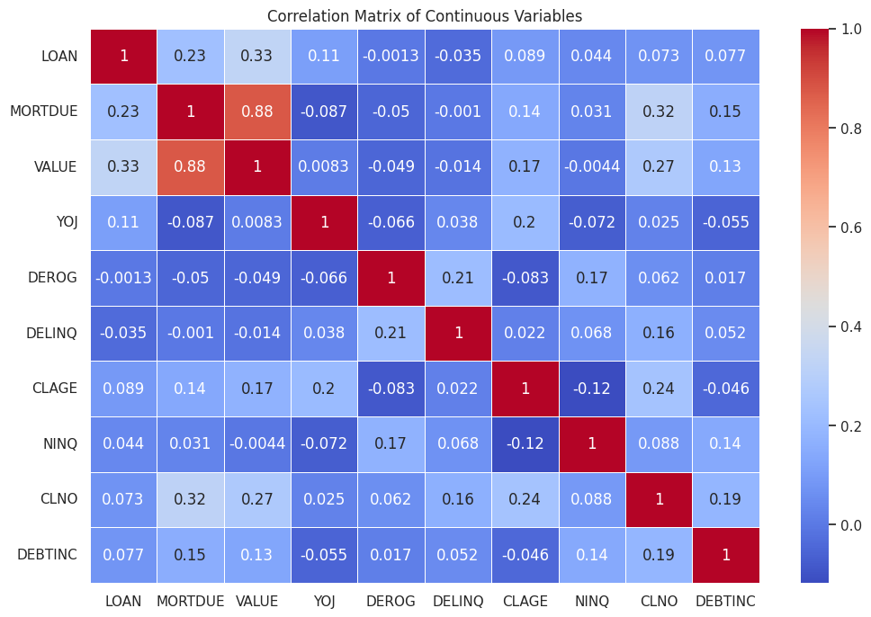
Exploratory Data Analysis:
MORTDUE (amount due on existing mortgage) and VALUE (value of current property) have a high positive correlation, which makes sense as the value of the property can affect the amount of mortgage.

Slide 17
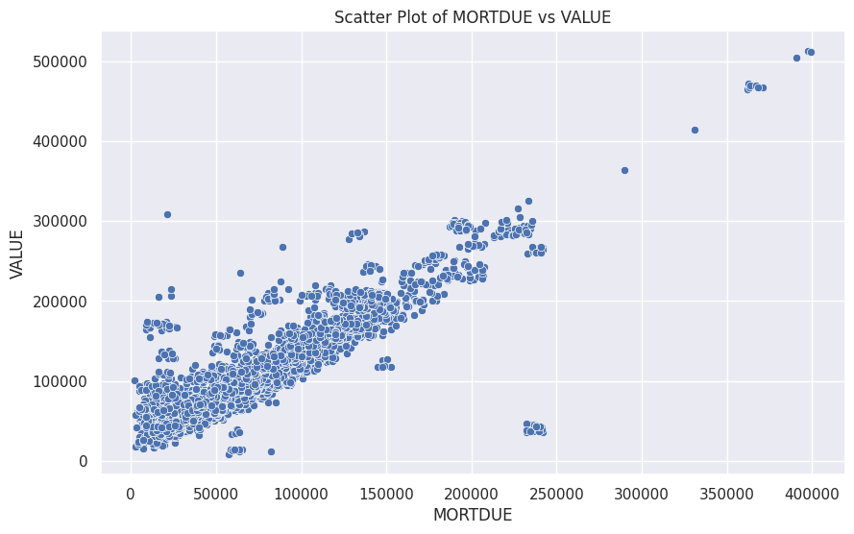
Exploratory Data Analysis:
Greater the value of the loan, more the amount of mortgage due

Slide 18
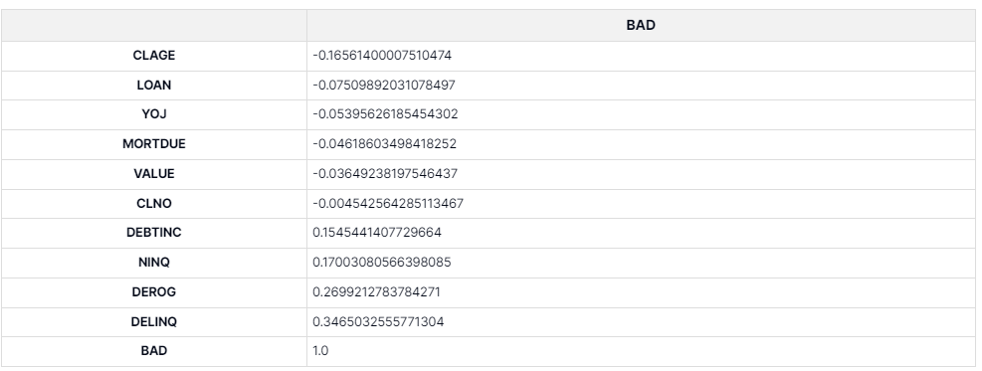
Exploratory Data Analysis: Correlation
DELINQ (number of delinquent credit lines) has the highest positive correlation with BAD, followed by DEROG (number of derogatory reports) and NINQ (number of recent credit inquiries). This suggests that customers with more delinquent credit lines, derogatory reports, or recent credit inquiries are more likely to be bad customers.
CLAGE (age of oldest credit line in months) has the highest negative correlation with BAD, suggesting that customers with older credit lines are less likely to be bad customers.

Slide 19
Model Building
Splitting the data:
70% train and 30% test set
The Model for comparison:
Log Regression Model
Decision Tree
Random Forest
Random Forest with Hyperparameter Tuning
80% can sometimes lead to overfitting but poorly on unseen data.
70% might not capture the entire complexity of the data, potentially leading to underfitting.
Due to Missing values, 70:30 split seemed reasonable

Slide 20
Log Regression
Accuracy :
Training Accuracy: 0.81
Test Accuracy: 0.78
The oldest credit line in months, a negative coefficient indicates that as this age increases, the likelihood of loan default decreases. A longer credit history might signify a more experienced borrower.
Years On Job suggests that with every additional year a person remains on their job, the likelihood of the loan default slightly decreases.
The number of credit lines suggests that having more credit lines slightly decreases the likelihood of the loan default. This might be counterintuitive and warrants further investigation.
Debt to Income Ratio, a negative coefficient suggests that as one's debt relative to their income increases, the likelihood of the loan default slightly decreases, which might seem unexpected.
The number of delinquent credit lines, a positive coefficient indicates that as delinquencies increase, the likelihood of the loan default increases, which is intuitive.
Missing Values Flags: Variables like DEBTINC_missing_values_flag likely indicate whether the primary value was missing. A positive coefficient for a missing values flag might suggest that records with missing data for that particular variable have a slightly higher likelihood of the loan default .

Slide 21
Decision Tree
Level 1: The first split in the tree is on the variable DEBTING missing_values_flag. This variable indicates whether there are any missing values in the data for Debt-to-income ratio of the applicant. If there are any missing values, then the applicant is more likely to default on the loan.
Level 2: The second split in the tree is on the variable DEBTINC. This variable measures the applicant's debt-to-income ratio. Borrowers with a high debt-to-income ratio are more likely to default on their loans because they have less money available to make their monthly payments.
Level 3: The third split in the tree is on the variable VALUE. This variable measures the value of the applicant's property. Borrowers with a high value-to-loan ratio (LTV) are more likely to default on their loans because they have less equity in their homes. This means that they are more likely to walk away from their homes if they are unable to make their mortgage payments.
Conclusion:
The decision tree analysis shows that the most important factors in predicting loan default are debt-to-income ratio, recent delinquencies, and number of existing credit lines. Borrowers with a high debt-to-income ratio, recent delinquencies, or a high number of existing credit lines are more likely to default on their loans.

Slide 22
Random Forest
Training: every time the model predicted a loan would be repaid or defaulted, it was correct.
Test: When the model predicted that a loan would be repaid, it was right 93.9% of the time. When it predicted a loan would default, it was right 84.6% of the time.
PRECISION
Training: The model correctly identified all instances where loans were repaid and defaulted.Test: The Model successfully identified 96.7% of all actual repayments and only 74.1% of actual defaults. This indicates a greater chance of missing potential defaults in the real-world scenarios
RECALL
Training: The perfect balance of precision and recall indicates a flawless prediction for both.
Test: While the model's predictions for repayments are near perfect, it has some difficulty in accurately predicting defaults when considering both precision and recall.
F1-SCORE
Training: Correct prediction made about a loan, whether it'd be repaid or defaulted
Test: 92.3% of the time, the model's prediction about a loan's outcome (repayment or default) was correct, indicating a reliable model but not as impeccable as the training data suggested.
ACCURACY
Support:
This represents the actual number of instances of repayments and defaults in the training and test datasets, giving an idea of the data distribution.
Macro and Weighted Averages:
The averages, especially the macro average, help underline that the model is slightly less adept at predicting defaults (class 1) than repayments (class 0) in the test set.
Contextual Summary: The model is exceptionally adept at predicting loan outcomes in the training set. In real-world scenarios (test set), it remains highly reliable, particularly for predicting repayments. However, lenders should be cautious as the model might miss out on identifying 1 in 4 actual defaults, potentially leading to financial risks.

Slide 23
Random Forest - HyperParameter Tuning
Training: every time the model predicted a loan would be repaid or defaulted, it was correct.
Test: There's a 6.4% chance it wrongly predicts a defaulting loan as being repaid.there's a 15.7% chance that a loan it flags as likely to default might actually get repaid.
PRECISION
Training: The model correctly identified all instances where loans were repaid and defaulted.
Test: The loans that were actually repaid, the model correctly identified 96.7% of them. Of all actual defaults, the model only caught 72.6%. This indicates that 27.4% of loans defaulted weren't flagged.
RECALL
Training: The perfect balance of precision and recall indicates a flawless prediction for both.
Test: Defaults have a score of 0.780, suggesting a reduced balance between precision and recall after hyperparameter tuning.
F1-SCORE
Training: Correct prediction made about a loan, whether it'd be repaid or defaulted
Test: the model correctly predicts the loan outcome 92.1% of the time. This is a reliable model, but after hyperparameter tuning, there's a small room for improvement.
ACCURACY
Support:
This represents the actual number of instances of repayments and defaults in the training and test datasets, giving an idea of the data distribution.
Macro and Weighted Averages:
The averages, especially the macro average, help underline that the model is slightly less adept at predicting defaults (class 1) than repayments (class 0) in the test set.
Contextual Summary: The model is exceptionally adept at predicting loan outcomes in the training set. In real-world scenarios (test set), it remains highly reliable, particularly for predicting repayments. However, lenders should be cautious as the model might miss out on identifying 1 in 4 actual defaults, potentially leading to financial risks.

Slide 24
Random Forest - HyperParameter Tuning
The model exhibits remarkable performance on the training data, capturing both repayments and defaults perfectly. When tested on unseen data, the model remains strong in predicting repayments, showing confidence in distinguishing responsible borrowers. However, its capability to detect risky borrowers (defaults) has decreased after hyperparameter tuning. Specifically, for every 100 actual defaulters, the model might miss 27 of them.
the model correctly predicts the loan outcome 92.1% of the time.

Slide 25
Random Forest - GridSearchCV
Train:Out of all the instances where the model predicts 'loan payback', 98% of them are actually correct. Out of predicts 'loan default', 77% of them are actually correct.
Test: Out of all predicts 'loan payback', 95% of them are actually correct.
PRECISION
Train:Out of all the actual 'loan payback' instances, the model correctly identifies 93% of them and for 'loan default' instances, the model correctly identifies 93% of them.
Test: Out of all the actual 'loan payback' instances, the model correctly identifies 92% of them.
RECALL
Training: The perfect balance of 96% loan payback precision and recall indicates a flawless prediction, for default the ratio is 85%
Test: Defaults of 75% right prediction, suggesting a reduced balance between precision and recall
F1-SCORE
Train: Accuracy (0.9317): The model correctly predicts the outcome (whether an applicant will default or pay back the loan) for 93.17% of the training cases.
Test: Accuracy (0.8983): The model correctly predicts the outcome for 89.83% of the test cases.
ACCURACY
Support:
This represents the actual number of instances of repayments and defaults in the training and test datasets, giving an idea of the data distribution.
Macro and Weighted Averages:
The averages, especially the macro average, help underline that the model is slightly less adept at predicting defaults (class 1) than repayments (class 0) in the test set.
Contextual Summary: The model is exceptionally adept at predicting loan outcomes in the training set. In real-world scenarios (test set), it remains highly reliable, particularly for predicting repayments. However, lenders should be cautious as the model might miss out on identifying 1 in 4 actual defaults, potentially leading to financial risks.

Slide 26
Random Forest - GridSearchCV
Since, the parameters were set to emphasise the sensitivity of Recall ( predicting loan defaulters),the model's tendency to predict 'loan default' when uncertain continues in the test set, but with a decreased precision. This means that while it's identifying potential defaulters with decent accuracy, it's also marking some genuine payers as defaulters.
The model leans towards predicting 'loan default' when in doubt, which means it tends to be cautious, it means potentially denying loans to applicants who might actually pay them back but on the positive side, the model aims to minimize the risk of defaulters.

Slide 27
Random Tree Models Comparison On Test Data:
Category | Random Tree Precision | Random Forest with Class Weights Precision | Random Forest with GridSearchCV Precision | Random Tree Recall | Random Forest with Class Weights Recall | Random Forest with GridSearchCV Recall | Random Tree F1-Score | Random Forest with Class Weights F1-Score | Random Forest with GridSearchCV F1-Score
0 | 0.95 | 0.94 | 0.96 | 0.97 | 0.97 | 0.91 | 0.96 | 0.95 | 0.93
1 | 0.85 | 0.86 | 0.7 | 0.77 | 0.73 | 0.82 | 0.81 | 0.79 | 0.75
Accuracy | 0.93 | 0.92 | 0.9
Macro Avg | 0.9 | 0.9 | 0.83 | 0.87 | 0.85 | 0.87 | 0.88 | 0.87 | 0.84
Weighted Avg | 0.93 | 0.92 | 0.91 | 0.93 | 0.92 | 0.9 | 0.93 | 0.92 | 0.9

Slide 28
IMPORTANT FEATURES

Slide 29
Features Importance:
Missing values for the Debt-to-Income ratio (DEBTINC), is the most influential feature in predicting loan default. This suggests that records with missing Debt-to-Income values might carry substantial information regarding default behavior, possibly because they could represent a segment of borrowers whose financial data isn't fully reported.
The Debt-to-Income (DEBTINC) ratio comes next in importance since a borrower's debt relative to their income can be a strong predictor of their ability to pay back loans.
Individuals with higher delinquencies in the past might be more likely to default.
The age of the oldest credit line (in months) plays a role in prediction. This could be related to the creditworthiness and financial maturity of borrowers.
Similar to the DEBTINC missing value flag, the absence of home value data might represent a specific segment of borrowers.
Variables like DEROG, REASON_HomeImp, VALUE, CLNO, etc., have lower importance scores but still contribute to the prediction. These involve counts of derogatory remarks, the reason for applying for the loan, number of credit lines, and others.

Slide 30
Model Performance vs. Interpretability:
Random Forest and Random Forest with class weights(0:0.2,1:0.8) are more complex models compared to Decision Tree. While they provide better performance in terms of precision, recall, and accuracy, they are less interpretable than the Decision Tree model.
Decision Tree is a simpler model and easier to interpret. However, its performance might not be as high as the Random Forest models.

Slide 31
Model Deployment in Production:
Random Forest with GridSearchCV has shown the best performance with a good balance of precision, recall, and accuracy. This model is ready to be deployed in production as it has a high recall of 0.82, which means it will correctly predict clients at risk of loan defaults. Its precision is 0.70, which is decent, and the accuracy is 0.90, indicating that the predictions made by the model are likely to be true.
Random Forest with class weights has also shown good performance but slightly lower recall compared to the Random Forest with GridSearchCV. This model can also be considered for deployment in production, but the Random Forest with GridSearchCV is a preferred choice.
Decision Tree models have lower performance metrics compared to Random Forest models and might not be the best choice for deployment in production for this specific problem.
To sum up, the best model to be deployed in production is Random Forest with GridSearchCV, as it provides the best balance of precision, recall, and accuracy, which are critical metrics for this business problem.

Slide 32
BUSINESS RECOMMENDATIONS

Slide 33
Measures of Success:
Recall (for Defaulters): This is about how many of the actual defaulters the model catches. This is crucial for risk management, as missing out on a defaulter can result in financial loss..
For a financial institution like HMEQ, not identifying a potential defaulter can be more costly than wrongly identifying a non-defaulter as a defaulter, hence these is more class weight on defaulters
Based on the metrics, Random Forest seems to be performing better, especially in terms of recall, which is a crucial metric for this use-case. The reason might be due to its ensemble nature, making use of multiple decision trees and aggregating their predictions to get a more accurate and robust result.
Variables like job descriptions aren't as crucial in determining loan defaults, suggesting that financial behavior metrics are more indicative of loan default risk than demographic ones.

Slide 34
Business Recommendation -HMEQ
If data missing for certain records is due to data collection issues, consider improving the data collection process, as this metric is crucial.
Implement thresholds or additional scrutiny for applications above a certain Debt-to-Income ratio.
Consider additional checks or a tiered interest rate based on number of past delinquencies
Deploy this model to predict the likelihood of loan defaults, but ensure that it is regularly updated with new data and checked for performance drift.
Given the high recall, the model is well-suited for early warning systems, where identifying potential defaulters is more crucial than ensuring every prediction is accurate.
Allow for model feedback refinement over time and ensures the model remains relevant as market dynamics change.
. While it's good at identifying potential defaulters (80% recall), there's a 29% chance that someone flagged as a defaulter might not actually default , human judgment, especially from those with domain expertise, remains invaluable. Ensure that model-driven recommendations complement, not replace, human expertise.
While Random Forest is performing well, further enhancements can be done using techniques like boosting, stacking, or even trying advanced models like Gradient Boosted Trees or Neural Networks. Feature engineering, selection, and better data preprocessing can also improve performance e.g.when filling missing data.

Slide 35
Appendix

Slide 36
Data Summary
The Home Equity dataset (HMEQ) contains baseline and loan performance information for 5,960 recent home equity loans. The target (BAD) is a binary variable that indicates whether an applicant has ultimately defaulted or has been severely delinquent. This adverse outcome occurred in 1,189 cases (20 percent). 12 input variables were registered for each applicant.
BAD: 1 = Client defaulted on loan, 0 = loan repaid
LOAN: Amount of loan approved.
MORTDUE: Amount due on the existing mortgage.
VALUE: Current value of the property.
REASON: Reason for the loan request. (HomeImp = home improvement, DebtCon= debt consolidation which means taking out a new loan to pay off other liabilities and consumer debts)
JOB: The type of job that loan applicant has such as manager, self, etc.
YOJ: Years at present job.
DEROG: Number of major derogatory reports (which indicates a serious delinquency or late payments).
DELINQ: Number of delinquent credit lines (a line of credit becomes delinquent when a borrower does not make the minimum required payments 30 to 60 days past the day on which the payments were due).
CLAGE: Age of the oldest credit line in months.
NINQ: Number of recent credit inquiries.
CLNO: Number of existing credit lines.
DEBTINC: Debt-to-income ratio (all your monthly debt payments divided by your gross monthly income. This number is one way lenders measure your ability to manage the monthly payments to repay the money you plan to borrow.

Slide 37
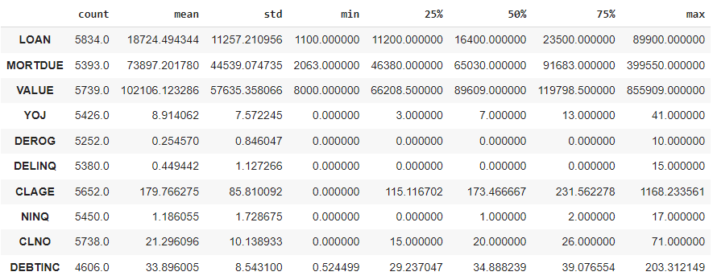
Summary Statistics
Attributes like DEROG and DELINQ, which represent derogatory reports and delinquent credit lines, respectively, have a majority of values at 0, indicating that most applicants have a clean credit history.
The DEBTINC attribute, representing the debt-to-income ratio, has values ranging from 0.52% to a very high 203.31%, indicating varied financial health among the applicants.
Some attributes have missing values, as indicated by the difference in counts, which will require missing value treatment.

Slide 38
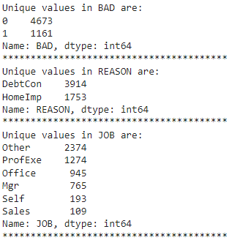
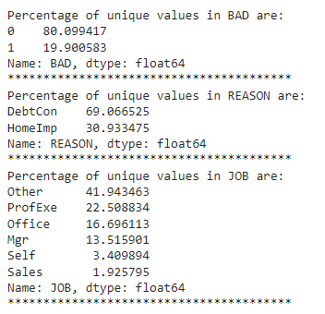
Count of Categorical Columns
A majority of the clients (4673 out of 5834) have repaid their loans, while 1161 have defaulted.
Most of the loans are taken for debt consolidation purposes.
The most common job type among loan applicants is "Other", followed by "Professional/Executive" and "Office.

Slide 39
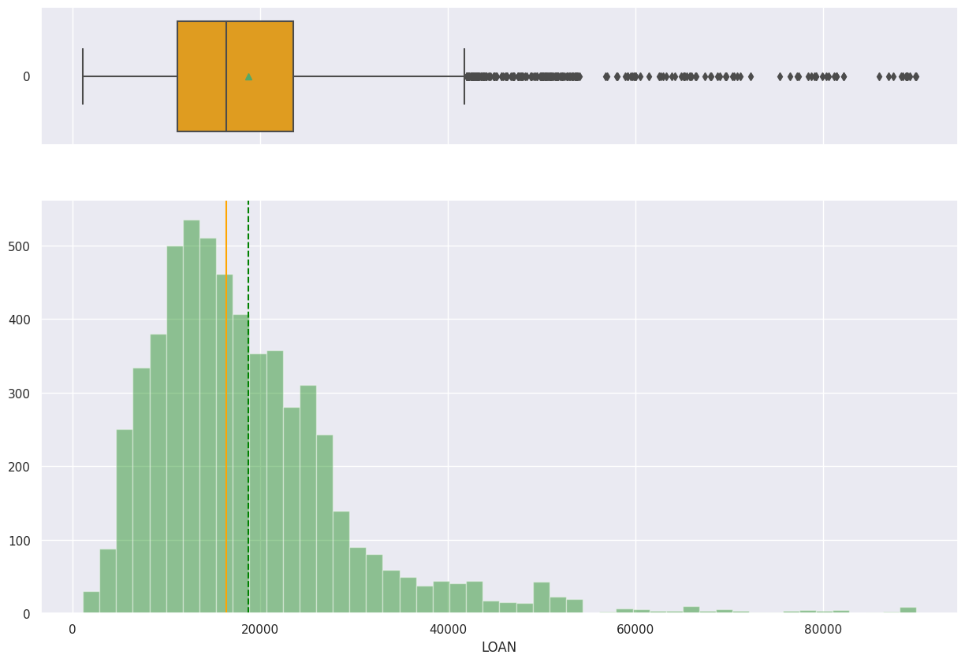
Exploratory Data Analysis:
Most of the loans are in the lower range, with a few loans in the higher range.
there are some outliers in the higher range of loan amounts.

Slide 40
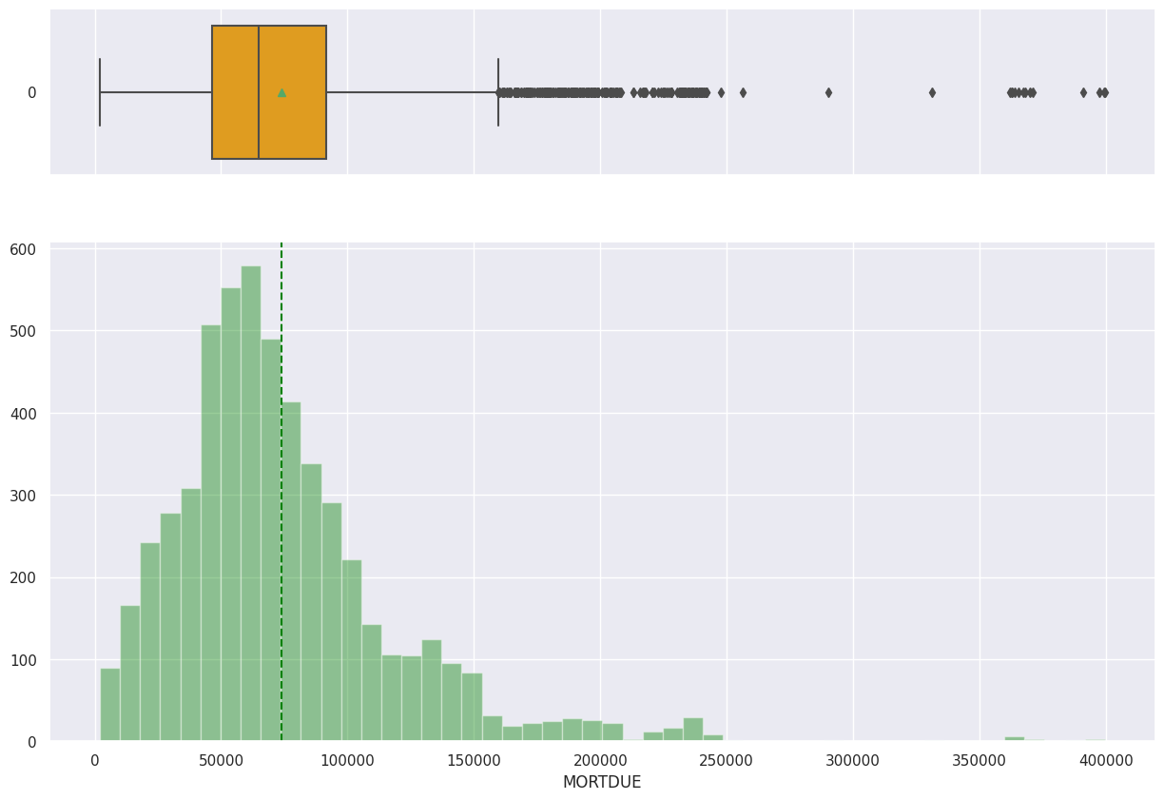
Exploratory Data Analysis:
The histogram shows the frequency distribution of the mortgage due amounts. Most of the mortgages due are in the lower range, with a few in the higher range.
there are some outliers in the higher range of mortgage due amounts.

Slide 41
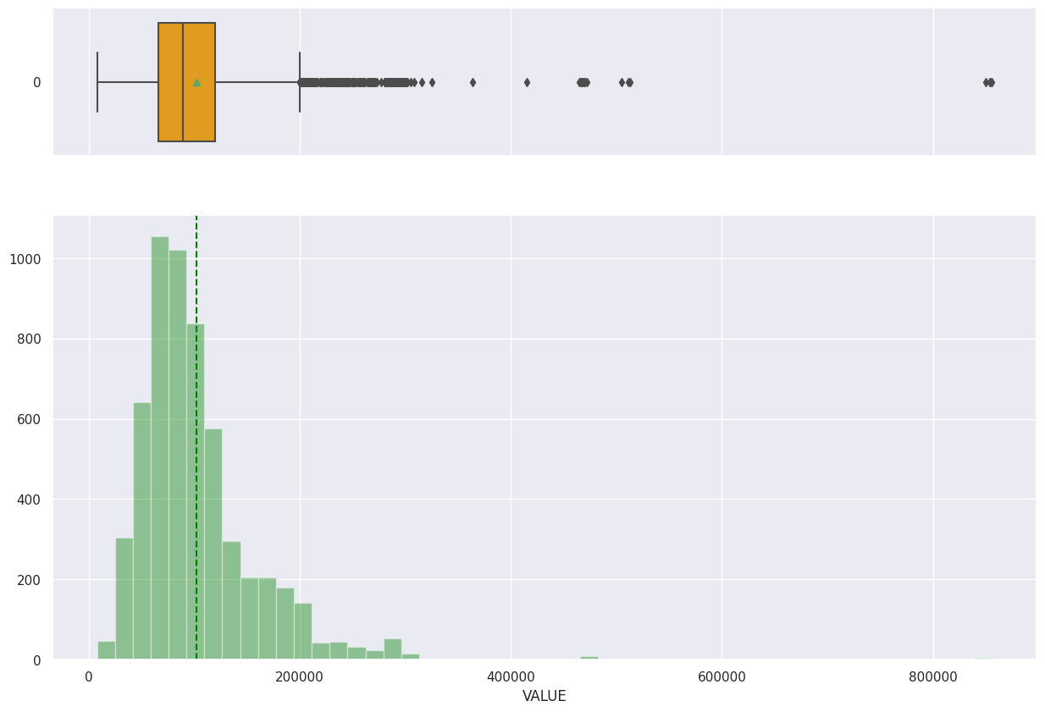
Exploratory Data Analysis:
The histogram shows the frequency distribution of the mortgage due amounts. Most of the mortgages due are in the lower range, with a few in the higher range.
there are some outliers in the higher range of mortgage due amounts.

Slide 42
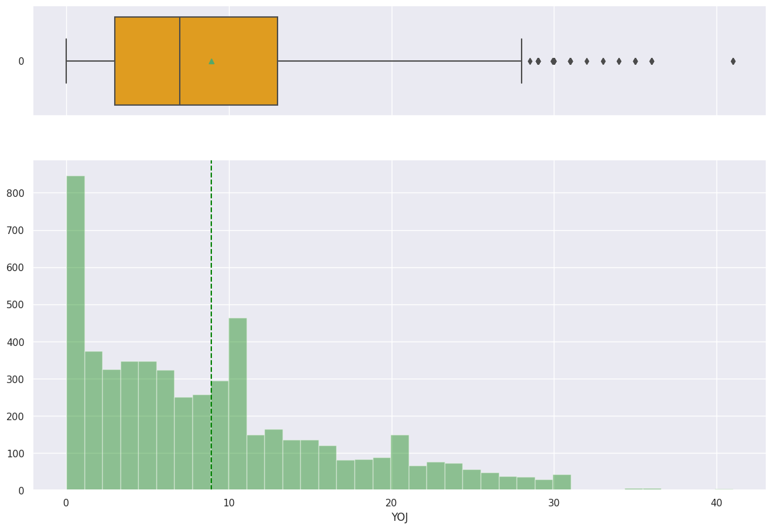
Exploratory Data Analysis:
The histogram shows the frequency distribution of the mortgage due amounts. Most of the mortgages due are in the lower range, with a few in the higher range.
there are some outliers in the higher range of mortgage due amounts.

Slide 43
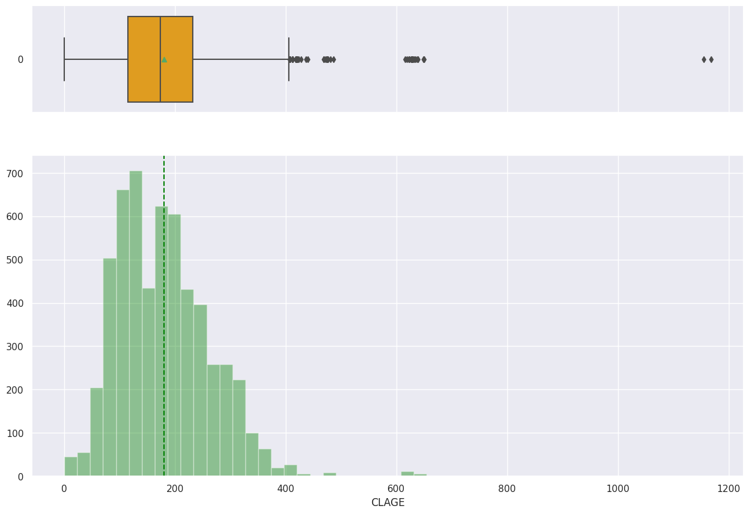
Exploratory Data Analysis:
The histogram shows the frequency distribution of the age of oldest credit line in months. Most of the values are in the lower range, indicating that most customers have newer credit lines.

Slide 44
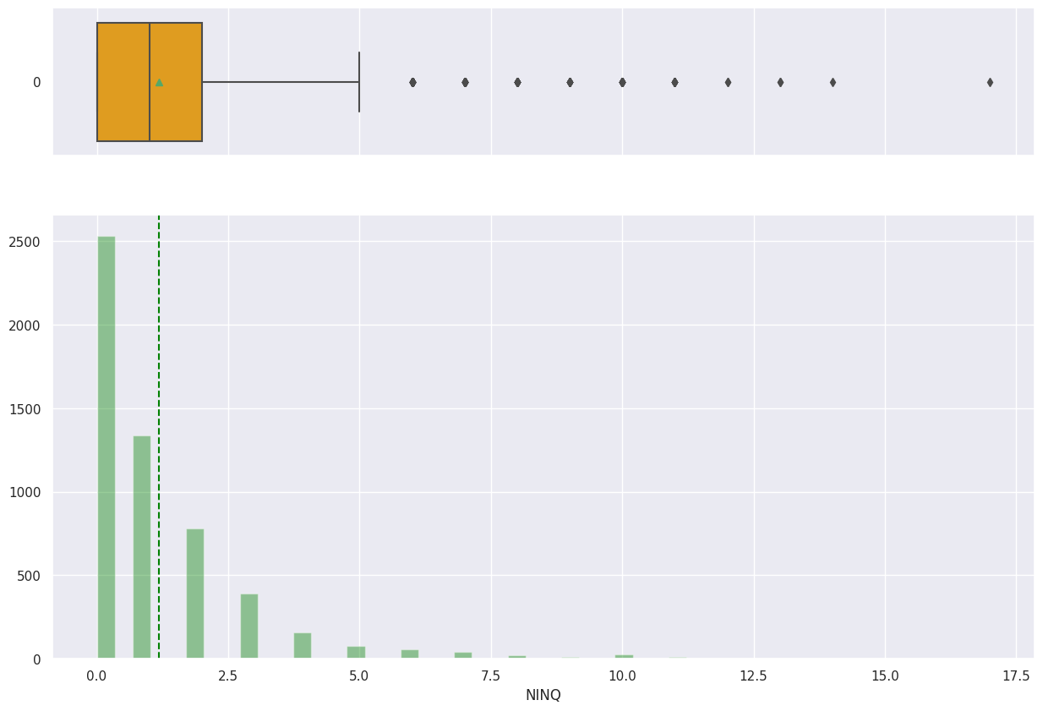
Exploratory Data Analysis:
The histogram shows the frequency distribution of the number of recent credit inquiries. Most of the values are in the lower range, indicating that most customers have few recent credit inquiries.

Slide 45
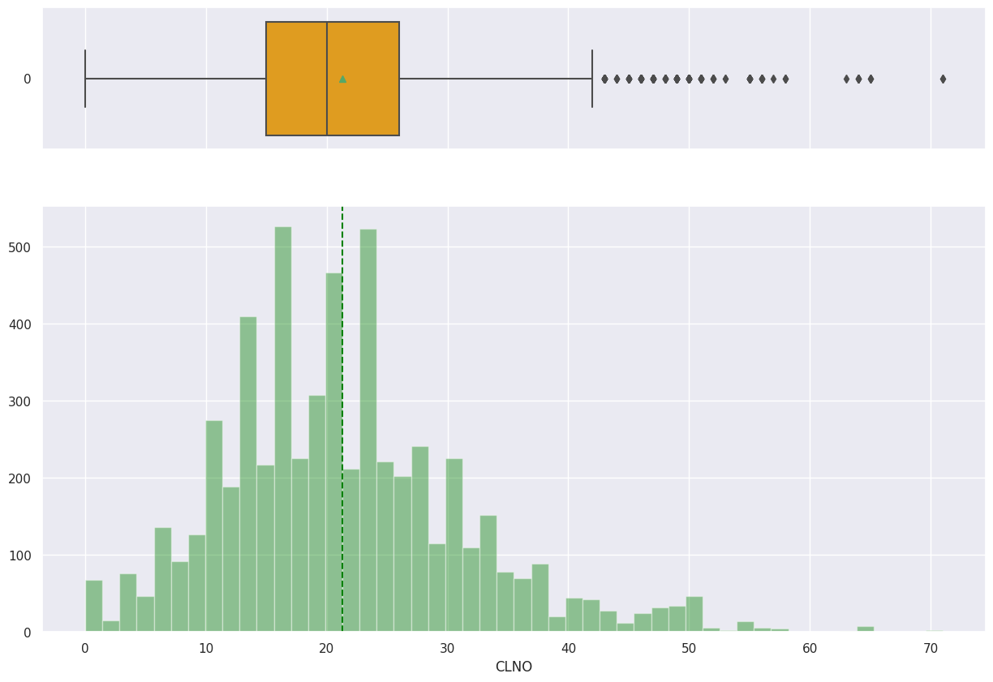
Exploratory Data Analysis:
The histogram shows the frequency distribution of the number of credit lines. The distribution appears to be somewhat normal, with most customers having a moderate number of credit lines.

Slide 46
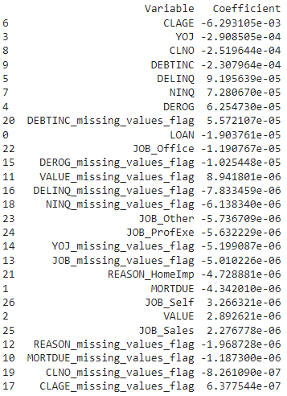
Log Regression
Accuracy :
Training Accuracy: 0.81
Test Accuracy: 0.78

Slide 47


Decision Tree
Accuracy :
Training Accuracy: 1.00
Test Accuracy: 0.86
Tuned Model Accuracy :
Training Accuracy: .93
Test Accuracy: 0.88

Slide 48
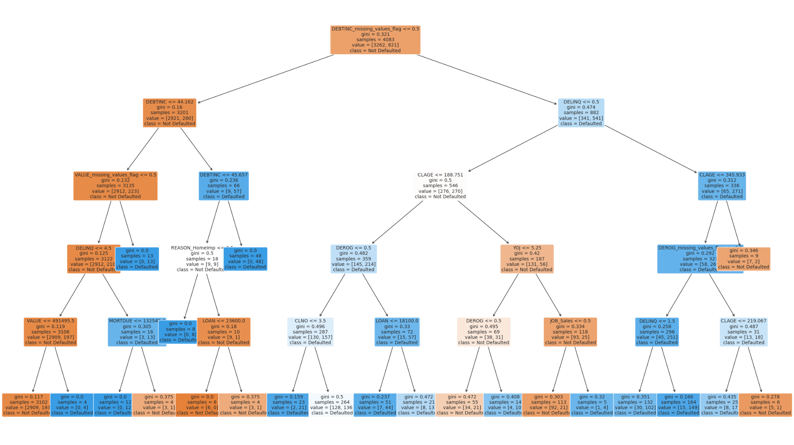
Decision Tree

Slide 49
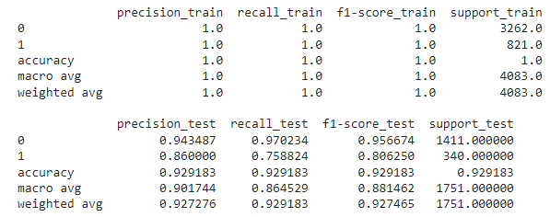

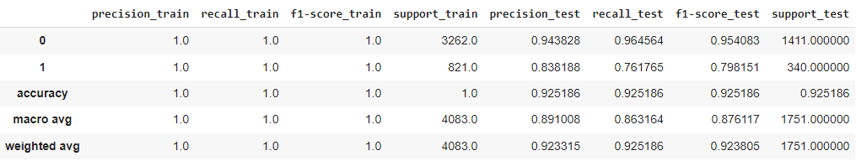
HyperParameter Tuning
Random Forest

Slide 50
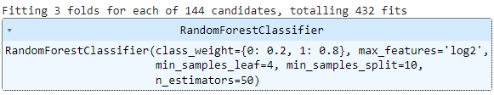
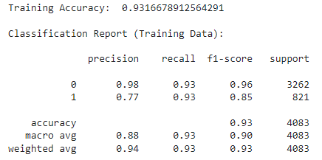
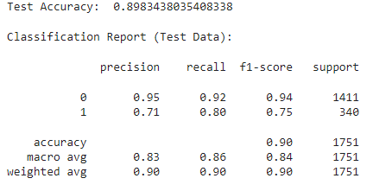
Random Forest - Grid Search

Slide 51
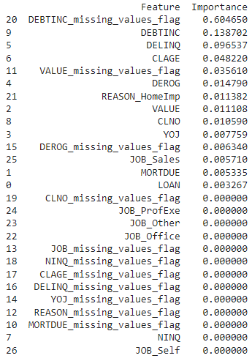
IMPORTANT FEATURES

