Slide 1
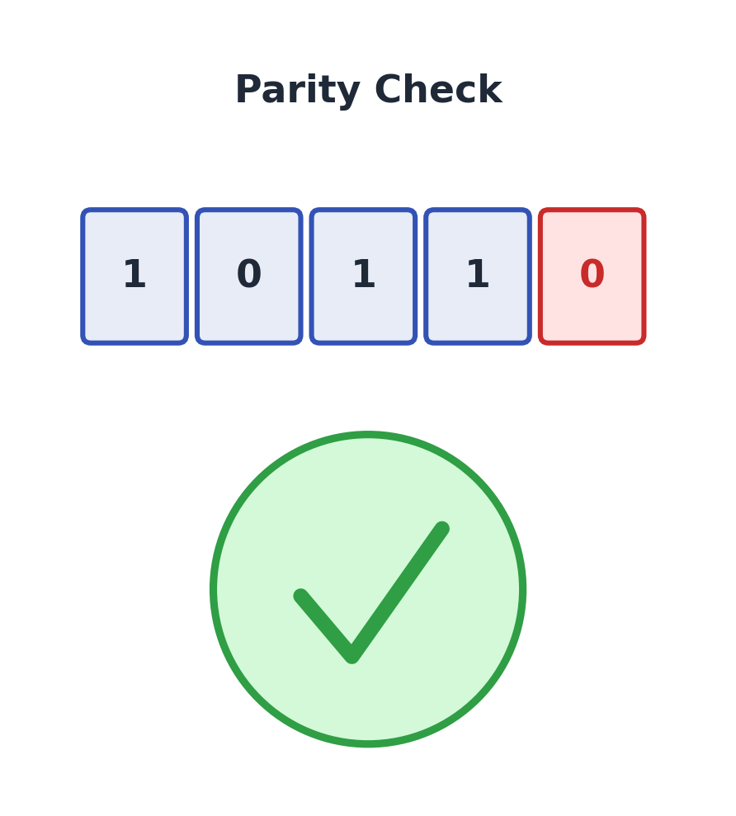
DDCA PROJECT PRESENTATION
Design and Simulation of a Digital Error Detection System Using Parity
Department of CSE · KLH University · Academic Year 2026–27
GUIDE
Kartheek V
M. Harshith Kumar
2620030453
Balasai Vaishnavi
2620030340
Pasham Thanay Kumar
2620030350
Bijjam Naga Harsha Vardhan Reddy
2620030433

Slide 2
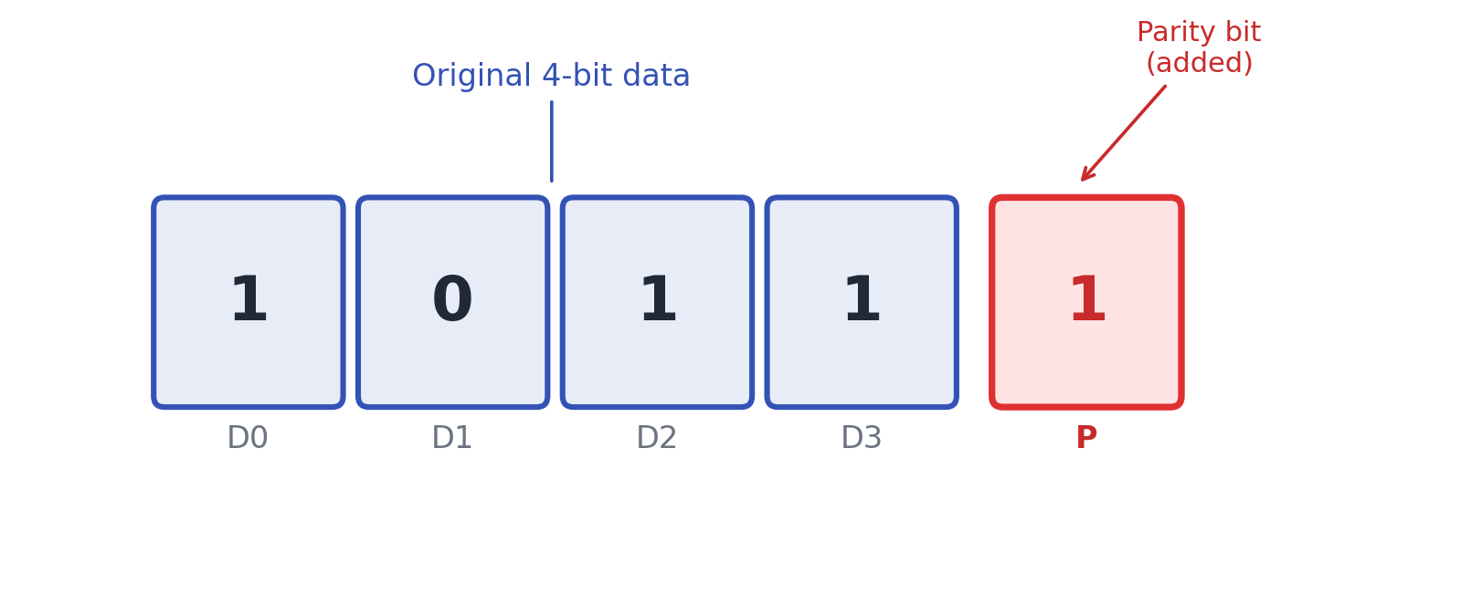
02 INTRODUCTION
BACKGROUND · DOMAIN · IMPORTANCE
Introduction
Background
Domain
Digital systems send data as 0s and 1s. Noise, interference, or hardware faults can flip bits and corrupt the message. Error detection is required for reliable transfer.
This work is in Digital Electronics and Communication. It uses logic circuits to generate and check a parity bit during binary transmission.
What is parity?
Importance
A parity bit is one extra bit added to the data. The receiver recomputes parity. If the result does not match, an error is flagged.
Parity is simple, low-cost, and used in computers and basic links. The project shows how XOR gates detect single-bit errors in practice.
DDCA PROJECT | PARITY ERROR DETECTION | KLH UNIVERSITY
02 / 10

Slide 3
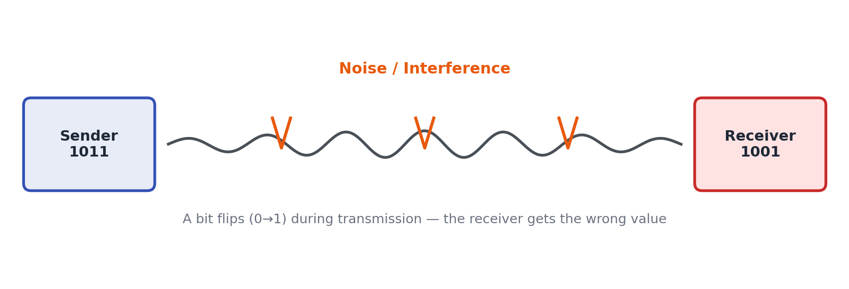
03 PROBLEM STATEMENT
PROBLEM · LIMITATIONS · NEED
Problem Statement
Problem
During digital transmission, noise or hardware faults can change bits. The receiver then gets wrong data. A simple method is needed to detect these errors and protect data integrity.
Limitations
Need for the project
Detects errors but cannot correct them
Detect errors in digital transfer
Cannot show the exact bit that failed
Keep a low-cost, simple method
Best for single-bit errors
Learn parity bits and XOR gates
Some multi-bit errors may pass
Simulate error and no-error cases
DDCA PROJECT | PARITY ERROR DETECTION | KLH UNIVERSITY
03 / 10

Slide 4
04 OBJECTIVES
PROJECT GOALS
Objectives
01
Design
02
Generate and check
Design a parity-based digital error detection system for binary data.
Generate and verify even and odd parity bits using logic gates.
03
Detect errors
04
Implement in logic
Detect single-bit errors that occur during digital transmission.
Build the system with XOR gates, switches, and LED indicators.
05
Simulate and test
06
Record results
Simulate the circuit in Logisim and verify error / no-error outputs.
Capture truth tables, test cases, and circuit screenshots for the report.
DDCA PROJECT | PARITY ERROR DETECTION | KLH UNIVERSITY
04 / 10

Slide 5
05 LITERATURE SURVEY
EXISTING METHODS AND GAPS
Literature Survey / Existing System
Previous methods
Existing solutions
Limitations
1. Parity bit method
1. Even parity checking
1. Cannot correct the error
2. Checksum method
2. Odd parity checking
2. Cannot show error position
3. Cyclic Redundancy Check (CRC)
3. Parity generator circuits
3. Weak for multi-bit errors
4. Hamming code (detect + correct)
4. Parity checker circuits
4. CRC is stronger but harder
DDCA PROJECT | PARITY ERROR DETECTION | KLH UNIVERSITY
05 / 10

Slide 6
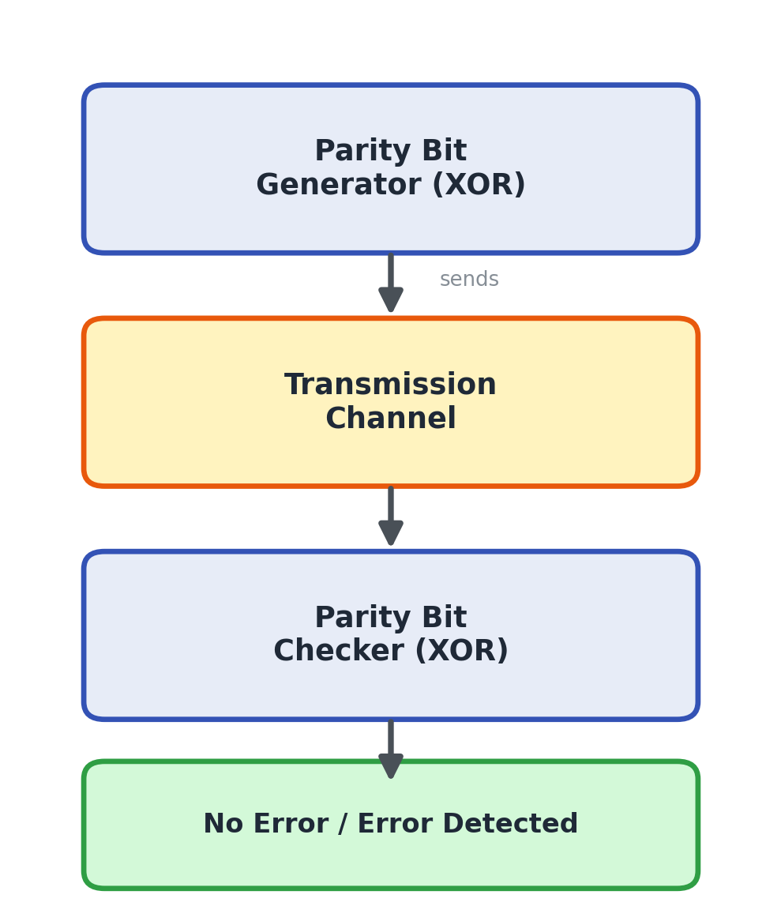
06 PROPOSED SYSTEM
SOLUTION · FEATURES · IMPROVEMENT
Proposed System
Proposed solution
A 4-bit parity generator and checker. XOR gates create even or odd parity at the sender. The receiver recomputes parity and shows No Error or Error Detected.
Even / odd parity
Both even and odd parity can be generated and checked.
XOR logic
Uses simple XOR gates, the standard parity building block.
Clear output
An LED or flag shows Error or No Error immediately.
Easy to simulate
The full path can be built and tested in Logisim.
DDCA PROJECT | PARITY ERROR DETECTION | KLH UNIVERSITY
06 / 10

Slide 7
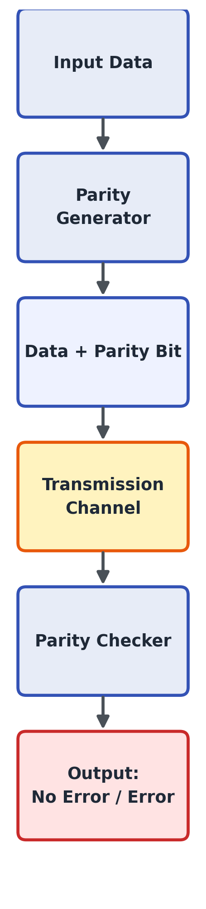
07 SYSTEM ARCHITECTURE
MODULES AND DATA FLOW
System Architecture / Block Diagram
1 Input Data
Accepts 4-bit binary data D3–D0.
2 Parity Generator
XOR network creates parity bit P.
3 Transmission Channel
Sends data + P. Noise may flip a bit.
4 Parity Checker
Recomputes parity on received bits.
5 Output
Shows No Error or Error Detected.
DDCA PROJECT | PARITY ERROR DETECTION | KLH UNIVERSITY
07 / 10

Slide 8
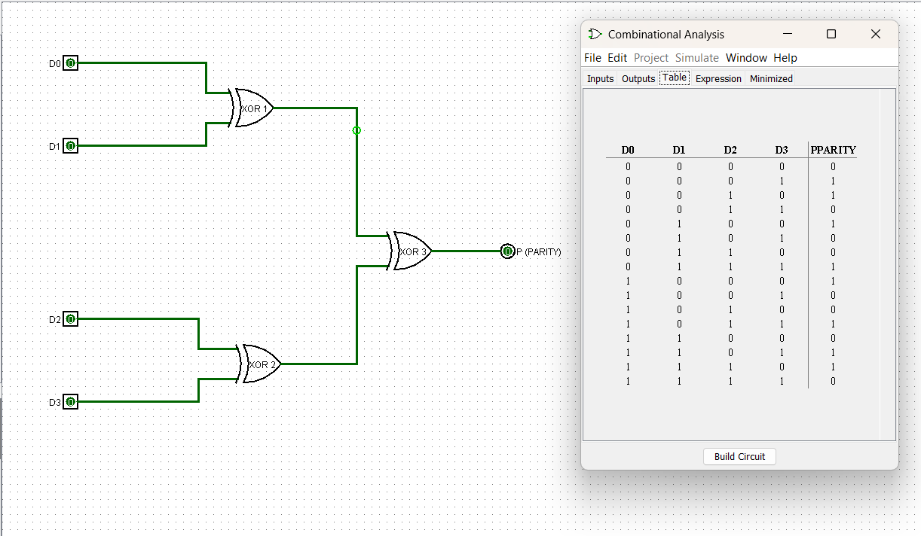
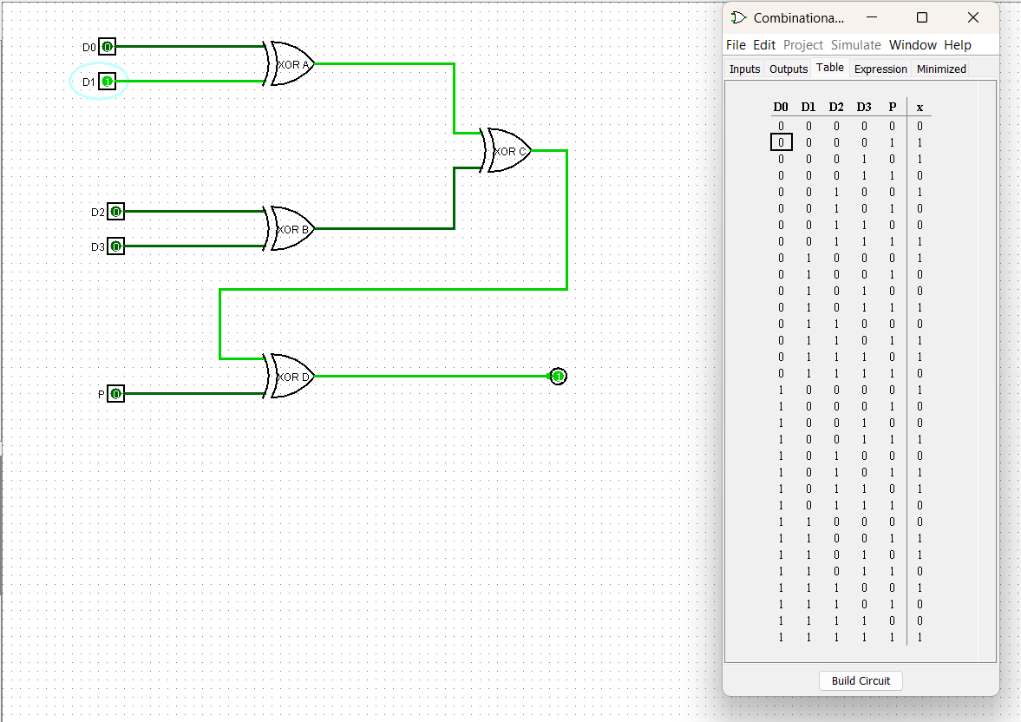
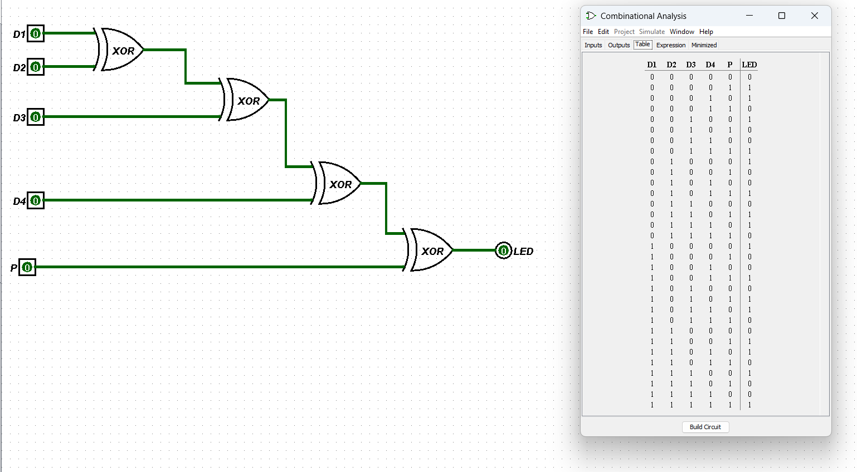
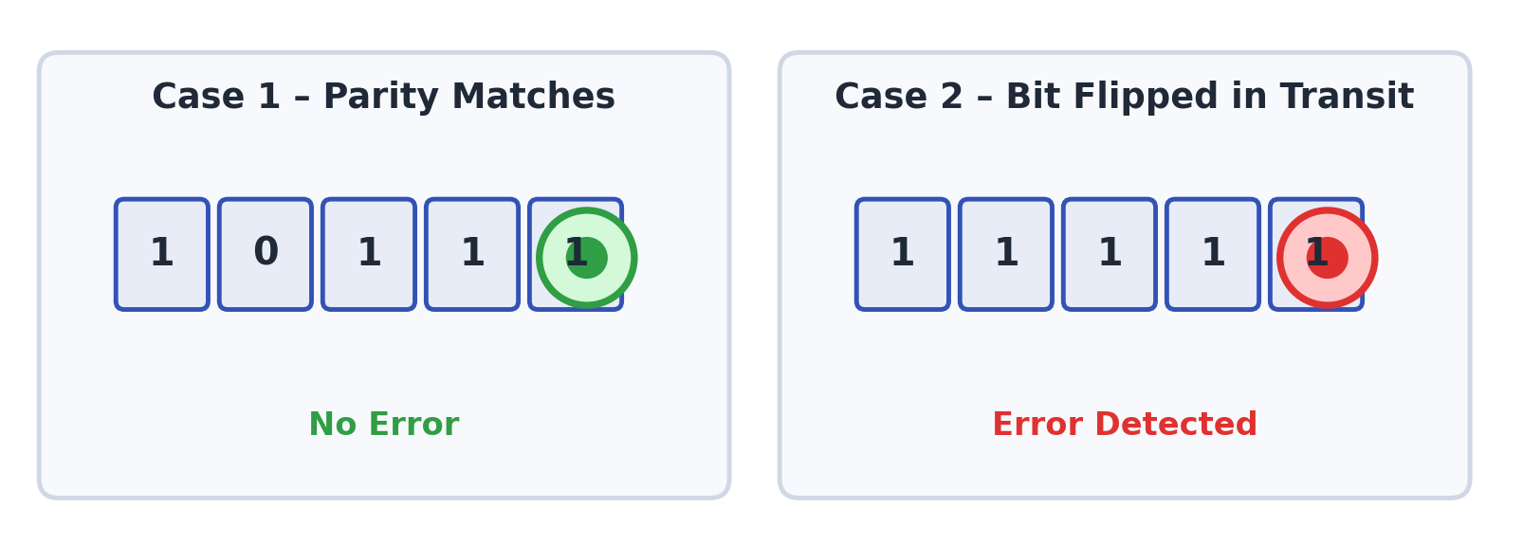
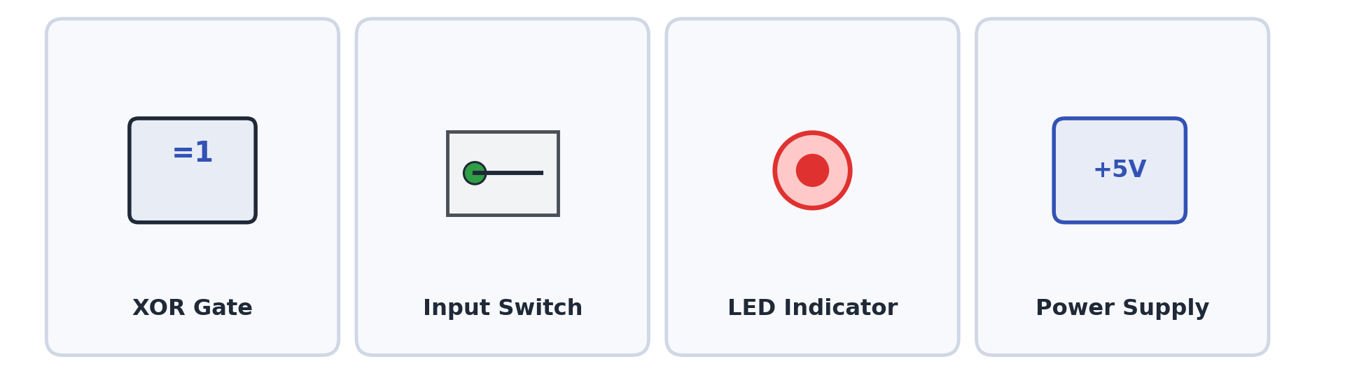
08 METHODOLOGY
DESIGN · COMPONENTS · WORKING
Methodology / Implementation
Design steps
Working principle
1. Take the 4-bit binary input.
The sender adds P so the chosen parity (even or odd) is true. The receiver computes parity again. Match → No Error. Mismatch → Error Detected.
2. Generate parity P using XOR gates.
3. Combine data bits with P.
4. Send the word through the channel.
5. Check received bits in the checker.
6. Display Error or No Error.
Parity Generator (Logisim)
Parity Checker (Logisim)
Parity Checker with LED
DDCA PROJECT | PARITY ERROR DETECTION | KLH UNIVERSITY
08 / 10

Slide 9
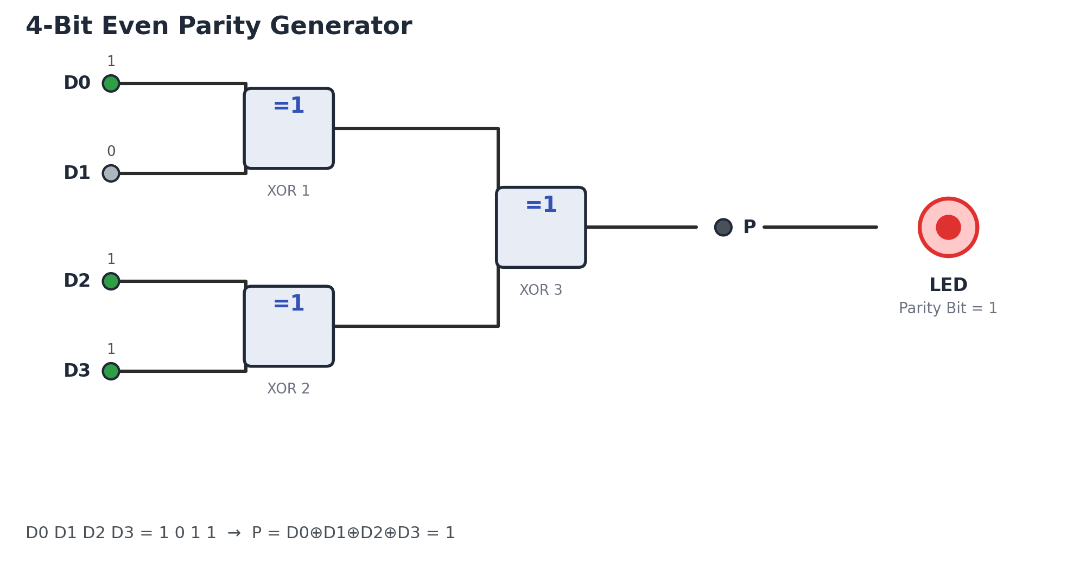
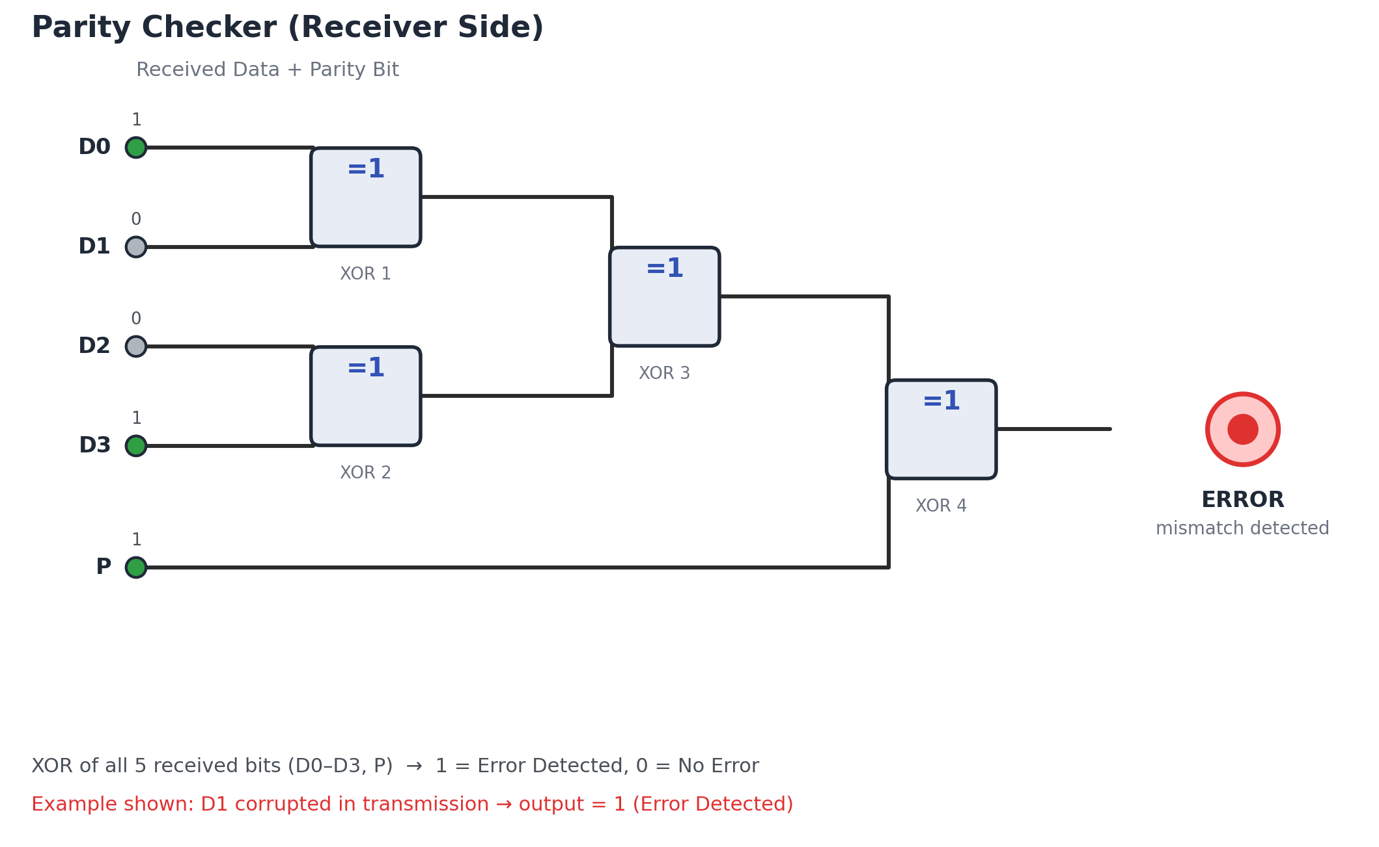
09 RESULTS AND DISCUSSION
CIRCUIT OUTPUTS AND TEST CASES
Results and Discussion
Sender — 4-bit Even Parity Generator
Receiver — Parity Checker (Error Detected)
What the simulation shows
Discussion
For data 1 0 1 1, even parity P = 1. If a bit flips on the way (example: D2), the checker XOR of all 5 received bits becomes 1 and the LED shows Error Detected.
Parity is reliable for one flipped bit. If two bits flip, even parity can look correct again, so the error may be missed. That is why stronger codes such as CRC are used in high-speed links.
DDCA PROJECT | PARITY ERROR DETECTION | KLH UNIVERSITY
09 / 10

Slide 10
10 CONCLUSION
ACHIEVEMENTS
Conclusion
Designed
Implemented
A 4-bit even/odd parity error-detection system was designed from generator to checker.
XOR-based generator and checker were built and can be simulated in Logisim.
Verified
Objectives met
Clean data gives No Error. A single flipped bit gives Error Detected.
The goals of design, generation, checking, implementation, and testing were fulfilled.
Limit understood
Next step
Parity cannot correct errors or always catch multi-bit faults.
The same idea can be extended to Hamming code for single-bit correction.
DDCA PROJECT | PARITY ERROR DETECTION | KLH UNIVERSITY
10 / 10

