Slide 1
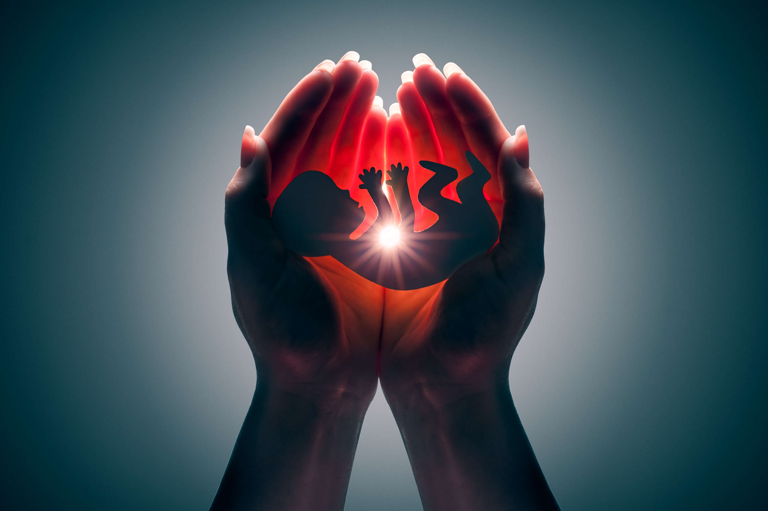
Embryology

Slide 2
Embryology
embryon + logia
Unborn
Study
The study of Unborn
Embryology is the branch of biology and medicine concerned with the study of embryos and their development.

Slide 3
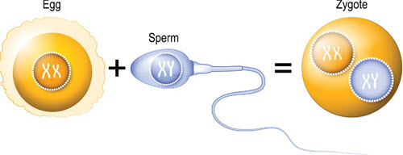
Fertilization and the zygote
Fertilization is the fusion of gametes to produce a new organism. In animals, the process involves a sperm fusing with an ovum, which eventually leads to the development of an embryo. The fertilized egg cell is known as the zygote.

Slide 4
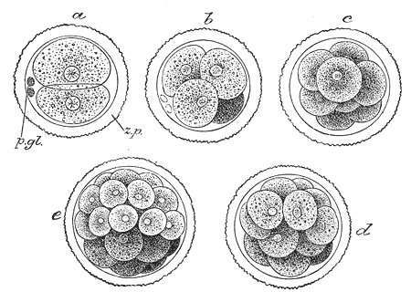
Cleavage
Cleavage is the division of cells in the early embryo. This process is marked when the zygote divides through mitosis
into two cells. This mitosis continues and the first two cells divide into four cells, then into eight cells and so on.

Slide 5
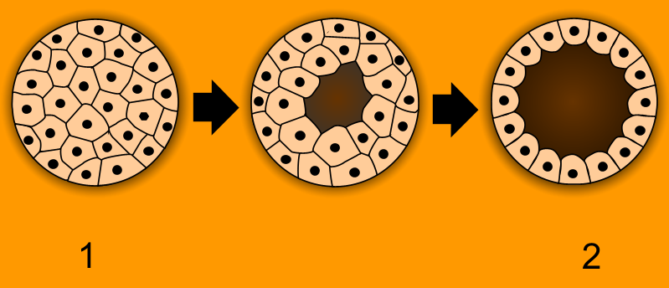
Morula and Blastula
When the cells number around sixteen the solid sphere of cells within the zona pellucida is referred to as a morula.
Blastula is a hollow ball of cells of in the early stages of development in an animal embryo. Blastula is formed from the morula in the process called blastulation

Slide 6
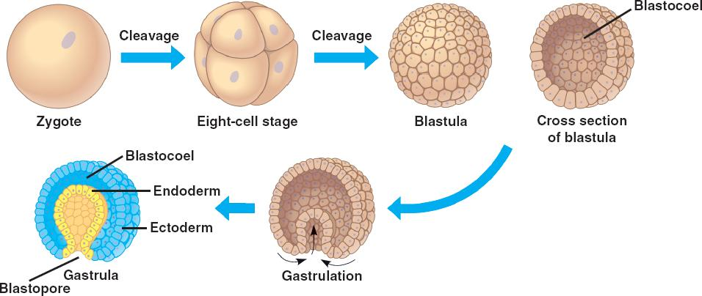
Gastrula
Gastrula is a stage of early embryo with two or three germ layers from which various organs are derived. Gastrula develops from the blastula in a process called gastrulation.
In triploblastic organisms the gastrula is three-layered. These three germ layers are known as the ectoderm, mesoderm, and endoderm.

