Slide 1
Welcome to my Cse-431 (Natural language processing) Paper Presentation
Group: 09
Presented By
Mehedi Hasan: 17301046
Elmi Tabassum: 18101222
Md. Morshedul Islam: 17101052
Shahed Mehrab Arnob: 17101134

Slide 2
Preparation of Bangla Speech Corpus from Publicly Available Audio & Text Author: Shafayat Ahmed, Nafis Sadeq, Sudipta Saha Shubha, Md. Nahidul Islam, Muhammad Abdullah Adnan, Mohammad Zuberul Islamz

Slide 3
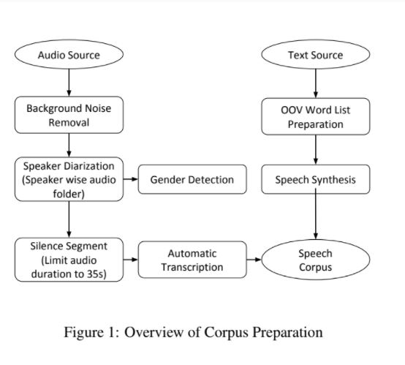
Intro of the system
In this paper, they focus on automatic preparation of a speech corpus for Bangladeshi Bangla. They have used publicly available Bangla audiobooks and TV news recordings as audio sources. They designed and implemented an iterative algorithm that takes as input a speech.
They have developed a 960 hours annotated speech corpus automatically from publicly available audio and text data.
They present an approach that requires minimal manual verification after the transcription process is completed.
Some related works are : Jang and Haupt-mann (Jang and Hauptmann, 1999) develop a speech corpus from captioned multimedia speech. Panayotov et al. (Panayotov et al., 2015) present 1000 hours of speech corpus for English by aligning texts and audio files of audiobooks.

Slide 4
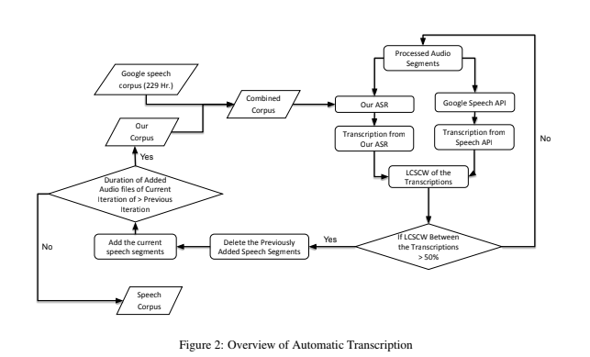
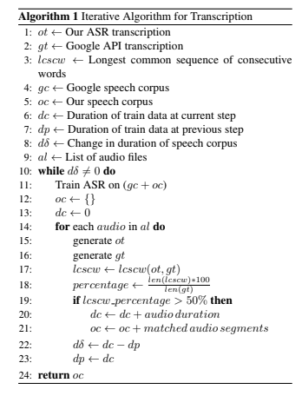
Corpus Preparation from Raw Audio
Background noise removal
Speaker diarization
Silence Segment
Automatic Transcription Generation
Out-of-Vocabulary Word List
TTS Model
Speech Synthesis

Slide 5
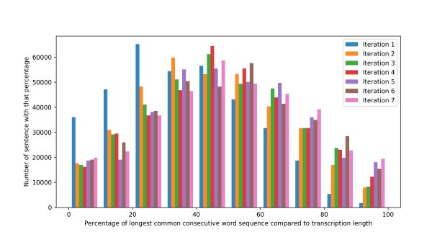
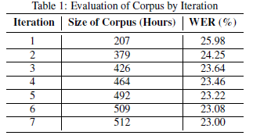
Evaluation of iterative Algorithm & Dataset
297065 transcribed audio files.
LCSCW between ASR and Google Speech API.
Hybrid CTC-Attention to evaluate performance.
Forced alignment technique

Slide 6
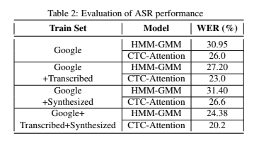
Evaluation of ASR PERFORMANCE & conclusion
13000 transcribed audio files used as second test dataset
HMM-GMM based system usage
Deep learning based end to end speech recognition
system
Increment of threshold percentage for future works

Slide 7
Thank You

