Slide 1

Madina Hasanzade PORTFOLIO project
for Algorithmics BootCamp 2022

Slide 2
01
02
HOME PAGE
SHOWCASE
03
04
ABOUT
PORTFOLIO
Here you can let me introduce myself
If you want to see my project showcae, let’s go!
A detailed explanation more..
Preview my projects and do shopping now!

Slide 3
01
HOMEPAGE – Welcome!
Explore button
Go shopping now
Social media paths
News about me
Footer for quick connection

Slide 4

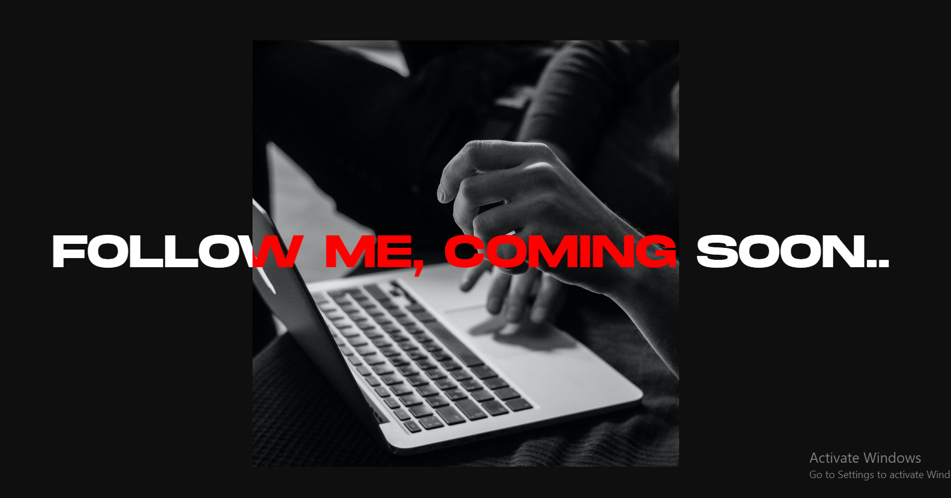
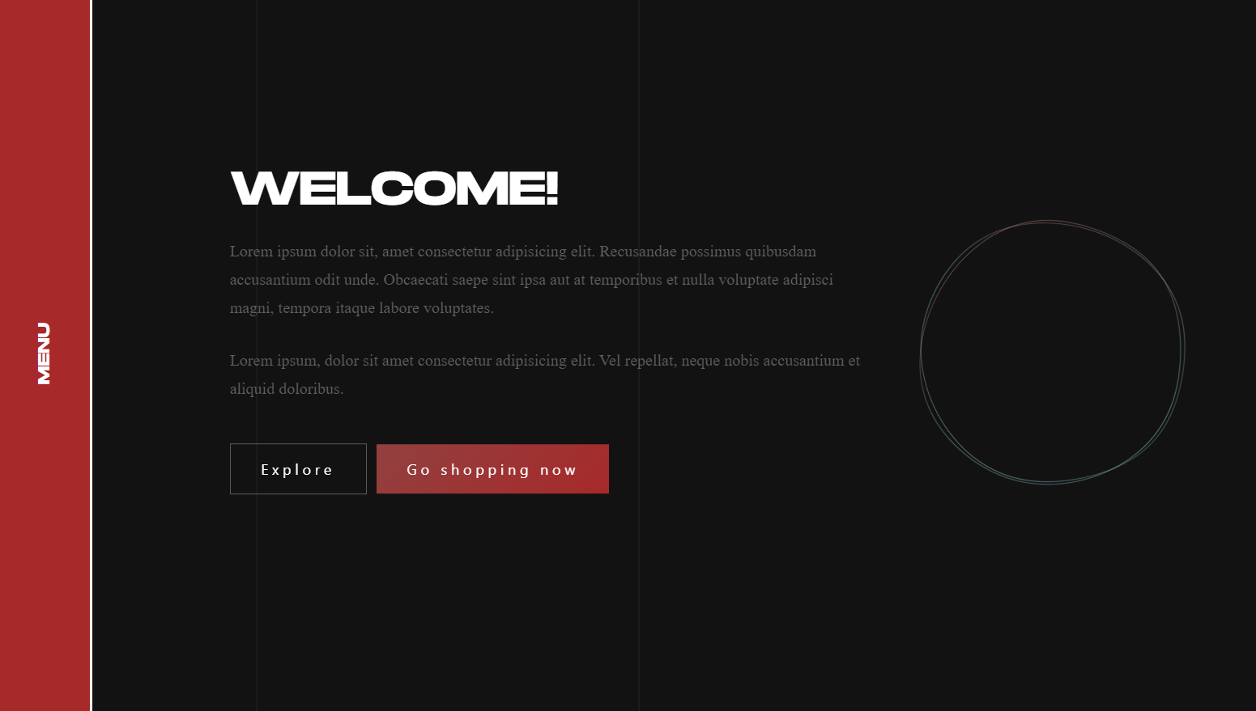
CONTENTS OF THIS PAGE

Slide 5
02
MY WORKS - SHOWCASE
Explore projects my dragging canvas

Slide 6
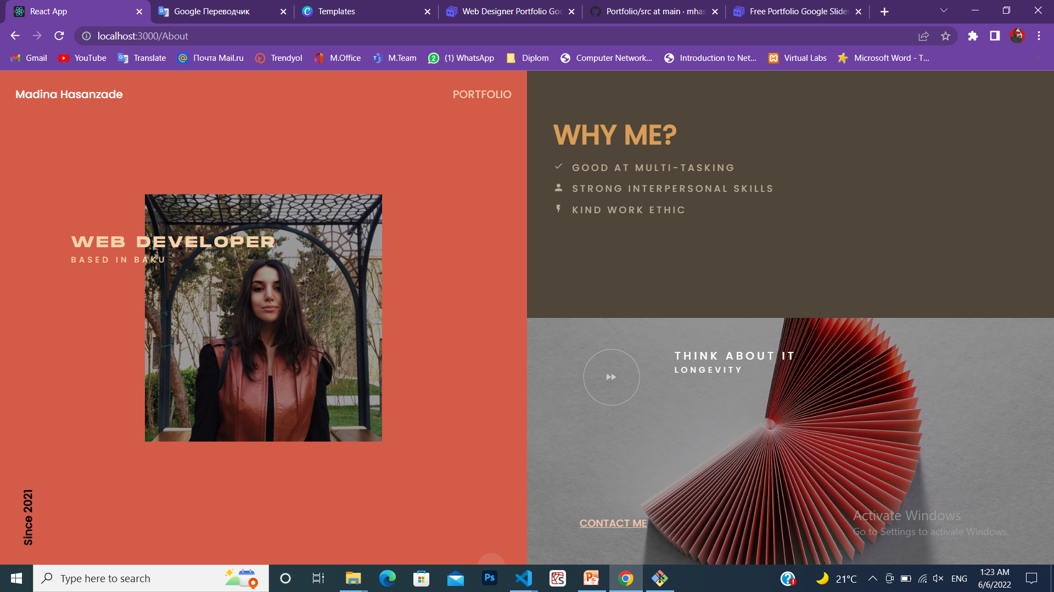
ABOUT!
03
General info and the reasons that why you should choose me for you next project!

Slide 7
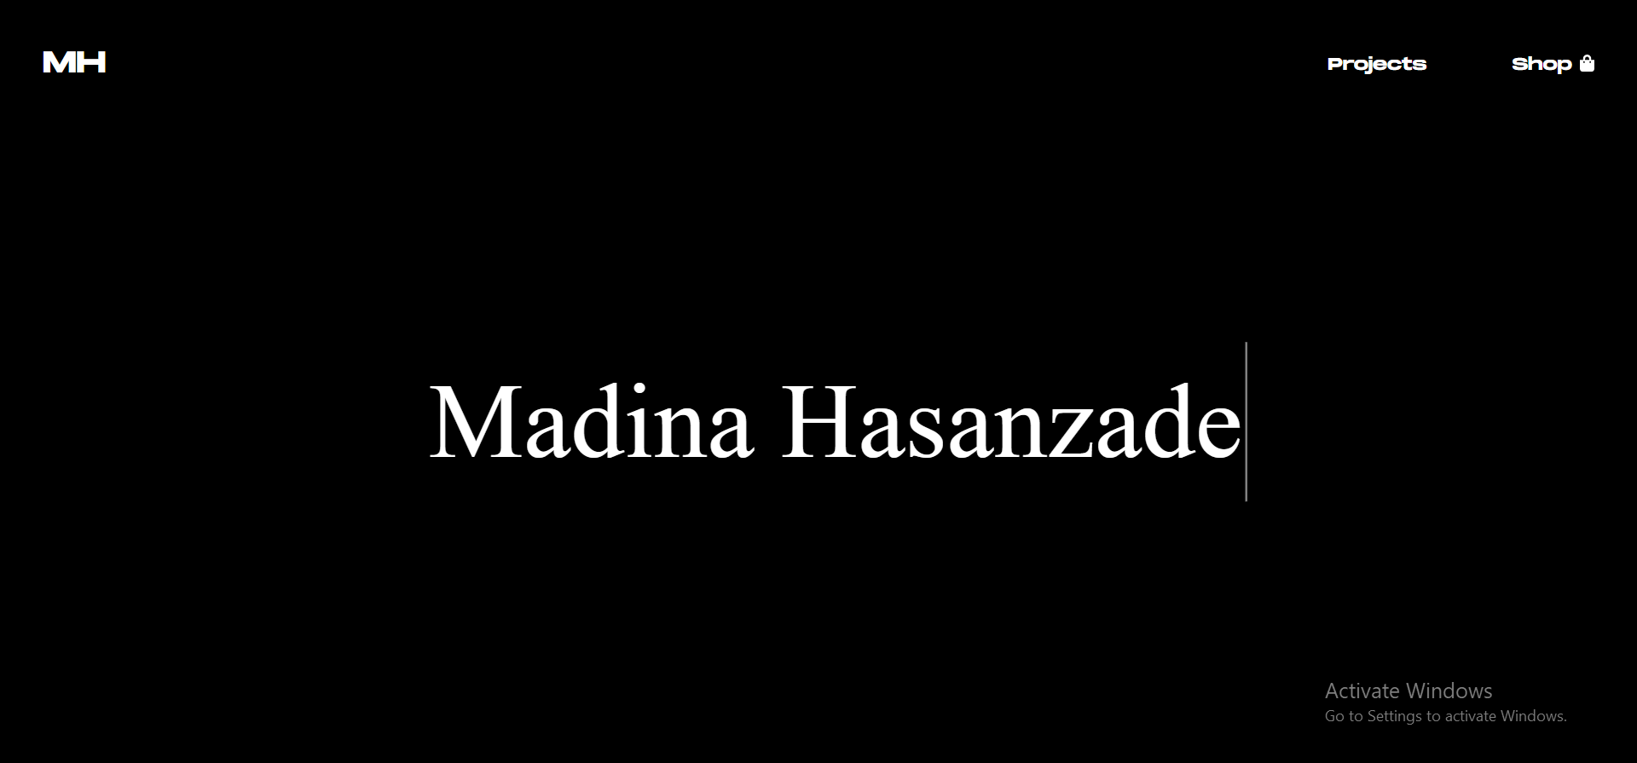
PROJECTS
04

Slide 8
THANKS
- Do you have any questions?

