Slide 1
SecurePay
Secure Digital Wallet System
Complex Computing Problem - Network Security & Information Assurance
Student: Muhammad Haseeb Sajid Roll No: F2024CY018 Class: Cyber Security
Submitted To: Sir M Azeem Afzal | NASTP Institute of Information Technology

Slide 2
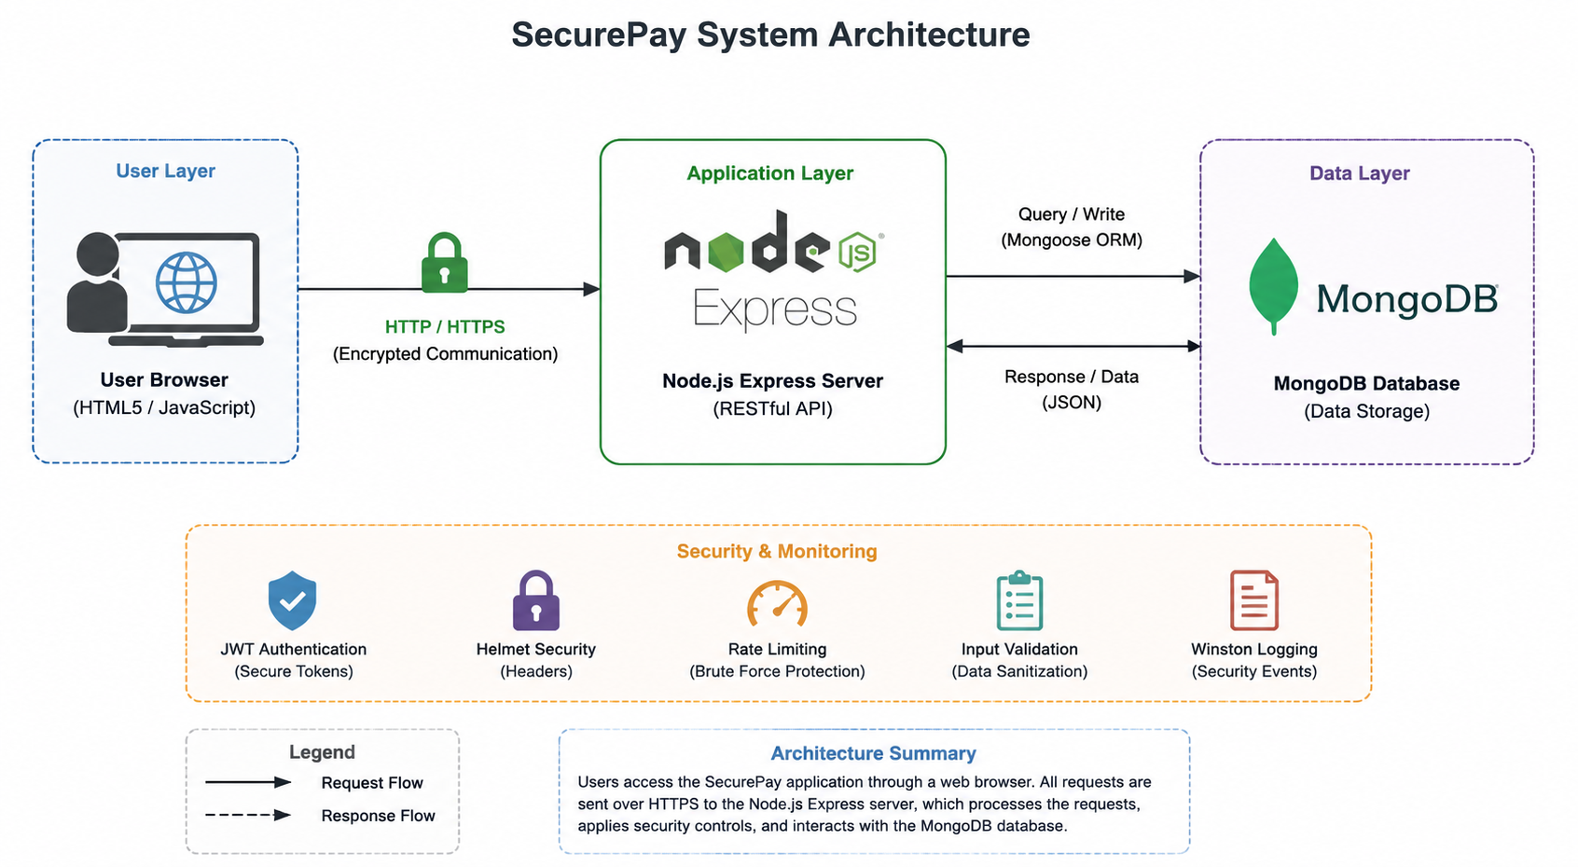
Network Security — Project Overview
SecurePay: What It Is & How It's Built
What is SecurePay?
System Architecture
A simulated digital wallet platform built to demonstrate real-world cybersecurity vulnerabilities and their fixes. Two Phases: Phase 1 — Vulnerable version with attack demos Phase 2 — Secure version with countermeasures Tech Stack: Frontend: HTML5 + Tailwind CSS
Backend: Node.js + Express.js
Database: MongoDB
Auth: JWT + bcrypt

Slide 3
Network Security — Threat & Risk Analysis
What can go wrong — and how bad is it?
Packet Sniffing
IDOR
CRITICAL
HIGH
Fix: HTTPS / TLS
Fix: Server-side auth
Brute Force Login
MongoDB Exposed
CRITICAL
HIGH
Fix: Rate limiting + lockout
Fix: Firewall + DB auth
MITM Attack
CRITICAL
Fix: HTTPS encryption
XSS Injection
HIGH
Fix: Input sanitization

Slide 4
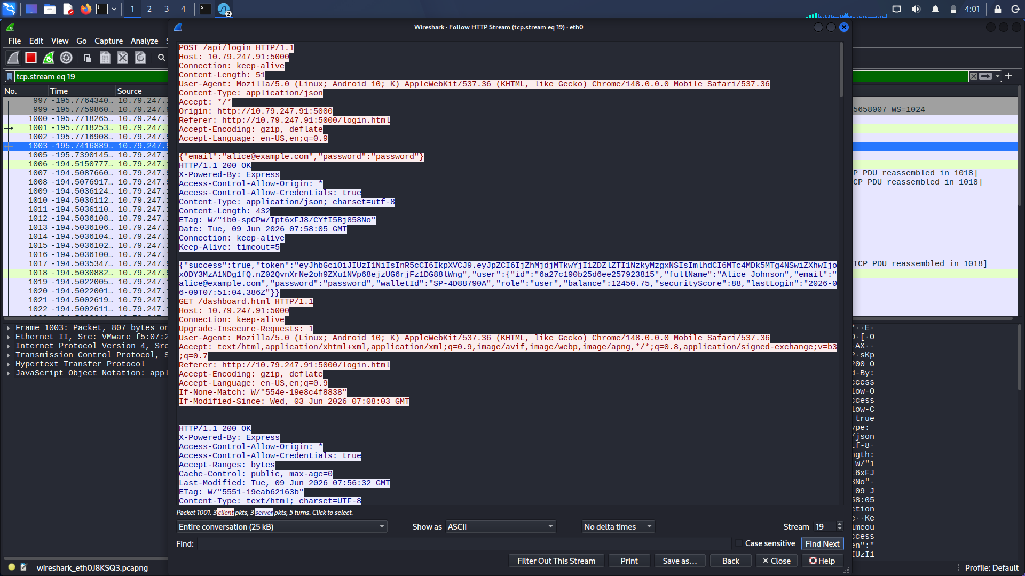
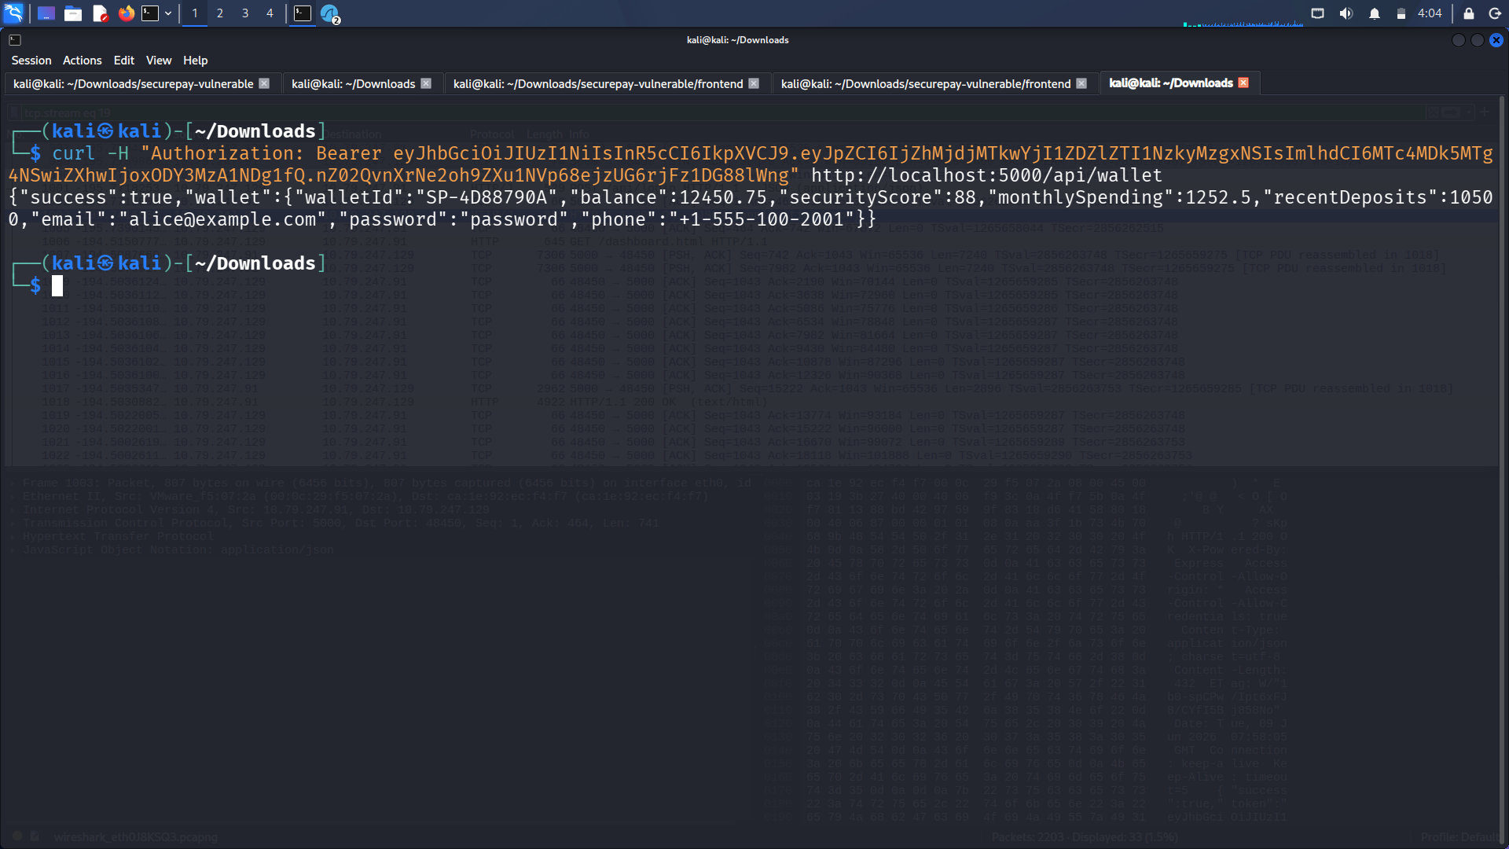
Network Security — Attack Demos (Part 1)
Attacks performed on the vulnerable version
01
Packet Sniffing
Tool: Wireshark
Captured plain-text credentials & JWT tokens over HTTP
02
Brute Force Login
Tool: Custom Python Script
Cracked password in under 5 seconds with a 15-word list
03
MITM Attack
Tool: Wireshark + curl
Stole JWT token mid-session and replayed it to hijack the account

Slide 5
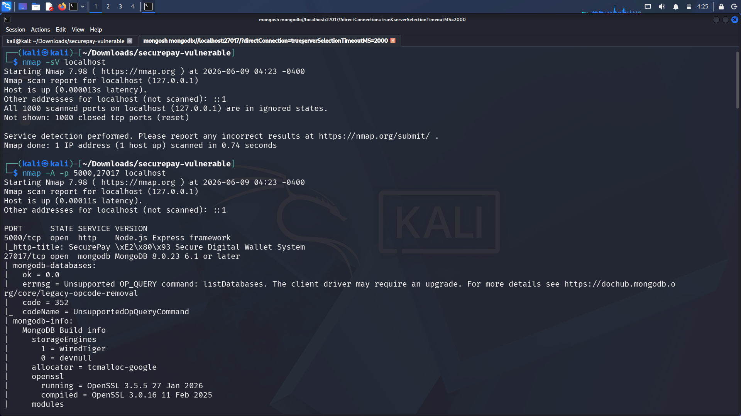
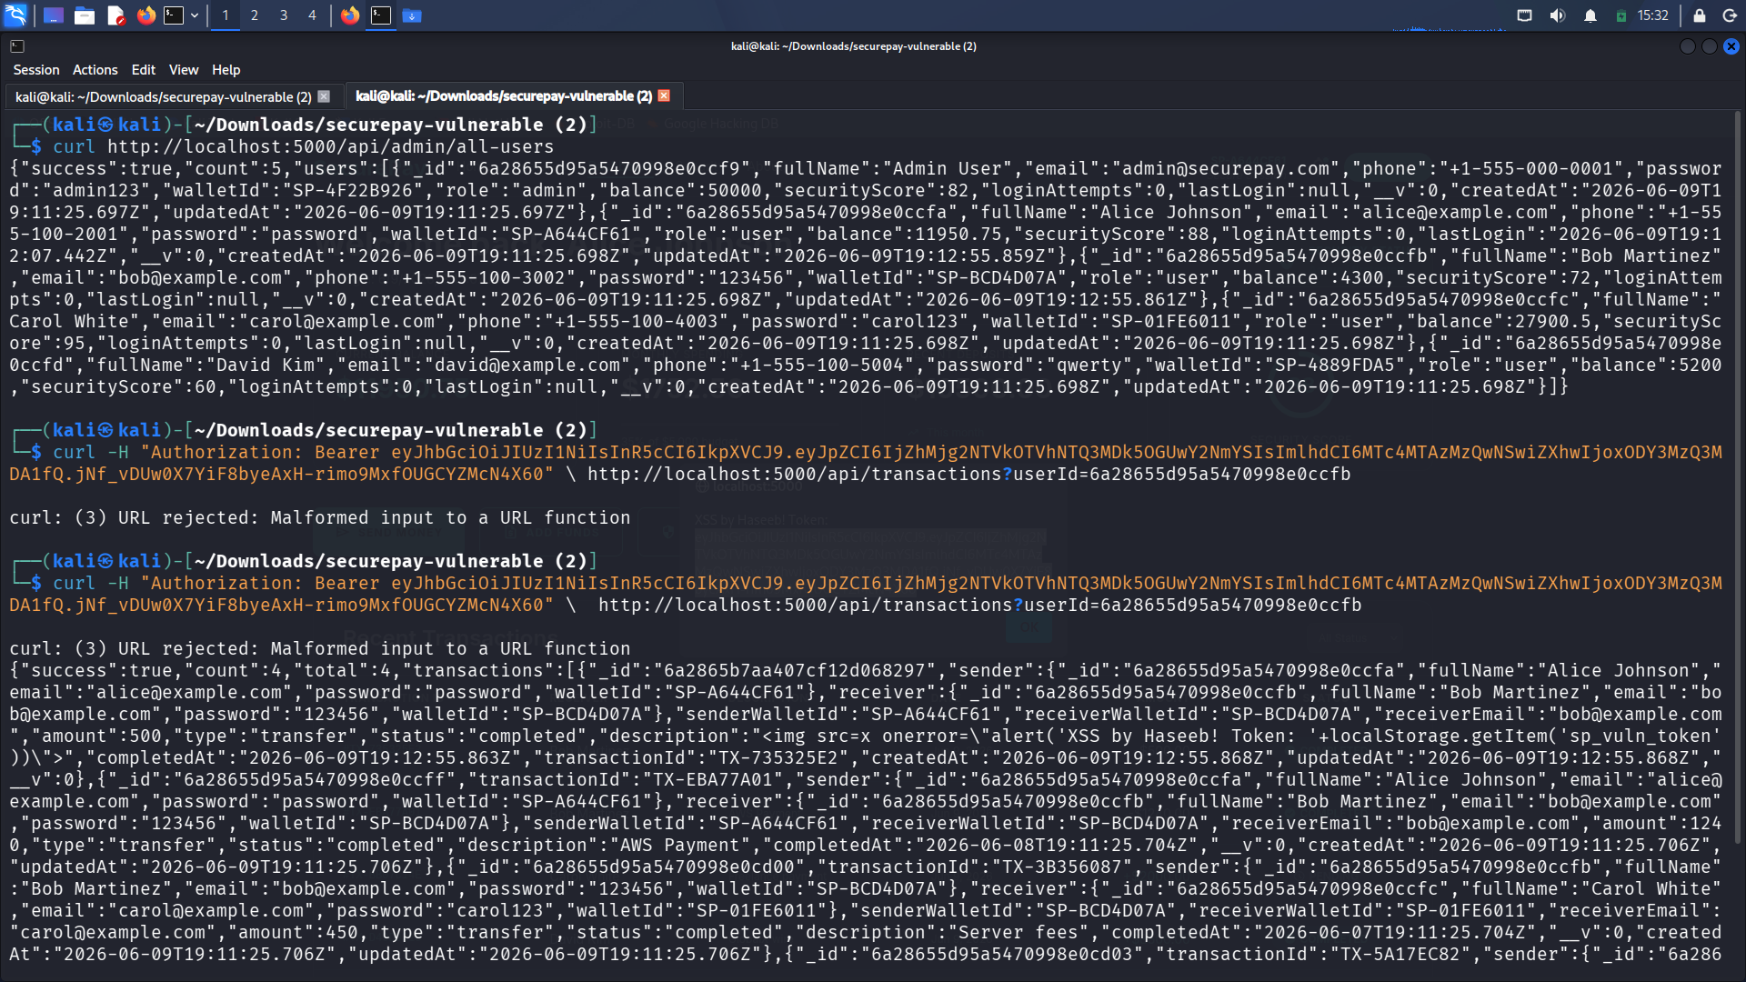
Network Security — Attack Demos (Part 2)
More vulnerabilities exposed
04
Nmap Port Scan
Tool: Nmap + mongosh
MongoDB port 27017 exposed — all user records retrieved without auth
05
XSS Injection
Tool: Browser + JavaScript
Stored XSS script fired for every user visiting the dashboard
06
IDOR Attack
Tool: curl + JWT
Accessed another user's full transaction history using only their userId

Slide 6
Network Security — Security Controls
Before & After: How each vulnerability was fixed
Vulnerability
Security Control Applied
Plain-text passwords
✓ bcrypt hashing (12 rounds)
Brute force login
✓ Rate limiting + 15-min lockout
XSS injection
✓ express-validator + Helmet CSP
IDOR data leak
✓ JWT req.user._id ownership check
HTTP sniffing
✓ HTTPS / TLS certificate enforced
MongoDB exposed
✓ Firewall rules + DB authentication

Slide 7
Network Security — Results & Takeaways
What we learned from building and breaking SecurePay
6
<5s
100%
Vulnerabilities Found & Fixed
Brute Force Crack Time (Vulnerable)
Traffic Encrypted After Fix
Key Takeaways
1. A visually professional app can hide critical vulnerabilities — security is invisible until broken.
2. HTTPS/TLS is the single most impactful control — it neutralizes sniffing, MITM, and token theft at once.
3. Rate limiting stops brute force in seconds; without it, any password is crackable.
4. Server-side validation is mandatory — never trust the client for access control (IDOR lesson).

Slide 8
Information Assurance — CIA Triad
How SecurePay protects Confidentiality, Integrity & Availability
Confidentiality
Integrity
Availability
→ bcrypt hashing (12 rounds)
→ Server-side amount validation
→ Rate limiting (100 req/15 min)
→ HTTPS/TLS encryption
→ Input sanitization + CSP headers
→ 10MB payload cap
→ JWT authentication on all routes
→ HTTPS prevents in-transit changes
→ Paginated DB queries
→ httpOnly cookies — no JS token access
→ Role-based access control (RBAC)
→ 10 transfers/min max per IP

Slide 9
Information Assurance — ISO 27001 & Risk Management
Standards mapping and risk register
ISO 27001:2022 Controls Mapped
Risk Register — Top Risks
5.14
Info Transfer
HTTPS/TLS for all traffic
Credential Theft
Score: 25
CRITICAL
5.17
Authentication Info
bcrypt + account lockout
Brute Force
Score: 20
CRITICAL
8.5
Secure Auth
JWT httpOnly cookies
MITM Attack
Score: 20
CRITICAL
8.7
Anti-Malware
Input sanitization + CSP
XSS Injection
Score: 16
HIGH
8.15
Logging
Winston 3-file audit trail
DB Exposure
Score: 15
HIGH
8.24
Cryptography
bcrypt + TLS + 256-bit JWT
IDOR
Score: 12
HIGH

Slide 10
Information Assurance - Conclusion
All layers working together to protect SecurePay
Network Encryption
Input Validation
L1
L5
HTTPS / TLS | Sniffing, MITM
express-validator | XSS, injection attacks
Rate Limiting
Security Headers
L2
L6
express-rate-limit | Brute force, DoS
Helmet.js | Clickjacking, MIME sniffing
Authentication
Logging & Monitoring
L3
L7
JWT + bcrypt | Unauthorized access
Winston logger | Attack detection, audit trail
Authorization
All Requirements: ACHIEVED ✓
L4
RBAC + JWT ownership | IDOR, privilege escalation
CIA triad, ISO 27001 controls, risk register, defense-in-depth — all implemented.

