Slide 1

Thin-Client Computers for the Food Processing Sector
5-Year Projections, Breakeven Analysis, and Investment Proposal

Slide 2
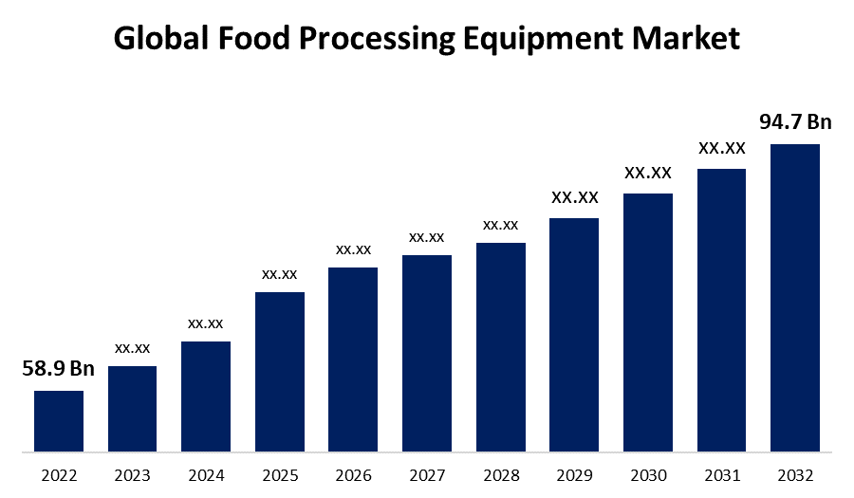
Business Overview
Product: Thin-client computers optimized for internet transaction processing.
Market Focus: Food processing sector.
Growth Opportunity: Leveraging rapid internet adoption trends.

Slide 3


5 year financial projection
Revenue demonstrates a consistent upward trend over five years, highlighting strong market demand and significant growth potential.
Manufacturing costs rise steadily, but remain proportionally lower than revenue, indicating effective cost control and healthy profit margins.
The company's transition into profitability by Year 2, marked by the PBT curve crossing above zero, highlights strong sales growth and effective cost management.
Key metrics:
Revenue expected to grow from $468K (Year 1) to $4.3M (Year 5).
Profitability achieved in Year 2, with PBT of $91K.
NPV (15% discount rate): Positive.

Slide 4

Breakeven Analysis
Units sold grew exponentially from 2,600 in Year 1 to 41,600 in Year 5, highlighting strong demand and scalability.
Slower growth in breakeven units compared to sales demonstrates improved operational efficiency.
Breakeven units consistently stay below throughout the 5 years projection than the units sold, reflecting increasing profitability.

Slide 5

Why invest?
Data fields | Year 1 | Year 2 | Year 3 | Year 4 | Year 5
Unit Sales | 2600 | 5200 | 10400 | 20800 | 41600
Price per unit | $180 | $156.60 | $136.24 | $118.53 | $103.12
Revenue | $468,000 | $814,320 | $1,416,917 | $2,465,435 | $4,289,857
Manufacturing cost per unit | $100 | $84 | $71 | $59 | $50
Manufacturing cost per unit (Lease) | $75 | $63 | $53 | $44 | $37
Total manufacturing cost | $360,000 | $527,600 | $750,368 | $1,124,618 | $1,753,359
Lease taken | NO | YES | YES | YES | YES
Marketing Expense | $112,320 | $195,437 | $340,060 | $591,704 | $1,029,566
Profit before Tax | ($4,320) | $91,283 | $326,489 | $749,113 | $1,506,933
Net present value | $1,457,457.86
Contribution Margin | 36.80 | 56.02 | 50.62 | 45.63 | 41.03
Breakeven point (units) A | 2717.4 | 3570.4 | 3950.7 | 4383.0 | 4874.2
Profitability from Year 2: Business's ability to move from negative PBT in Year 1 to positive PBT in Year 2 makes it a favorable investment.
Scalability: The projections suggest that the business can grow rapidly while maintaining profitability. By Year 5, revenue is expected to exceed $4 million, with a profit before tax approaching $1.5 million.
Growth: With steady revenue growth and efficient cost management, the company is poised for long-term profitability and scalability.

Slide 6
Complete Statement
Data |  |  | Data fields | Year 1 | Year 2 | Year 3 | Year 4 | Year 5
Unit sales (1st year) | 2600 |  | Unit Sales | 2600 | 5200 | 10400 | 20800 | 41600
Unit manufacturing cost | $100 |  | Price per unit | $180 | $156.60 | $136.24 | $118.53 | $103.12
Price Per Unit (1st year) | $180 |  | Revenue | $468,000 | $814,320 | $1,416,917 | $2,465,435 | $4,289,857
Yearly sales growth | 100% |  | Manufacturing cost per unit | $100 | $84 | $71 | $59 | $50
Yearly price decline | 13% |  | Manufacturing cost per unit (Lease) | $75 | $63 | $53 | $44 | $37
Annual manufacturing cost deduction | 16% |  | Total manufacturing cost | $360,000 | $527,600 | $750,368 | $1,124,618 | $1,753,359
Marketing Expenses (revenue percent) | 24% |  | Lease taken | NO | YES | YES | YES | YES
Fixed cost (Annual) | $100,000 |  | Marketing Expense | $112,320 | $195,437 | $340,060 | $591,704 | $1,029,566
Discount rate | 15% |  | Profit before Tax | ($4,320) | $91,283 | $326,489 | $749,113 | $1,506,933
Manufacturing cost deduction after lease 1ST YEAR | 25% |  | Net present value | $1,457,457.86
Fixed cost (Annual lease) | $200,000 |  | Contribution Margin | 36.80 | 56.02 | 50.62 | 45.63 | 41.03
 |  |  | Breakeven point (units) A | 2717.4 | 3570.4 | 3950.7 | 4383.0 | 4874.2
 |  |  | Unit sales | PBT 1st year | PBT 2nd year
 |  |  |  | ($4,320) | $91,283
 |  |  | 1000 | -63200 | -29968
 |  |  | 1050 | -61360 | -26466.4
 |  |  | 1100 | -59520 | -22964.8
 |  |  | 1150 | -57680 | -19463.2
 |  |  | 1200 | -55840 | -15961.6
 |  |  | 1250 | -54000 | -12460
 |  |  | 1300 | -52160 | -8958.4
 |  |  | 1350 | -50320 | -5456.8
 |  |  | 1400 | -48480 | -1955.2
Break Even point for 2nd year (units) B |  |  | 1450 | -46640 | 1546.4
 |  |  | 1500 | -44800 | 5048
 |  |  | 1550 | -42960 | 8549.6
 |  |  | 1600 | -41120 | 12051.2
 |  |  | 1650 | -39280 | 15552.8
 |  |  | 1700 | -37440 | 19054.4

Slide 7
Additional formatted data
Years | Revenue | Total Manufacturing Cost | Profit before tax
Year 1 | $2,600 | $360,000 | ($4,320)
Year 2 | $814,320 | $527,600 | $91,283
Year 3 | $1,416,917 | $750,368 | $326,489
Year 4 | $2,465,435 | $59 | $749,113
Year 5 | $4,289,857 | $1,753,359 | $1,506,933
Years | Units sold | Breakeven units
1 | 2600 | 2717.391304
2 | 5200 | 3570.408455
3 | 10400 | 3950.701566
4 | 20800 | 4383.041885
5 | 41600 | 4874.239616
Years | Revenue
1 | $468,000
2 | $814,320
3 | $1,416,917
4 | $2,465,435
5 | $4,289,857

