Slide 1

Etl Project
Prashant Kapadia
Mohammad Hashem
10/02/2020

Slide 2

Objective
Extract Transform Load
To polish and prepare two sources of data on US movie industry. The datasets will be cleaned, modeled and stored into the SQL database.

Slide 3
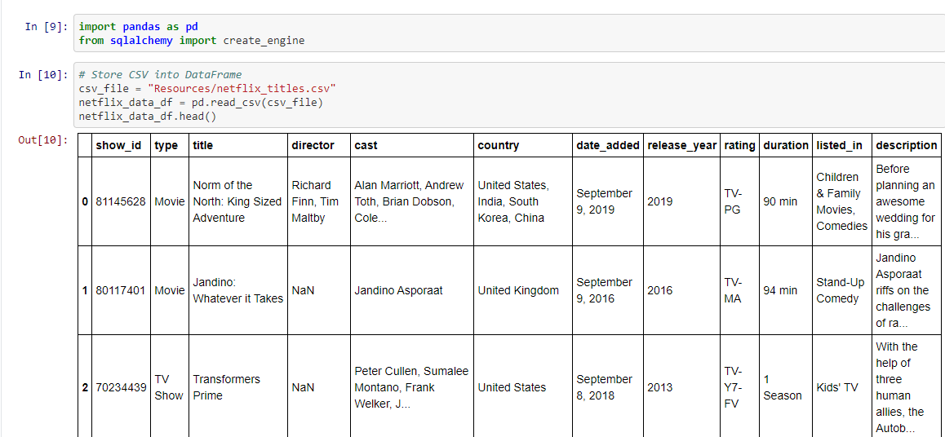
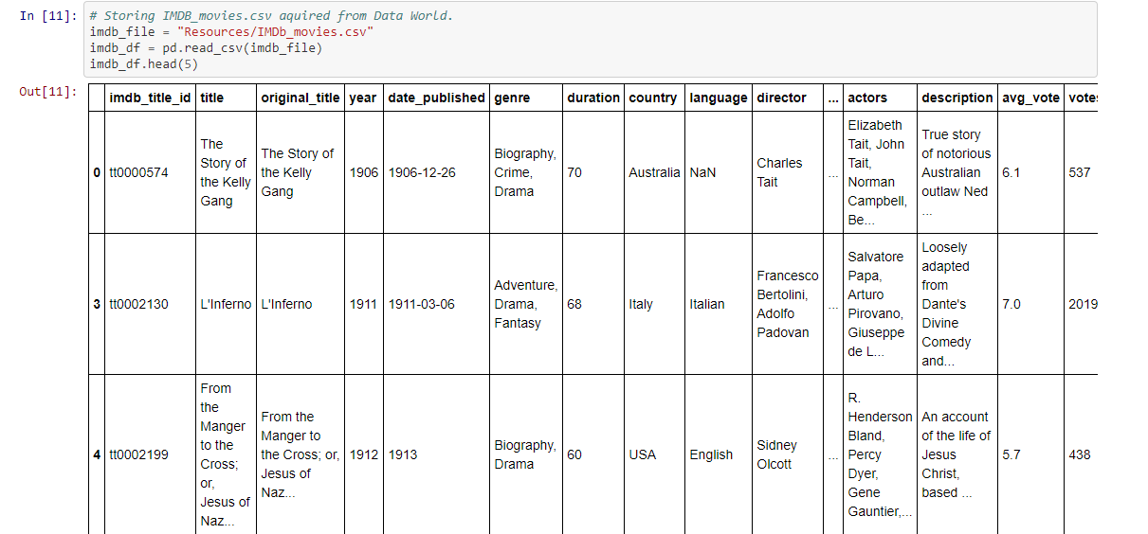
extract
IMDB Dataset
Netflix Dataset
File format: CSV
Data source: https://www.kaggle.com/
File format: CSV
Data source: https://data.world/

Slide 4
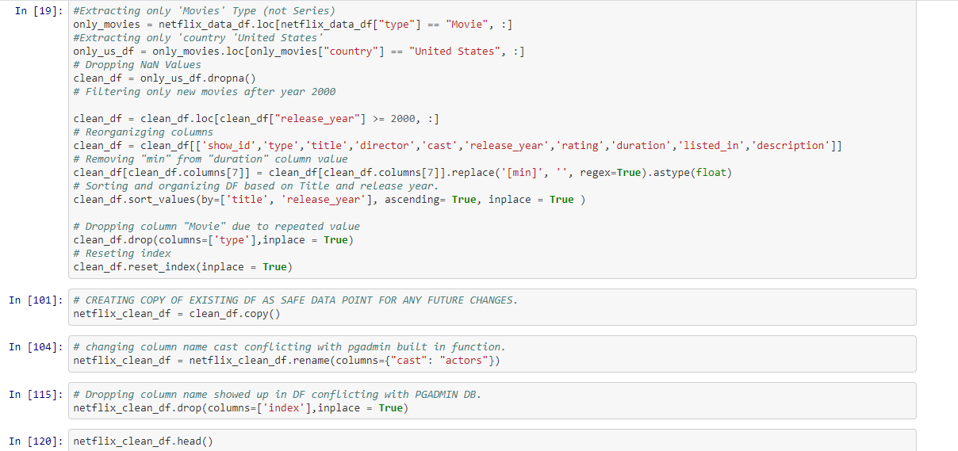
Transform
Columns dropped
Rows dropped
Data Cleaned

Slide 5
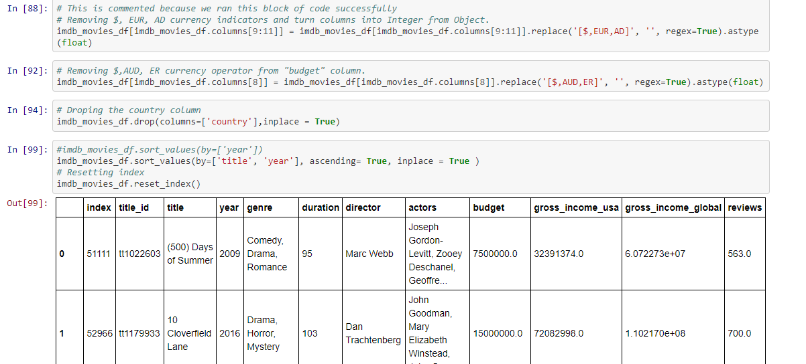
Transform
Columns dropped
Rows dropped
Data Cleaned

Slide 6
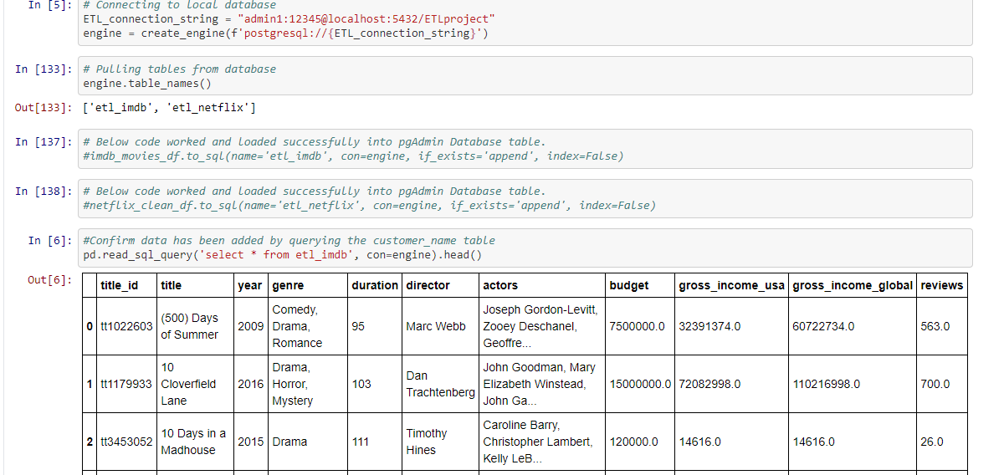
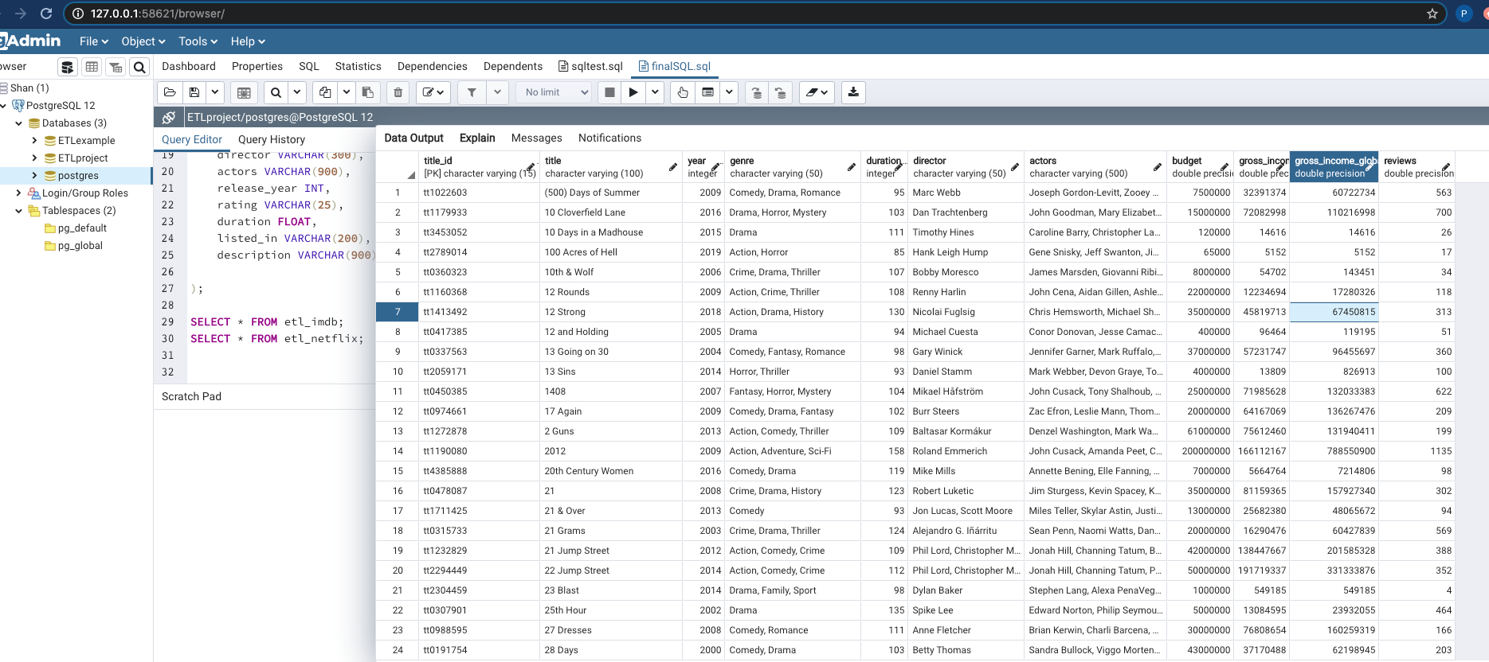
Load & store
Connect to sql
Load and stored to sql
Engine connection
Data stored

Slide 7
THANK YOU
End

