Slide 1


Movie Search Project
11/16/2020
Rachel Harless
Mohammad Hashem
Prashant Kapadia
Ashley Roberts

Slide 2

Objective
Do you want to watch top rated movies across the streaming platforms? If yes, then we saved hours of your research time. This Movie Search Project will let you to find your favorite movies based on Genre and Age chosen. It will display the information about that movie. Please make sure to have popcorn and soda ready…….enjoy!!!!
Movie Search & visualization
Create an interactive search engine that will help the user choose a movie to watch.
Visualize movies based on run-time, and IMDB/Rotten Tomatoes ratings

Slide 3
Full stack front end-back end technology
Back end
Front end
Flask App
Sql Database
Python
Pandas
HTML, CSS, Bootstrap
Plotly
D3
Java Scripts
JQuery

Slide 4
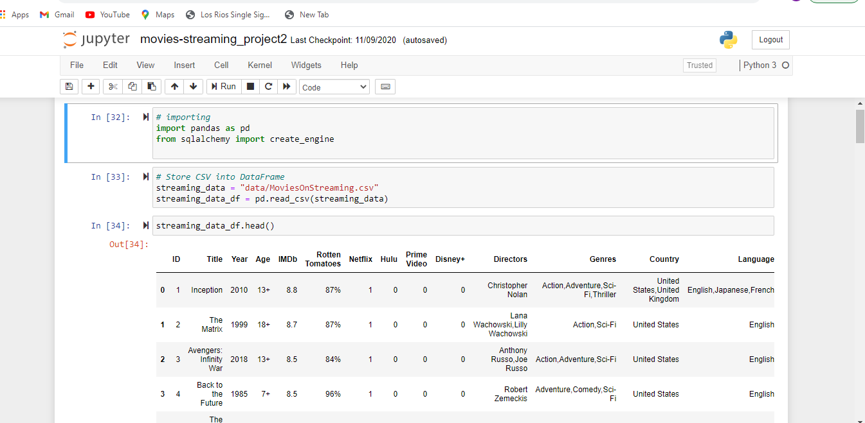
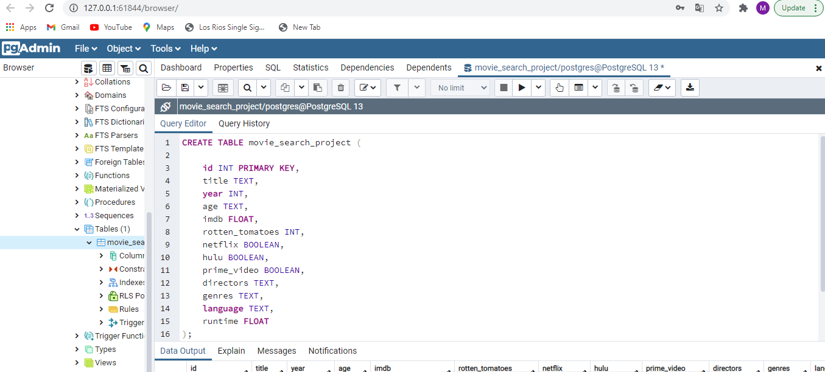
DATA EXTRACTION AND LOADING
File format: CSV
Data source: https://www.kaggle.com/
Data frame
PGaDMIN (SQL)

Slide 5

Rows dropped
Columns dropped &/or renamed
NAN Values Dropped
Filtered for U.S. only
Dropped Duplicated Date
Data Conversion
Data sorting
Data Cleaning

Slide 6


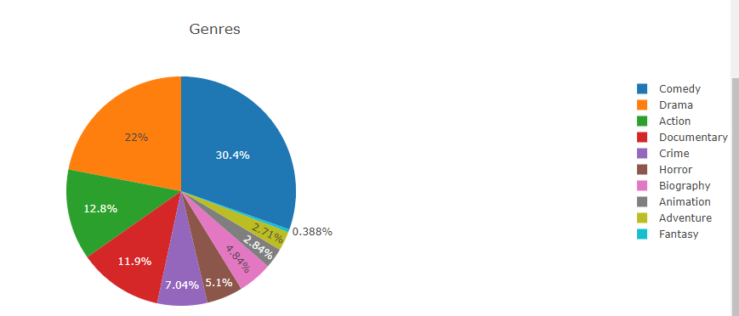
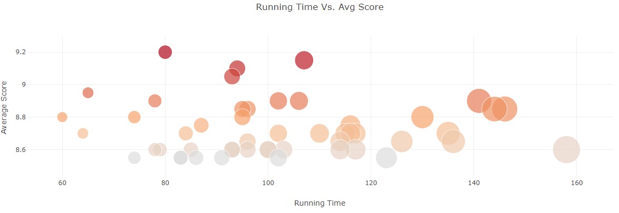
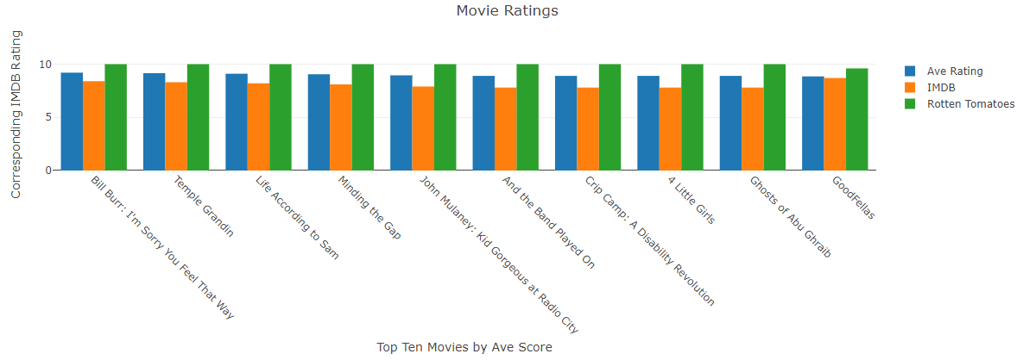
dashboard

Slide 7
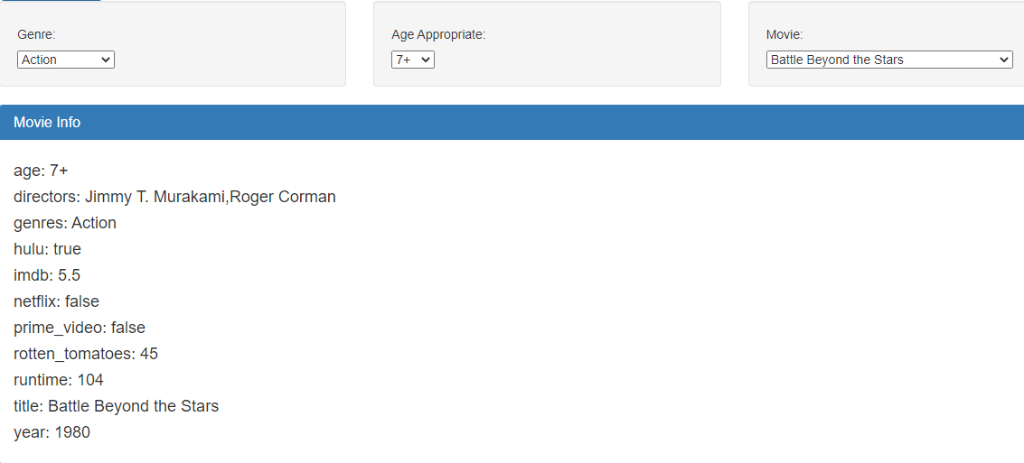
User interaction with data
User can filter movies by genres and age

Slide 8
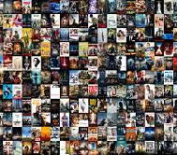
THANK YOU
Questions?

