Slide 1

WEEKLY PROGRESS UPDATE · WEEK OF 14–20 JULY 2026
Shaping Change
Building strong roots for safety
● ON TRACK
THIS WEEK
MILESTONES
✓ 14 Jul — Edu sign-off
✓ 16 Jul — PVAW sign-off
▸ 26–27 Jul — Phase 1 preview
○ mid-Aug — first draft
Phase 1 preview → your feedback before the advisory group meeting.
✓ Educational content approved — Edu team (14 Jul)
✓ PVAW sign-off — pedagogy, prevention approach, statistics & citations (16 Jul)
✓ Scope locked & project plan confirmed to mid-August
✓ Screen-by-screen design mockups produced — all 22 screens
✓ Screen flow & interactions mapped end-to-end
▸ Build environment set up; Phase 1 development underway
✓ Content · ✓ Design · ▸ Build (in progress) · ○ Accessibility + security · ○ QA + first draft
Notes:
Quick status. Both content approvals are now in — Edu signed off on the 14th, PVAW on the 16th — so the content is locked. This week I turned the approved blueprint into screen-by-screen design mockups for all 22 screens, mapped the full flow, confirmed the plan to a mid-August first draft, and set up the build and started Phase 1 development. Next milestone is a Phase 1 preview for you on the 26th–27th, so we can fold in your feedback before the advisory group meeting. On track.

Slide 2
SHAPING CHANGE · PROGRESS UPDATE
What’s locked — and what’s next
LOCKED THIS WEEK (from the sign-offs)
• Activity title — “Shaping Change: Building strong roots for safety”
• Character & scenario — Mr. Atlas — migration pressure & loss of status (primary-prevention framing)
• Prevention approach — internal-cause model — no depicted physical violence; escalation shown through non-physical behaviour
• Statistics — finalised with citations (AIHW 2018 · PM&C 2023 · ABS 2021), placed at the end
• Structure — beliefs + attitudes combined; one scenario with a couple of pathways
NEXT — TO MID-AUGUST
• Preview Phase 1 with you — 26–27 Jul — to fold in your feedback before the advisory group meeting
• Complete Phase 2 — the rebuild outcomes and reflection
• Accessibility pass — WCAG 2.1 AA — built for EAL learners
• Security & privacy review — with the Digital team / IT sign-off
• Internal QA & review — test the flow end-to-end
★ First playable draft — mid-August
On track, no blockers. Next step: preview Phase 1 with you on 26–27 July to fold in changes before the advisory group meeting. (Still to confirm the character name with the Digital team.)
Notes:
These are the decisions the two sign-offs locked in — the title, the character and scenario, the prevention approach (no depicted physical violence), the finalised statistics with citations, and the structure. Next I will preview Phase 1 with you on the 26th–27th, complete Phase 2, then do the accessibility and security/privacy work and internal QA — landing the first playable draft in mid-August. No blockers; still to confirm the character name with the Digital team.

Slide 3
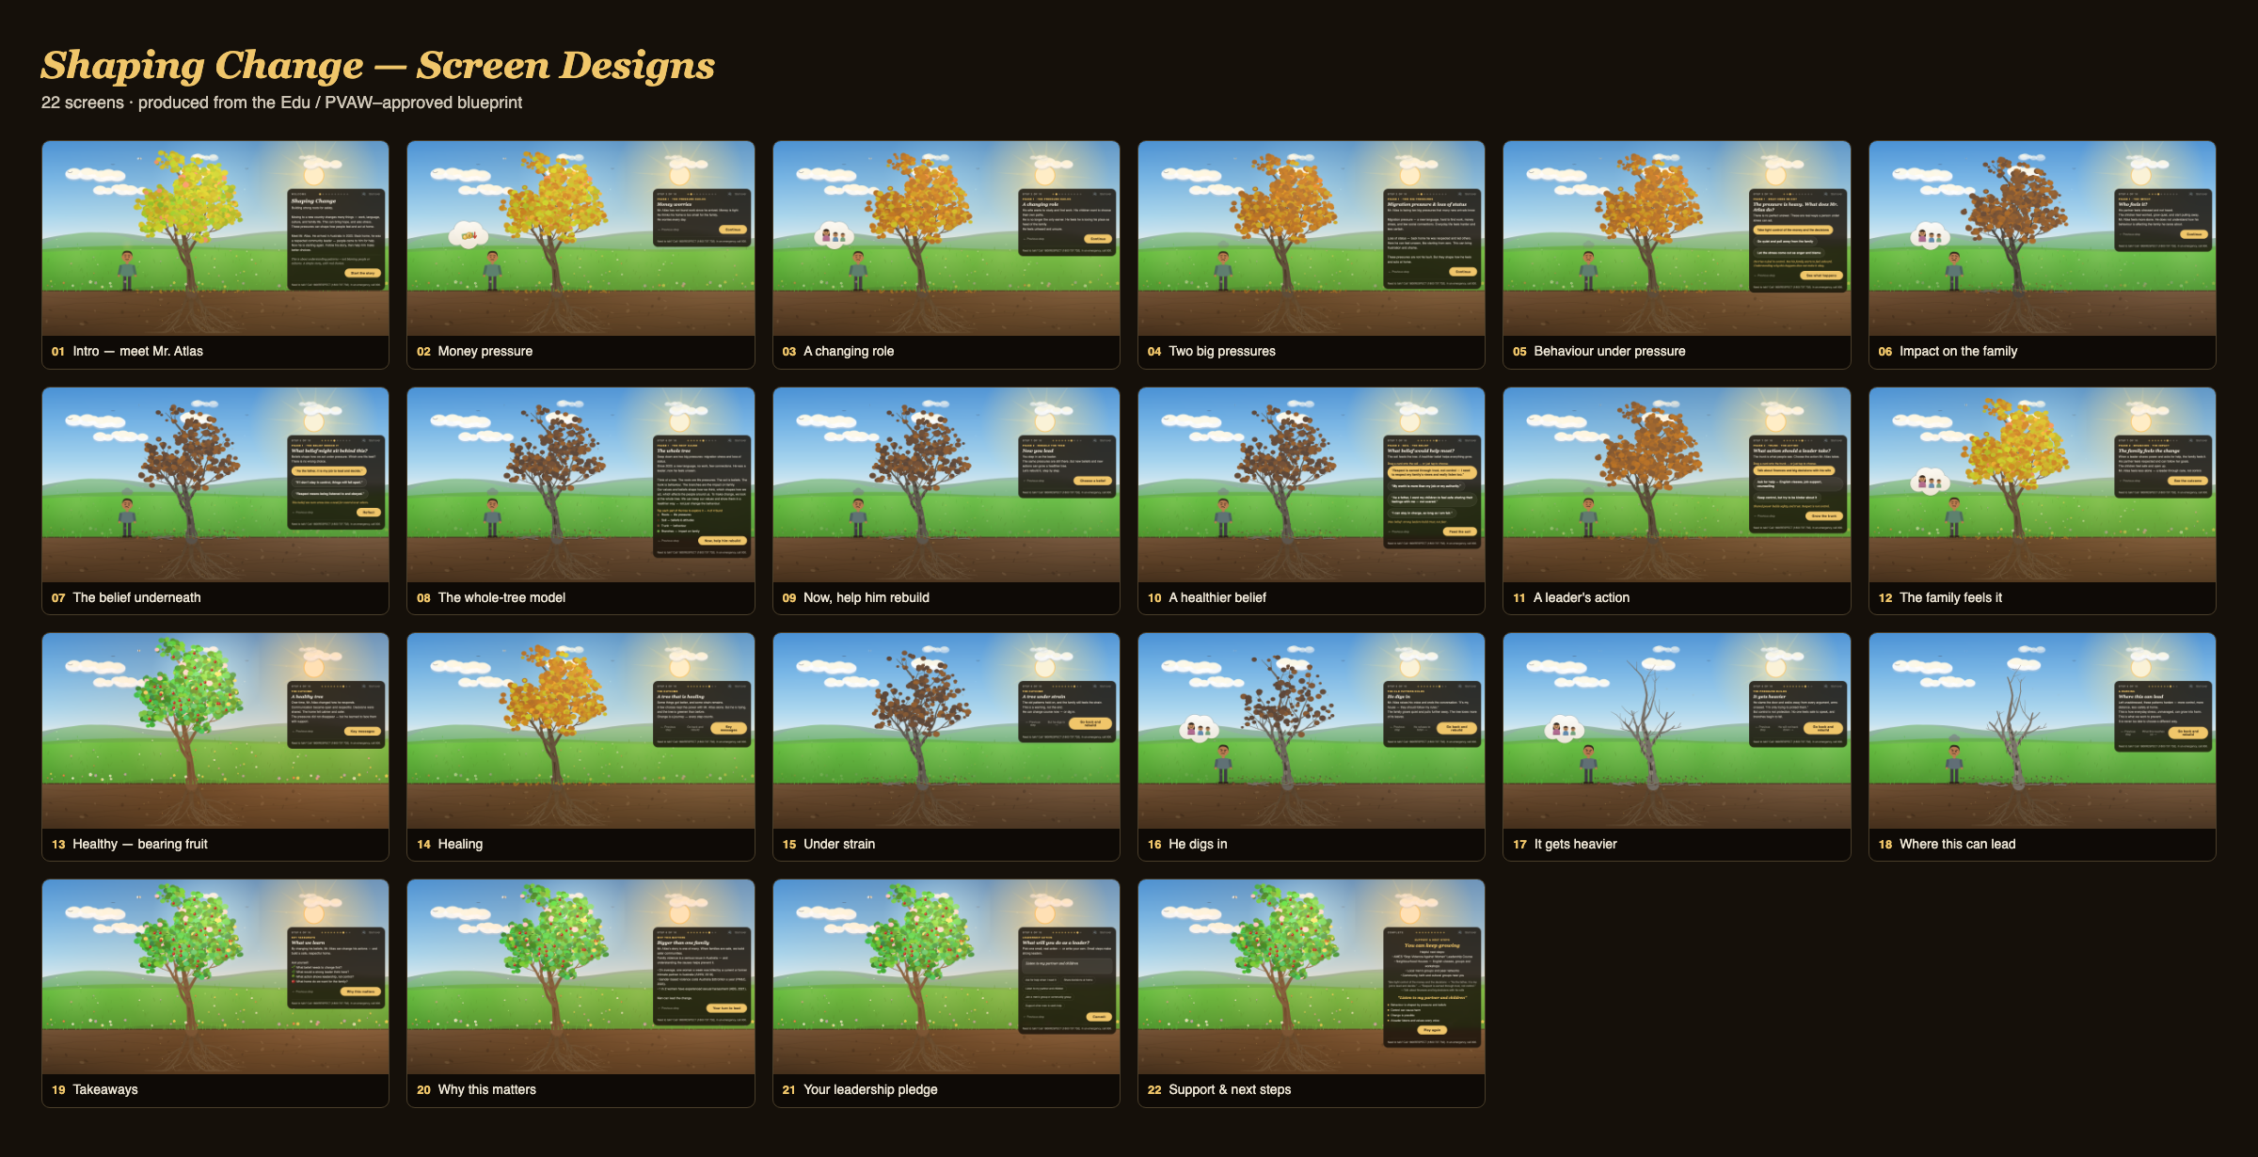
Notes:
These are the design mockups produced this week — one for every screen in the journey, using the exact copy and flow that Edu and PVAW signed off. You can see the story in the tree: it declines through Phase 1 as the pressure builds, then heals (and bears fruit) as he rebuilds. This is what I am now building into Phase 1 for the preview on the 26th–27th.

