Slide 1
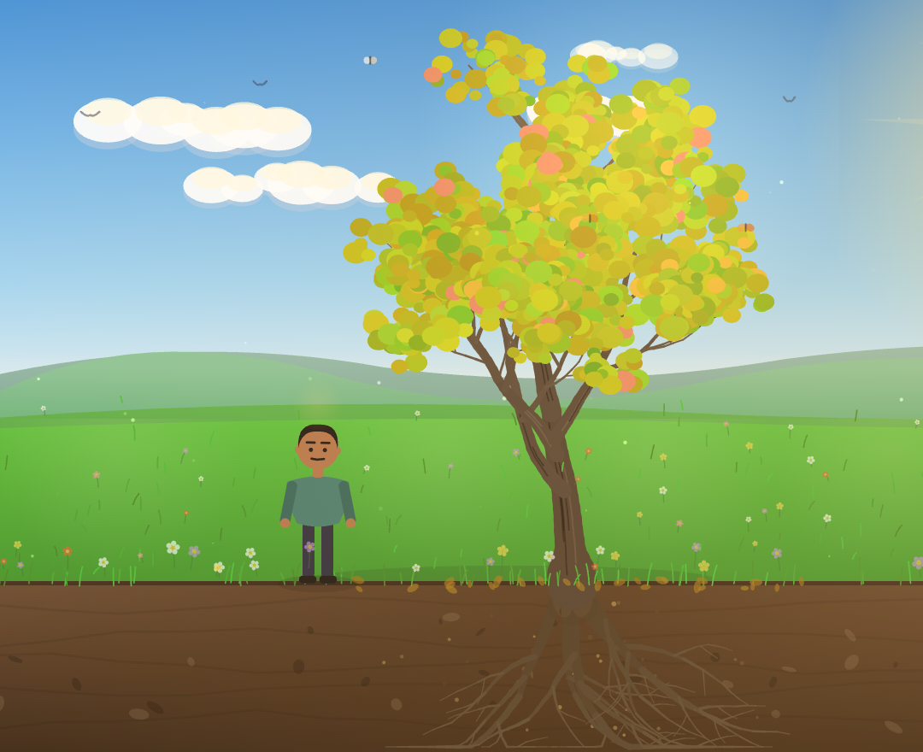
ACTIVITY BRIEF
Shaping Change
Building strong roots for safety
Stronger Voices for Action — Project Advisory Group
Phase 1 preview · [Presenter] · [Date]
Notes:
Good morning/afternoon. Thank you for the time. I'm going to give a short brief on the Shaping Change activity — what it is, why we're building it, and a walk through Phase 1, which is built. I'll keep the brief to about 15 minutes and leave plenty of room for questions. This activity sits within the Stronger Voices for Action work as a primary-prevention piece aimed at engaging men as leaders of positive change.

Slide 2
SHAPING CHANGE · ACTIVITY BRIEF
What it is
A short, reflective, interactive digital activity
• Primary prevention of family and domestic violence — engaging men as part of the change.
• For newly-arrived and migrant-community men positioned as leaders of positive change, not as a problem.
• Simple English (EAL) self-paced, about 10–15 minutes, works on a phone or a shared device.
• Meaning carried by a story and a growing tree one man's journey — not lectures or statistics.
Notes:
In one line: it's a short, reflective digital activity for primary prevention, made for men from newly-arrived and migrant communities, in simple English. It's self-paced and takes about 10–15 minutes. The important design choice is that the meaning is carried by a story and a growing tree — the learner feels the idea rather than being lectured, which suits a wide range of English literacy.

Slide 3
SHAPING CHANGE · ACTIVITY BRIEF
Why this activity
The need it responds to
• Settlement is a period of real pressure and change — work, language, culture, and family roles.
• Primary prevention means addressing the drivers of violence — gender inequality, rigid roles, control — before harm occurs.
• Men are essential to that change; the activity invites them in as part of the solution.
• It normalises the pressure, and clearly separates understanding it from excusing any harm.
Notes:
Why this, and why now. Arriving and settling in a new country brings genuine pressure across work, language, culture and changing family roles. Primary prevention means getting upstream of violence — to the drivers like gender inequality and rigid ideas about control — before any harm. Men are central to that, so we engage them as part of the solution. A careful line we hold throughout: we normalise the pressure people feel, while being clear that understanding a behaviour is never the same as excusing it.

Slide 4
SHAPING CHANGE · ACTIVITY BRIEF
Understanding patterns — not blaming people
Our pedagogy, developed with Education and PVAW
• Non-judgemental and strengths-based — safety, equity and respect as shared values.
• A soft, reflective story — no depicted violence.
• Violence is always a choice, and is driven by gender inequality — the activity keeps that frame gentle and clear.
• The 1800RESPECT / 000 support line is present on every single screen.
Notes:
The heart of the approach is: understand patterns, don't blame people or cultures. It's strengths-based and non-judgemental, built around safety, equity and respect. There is no depicted violence — it's a soft, reflective story. We keep the primary-prevention message clear but gentle: violence is a choice, and it's driven by gender inequality. And on every screen, without exception, the 1800RESPECT and 000 support line is visible. This has been shaped closely with our Education and PVAW colleagues.

Slide 5
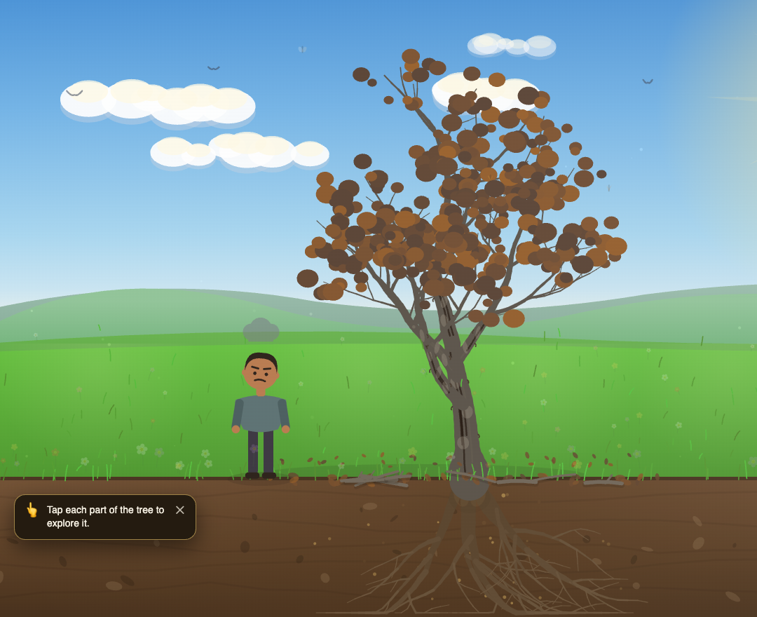
SHAPING CHANGE · ACTIVITY BRIEF
The big idea: the whole tree
• Roots — the life pressures — migration stress, loss of status
• Soil — beliefs and attitudes
• Trunk — behaviour
• Branches — the impact on the family
"Our values shape how we think, which shapes how we act, which affects the people around us."
Notes:
Everything hangs off one simple idea — a tree. The roots are the life pressures a person is under. The soil is their beliefs and attitudes. The trunk is their behaviour — what people see. And the branches are the impact on the family. The message is that our values shape how we think, which shapes how we act, which affects those around us. To make change we look at the whole tree — and importantly, we can keep our values and express them in a healthier way.

Slide 6
SHAPING CHANGE · ACTIVITY BRIEF
How the activity works — two phases
The same tree runs through both — it declines, then heals
PHASE 1
Experience the Problem
Follow the story. The tree declines as the pressure builds — the learner sees how pressure can turn into harmful behaviour, and the impact on the family.
● Built — we'll walk through it now
PHASE 2
Rebuild the Outcome
The learner steps in as the leader and helps grow a healthier outcome — new beliefs, new actions, a stronger home.
● In development
Notes:
The activity is two phases, and the same tree runs through both. In Phase 1 — Experience the Problem — we follow the story and the tree declines as pressure builds. In Phase 2 — Rebuild the Outcome — the learner becomes the leader and helps grow a healthier outcome. Phase 1 is built, and that's what I'll show you today. Phase 2 is in development and follows the same tree.

Slide 7
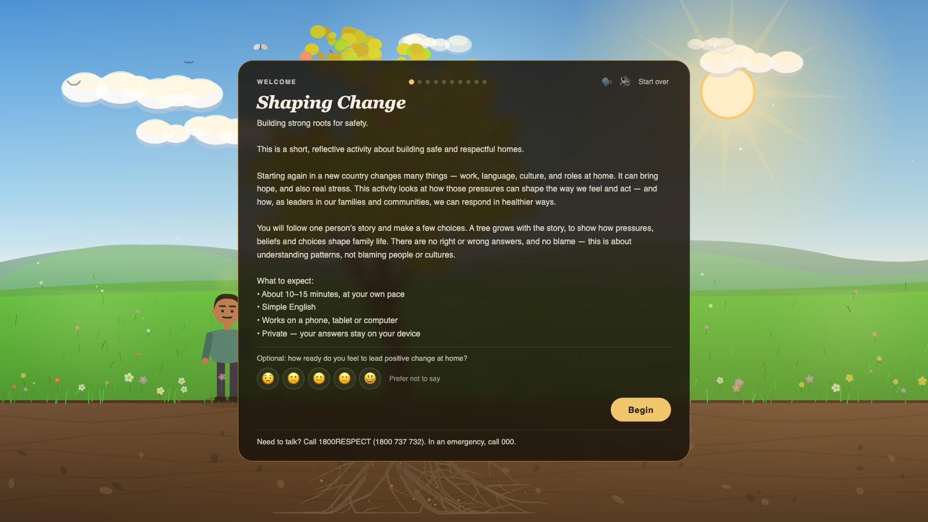
SHAPING CHANGE · ACTIVITY BRIEF
PHASE 1 · WELCOME
A gentle welcome
Opening · the landing screen
• Plain-language expectations up front: about 10–15 minutes, at your own pace, on any device.
• "Understanding patterns — not blaming people or cultures." The frame is set before the story.
• Private and self-paced; an optional one-tap check-in invites reflection, never pressure.
Notes:
We open on a short welcome — a landing screen we added in response to feedback that learners want a little context before they begin. In plain language it sets expectations: a short, reflective activity, about 10–15 minutes, at your own pace, with no right or wrong answers. It states our frame up front — understanding patterns, not blaming people or cultures — and offers an entirely optional one-tap check-in on how ready someone feels to lead positive change at home.

Slide 8
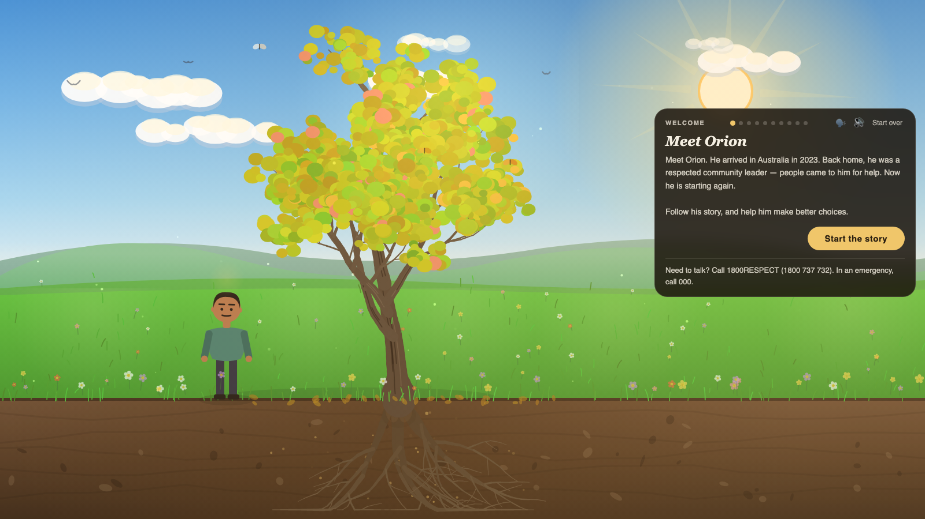
SHAPING CHANGE · ACTIVITY BRIEF
PHASE 1 · MEET
Meet Orion
Opening
• Arrived in 2023; back home he was a respected community leader.
• Warm, non-judgemental tone — "understanding patterns, not blaming people."
• Follow his story, and help him make better choices along the way.
Notes:
We then meet our character, Orion. He arrived in Australia in 2023, and back home he was a respected community leader — people came to him for help. That matters: he's not a villain, he's someone many in the room will recognise. The tone is warm and non-judgemental, and the learner is invited to follow his story and help him make better choices.

Slide 9
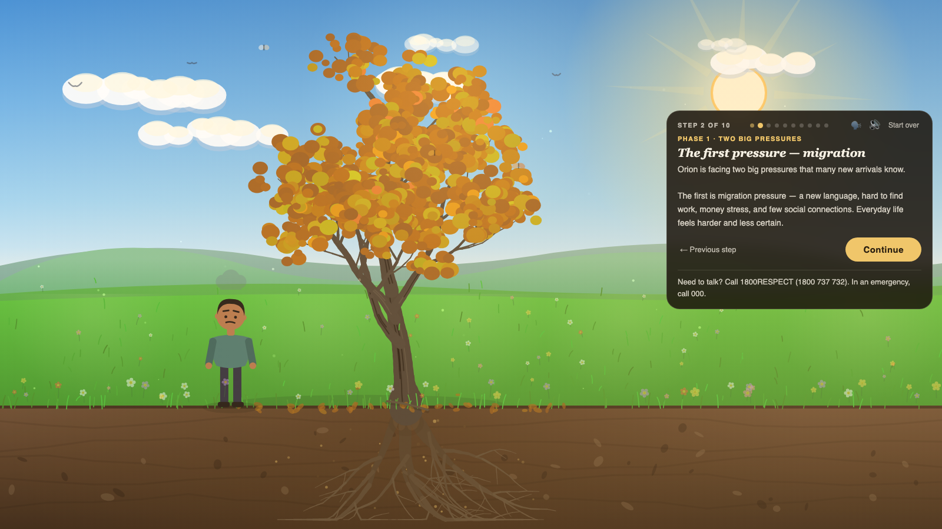
SHAPING CHANGE · ACTIVITY BRIEF
PHASE 1 · THE PRESSURES
The pressures build
Phase 1 · The pressures
• Two named pressures: migration pressure, and loss of status.
• Money worries and changing family roles come first, each on its own screen.
• Deliberately split into small, single-idea screens for lower English literacy.
• "These are not his fault — but they shape how he feels and acts."
Notes:
We then build the pressure. Money is tight, he hasn't found work; his wife wants to study and work and the children want their own paths, so he feels his role changing. We name two big pressures explicitly — migration pressure, and loss of status — because recognising them is the first step. And we state plainly: these are not his fault, but they do shape how he feels and acts at home. The tree is quietly beginning to strain.

Slide 10
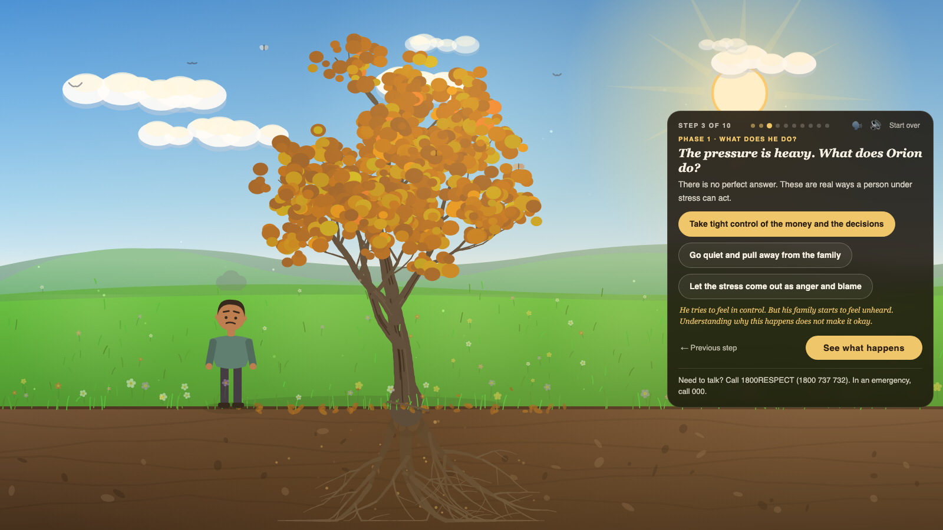
SHAPING CHANGE · ACTIVITY BRIEF
PHASE 1 · THE CHOICE
The moment of choice
Phase 1 · The behaviour
• The learner chooses how a stressed person might respond.
• No perfect answer; gentle, non-shaming feedback follows each.
• Naming the behaviour is the first step to understanding it.
Notes:
Here the learner makes a choice — how might someone under this much pressure respond? Take tight control, go quiet and pull away, or let it come out as anger. There's no perfect answer, and the feedback is gentle and never shaming — it names the behaviour and makes clear that understanding why it happens is not the same as saying it's okay. This is the activity's honest centre, handled softly.

Slide 11
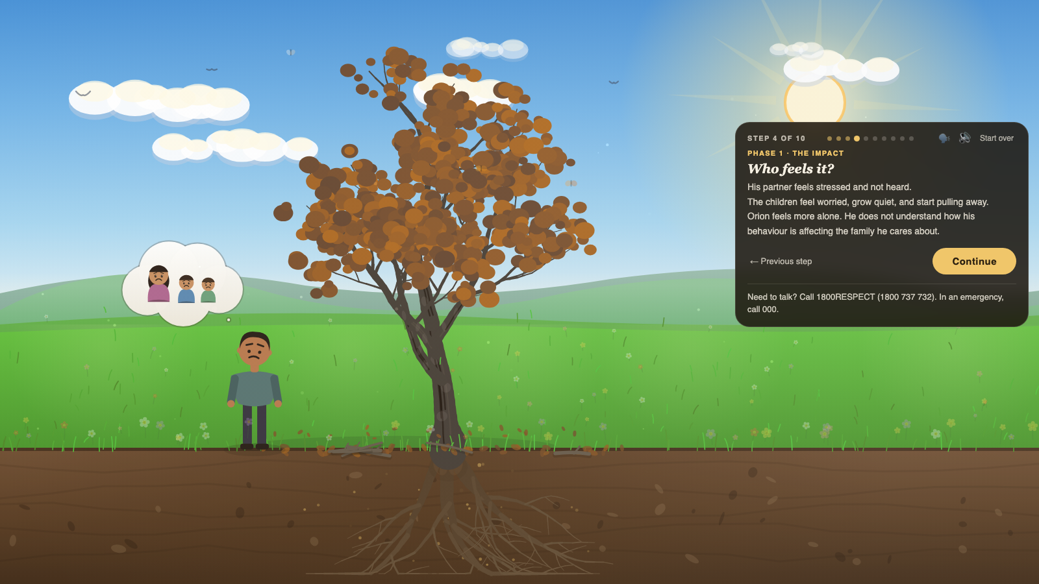
SHAPING CHANGE · ACTIVITY BRIEF
PHASE 1 · THE IMPACT
Who feels it?
Phase 1 · The impact
• The ripple to partner and children — worry, distance, quiet.
• Shown through feeling and the declining tree — no depicted violence.
• Builds empathy for the whole family.
Notes:
Next we show who feels it. The partner feels unheard; the children grow quiet and pull away; and he feels more alone, not seeing how his behaviour is landing on the family he cares about. Crucially there is no depicted violence — the impact is carried by feeling, by a thought bubble, and by the declining tree. It builds empathy for the whole family.

Slide 12
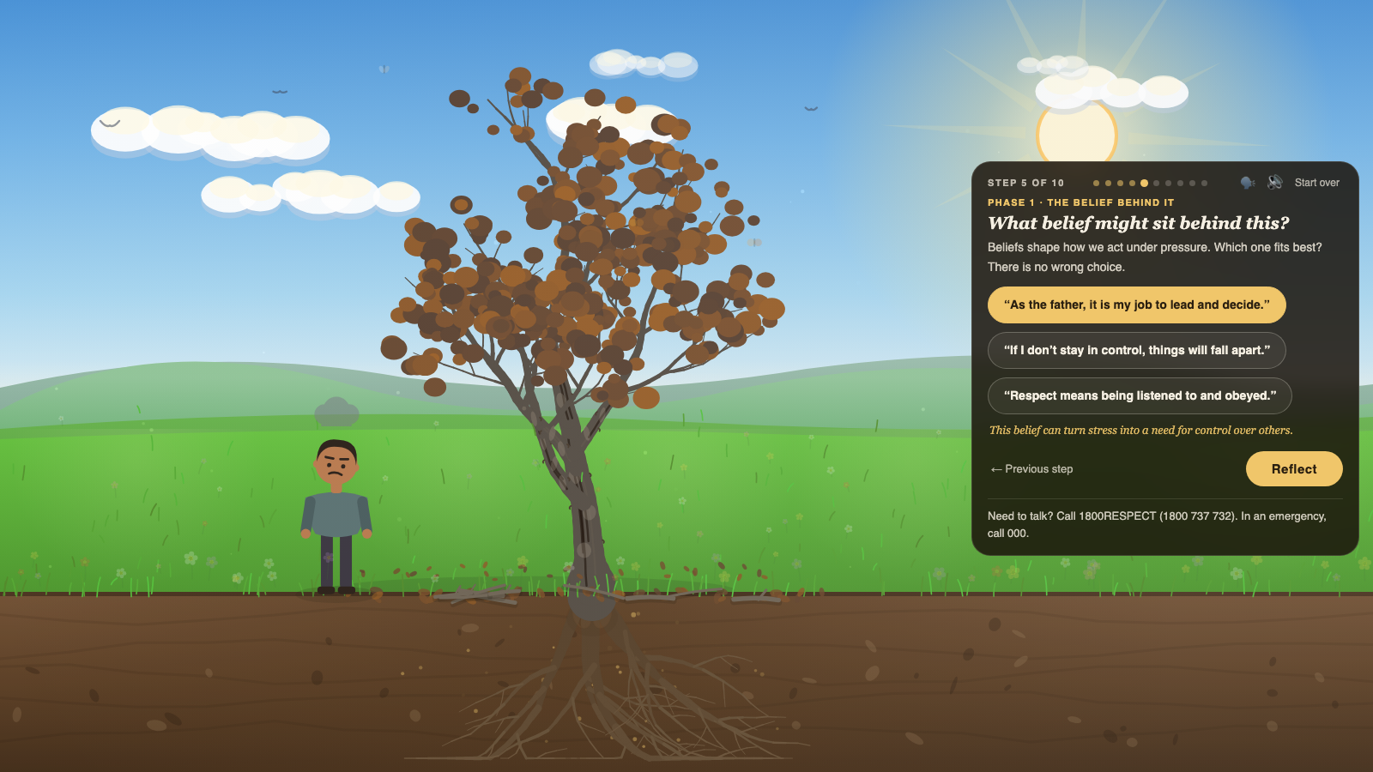
SHAPING CHANGE · ACTIVITY BRIEF
PHASE 1 · THE BELIEF
The belief underneath
Phase 1 · The belief
• Surfaces the belief driving the behaviour — the "soil."
• A reflection point, not blame — "there is no wrong choice."
• Sets up the idea that changing beliefs can change actions.
Notes:
We then gently surface the belief sitting underneath — for example, "as the father, it is my job to lead and decide." In tree terms, this is the soil. It's framed as reflection, not blame — there's no wrong choice here — and it sets up the key idea that if we can shift the belief, we can shift the behaviour.

Slide 13
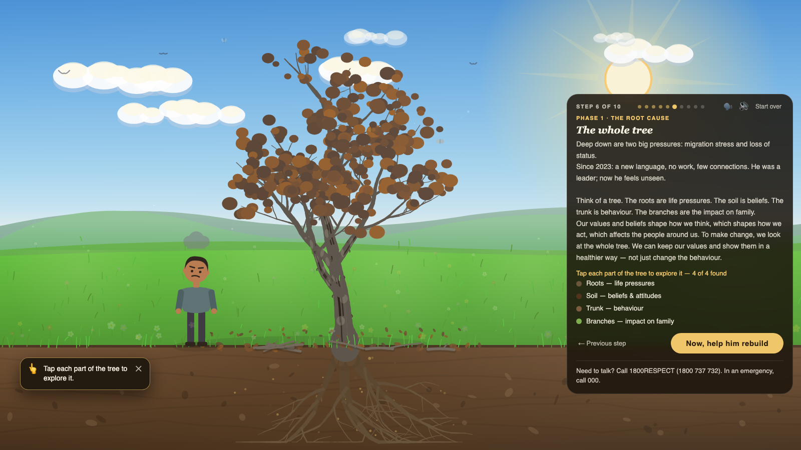
SHAPING CHANGE · ACTIVITY BRIEF
PHASE 1 · THE MODEL
The whole tree revealed
Phase 1 · The tree model
• The model comes together: roots, soil, trunk, branches.
• Interactive — the learner taps each part of the tree to discover it.
• Closes Phase 1 and sets up the rebuild.
Notes:
Phase 1 closes by pulling it all together on the tree the learner has been watching. The roots are the pressures, the soil the beliefs, the trunk the behaviour, the branches the impact. It's interactive — they tap each part of the tree to discover it, so the model is discovered rather than read. This is the pivot point: having experienced the problem, the learner is ready to help rebuild — which is Phase 2.

Slide 14
SHAPING CHANGE · ACTIVITY BRIEF
Built for reach — and for safety
Designed for this audience and this subject
• Accessible simple English, screen-reader friendly, keyboard-operable, tap or drag (WCAG 2.1 AA).
• Works on any device phone, tablet or computer — the text always fits, with no scrolling to read it.
• A personalised take-home summary print or save the choices the learner made and the leadership pledge they wrote.
• Private answers stay on the learner's own device.
• Safe by design no depicted violence; the support line on every screen; built with Edu & PVAW.
Notes:
A few things that make it fit this audience and this subject. It's accessible — simple English, and it meets common accessibility standards so it works with screen readers and a keyboard, not just touch. It works on any device — phone, tablet or computer — and the layout is designed so the text always fits without the learner ever needing to scroll to read it, which matters for lower literacy. At the end, the learner can take home a personalised summary — the choices they made and the leadership pledge they wrote. Answers stay on the learner's own device. And it's safe by design — no depicted violence, the support line always present, and shaped throughout with our Education and PVAW teams.

Slide 15
SHAPING CHANGE · ACTIVITY BRIEF
Where it's at — and what's next
Status and next steps
• Phase 1 is built the experience you've just seen, now refined from team feedback.
• Phase 2 in development the rebuild — same tree, learner as leader.
• Screen designs out for review with Education, PVAW and Digital — comments welcome.
• Evaluation optional before/after reflection, plus anonymous engagement measures.
• For confirmation closing statistics wording, and the delivery model.
Notes:
Where we are: Phase 1 is built — that's what you've just seen, and it's been refined from team feedback. Phase 2, the rebuild, is in development and uses the same tree. The full screen designs are out for review with Education, PVAW and Digital, and comments are very welcome. On evaluation, we have an optional before-and-after reflection built in, plus anonymous engagement measures. And there are a couple of things we'd like this group's steer on — the wording of the closing statistics, and how best to deliver it.

Slide 16
SHAPING CHANGE · ACTIVITY BRIEF
For discussion
We'd welcome the group's view on
• Does the tone and framing feel right for our communities?
• How might this be delivered — self-paced, in groups, or both?
• What would make this most useful to the services and leaders you work with?
• What matters most as we shape Phase 2 — the rebuild?
• Anything we should be careful about, given the subject and the audience?
Notes:
I'll stop there and open it up. A few things we'd genuinely value your view on: does the tone feel right for our communities; how you'd see it delivered — self-paced, in groups, or both; what would make it most useful to the leaders and services you work with; what matters most as we shape Phase 2; and anything we should hold in mind given the subject and the audience. Over to you — happy to take any questions.

Slide 17
Thank you
Questions & discussion
Shaping Change: Building strong roots for safety · Stronger Voices for Action
Support is always available — 1800RESPECT (1800 737 732) · in an emergency, 000
Notes:
Thank you. Reminder for the room that support is always available — 1800RESPECT, and 000 in an emergency. Happy to keep talking or follow up individually.

