Slide 1
MDCT Project and Perceptual Similarity in Image Compression
Moeez Amjad -65053
Muhammad Hamza Aslam-70413
Sajid Ali khan-66414

Slide 2
Introduction
Problem Statement:
Aim: To analyze the effectiveness of image compression using MDCT compared to DCT.
Focus: Evaluating perceptual similarity, compression ratio, and bits per pixel (BPP).
Solution Approach Overview:
MDCT and DCT for color and greyscale images.
Perceptual similarity metrics using the LPIPS model.

Slide 3
Methods
MDCT for Color Images:
Divide into Y, Cb, Cr channels.
Apply MDCT, quantize, zigzag scan, and compress.
DCT for Color Images:
Same steps as MDCT but using standard DCT.
Perceptual Similarity Metric:
Use LPIPS model for comparison.

Slide 4
Implementation tasks
MDCT Implementation:
Define quantization matrix.
Implement MDCT with window functions.
Encode and decode images.
Comparison with DCT:
Implement DCT-based compression.
Use the same images for a fair comparison.
Evaluation Metrics:
Compression ratios and BPP.
Perceptual similarity using LPIPS.

Slide 5
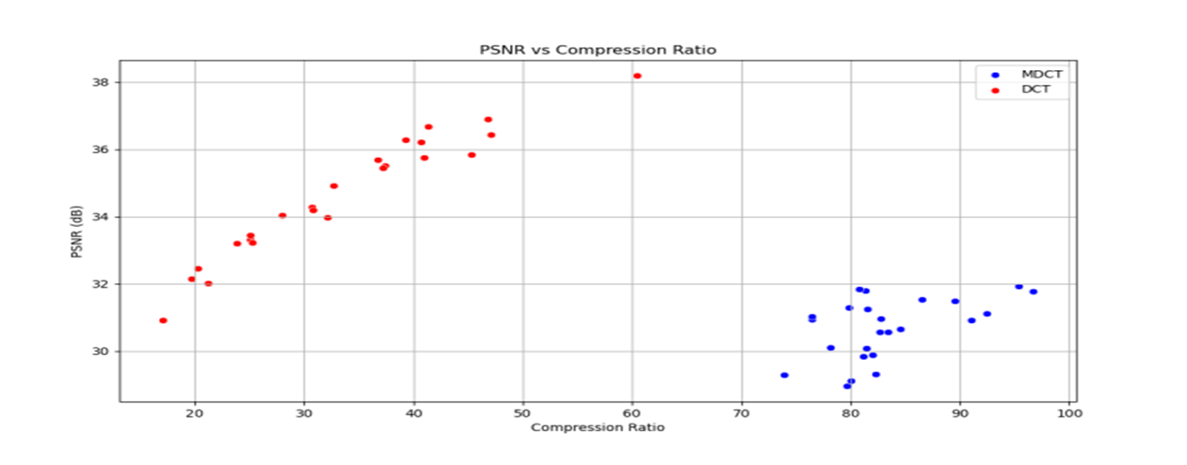
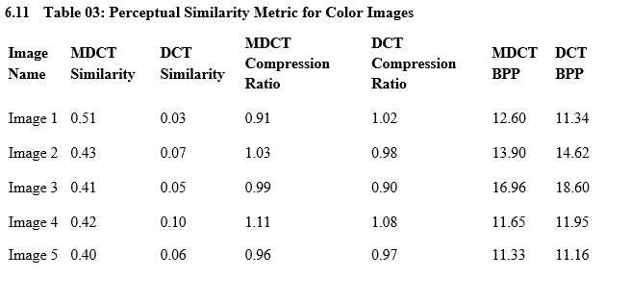
Results For Color Images

Slide 6
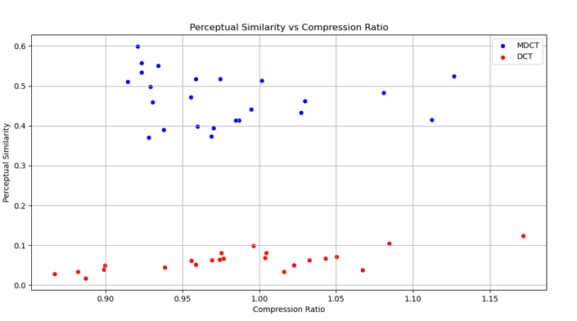
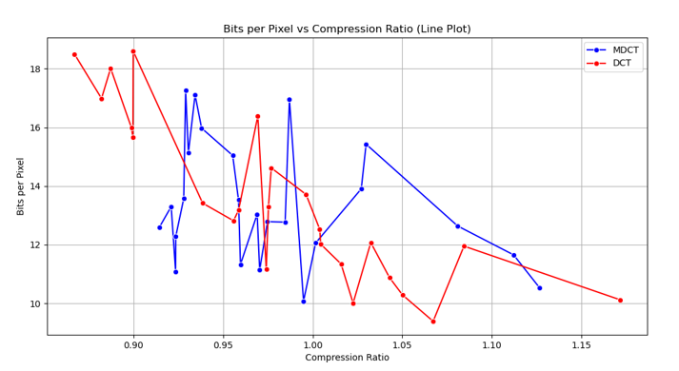

Slide 7
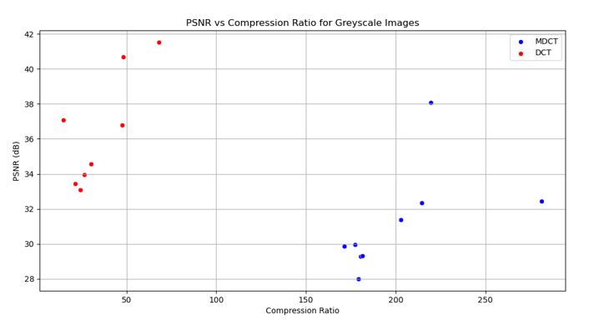
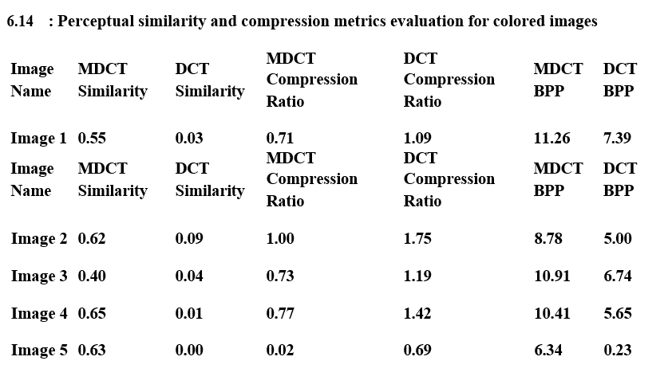
Results for Greyscale Images

Slide 8
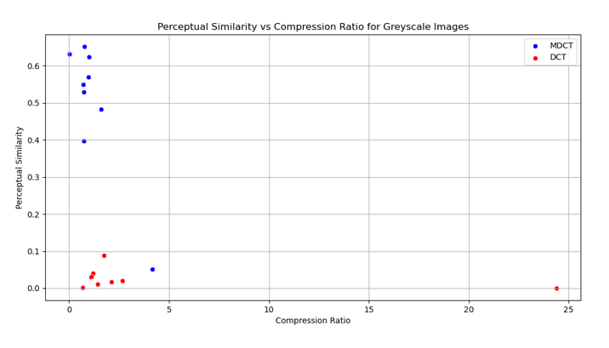
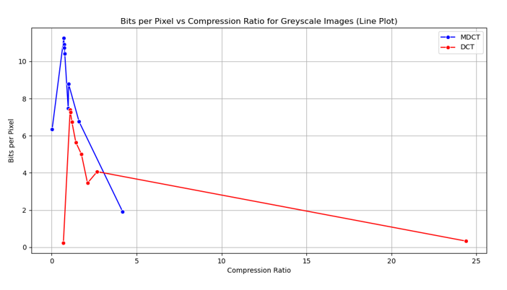

Slide 9
Conclusion
MDCT offers better perceptual similarity.
DCT achieves higher compression ratios.
Trade-off between image quality and compression efficiency.

