Slide 1
THREE-TIER ARCHITECTURE
Three-Tier Application on GKE
Production platform · Istio service mesh, STRICT mTLS · delivered end to end by Argo CD
By: Mohammad Hassan Ur Rehman
DevOps Engineer

Slide 2
CONTENTS
Key Points
01
The Goal
What the platform had to prove
02
Architecture Diagram
Request path, user to database
03
Infrastructure Highlights
Cloud infrastructure · delivery pipeline
04
Architecture Pillars
High performance · resilience · secure · cost optimized
05
Measured Capacity
Load-tested, not estimated
06
Summary
What is proven, and what is not
gke-3tier
01 / 10

Slide 3
GOAL
The Goal
Run a production-shaped three-tier application on GKE, where the cloud stops at the cluster edge and everything inside it is reconciled from Git — then measure what it actually serves, rather than asserting a number.
The rule that shaped every decision. Terraform owns everything up to and including the cluster. Argo CD owns everything inside it. No kubectl patch, no console edits — if the cluster holds state no file describes, the repository has stopped being the source of truth.
WHAT "PRODUCTION-SHAPED" MEANT HERE
Encryption and identity-based authorization between every tier, not just at the edge
A database that survives losing a node, not just one that has backups
Canary releases on both application tiers, not a single blue/green switch
A capacity number backed by a load test and its method, not a round figure
gke-3tier
02 / 10

Slide 4
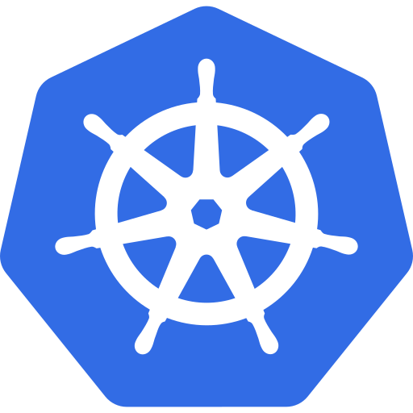


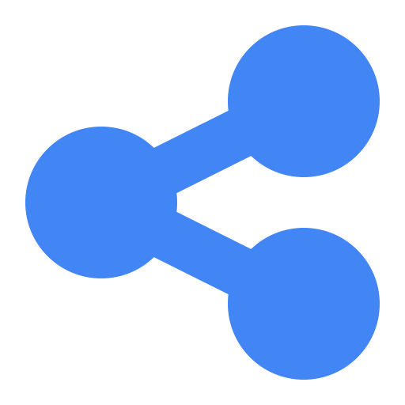


ARCHITECTURE
Architecture Diagram
GKE CLUSTER
Web Tier
API Tier
Data Tier
User
Istio Sidecar
Istio Sidecar
Redis Cache
Cloudflare DNS
GCP Load
Balancer
mTLS
mTLS
mTLS
pod
pod
Postgres Cluster
Web
API
CloudNativePG · 2 instances
nginx + React SPA
Node / Express
outside mesh · own TLS 1.3
spot pool · autoscaled
spot pool · autoscaled
stable pool
gke-3tier
03 / 10

Slide 5
INFRASTRUCTURE
Infrastructure Highlights
GOOGLE CLOUD — PROVISIONED BY TERRAFORM
CLOUDFLARE · DELIVERY · LOCAL
VPC with secondary ranges for pods and services
GKE — two node pools: stable (2× e2-standard-2) and spot (autoscaled 1–3× e2-standard-2)
CloudNativePG PostgreSQL — 2 instances, required pod anti-affinity
Redis — self-hosted in-cluster, inside the mesh
Artifact Registry for the web and api images
Secret Manager — access bound per secret, never project-wide
Workload Identity Federation — CI authenticates with zero service-account keys
Bootstrap identity and infrastructure kept in separate Terraform state
Scoped node service account, not the default compute account (which carries Editor)
Cloudflare — DNS and TLS in front of the cluster
GitHub Actions — builds images, commits the tag to the GitOps repo
Holds no cluster credentials — it never talks to the cluster
Argo CD — 20 Applications in an app-of-apps, ordered by sync wave
Kustomize overlays; Argo Rollouts canary on both application tiers
kube-prometheus-stack — dashboards kept as ConfigMaps in Git, not clicked together
Local — multi-stage Docker builds for web (nginx) and api (node)
gke-3tier
04 / 10

Slide 6
ARCHITECTURE PILLAR · 1 OF 4
High Performance
Four pillars this platform is designed and measured against. The first is response time under real load.
Istio sidecar mesh — mTLS and routing are handled locally at each pod, not through a shared gateway hop between every service
Redis cache — 70%+ hit rate on the summary endpoint under load, measured in the load test
Sidecar CPU sized from measurement, not the chart default — 100m → 30m, above both the observed peak and Istio's own published figure for this throughput
Horizontal Pod Autoscaler — 2–6 replicas per tier, reacting to CPU
Postgres read/write split available via CloudNativePG's -rw / -ro services
gke-3tier
05 / 10

Slide 7
ARCHITECTURE PILLAR · 2 OF 4
Resilience
Designed for the failures that actually happen on this platform — not a generic checklist.
Application tier runs on spot nodes — 3 preemptions absorbed during this build with no customer-visible effect
Postgres — 2 instances with required pod anti-affinity, after both were found on the same node once
Every failurePolicy: Fail admission webhook runs 2 replicas across 2 nodes — cert-manager, CloudNativePG operator, External Secrets, istiod
Argo Rollouts canary on both tiers; dynamicStableScale so a canary fits the pool instead of needing double the pods
PodDisruptionBudgets corrected after they were found blocking node drains for volumes that no longer existed
gke-3tier
06 / 10

Slide 8
ARCHITECTURE PILLAR · 3 OF 4
Secure
Identity replaces addresses and standing keys at every layer.
STRICT mTLS across the mesh, default-deny, every permitted path stated explicitly against a verified service-account identity
Workload Identity Federation — CI authenticates to GCP with no service-account key in existence
Secret Manager access bound per secret — a compromised operator cannot read everything
CI holds infrastructure rights but deliberately no IAM-admin rights, so it cannot widen its own access
Argo CD and Grafana reachable only over Tailscale — never the public internet
Sidecars injected via the CNI agent, so no application pod needs NET_ADMIN
gke-3tier
07 / 10

Slide 9
ARCHITECTURE PILLAR · 4 OF 4
Cost Optimized
Every request sized from what was actually measured — not the chart defaults, and not a guess.
Application tier on spot — the pool autoscales down to 1 node when idle
Machine type corrected after measurement: e2-medium is shared-core, so GKE reserves a flat 1060m regardless of load; e2-standard-2 delivers 1930m for the same 2-vCPU listing
Same price tier, roughly 3.5× the usable capacity per node
Sidecar CPU request dropped from the chart's 100m to 30m after measuring 3–4m actual use — recovered headroom across every mesh pod without changing a limit
Single NAT gateway; no idle duplicate load balancers
gke-3tier
08 / 10

Slide 10
MEASUREMENTS
Measured Capacity
Load generated inside the cluster and inside the mesh, so the number measures the application rather than the tester's internet connection.
Load | Mean | p95 | Pods | Per pod
32 req/s | 7 ms | 21 ms | 4 | 8.0 | flat
55 req/s | 52 ms | 320 ms | 6 | 9.2 | knee
83 req/s | 140 ms | 855 ms | 6 | 13.8
140 req/s | 329 ms | 1864 ms | 6 | 23.3
171 req/s | 679 ms | 3631 ms | 6 | 28.5 | saturated
The usable number is the knee, not the peak. Below roughly 32 req/s the mean holds flat at 7 ms. Peak throughput is 171 req/s, but by then a request takes 679 ms — the system is still serving and no longer worth serving from. At one user action every 30 seconds that is roughly 960 concurrent users comfortably, against a measured ceiling far above it.
What is not proven: the true ceiling. Every run so far was bound by the load generator, not the application, so 171 req/s is a floor, not a maximum.
gke-3tier
09 / 10

Slide 11
SUMMARY
Summary
A three-tier application on GKE, delivered entirely through Git, with mTLS and identity-based authorization between every tier, canary releases on both application tiers, and a database that survives losing a node.
WHAT IS PROVEN
32 req/s at a 7 ms mean, with headroom to spare
~960 concurrent users comfortably, at one action every 30 seconds
A measured saturation point at 171 req/s (679 ms mean) — not asserted, tested
Zero failures once the two limits the platform had written on itself were removed
Scaling this platform further is a configuration change — HPA ceilings, node-pool maximums — not an architectural one. And the capacity figures above are a floor: every load-test run so far was bound by the generator, not the application, so the true ceiling remains unmeasured. Saying so is the point — a capacity number without the method behind it is a guess with a decimal place.
gke-3tier
10 / 10

