Slide 1
WEAPON DETECTION SYSTEM

Slide 2
Group Members
Muhammad Hassan (BSEF19A006)
Muhammad Ashar (BSEF19A035)
Syed Kashif Hassan Kazmi (BSEF19A040)
Umer Farooq (BSEF19A014)

Slide 3

Problem Statement
To make a Real time weapon detection algorithm for security purposes.
weapon

Slide 4
Applications
Detection of weapons like knife and guns in video surveillance footage.
Real world use is in highly populated and complex scenes.

Slide 5
Proposed Solution
Detection of weapons like knife and guns in video surveillance footage.
Real world use is in highly populated and complex scenes.
Tensorflow object detection api

Slide 6
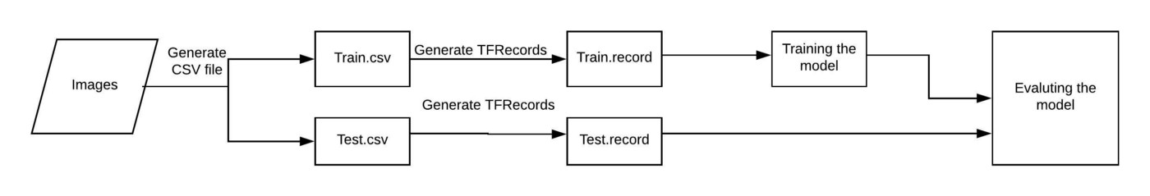
TF Object Detection Api

Slide 7
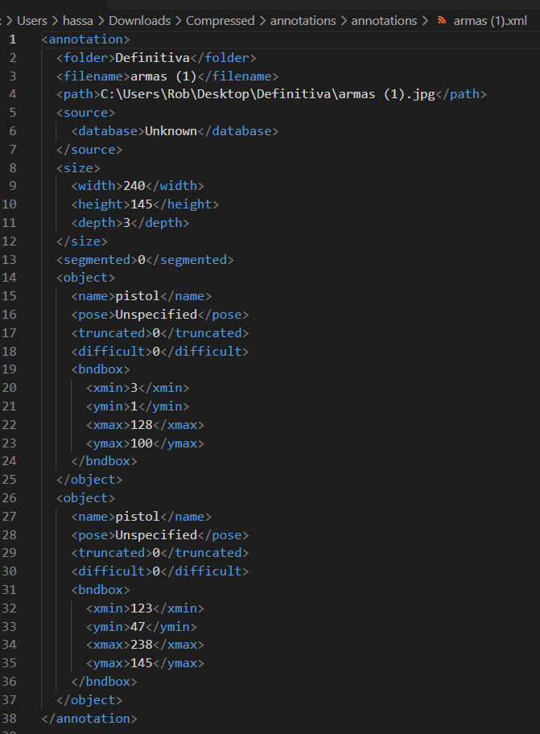
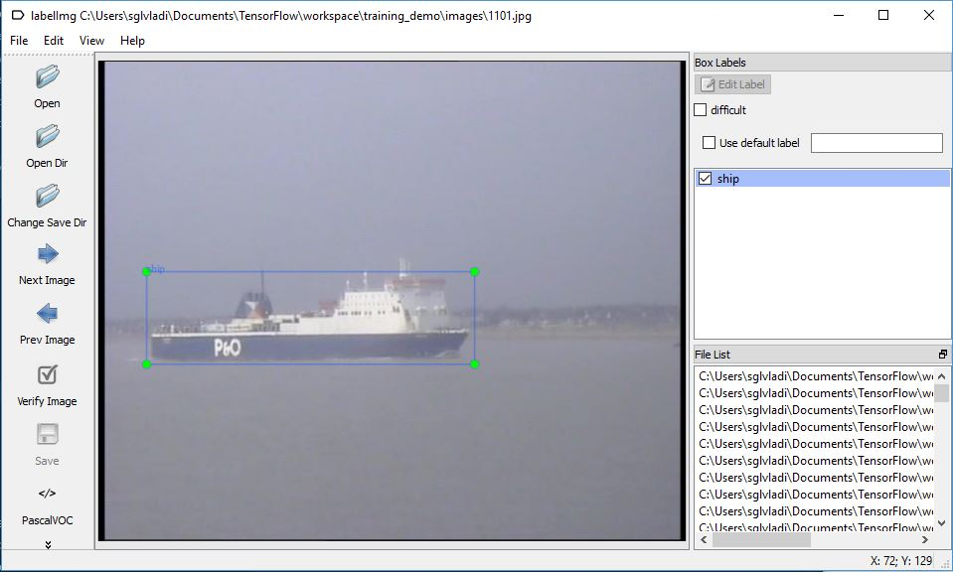
Pascal VOC XML
Annotation

Slide 8
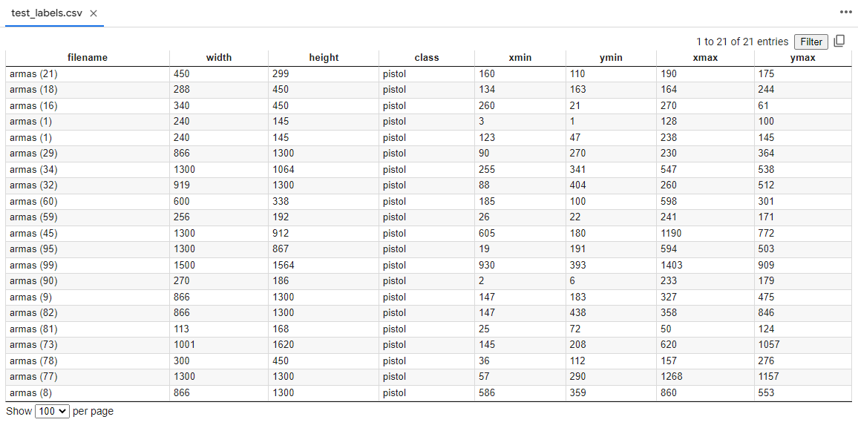
CSV File

Slide 9
TFRecord format
The TFRecord format is a simple format for storing a sequence of binary recorde. Converting your data into TFRecords has many advantages, such as. More efficient storage: the TFRecords data can take up less space than the original data; it can also be partitioned into multiple files.

Slide 10
.pb & .tflite
python export_tflite_graph_tf2.py --pipeline_config_path [pipeline config file ]
--output_directory [output file directory where .pb model will be saved]
tflite_convert --saved_model_dir=[saved model directory] --output_file [out file directory]

Slide 11
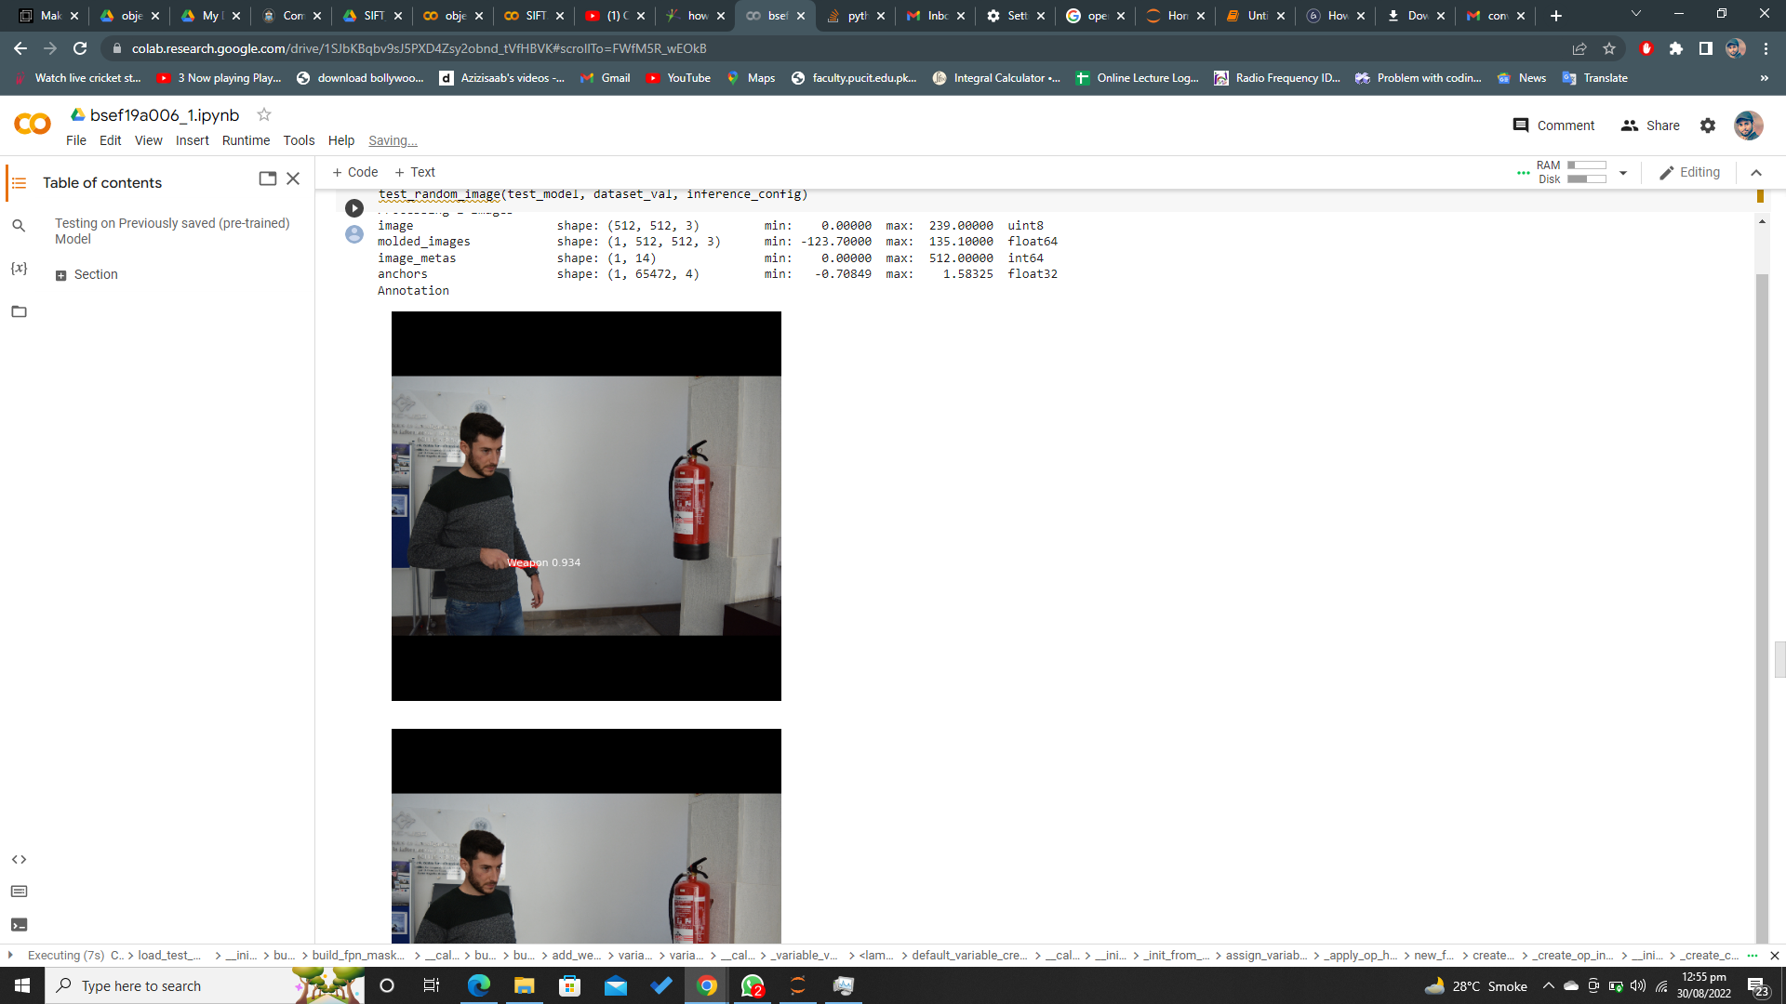
Qualitative Results
Quantitative Results
System is tested on recorded cctv video. Results demonstrated that the overall detection accuracy of TF Object Detection API is > 80%

Slide 12
DrawBack / Future Direction
Difficulty in detecting weapon in very low resolution of cctv
Lag in alarming
Medium Dependent
Difficulty in detecting weapon far at distance
Cannot Detect weapon like teaser gun etc
Can also detect other objects as weapon in highly populated complex
scenes.

Slide 13
Contributions
Muhammad Ashar
Syed Kashif Hassan Kazmi
Umer Farooq
Muhammad Hassan
Data Set Collection + Application
Annotation + Model Training
Annotation + Model Training
Data Set Collection + Application

Slide 14
References
John Canny. “A computational approach to edge detection”. In: IEEE Transactions on pattern analysis and machine intelligence 6 (1986), pp. 679–698.
https://tensorflow-object-detection-api-tutorial.readthedocs.io/en/tensorflow-1.14/training.html

Slide 15
QnA Session

