Slide 1
TradeTrack
"Your Trusted Companion, From Stock to Sale."
A Project by CodeCraft

Slide 2
TradeTrack: Streamlining Store & Inventory Management
Java-based desktop application with JavaFX frontend
Real-time inventory and order tracking
Role-specific interfaces for customers and staff
Powered by MySQL database for robust data management

Slide 3
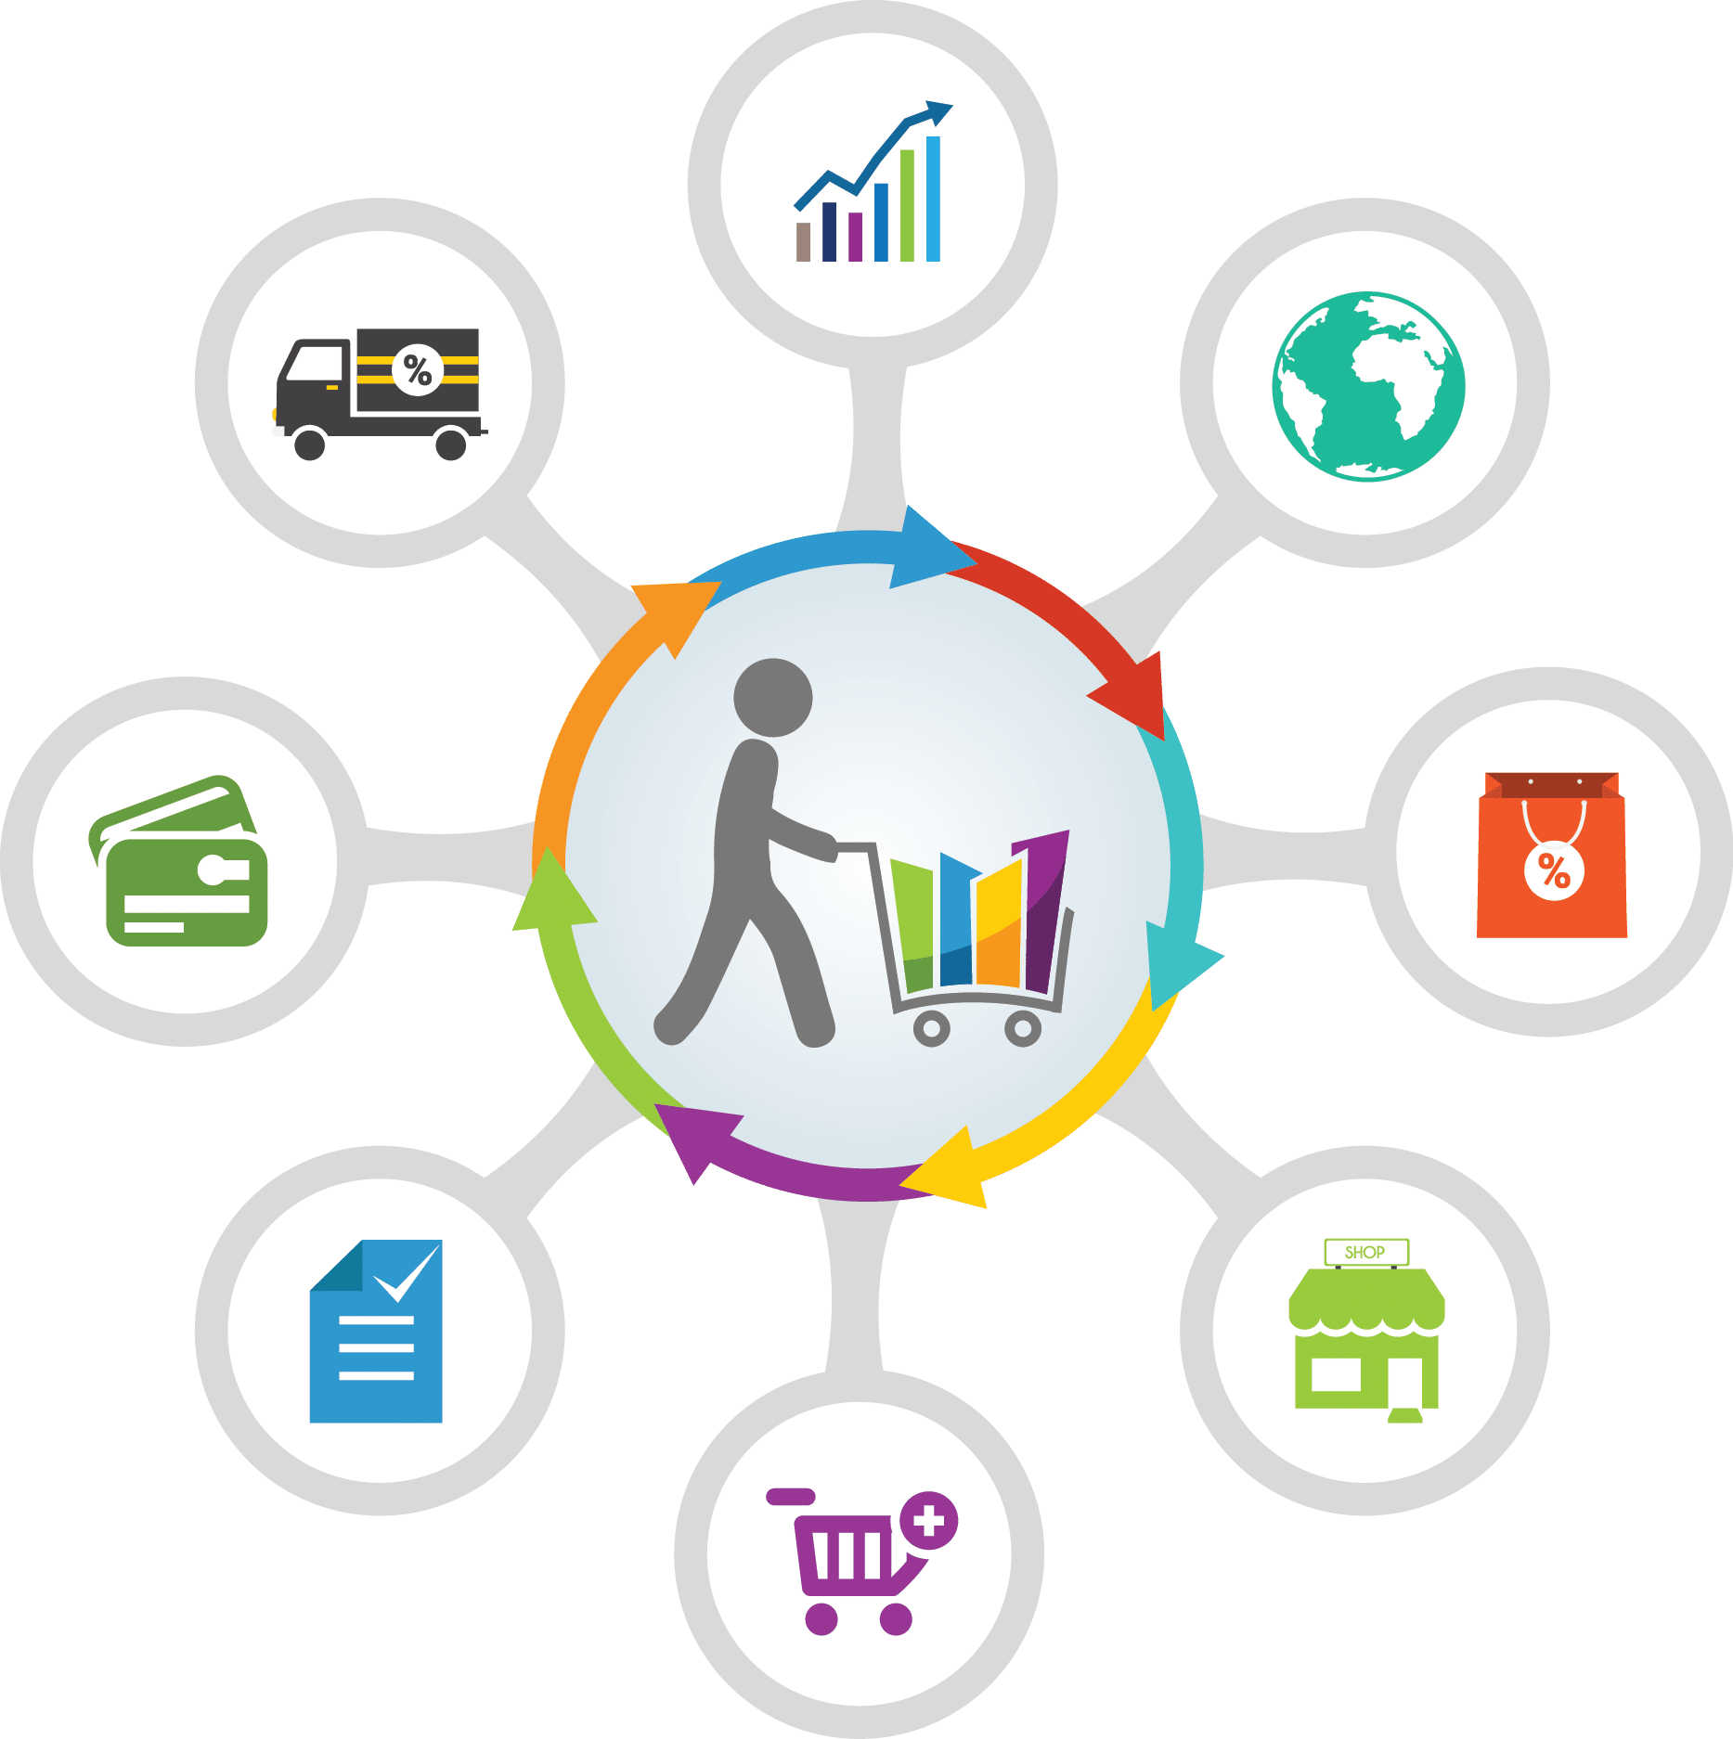
Why TradeTrack ?
Efficient Operations: Automates inventory, orders, and customer management.
Customizable & Scalable: Ideal for growing small to medium-sized businesses.
User-Friendly: Intuitive dashboards for staff and customers.
Real-Time Data: Keeps stock and orders updated for smooth operations.

Slide 4
Navigating TradeTrack

Slide 5
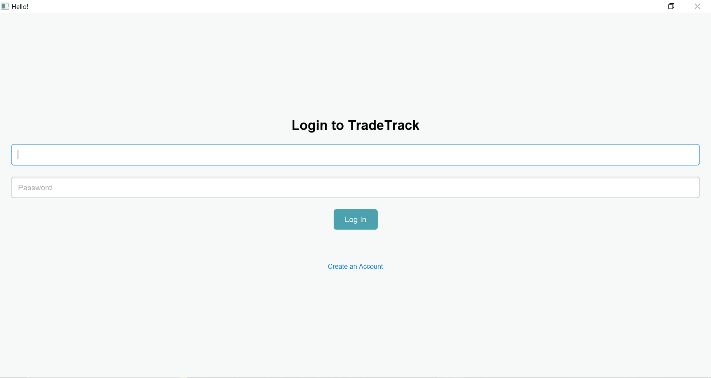

Slide 6
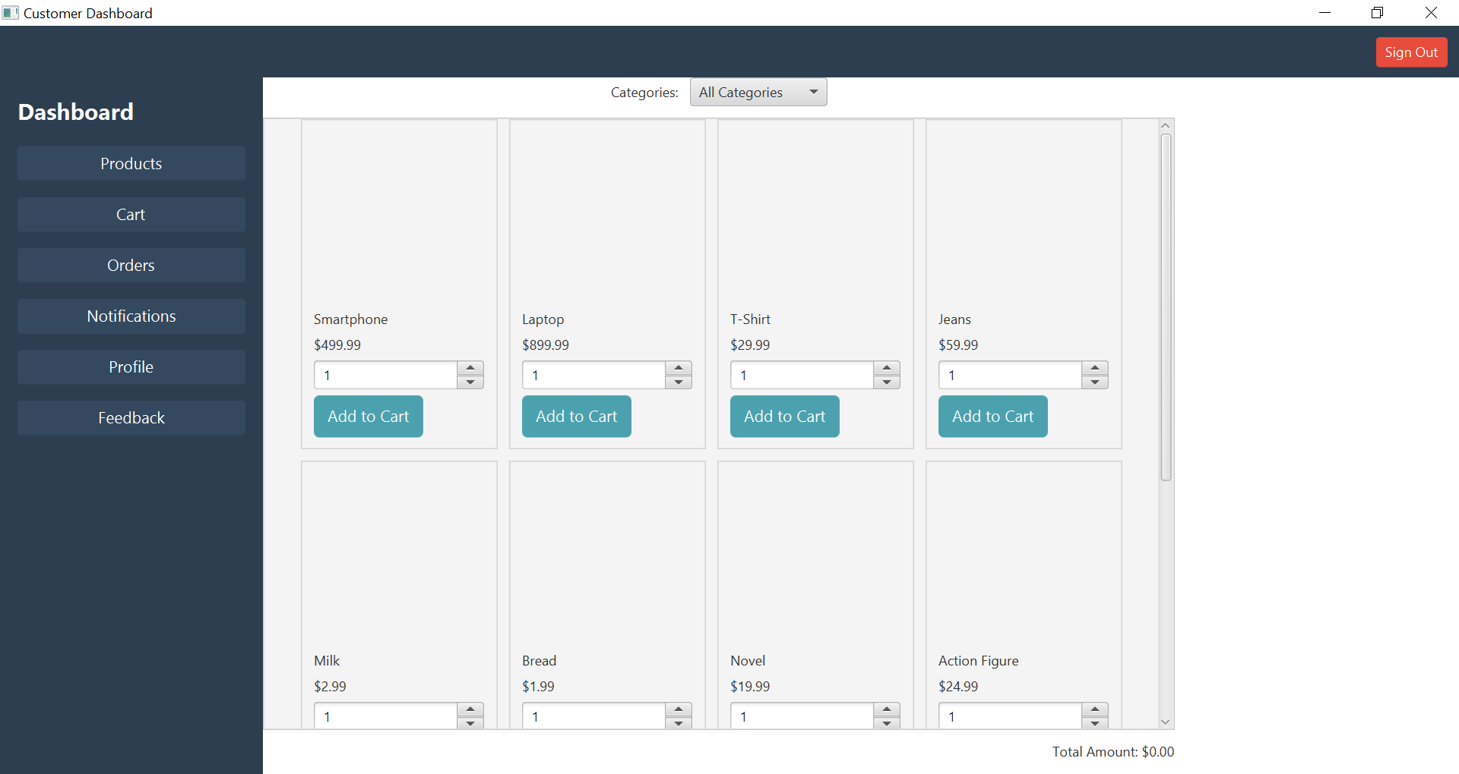
View Product Catalogue

Slide 7
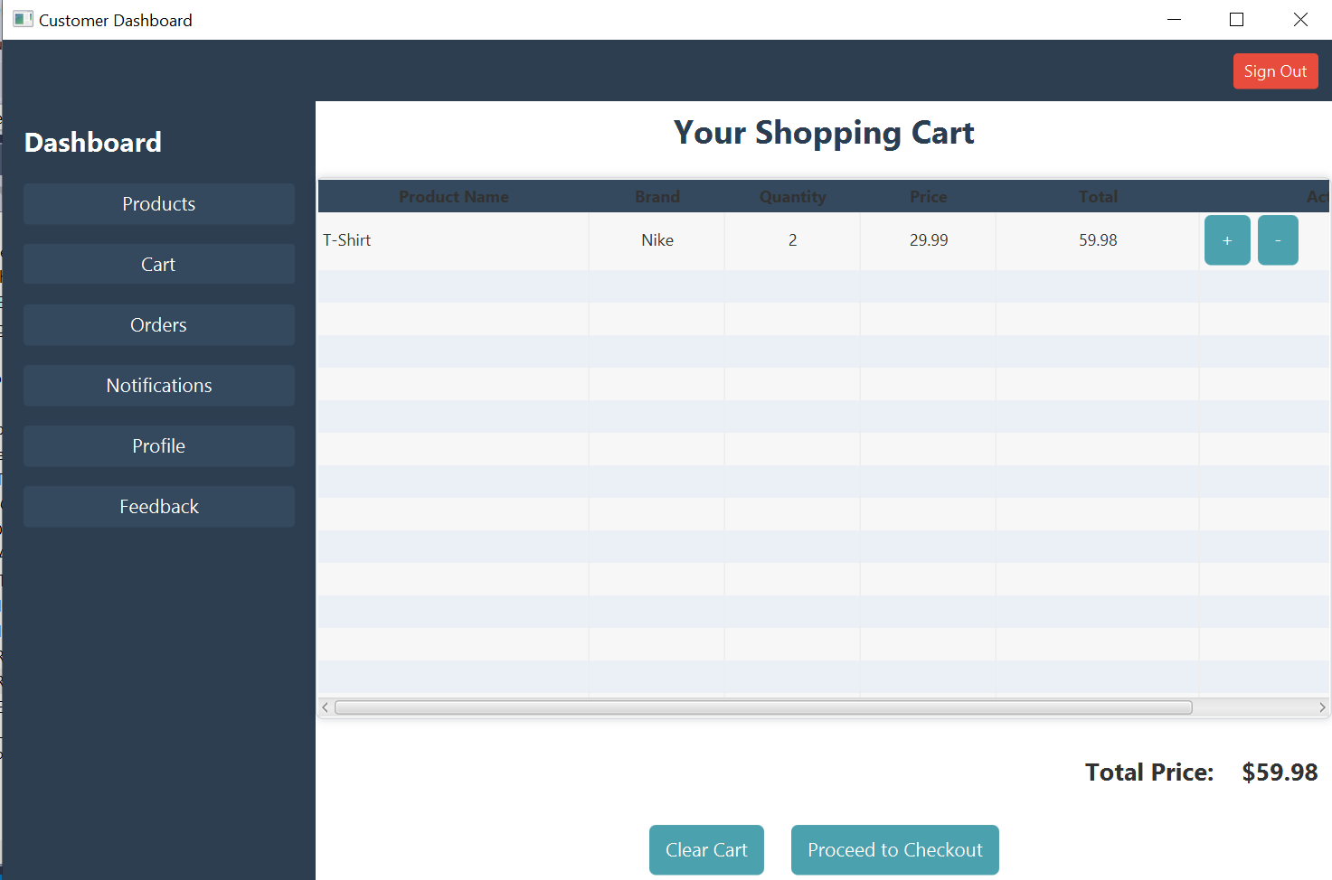

Slide 8
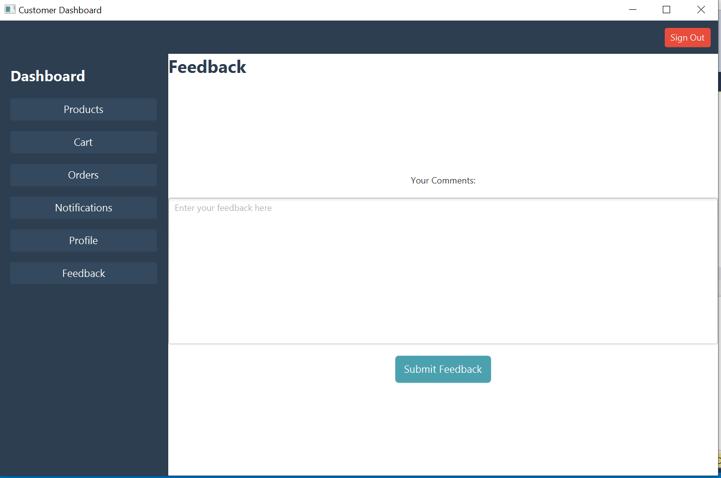

Slide 9
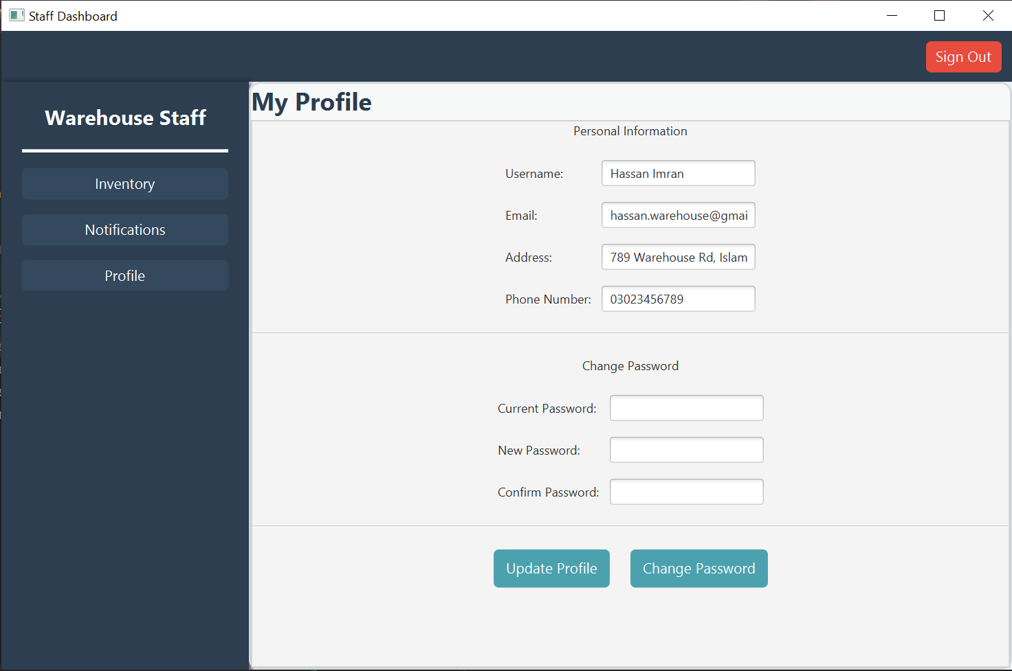

Slide 10
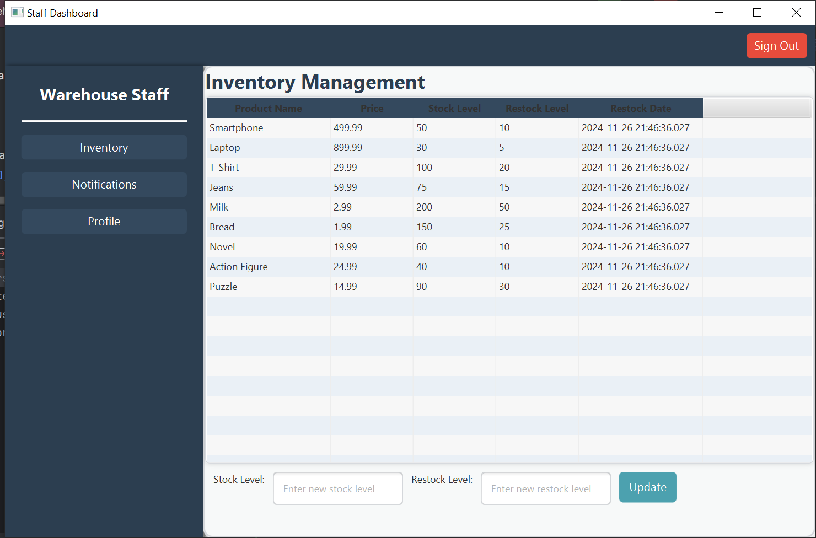

Slide 11
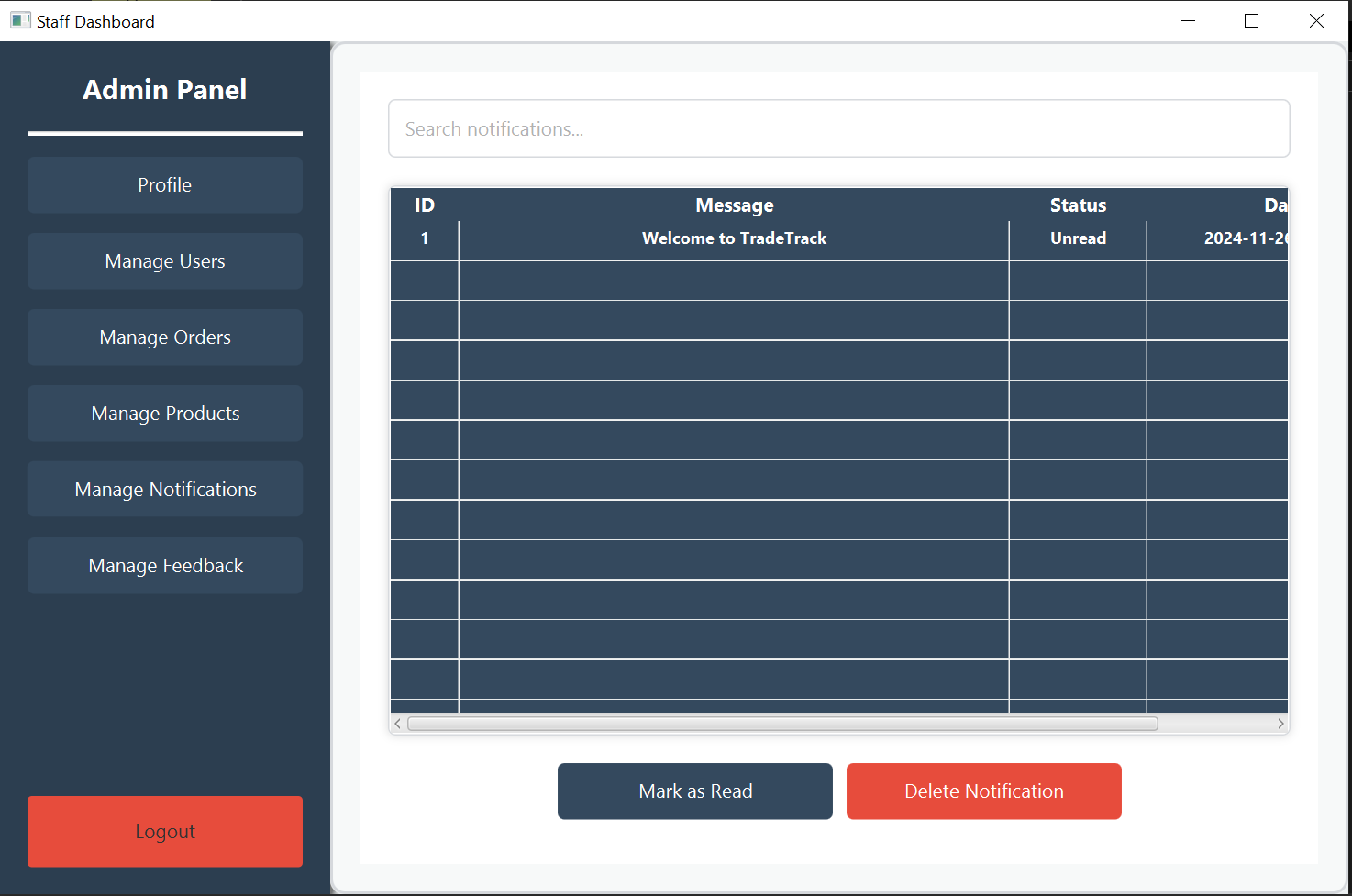

Slide 12
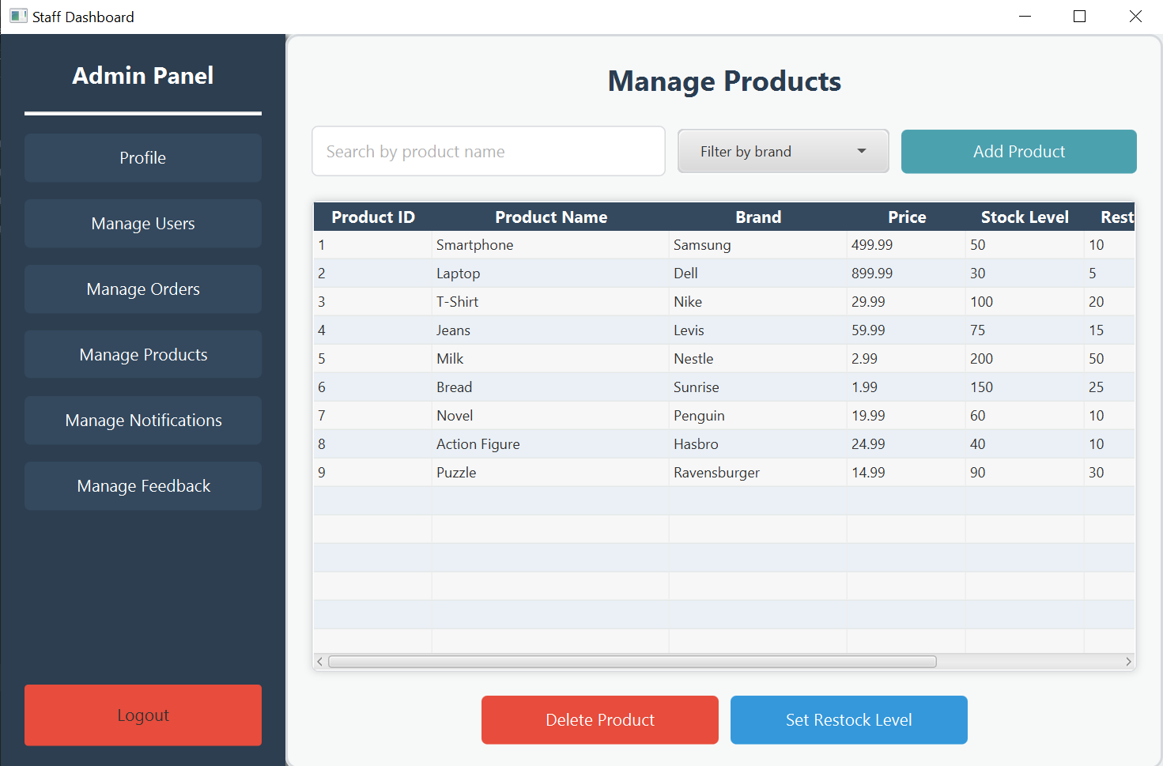

Slide 13
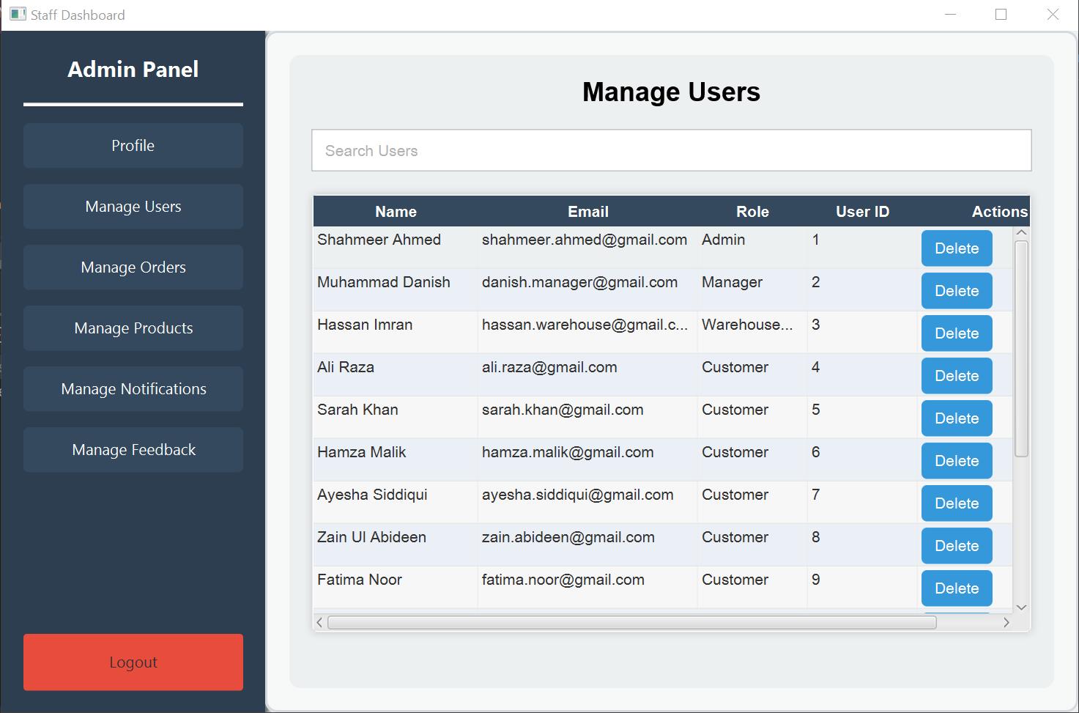

Slide 14
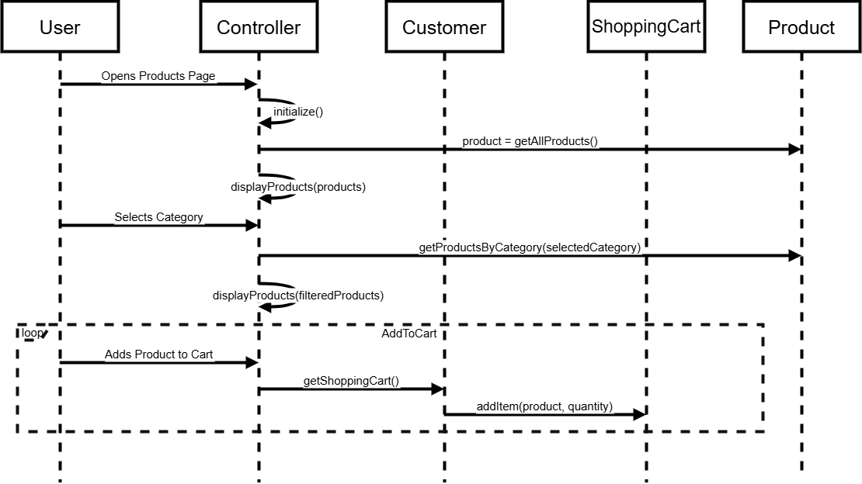
Key Use Case Analysis : View Product Catalogue

Slide 15
Extended Use Case : View Product Catalogue
Component Description
Use Case Name: View Product Catalog
Scope: TradeTrack eCommerce System
Level: User-goal
Primary Actor: Customer
Stakeholders and Interests:
Customer: Wants to browse products easily.
Store: Aims to present available products clearly
___________________________________________
Preconditions
The customer has access to the eCommerce platform.
Postconditions
The customer successfully views the product catalog.
Main Success Scenario
Customer navigates to the product catalog.
Customer browses and filters products.
Customer searches for specific items.
Customer views product details.
__________________________________
Extensions
Failure to Load Product Data: If the product data fails to load, the system displays an error message.

Slide 16
Technical Details

Slide 17
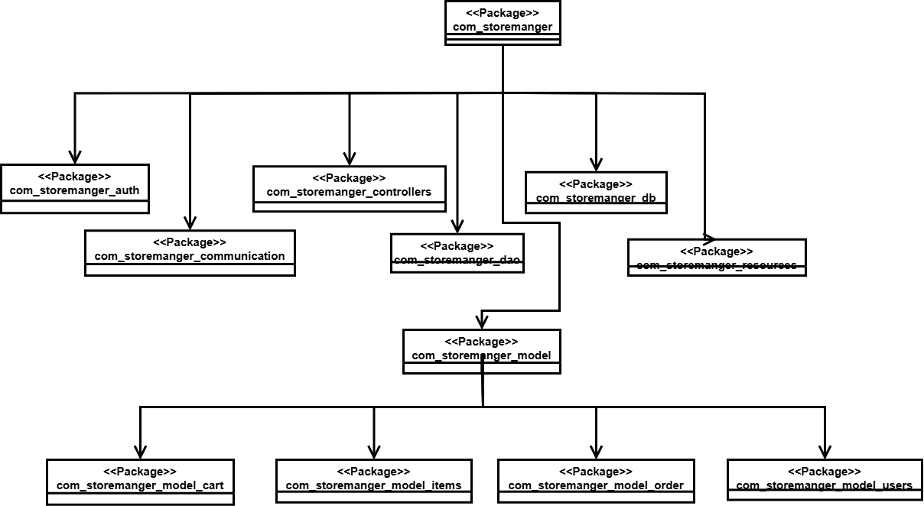
Package Diagram
Package Diagram

Slide 18
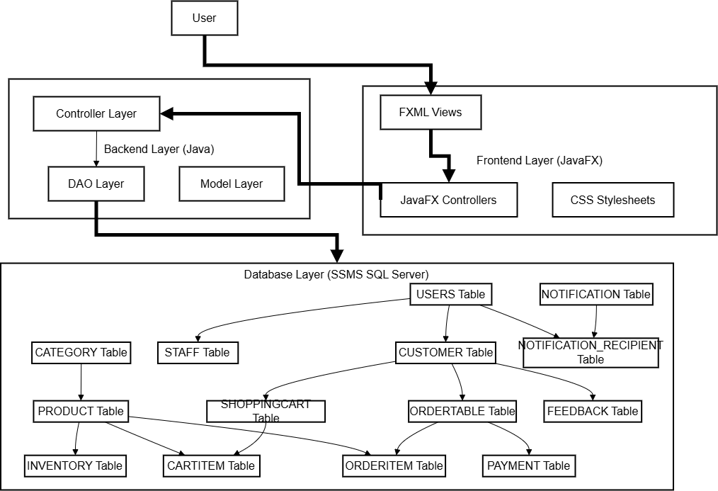
Component
Diagram

Slide 19
Design Patterns Used

Slide 20
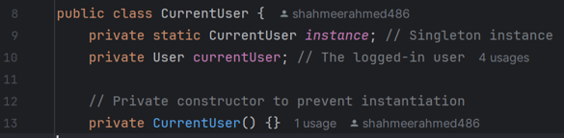
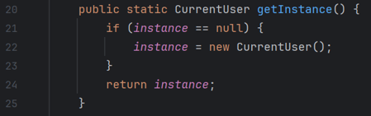
Singleton
Ensure that only one instance of the Current User object exists throughout the application, providing a centralized and consistent way to access user details.

Slide 21
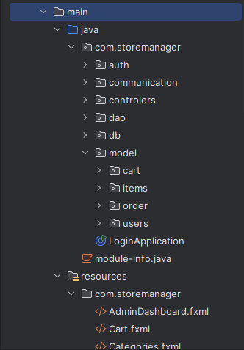
MVC (Model-View-Controller):
DAO Design Pattern
Model: Classes like Customer, Order, and Product encapsulate the application's data and business logic.
View: JavaFX user interfaces display product details, customer orders, etc.
Controller: Classes like OrderController and CustomerProductsController handle user interactions and mediate between the view and the model.
In the Store & Inventory Management system, the DAO (Data Access Object) pattern provides an abstract interface to manage database operations for entities like products, orders, inventory, and users.
It separates the persistence logic from the business logic, ensuring cleaner code, easier testing, and flexibility to adapt the database layer without affecting other parts of the system.

Slide 22
GRASP Concepts Used
(General Responsibility Assignment Software Patterns)
Information Expert: Customer class manages shopping cart and customer-specific details.
Creator: Shopping Cart creates CartItem objects.
Controller: CustomerProductsController handles user interactions and delegates to model classes.
Low Coupling: Order and Payment classes communicate through interfaces, reducing direct dependencies.
Polymorphism: Multiple Types of Users Implemented through a common Interface ‘Users' allowing flexibility as well as simplicity in managing common operations

