Slide 1

AI Nexus Insight
Eliminating the $150B 'Invisible Leak' in Clinic Revenue

Slide 2

The $150 Billion Revenue Leak
• No-shows cost the US healthcare system $150B annually.
• Average clinic loses 18% - 30% of potential revenue.
• A single missed appointment costs an average of $200.
• For a clinic with 20 appts/day, that's $4,000/week in lost revenue.

Slide 3
Frictionless Patient Onboarding
• Inspired by High-Conversion Kiosks (KFC/McDonald's style).
• Patients book in under 30 seconds—no complex portals.
• Clean, premium UI that builds trust instantly.
• Designed for conversion: The faster they book, the more likely they show.

Slide 4
AI Pattern Analysis & Automation
• Automated SMS Webhooks: Patients reply 'YES' to confirm.
• Real-time Dashboard: Your schedule updates without human intervention.
• Predictive Alerts: AI identifies high-risk appointments BEFORE they miss.
• Target zero manual follow-ups.

Slide 5
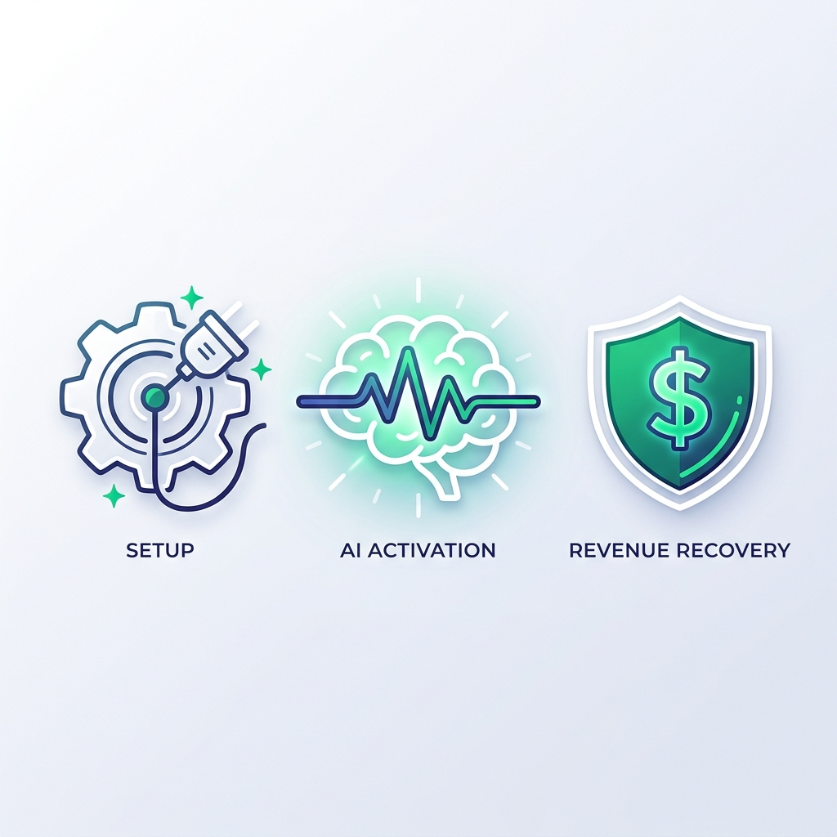
The 7-Day Revenue Recovery Roadmap
PHASE 1: Day 1-2
ZERO-FRICTION SETUP
PHASE 2: Day 3-5
AI CALIBRATION
PHASE 3: Day 7+
REVENUE RESTORED
Sync your existing schedule in 15 mins. No complex IT integration required.
Engine identifies your 'Risk Zones' and starts smart SMS sequences.
Recover your first $200+ slot. View live 'ROI Reports' on your dashboard.

Slide 6
Become a Founding Partner
We are onboarding ONLY 5 clinics this month to ensure success.
• Lifetime 'Early Adopter' Pricing (50% off Forever)
• Custom AI Model Tuning for your specific patient base
• Priority access to new Revenue Recovery features
• White-glove implementation & direct team support

Slide 7
Ready to Fix Your Revenue Leak?
Schedule your 15-minute deep-dive demo today.
BOOK A DEMO

