Slide 1
Impeccable
A design-director skill for Claude Code
What it is
Setup
Usage
Benefits
Limitations
Docs & samples
Skill version 4.0.0 · Notes from the Maven Fuzzy Factory (Toy Store) redesign · Hassan Rahman
Notes:
Impeccable is a Claude Code skill that turns UI requests into a directed design process: product context, a chosen visual direction, a build held to a quality floor, an independent review and a recorded design system.

Slide 2




What Impeccable is
A skill that makes Claude work like a design director, not a template generator
Loads product and design context before touching UI
Rolls a visual direction so every project does not land on the same look
Builds against a craft floor: contrast, states, focus, motion, anti-patterns
Hands the finished build to a fresh reviewer, then records DESIGN.md
It picks one of four modes from the surface being built:
Persuade
Operate
Landing, marketing, pricing: the visitor decides and acts
Apps, dashboards, tools: the visitor completes a task
Read
Experience
Docs, articles, guides: the visitor understands
Portfolios, galleries: the work itself leads
The Toy Store dashboard ran in Operate mode.

Slide 3
Setup
Four steps from install to a project Claude understands
1
2
3
4
Install the skill
Load context
Capture product
Record the system
Place the skill folder under ~/.claude/skills/
Once per session Claude runs
Short interview, writes PRODUCT.md
From existing code, or after a build
skills/impeccable
impeccable context
/impeccable init
/impeccable document
Installer options: impeccable.style/docs
Self-contained binary; Windows uses impeccable.cmd
Users, purpose, constraints, evidence
Writes DESIGN.md + .impeccable/design.json
Optional: /impeccable hooks on runs the design detector after every UI edit. /impeccable doctor repairs stale context files.

Slide 4
Usage: one entry point, many commands
Type /impeccable <command> [target], or describe the change in plain words and it routes itself.
Build
Evaluate
Refine
shape · init · document · extract
critique · audit
polish · bolder · quieter · distill · harden · onboard
Plan UX, capture product truth, extract a design system
Heuristic UX review; technical a11y, performance, responsive checks
Adjust intensity, strip complexity, add edge cases and first-run
Enhance
Fix
Iterate
animate · colorize · typeset · layout · delight · overdrive
clarify · adapt · optimize
live
Motion, colour, type, spacing, personality, ambitious effects
UX copy, devices and screen sizes, UI performance
Pick elements in the browser and generate alternatives

Slide 5
Usage: how a redesign actually runs
The Toy Store dashboard, from "make it professional" to a shipped, documented design
1
2
3
4
5
6
7
Interview
Direction roll
Contract
Build
Detect
Review
Document
Users, story, constraints
Seeded choices on a decision page
Thesis, world, first viewport
Against the craft floor
Mechanical anti-pattern scan
Fresh reviewer, screenshots only
System from the shipped build
PRODUCT.md
You pick one
Surface brief
HTML / CSS / JS
impeccable detect
ship / fix / rebuild
DESIGN.md
9
direction cards shown, 1 chosen
8
material fixes from the full review
3
verdict passes, the last one "ship"

Slide 6




Benefits
Escapes the generic AI look
A seeded roll and named anti-patterns (gradient text, glass, eyebrow labels, hard shadows) keep designs off the category default.
Context that survives sessions
PRODUCT.md, DESIGN.md and design.json let any later edit stay on-brand without re-explaining.
A real quality floor
Contrast, focus rings, states, motion rules and browser surfaces are checked, not assumed.
Independent review with evidence
A fresh reviewer judges screenshots against the contract; fixes are scored resolved, partial or unresolved.
Toy Store redesign: every item was closed before "ship".

Slide 7






Limitations, and how to work with them
It takes time and tokens
Comp-first needs image generation
Interviews, a direction round and up to three review rounds. Use narrow commands (polish, layout) for small fixes.
Without an image tool it builds code-first; the ambition lives in a written contract instead of a mock.
The reviewer only sees screenshots
The roll may surprise you
You must capture valid desktop and mobile shots. Headless Chrome cannot go below ~500px, so mobile needs an iframe or device tool.
A seeded direction can feel off-brief. Re-roll (safer / bolder) or take the category standard.
The detector can false-alarm
It adds files to the repo
Flags like cramped-padding on an intentional ruled strip need human judgement.
Commit design.json and surfaces/; git-ignore .impeccable/review, questions, build and mocks.

Slide 8
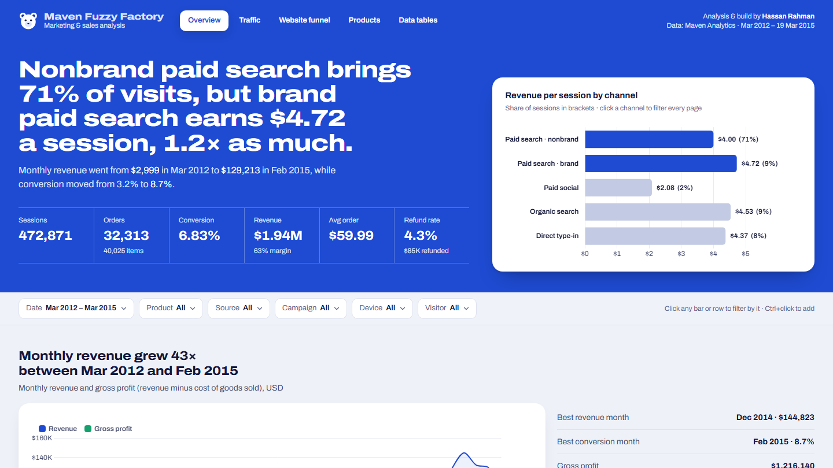




Docs & samples
Documentation
impeccable.style/docs
Project site
impeccable.style
Skill source
github.com/pbakaus/impeccable
Toy Store Overview after the redesign: a live finding headline, a key-figures strip, and the chart that proves it. Sample code in toy-store/web; the design system is in toy-store/DESIGN.md.
Sample: Toy Store analysis
github.com/mhassanrahman/impeccable-design-apps
Notes:
Links: https://impeccable.style/docs/ · https://impeccable.style · https://github.com/pbakaus/impeccable · https://github.com/mhassanrahman/impeccable-design-apps (toy-store/web).

