Slide 1
Customer Churn Analysis & Retention Strategy
Professional Business Analytics Presentation

Slide 2
Business Problem
Customer churn causes revenue loss and impacts long-term growth.

Slide 3
Project Objectives
Analyze churn behavior, identify drivers, and recommend retention strategies.

Slide 4
Dataset Overview
7043 customers, 21 variables, telecom business data.

Slide 5
Methodology
Data Cleaning → EDA → Statistical Analysis → Segmentation → Recommendations

Slide 6
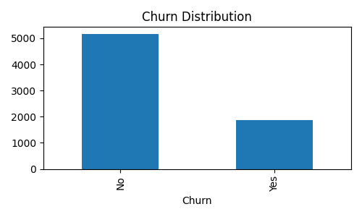
Churn Distribution

Slide 7
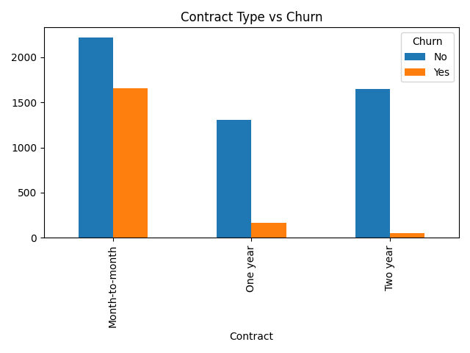
Contract Analysis

Slide 8
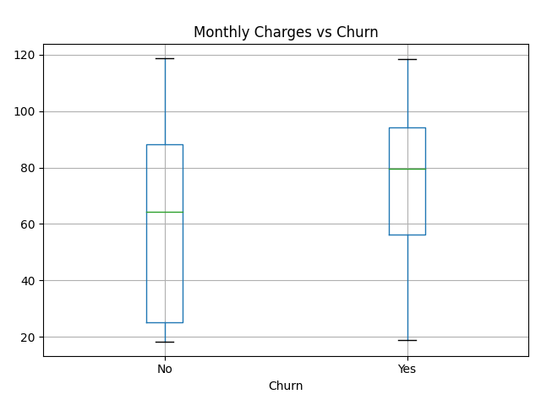
Monthly Charges Analysis

Slide 9
Key Insights
Month-to-month contracts, high charges and low tenure drive churn.

Slide 10
Recommendations
Contract discounts, onboarding, loyalty programs, predictive retention.

Slide 11
Implementation Plan
4-week rollout followed by KPI monitoring.

Slide 12
Conclusion
Data-driven actions can reduce churn and improve profitability.

