Slide 1
Automatic Picture Pulling
By Meghan Hatzipetro

Slide 2
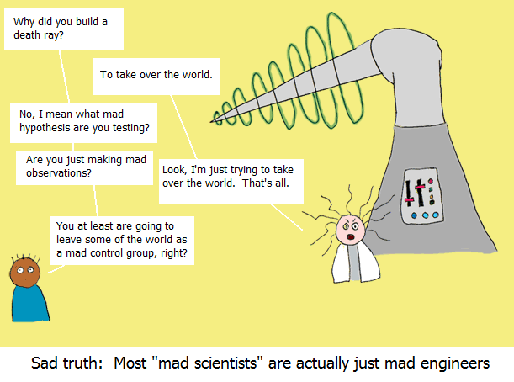
Mad Scientist

Slide 3
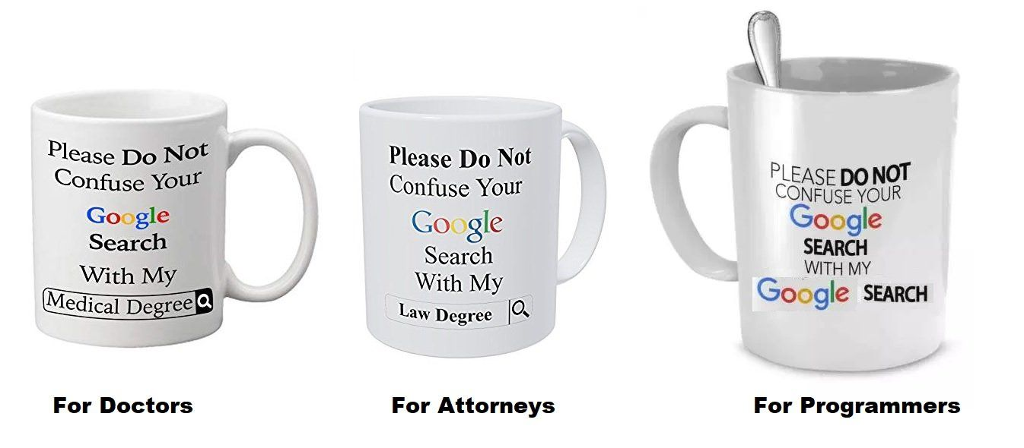
Programmer Mug Meme

Slide 4
Rick Roll
Even programmers like to have a little fun...

