Slide 1


Asynchronous programming using async and await; Practical examples included
Dr. Matheus Hauder Date: 21.07.2023

Slide 2

Agenda
Introduction Asynchronous Programming
Definition
Synchronous, Asynchronous and Multi-Threading Models
Benefits
Asynchronous Programming in Python
Callback
Awaitable Objects
Merge Parallel Tasks
Sequential Task Execution
Further Literature

Slide 3
Agenda
Introduction Asynchronous Programming
Definition
Synchronous, Asynchronous and Multi-Threading Models
Benefits
Asynchronous Programming in Python
Callback
Awaitable Objects
Merge Parallel Tasks
Sequential Task Execution
Further Literature

Slide 4
Definition: Asynchronous Programming
“An asynchronous task is operated independently from other tasks in a program. It allows processing of tasks that require long-time duration to be processed in the background, while other tasks can continue to execute.“
Originally asynchronous is a Greek word with the constituents
Asyn -> not with
Chronos -> time
Programming languages such as Python, JavaScript and C# use asynchronous methods
They are typically declared and used with the keywords async and await

Slide 5
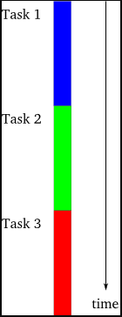
Asynchronous Programming: Comparison of different programming models (1)
Single-threaded synchronous model
Task is an operation that needs to be executed in a program, e.g., performing a computation
Execution of tasks is happening one at a time with finishing one before another task starts
Tasks are performed in definite order making the output available to the subsequent tasks

Slide 6
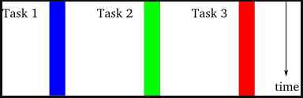
Asynchronous Programming: Comparison of different programming models (2)
Multi-threaded synchronous model
Each task is executed in a separate thread of control
Threads are managed by the operating system (OS) and may run concurrently in case multiple processors or cores are available
OS is handling the threaded execution
Thread coordination and communication might be required in case the threads are not independent

Slide 7
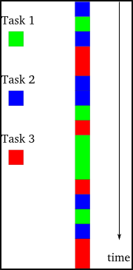
Asynchronous Programming: Comparison of different programming models (3)
Asynchronous model
Tasks are interleaved with each other, e.g., execution task 2 is interrupted with execution of task 1
There is only a single thread of control
Even in multiprocessor systems task are interleaved against each other
Tasks might have dependencies and downstream tasks must wait if input from upstream task is required

Slide 8

Question: What is the difference between the asynchronous and multi-threaded models for the programmer?
In the asynchronous model the programmer can explicitly organize execution order between tasks
In the multi-threaded model, the decision to suspend threads is organized by the OS and outside the control of the programmer
In the multi-threaded model, programmer must assume suspension and replacement of threats at any time and must organize access to shared resources

Slide 9
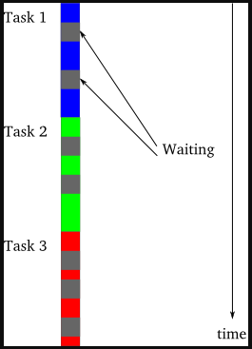
Benefits of the Asynchronous Programming Model
Benefits of asynchronous model
Asynchronous model can dramatically outperform synchronous model, if tasks are forced to wait or block through e.g.,
I/O requests to files, databases
Network requests
Even network requests in ~ 20 milliseconds are slow compared to today’s CPU speed
Gray areas are waiting areas that are filled-up with other tasks in the asynchronous model

Slide 10
Question: In which situations or examples can the asynchronous model outperform the synchronous model?
Tasks perform lots of I/O that create to waiting times, e.g., file, database or network communication
There are many tasks that can be executed independent of each other, e.g., busy web server
Avoids overhead for additional threads, e.g., memory for creation of new threads, expensive context switching between threads
Programming model is simpler and easier to read compared to multi-threaded models, especially using async and await

Slide 11
Agenda
Introduction Asynchronous Programming
Definition
Synchronous, Asynchronous and Multi-Threading Models
Benefits
Asynchronous Programming in Python
Callback
Awaitable Objects
Merge Parallel Tasks
Sequential Task Execution
Further Literature

Slide 12
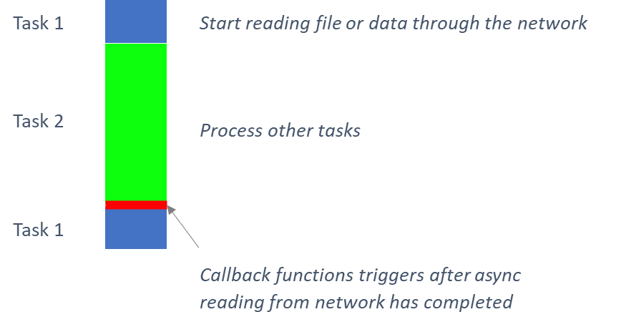
Principle of Callback Functions
Blockings should be avoided, and execution of code should continue with other tasks if possible
Callback function is provided to continue interrupted execution as soon as possible, e.g., reading of file or network is completed
The semantics of this is “don’t wait continually for this task to finish and continue”
Caution! Debugging becomes more difficult in this programming model

Slide 13
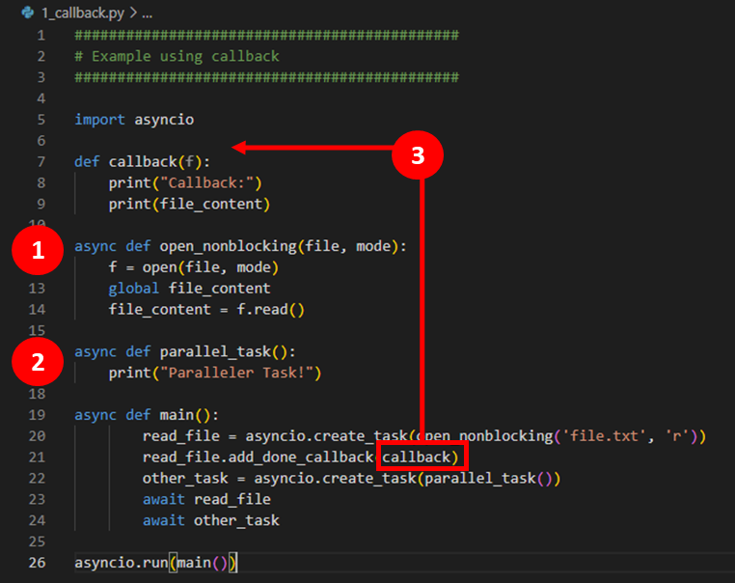

Example for Callback function in Python
1
Function is reading data from file and stores result in global variable
Parallel task is executed immediately not waiting until reading of file is completed
After reading is completed, callback function executed with processing of the result
2
3
Code maintainability and readability worse
Debugging changes execution timing
“Callback Hell” from many nested callbacks
Exceptions are more difficult to catch
Source code on github: https://github.com/mhauder-hm/async_programming

Slide 14
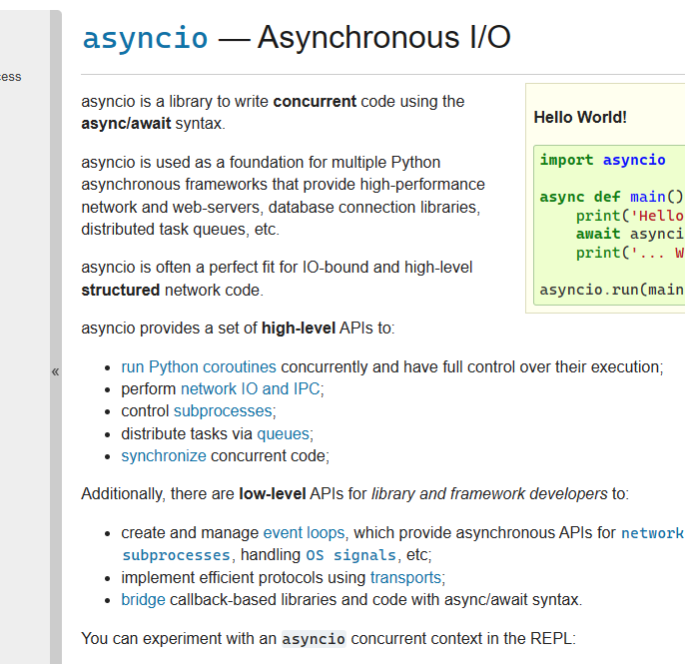
Using async and await in Python
Async / await have been introduced in Python 3.5 in 2015 and are also used in other programming languages like C# or TypeScript
Asynchronous functions are called Coroutines and are declared with async def:
Definition with async functions with keyword async before def
async function can be interrupted in order to share resources
Keyword await can only be defined within coroutines
At this point execution is interrupted until the result of asynchronous operation is available
In Python the asyncio library [1] provides concurrent programming using the async / await syntax that provides e.g.

Slide 15
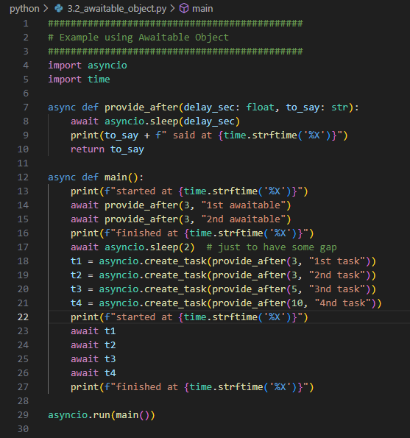
Example: Awaitable Objects
Function is reading data from file and stores result in global variable
Parallel task is executed immediately not waiting until reading of file is completed
After reading is completed, callback function executed with processing of the result
Source code on github: https://github.com/mhauder-hm/async_programming

Slide 16
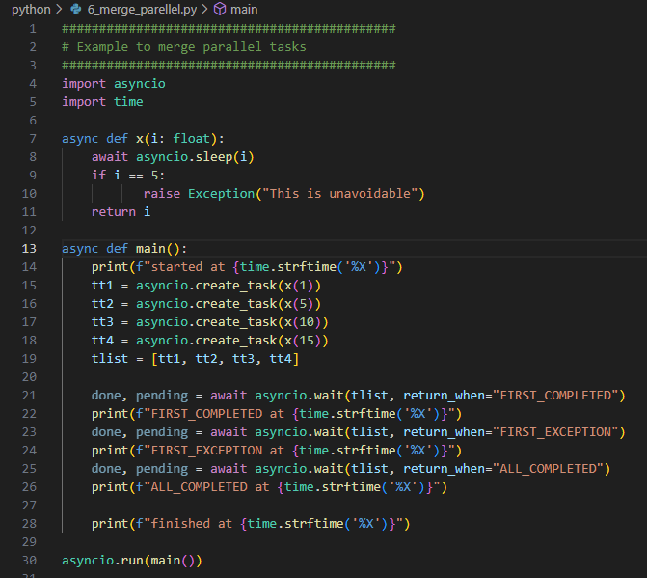
Example: Merge Parallel Tasks
Function is reading data from file and stores result in global variable
Parallel task is executed immediately not waiting until reading of file is completed
After reading is completed, callback function executed with processing of the result
Source code on github: https://github.com/mhauder-hm/async_programming

Slide 17
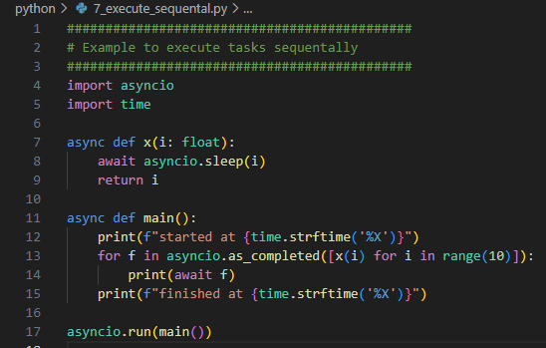
Example: Sequential Task Execution
Function is reading data from file and stores result in global variable
Parallel task is executed immediately not waiting until reading of file is completed
After reading is completed, callback function executed with processing of the result
Source code on github: https://github.com/mhauder-hm/async_programming

Slide 18
Agenda
Introduction Asynchronous Programming
Definition
Synchronous, Asynchronous and Multi-Threading Models
Benefits
Asynchronous Programming in Python
Callback
Awaitable Objects
Merge Parallel Tasks
Sequential Task Execution
Further Literature

Slide 19
Further Literature
asyncio – Documentation of Asynchronous I/O for Python: asyncio — Asynchronous I/O — Python 3.11.4 documentation
Source code for async programming (github): https://github.com/mhauder-hm/async_programming

