Slide 1
Market Reaction to Major Weather Events
2025
Miranda McMurray

Slide 2
Problem Statement
Data Collection and Cleaning
Exploratory Analysis
Model Selection
Results
Recommendations
Agenda

Slide 3

Data Cleaning and Collection
Collection
F
W
FRED
Weather
All indices are downloaded as individual csv files
Bulk data download from the NOAA weather event database
Every file was formatted the same
Observation date, index reading
Indices are recorded at different intervals
Daily values are used for this dataset
All missing values are forward filled.
One dataset
23 columns were dropped initially
‘Property Damage’, ‘num_events’, ‘Total Injuries and Deaths’

Slide 4
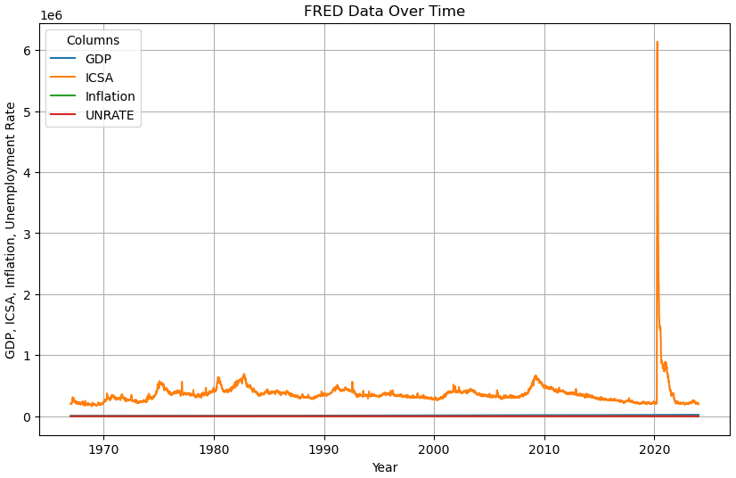
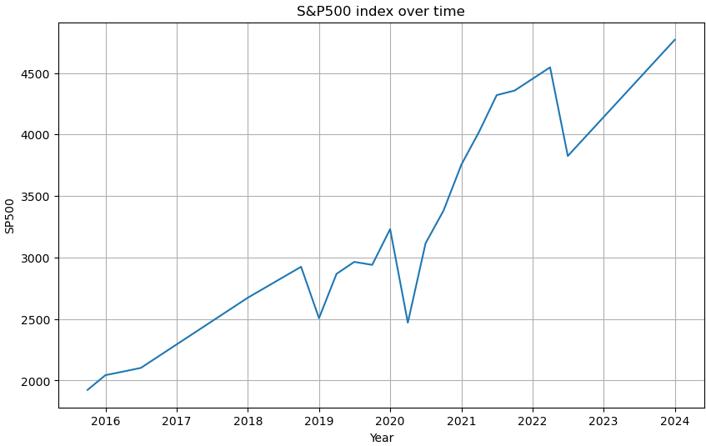
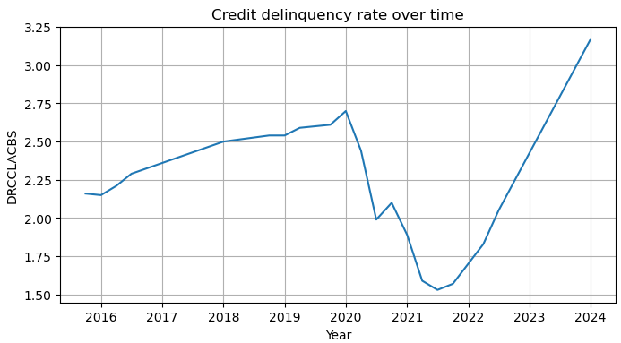
Exploratory Analysis
Graphs
Trends
The jumps in ICSA are substantial enough to make all other indices appear flat. The largest reaction is seen in each index.
From 2021-2022, S&P500 and credit card delinquency show opposite trends. 2022 onward they both trend positive.

Slide 5
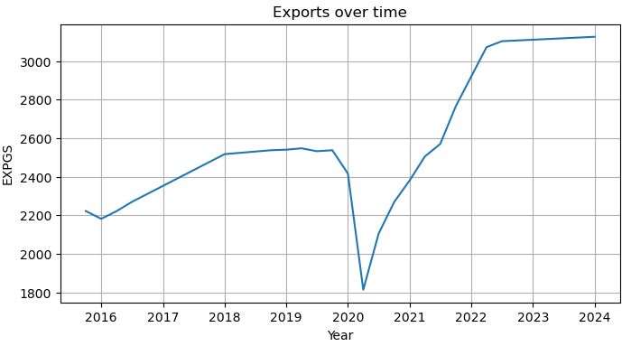
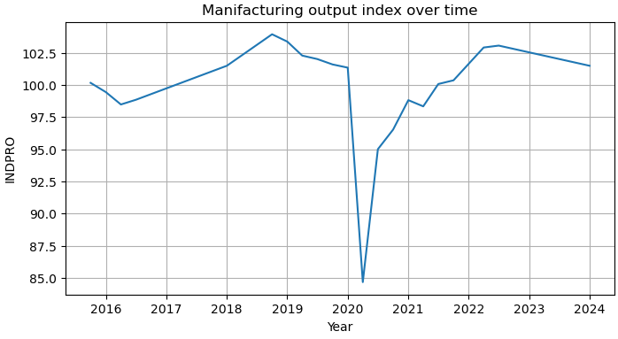
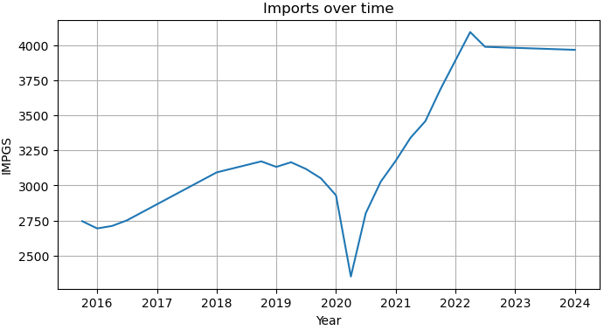
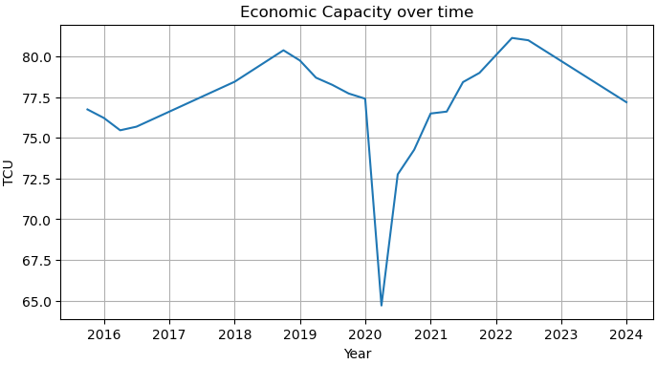
Exploratory Analysis
Graphs
Trends
Manufacturing and Economic Capacity are nearly identical. This is also expected, as manufacturing output is measured in economic capacity.
Imports and exports exhibit similar trends, which is not unusual but worth noting for understanding market behavior.

Slide 6
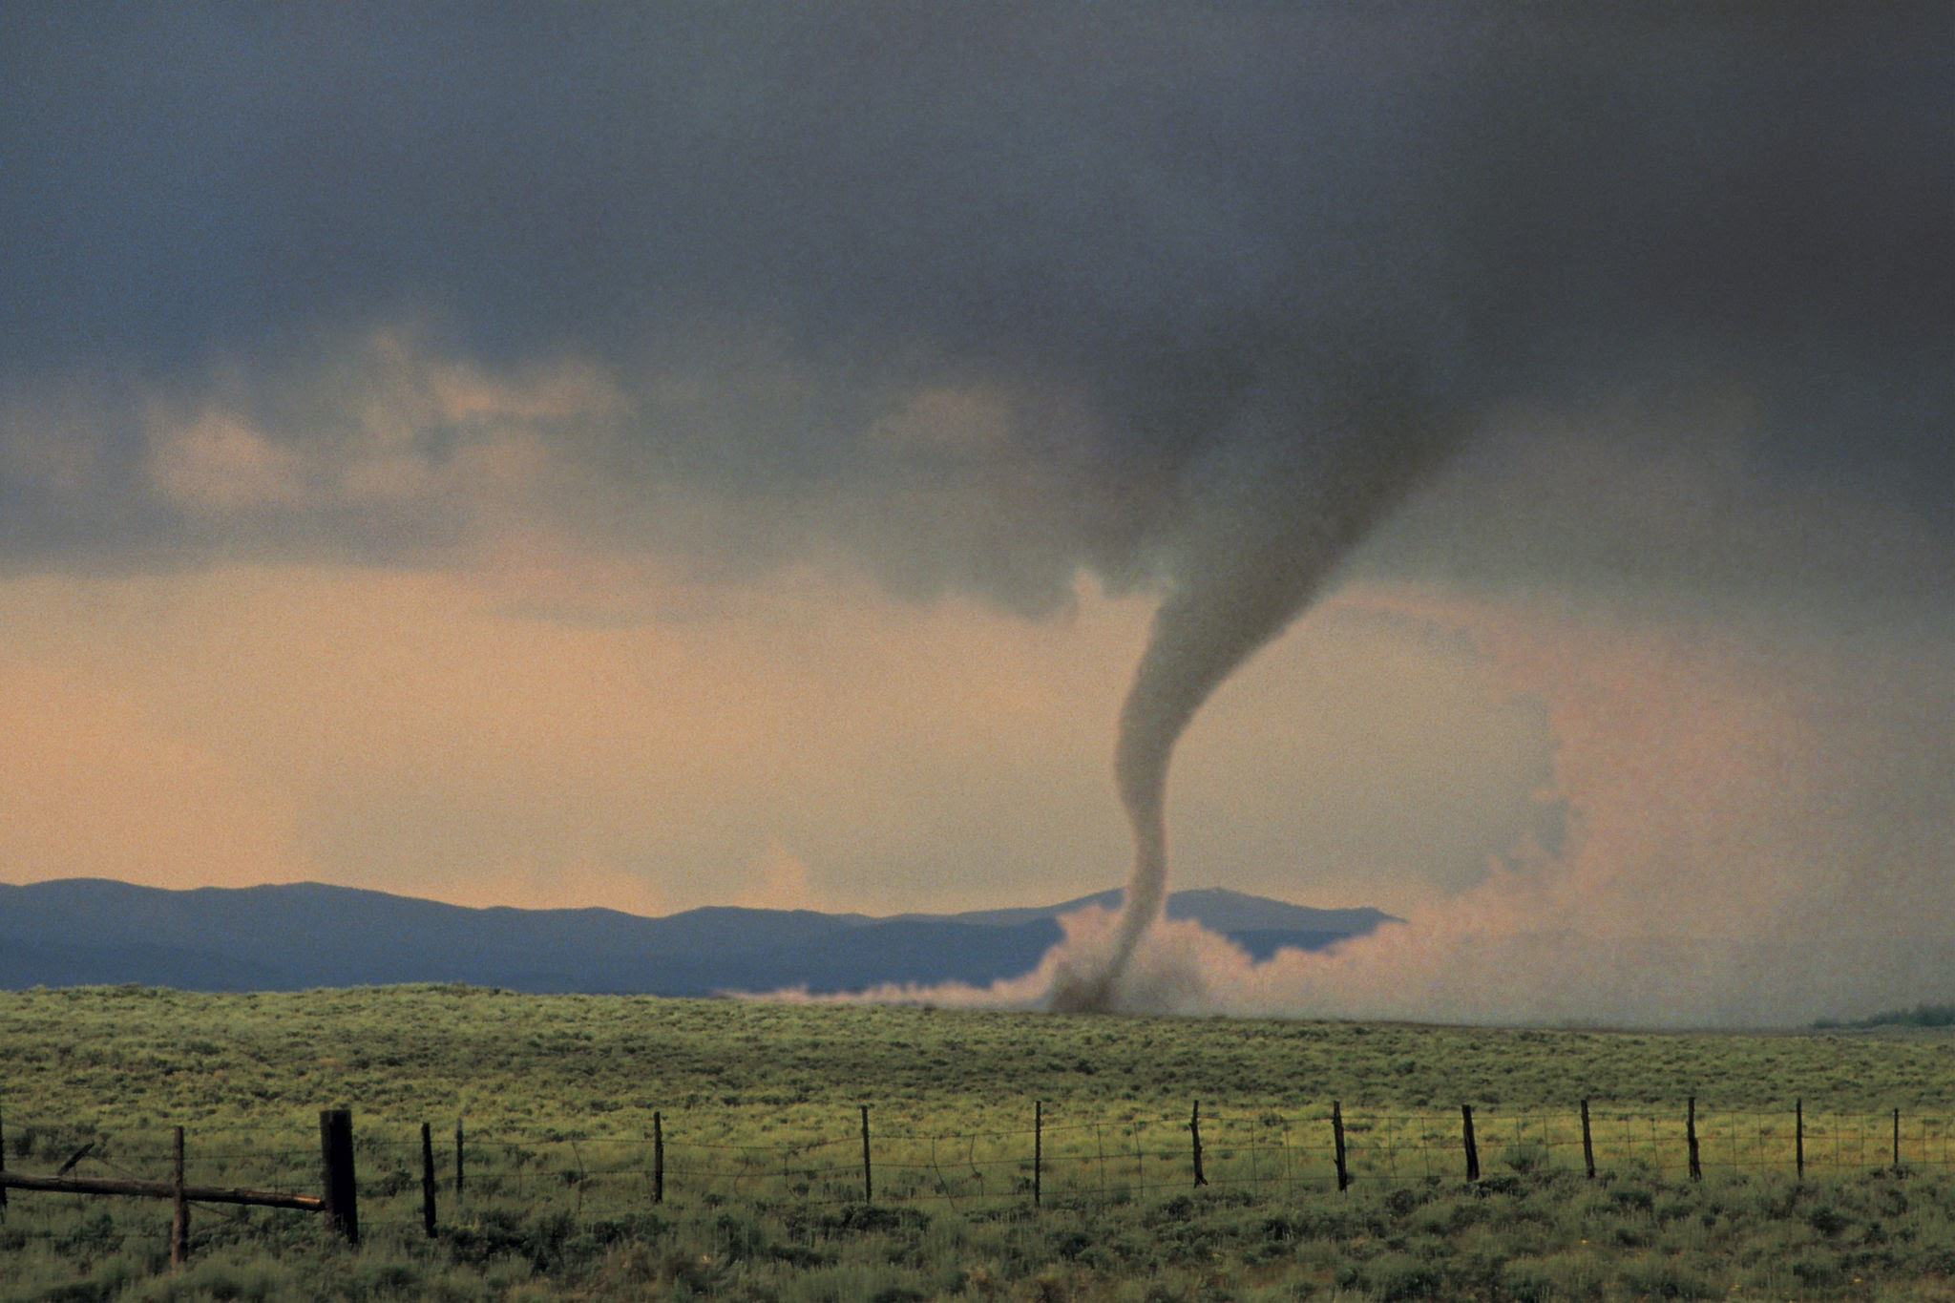
Model Selection
XGBoost
Relevance
ARIMA
Linear Regression
Relevance
Relevance
Good for datasets with lots of features
Captures non-linear patterns that might be missed with Random Forest
Captures autocorrelation
Great for time series forecasting
Good for smaller datasets
Good for identifying simple relationships
Great baseline model
Random Forest Regression
Relevance
Also great for datasets with many features
Not as impacted by outliers

Slide 7
Results
Window Size
Notes
Group 1
14 Days
Top performing models maxed out the parameters.
Group 2
30 Days
Best models scored 20 percentage points lower than group 1 models but experienced less overfitting.
Group 3
90 Days
Scores are low and linear regression fits this time window size the best. Feature relationships are lost.
ARIMA
90 Days
Captures non linear relationships better at larger window sizes than regression models.

Slide 8
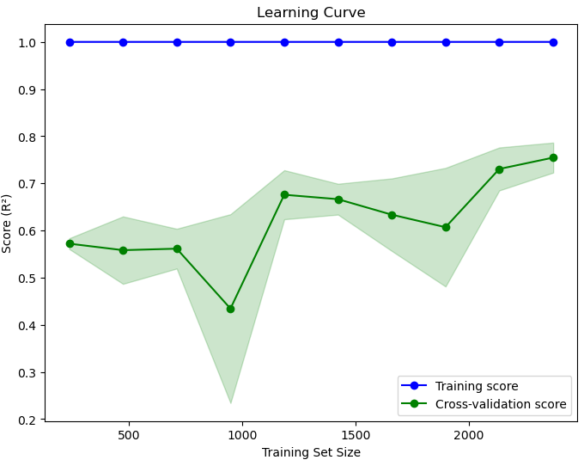
Group 1
Model Type
XGBoost
R2
0.79
Parameters
max_depth=12, learning_rate=0.1, n_estimators=275
Target
‘
‘VIXCLS_pct_biweekly’

Slide 9
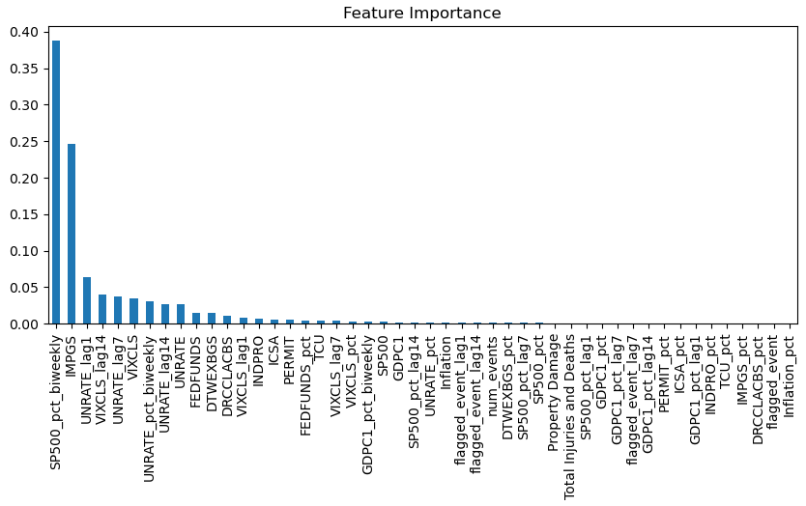
Feature Importance: Group 1

Slide 10
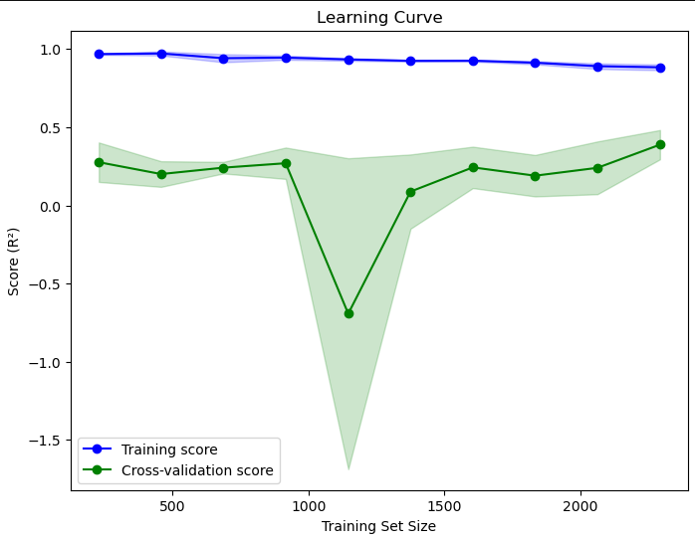
Group 2
Model Type
Random Forest Regression
R2
0.67
Parameters
max_depth=5, n_estimators=100
Target
‘VIXCLS_pct_monthly’

Slide 11
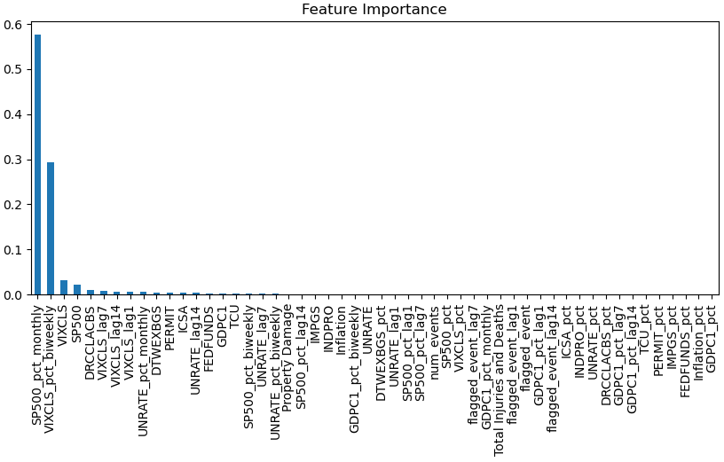
Feature Importance: Group 1

Slide 12
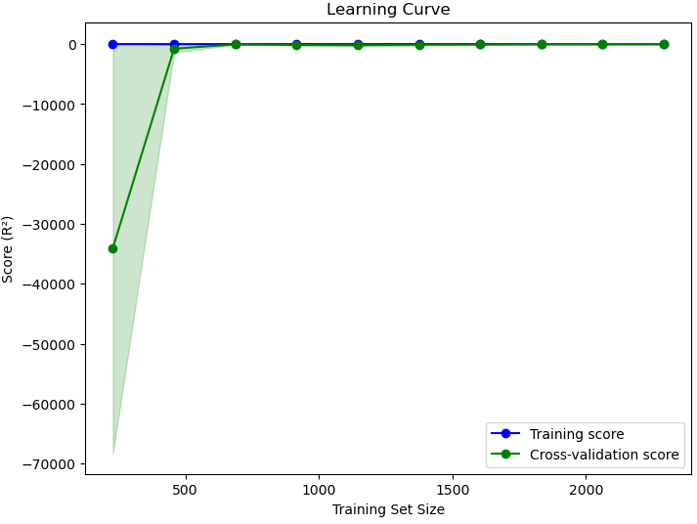
Group 3
Model Type
Linear Regression
R2
0.68
Parameters
N/A
Target
‘VIXCLS_pct_quarterly’

Slide 13
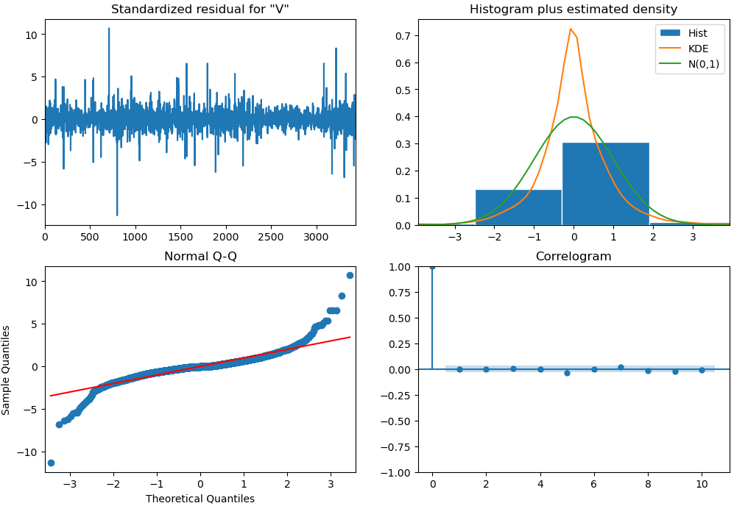
ARIMA
Model Type
ARIMA
R2
0.31
Parameters
N/A
Target
‘VIXCLS_pct_quarterly’

Slide 14
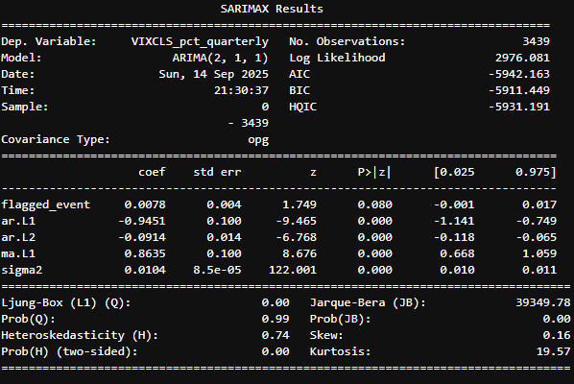
Results Summary
Features
Biweekly
Target: VIXCLS_pct_biweekly
Important features: SP500_pct_biweekly, IMPGS, UNRATE_lag1
Monthly
Target: VIXCLS_pct_monthly
Important features: SP500_pct_montly, VIXCLS_biweekly, VIXCLS
Quarterly
Target: VIXCLS_pct_quarterly
Important features: N/A
The ARIMA results are depicted in the image in the middle. The results indicate that flagged_event is minimally significant on the quarterly level.

Slide 15
Future Steps
Goals
Models
SARIMA
Good at capturing seasonality
VAR
Runs multiple time series at one time and is good for interconnected variables
LSTM
Captures short and long term dependencies
STARIMA
Like ARIMA, but with spatial relationships
Build a reliable market forecasting model with weather dependencies
Evidence shows a relationship, but further work is needed to capture its full potential
Continue data collection and refine models to improve accuracy and robustness
Data
More Data is needed to reduce the risk of overfitting
The learning curves suggest this is an issue
Some data used goes back as far as the 1950s
Spatial data from the weather dataset should be reintegrated

Slide 16
Thank you

