Slide 1
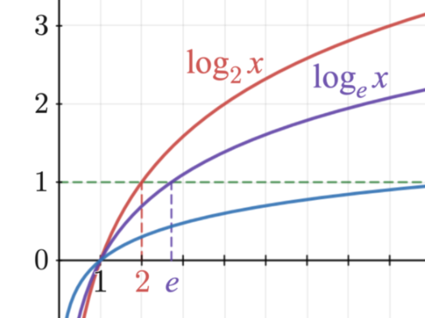
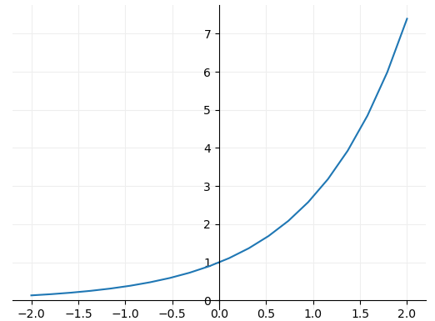

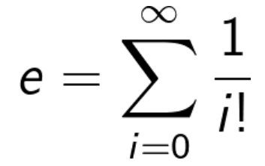
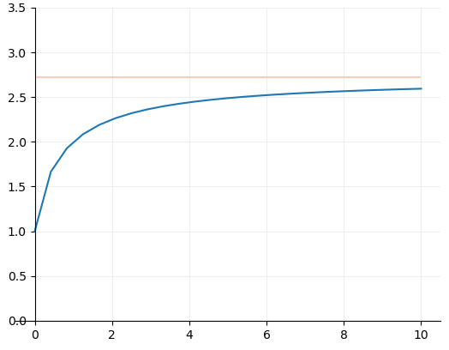

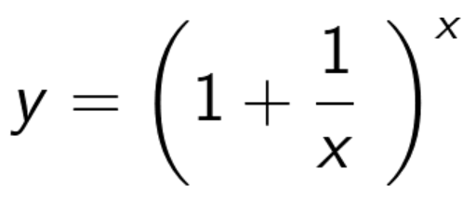
Graph Database
General Functions
Exponential
What's so special about Euler's Number?
Euler originally defined e through calculating the first 15 components of the following summation:
Note that this graph is asymptotic to e.
In fact, there are many ways of calculating the value of e, but none of them ever give a totally exact answer, because e is irrational, and its digits go on forever without repeating. It can be defined to 10 significant figures as the following:
e = 2.7 1828 1828
https://www.mathsisfun.com/numbers/e-eulers-number.html#:~:text=It%20is%20often%20called%20Euler's,so%20is%20worth%20learning%20about.

Slide 2
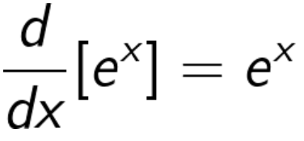
Graph Database
General Functions
Exponential
What's so special about Euler's Number?
e has many very interesting properties. The most remarkable is that the differential of e^x is e^x. That’s to say when:
Slope is equal to 1 where y=1
If that value of e was any larger the derivative would be larger than e^x and if it were any smaller the derivative would be smaller.
Therefore on the flip side the integral of e^x is also e^x. This means that we know the area under the graph
Y=4
Hence the area is equal to 4

Slide 3
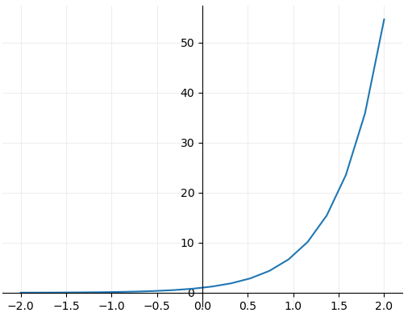
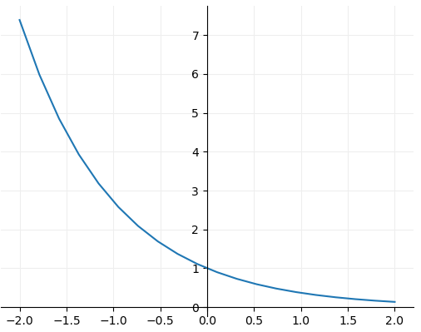
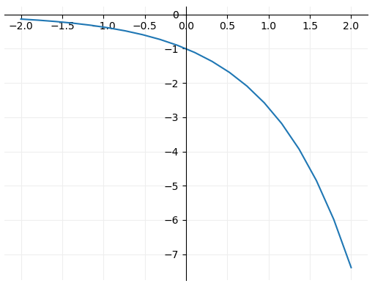

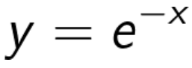


Graph Database
General Functions
Exponential
Other Exponential Functions
Here we’re simply doubling the value of the exponent, meaning the gradient is increased in comparison to previous graphs shown.
Here we’re taking the reciprocal of e^x. It is effectively a mirror around the line x=0 or y axis.
The mirror this time is around y=0 or the x axis.

Slide 4
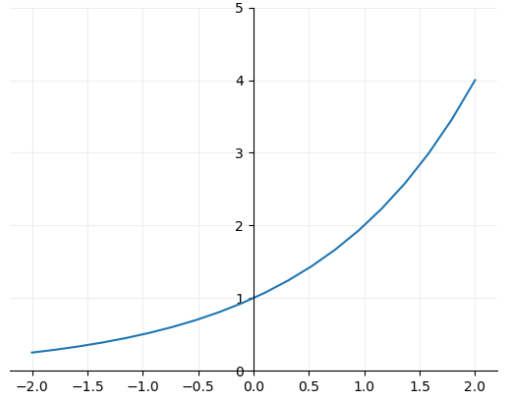
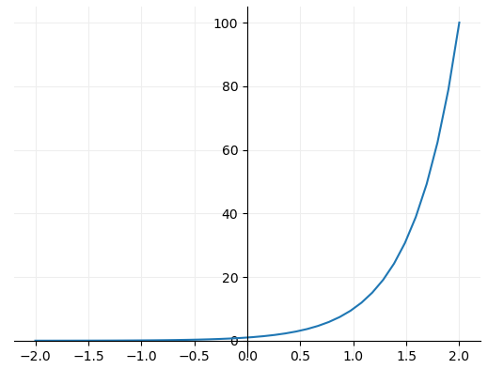
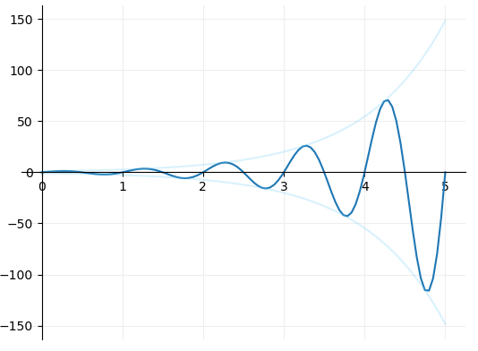



Graph Database
General Functions
Exponential
Other Exponential Functions
The exponent remains x but the base is reduced from the value of e. Note the gradient or slope is now shallower in comparison. The growth is slower
The base has now increased to 10 and the gradient takes off.
Combination of a sine and exponential function. By having x multiplied by 2pi in the sine function we can get a full wavelength for every increment of 1 on the x axis.

Slide 5
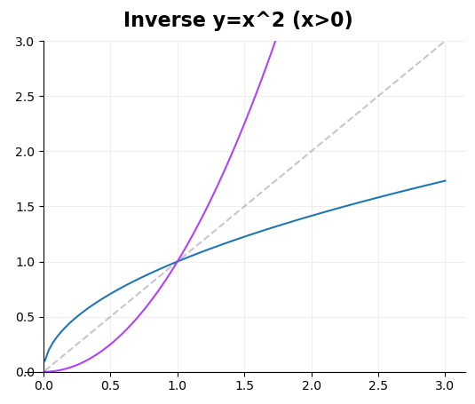



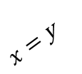




Graph Database
General Functions
Logarithmic
Logarithmic functions are the inverse to their exponential counterparts. Some basics on taking an inverse of a function
To be able to have an inverse function we need the function to produce unique values. A basic example where this is not the case is where y = x^2. In order to find the inverse of this function we need to restrict x to positive or negative values only.
When plotting the inverse, the resultant function will be mirrored around the axis y = x.
We can achieve this by reversing the values of x and y in a function.
Here we take the equation:
$$y=x^{2}$$
$x=$ y
We invert x and y and make y the subject:
$$y=x^{0.5}$$
$$x=y^{2}$$
$$y^{2}=x$$
$$y=x^{2}$$
Square root both sides:
$$\sqrt{y^{2}}=\sqrt{x}$$
$$y=x^{0.5}$$

Slide 6
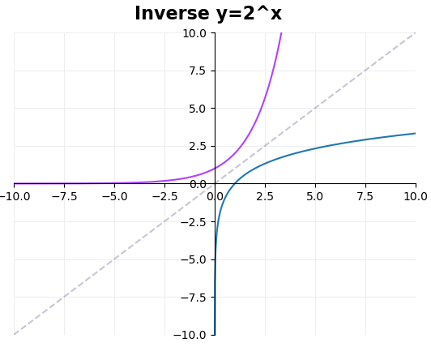

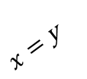






Graph Database
General Functions
Logarithmic
Back to the original statement: logarithmic functions are the inverse to their exponential counterparts.
So lets take the following simple exponential function:
$$y=2^{x}$$
And inverse it:
$$y=2^{x}$$
$x=$ y
$$x=2^{y}$$
This is now a logarithmic equation and can be written in the form:
$$y=\log_{2}\left(x\right)$$
$$y=\log_{2}\left(x\right)$$
Note that in a logarithmic function its very easy to calculate what x is given y but much harder to calculate what y is given x. This leads the equation to be unintuitive. For example we can not provide the equation with negative values of x. Note the general form of a logarithmic equation below.
$$y=\log_{b}\left(x\right)$$
$$x=b^{y}$$

Slide 7
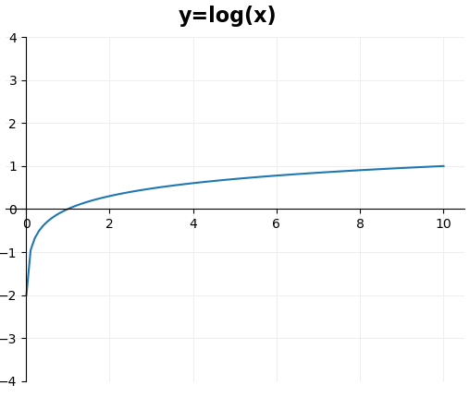
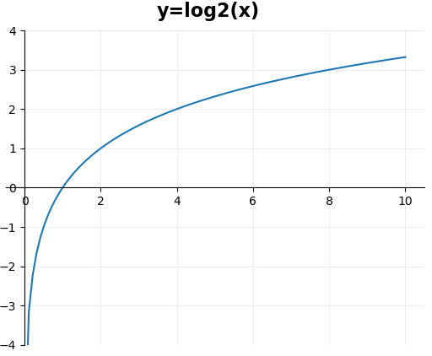
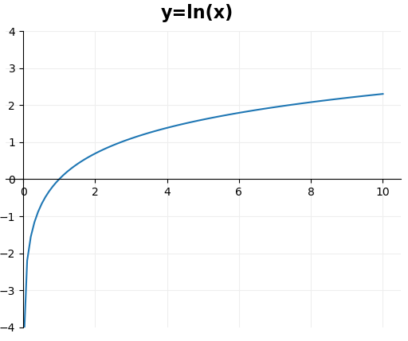








Graph Database
General Functions
Logarithmic
Common Logarithm
Binary Logarithm
Natural Logarithm
$$x={10}^{y}$$
$$x=2^{y}$$
$$x=e^{y}$$
$$x={2.718}^{y}$$
$$y=\log\left(x\right)$$
$$y=\log_{2}\left(x\right)$$
$$y=\ln\left(x\right)$$
$$y=\log_{e}\left(x\right)$$

Slide 8
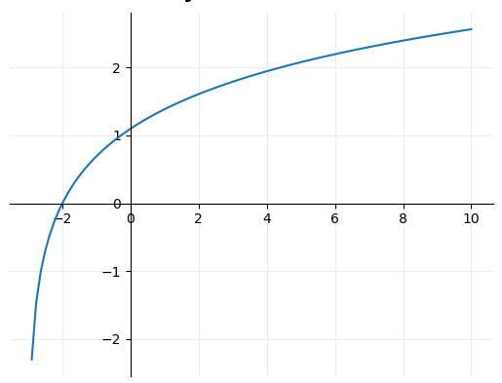
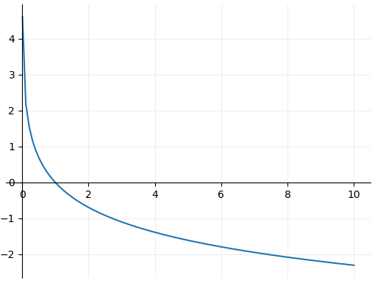


Graph Database
General Functions
Logarithmic
Note that where we have y equal to any exponential function, it will always be asymptotic to the x axis. The exception to this is if we have y = (e^x)+3 the function will now be asymptotic to y=3.
On the flip to this where y is equal to a logarithm, the function will always be asymptotic to the y axis (x=0). The exception to this is if we have y = log(x + 3) the function will now be asymptotic to x=-3.
$$y=\ln\left(x+3\right)$$
$$y=−ln\left(x\right)$$

Slide 9
Graph Database
General Functions
Logarithmic
Note that where we have y equal to any exponential function, it will always be asymptotic to the x axis. The exception to this is if we have y = (e^x)+3 the function will now be asymptotic to y=3.
On the flip to this where y is equal to a logarithm, the function will always be asymptotic to the y axis (x=0). The exception to this is if we have y = log(x + 3) the function will now be asymptotic to x=-3.
$$y=\ln\left(x+3\right)$$
$$y=−ln\left(x\right)$$

Slide 10
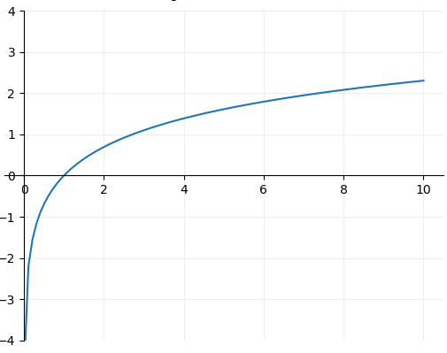
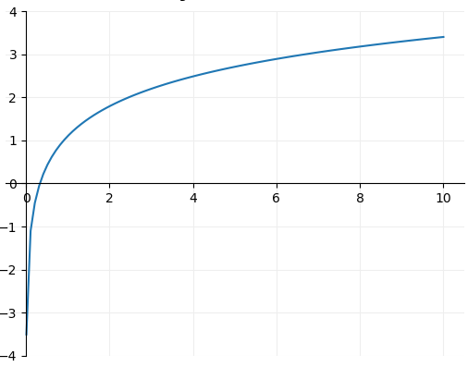



Graph Database
General Functions
Logarithmic
$$y=\ln\left(x\right)$$
$$y=\ln\left(3x\right)$$
Here $ⅇ^{y}=3x$ so given a value of y, x is three times smaller than its counterpart to the right.

Slide 11
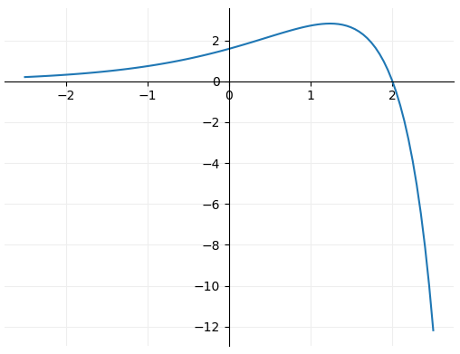
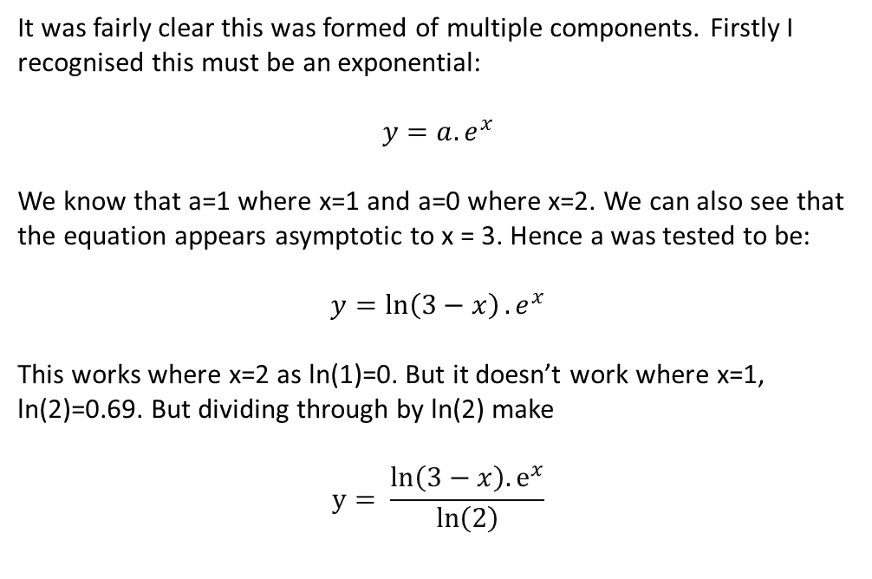
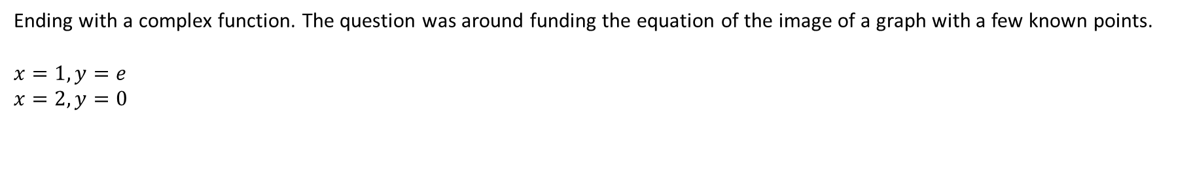
Graph Database
General Functions
Composite Functions
Ending with a complex function. The question was around funding the equation of the image of a graph with a few known points.
$$x=1, y=e$$
$$x=2, y=0$$
It was fairly clear this was formed of multiple components. Firstly I recognised this must be an exponential:
$$y=a.e^{x}$$
We know that a=1 where x=1 and a=0 where x=2. We can also see that the equation appears asymptotic to x = 3. Hence a was tested to be:
$$y=\ln\left(3−x\right).e^{x}$$
This works where x=2 as ln(1)=0. But it doesn’t work where x=1, ln(2)=0.69. But dividing through by ln(2) make
$$y= \frac{\ln\left(3−x\right){.ⅇ}^{x}}{\ln\left(2\right)}$$

Slide 12
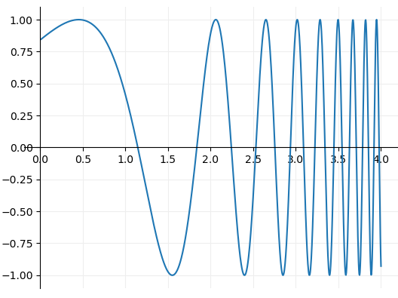
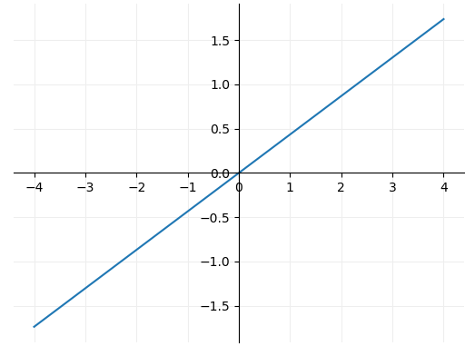
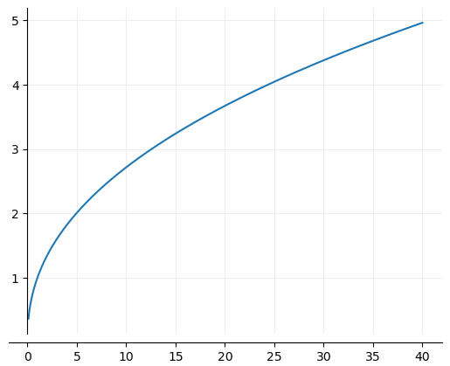










Graph Database
General Functions
Composite Functions
A function composition or a composite function is an operation that takes two functions f and g and produces a function h such that h(x) = g(f(x)).
A few examples can be seen below.
$$f\left(x\right)=log⁡(x)$$
$$g\left(x\right)=e^{x}$$
$$f\left(x\right)=e^{x}$$
$$g(x)=log⁡(x)$$
$$f\left(x\right)=sin⁡(x)$$
$$g\left(x\right)=e^{x}$$
$$f(g(x)=\log\left(e^{x}\right)$$
$$f(g(x)=e^{log\left(x\right)}$$
$$f(g(x)=\sin\left(e^{x}\right)$$
An exponential inside a logarithm in this case produces a straight line because of the following:
$${10}^{y}=e^{x}$$

Slide 13
Graph Database
Loss Functions
Cross-Entropy

Slide 14
Graph Database
Activation Functions
Sigmoid

