Slide 1
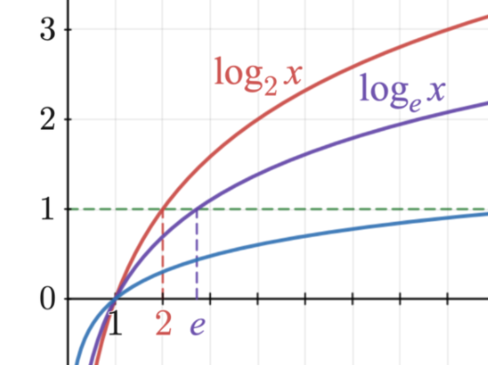
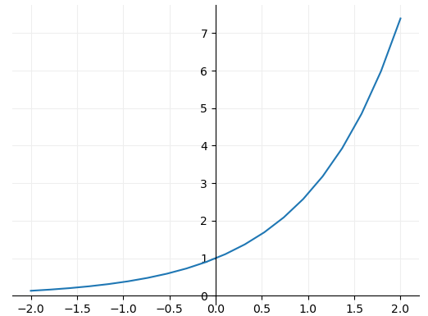

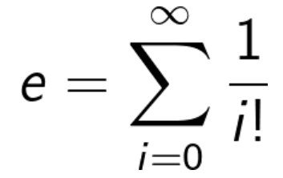
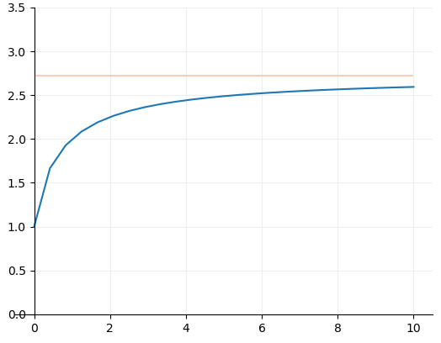

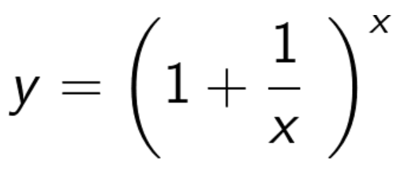
Graph Database
General Functions
Exponential
What's so special about Euler's Number?
Euler originally defined e through calculating the first 15 components of the following summation:
Note that this graph is asymptotic to e.
In fact, there are many ways of calculating the value of e, but none of them ever give a totally exact answer, because e is irrational, and its digits go on forever without repeating. It can be defined to 10 significant figures as the following:
e = 2.7 1828 1828
https://www.mathsisfun.com/numbers/e-eulers-number.html#:~:text=It%20is%20often%20called%20Euler's,so%20is%20worth%20learning%20about.

Slide 2
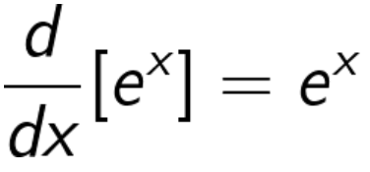
Graph Database
General Functions
Exponential
What's so special about Euler's Number?
e has many very interesting properties. The most remarkable is that the differential of e^x is e^x. That’s to say when:
Slope is equal to 1 where y=1
If that value of e was any larger the derivative would be larger than e^x and if it were any smaller the derivative would be smaller.
Therefore on the flip side the integral of e^x is also e^x. This means that we know the area under the graph
Y=4
Hence the area is equal to 4

Slide 3
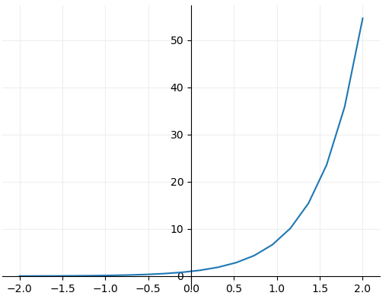
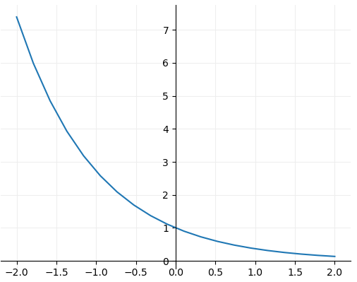
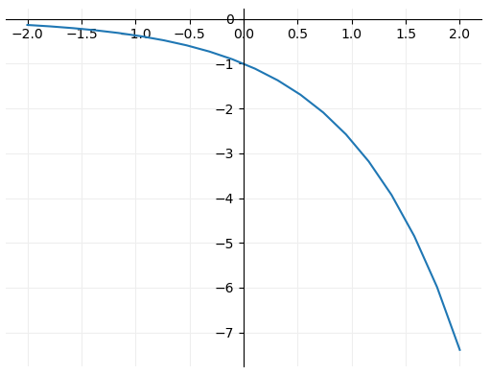

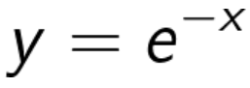


Graph Database
General Functions
Exponential
Other Exponential Functions
Here we’re simply doubling the value of the exponent, meaning the gradient is increased in comparison to previous graphs shown.
Here we’re taking the inverse of e^x. It is effectively a mirror around the line x=0 or y axis.
The mirror this time is around y=0 or the x axis.

Slide 4
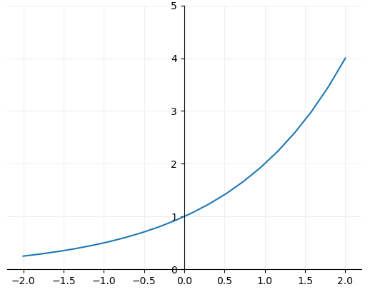
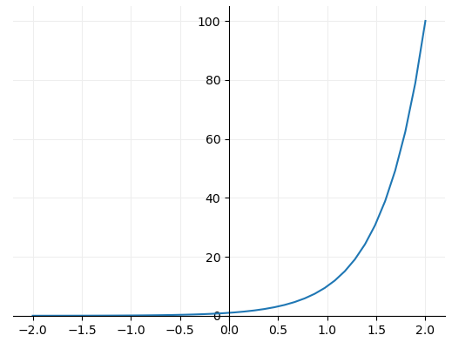
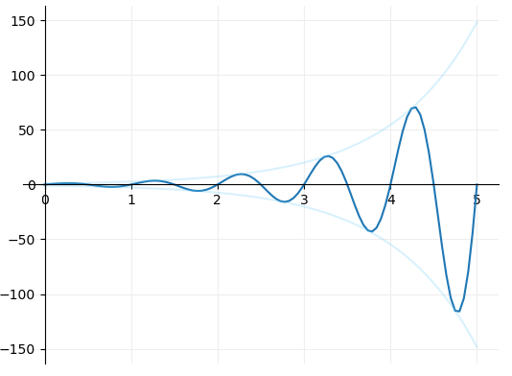



Graph Database
General Functions
Exponential
Other Exponential Functions
The exponent remains x but the base is reduced from the value of e. Note the gradient or slope is now shallower in comparison. The growth is slower
The base has now increased to 10 and the gradient takes off.
Complex composite function, which is the combination of a sine and exponential function. By having x multiplied by 2pi in the sine function we can get a full wavelength for every increment of 1 on the x axis.

Slide 5
Graph Database
General Functions
Logarithmic

Slide 6
Graph Database
General Functions
Natural Logarithmic

Slide 7
Graph Database
General Functions
Composite Functions

Slide 8
Graph Database
Loss Functions
Cross-Entropy

Slide 9
Graph Database
Activation Functions
Sigmoid

