Slide 1

DP-900 Microsoft Azure Fundamentals
https://learn.microsoft.com/en-us/training/paths/azure-data-fundamentals-explore-core-data-concepts/
Section 1
Microsoft Azure Data Fundamentals: Explore core data concepts

Slide 2
DP-900 Microsoft Azure Fundamentals
Microsoft Azure Data Fundamentals: Explore core data concepts
Date: 26/02/23
Data Formats
Structured Data
Structured data is data that adheres to a fixed schema, so all of the data has the same fields or properties
Semi-structured data
Semi-structured data is information that has some structure, but which allows for some variation between entity instances.
Examples include JSON, XML, HTML etc.
Unstructured data
Not all data is structured or even semi-structured. For example, documents, images, audio and video data, and binary files might not have a specific structure.

Slide 3
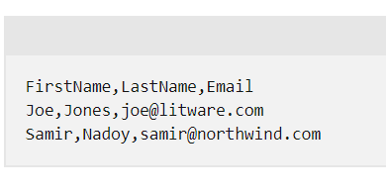
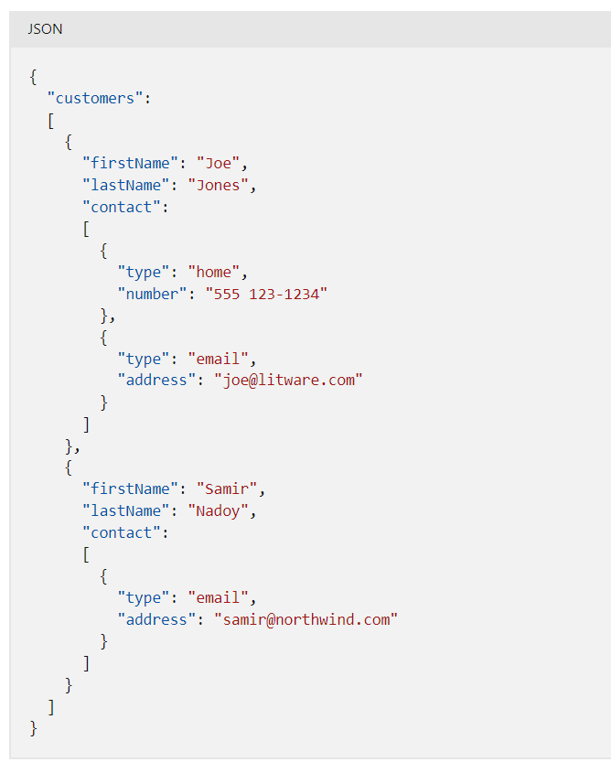
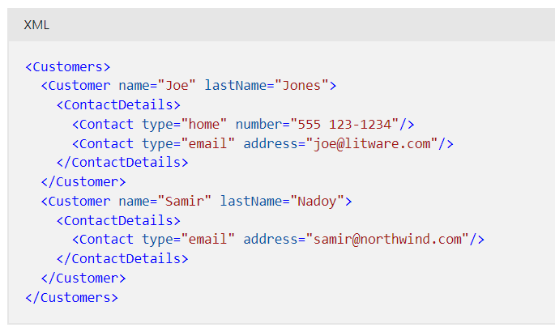
DP-900 Microsoft Azure Fundamentals
Microsoft Azure Data Fundamentals: Explore core data concepts
Date: 26/02/23
File Storage
Delimited text files
Data is often stored in plain text format with specific field delimiters and row terminators. The most common format for delimited data is comma-separated values (CSV) in which fields are separated by commas, and rows are terminated by a carriage return / new line.
JavaScript Object Notation (JSON)
JSON is a ubiquitous format in which a hierarchical document schema is used to define data entities (objects) that have multiple attributes. Each attribute might be an object (or a collection of objects); making JSON a flexible format that's good for both structured and semi-structured data.
Note that each object in a JSON file may contain different attributes making it a key semi-structured data type.
CSV
XML
It's largely been superseded by the less verbose JSON format
Binary Large Object (BLOB)
Ultimately, all files are stored as binary data (1's and 0's), but in the human-readable formats discussed above, the bytes of binary data are mapped to printable characters (typically through a character encoding scheme such as ASCII or Unicode). Some file formats however, particularly for unstructured data, store the data as raw binary that must be interpreted by applications and rendered.
Common types of data stored as binary include images, video, audio, and application-specific documents.

Slide 4
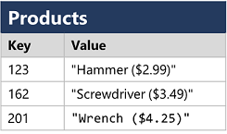
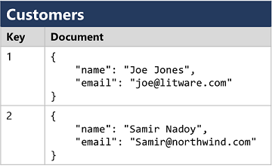
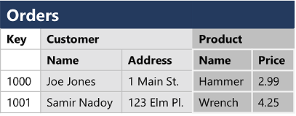
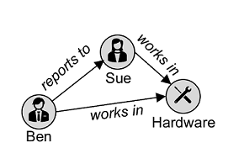
DP-900 Microsoft Azure Fundamentals
Microsoft Azure Data Fundamentals: Explore core data concepts
Date: 26/02/23
Relational Databases
Relational databases are commonly used to store and query structured data
Each instance of an entity is assigned a primary key that uniquely identifies it; and these keys are used to reference the entity instance in other tables
This use of keys to reference data entities enables a relational database to be normalized; which in part means the elimination of duplicate data values (this is effectively good data modelling where we break out information in one main table into a single fact table and multiple dimension tables to prevent unnecessary duplication – a good example of this is the financial monitoring work)
Non-relational databases (e.g., Cosmos DB)
Key-Value Databases
These are effectively python dictionaries. The associated value can be in any format
Document Databases
Specific form of key-value database in which the value is a JSON document (which the system is optimized to parse and query)
Column Family Databases
Store tabular data comprising rows and columns, but you can divide the columns into groups known as column-families.
Each column family holds a set of columns that are logically related together.
Graph Databases
Stores entities as nodes with links to define relationships between them.

Slide 5
DP-900 Microsoft Azure Fundamentals
Microsoft Azure Data Fundamentals: Explore core data concepts
Date: 26/02/23
Transactional Data Processing
A transactional system records transactions that encapsulate specific events that the organization wants to track
Transactional systems are often high-volume, sometimes handling many millions of transactions in a single day. The data being processed has to be accessible very quickly. The work performed by transactional systems is often referred to as Online Transactional Processing (OLTP).
Optimized for both read and write operations in order to support transactional workloads in which data records are created, retrieved, updated, and deleted (often referred to as CRUD operations)
ACID Semantics
Atomicity – each transaction is treated as a single unit, which succeeds completely or fails completely. For example, a transaction that involved debiting funds from one account and crediting the same amount to another account must complete both actions. If either action can't be completed, then the other action must fail.
Consistency – transactions can only take the data in the database from one valid state to another. To continue the debit and credit example above, the completed state of the transaction must reflect the transfer of funds from one account to the other.
Isolation – concurrent transactions cannot interfere with one another, and must result in a consistent database state. For example, while the transaction to transfer funds from one account to another is in-process, another transaction that checks the balance of these accounts must return consistent results - the balance-checking transaction can't retrieve a value for one account that reflects the balance before the transfer, and a value for the other account that reflects the balance after the transfer.
Durability – when a transaction has been committed, it will remain committed. After the account transfer transaction has completed, the revised account balances are persisted so that even if the database system were to be switched off, the committed transaction would be reflected when it is switched on again.

Slide 6
DP-900 Microsoft Azure Fundamentals
Microsoft Azure Data Fundamentals: Explore core data concepts
Date: 26/02/23
Analytical Data Processing
Stages of an analytical data processing flow can be seen below
1.) Establish/understand where the underlying data store is. This could be a:
Data Lake: large collection of file-based data is stored (e.g. 100’s of excel or csv files in a file system or on sharepoint.)
Operational or OLTP Database: operational database which includes information on live transactions.
2.) Develop an ETL process which extracts the relevant data from the possible sources above, transforms this data and loads into a data warehouse. Commonly, a data warehouse schema is based on fact tables that contain numeric values you want to analyze (for example, sales amounts), with related dimension tables that represent the entities by which you want to measure them (for example, customer or product). An example of this would be a fact table and set of dimension tables optimized and ready for ingestion into Power BI, or into an OLAP model. It should be noted that especially when working with OLTP databases, ETL pipelines should be run on a daily or weekly basis when the expected load is low e.g., in the middle of the night when purchases are expected to be low.
3.) At this point we may stop, and data may be ingested from the data warehouse directly into power bi. It is possible however that the data in the data warehouse may be aggregated and loaded into an online analytical processing (OLAP) model, or cube. This is where possible measures and calculations are already made, which rapidly speeds up querying. For examples, total sales on 26th Feb 2023 may already have been calculated in the OLAP cube, meaning on the fly calculations are not necessary. The issue with this model is that what measures are pre-calculated in the OLAP meaning what needs to be calculated needs to be well understood. https://www.youtube.com/watch?v=2ryG3Jy6eIY

Slide 7
DP-900 Microsoft Azure Fundamentals
Microsoft Azure Data Fundamentals: Explore core data concepts
Date: 26/02/23
Extra: OLAP Cubes
This is some extra work looking into OLAP cubes and what they are used for.
In our OLTP database, we may have thousands of rows per day, each with columns/attributes pertaining to information on a given transaction e.g., location, date, branch, salesperson etc. When we come to analytics, we often want to view this data in an aggregated format to retrieve useful insight. In the above scenario we may want to know which salespeople are performing best, or which branch is underperforming. In a cube, we take each attribute (called dimension) that we’re interested in and calculate each possible aggregation against each other attribute.
The calculations occur at the lowest level, take the example on the right. We defined our three dimensions which we can use to display directly in a query or aggregate further in very quick time. For example, total bakery sales in January across all three branches is 33 + 26 + 28 = 87. This is far quicker than querying an OLTP database which may have thousands of entries with sales in those three attributes.
Note that an OLTP cube can have any number of dimensions but often anything over 7 is too many for a user to comprehend.
Attribute: Total Sales
Dimensions: Date, Salesperson, Store
Date
Mar
14
Feb
27
8
11
9
38
Jan
33
26
28
8
38
Bakery
33
26
28
28
11
Type
27
Canned
13
21
18
18
27
12
4
33
33
23
Meat
Manch
London
Bristol
Store

Slide 8

DP-900 Microsoft Azure Fundamentals
Microsoft Azure Data Fundamentals: Explore core data concepts
Date: 27/02/23
Azure SQL
Azure SQL Database – a fully managed platform-as-a-service (PaaS) database hosted in Azure.
Azure SQL Managed Instance – a hosted instance of SQL Server with automated maintenance, which allows more flexible configuration than Azure SQL DB but with more administrative responsibility for the owner.
Azure SQL VM – a virtual machine with an installation of SQL Server, allowing maximum configurability with full management responsibility.
This is just one example of a possible flow. Maybe the Azure SQL database is simple and can be queried directly without the need for a data warehouse. Or maybe we’re dealing with OLTP databases and after the data warehouse stage we need the engineer to design an OLAP.
Azure SQL Database
ETL
Power BI Dashboard
Data Warehouse
Data Connection
Azure SQL Database
ETL
Database Administrator
Data Engineer
Data Analyst

Slide 9
DP-900 Microsoft Azure Fundamentals
Microsoft Azure Data Fundamentals: Explore core data concepts
Date: 27/02/23
Azure Database for open-source relational databases
Azure Database for MySQL - a simple-to-use open-source database management system that is commonly used in Linux, Apache, MySQL, and PHP (LAMP) stack apps.
Azure Database for MariaDB - a newer database management system, created by the original developers of MySQL. The database engine has since been rewritten and optimized to improve performance. MariaDB offers compatibility with Oracle Database (another popular commercial database management system).
Azure Database for PostgreSQL - a hybrid relational-object database. You can store data in relational tables, but a PostgreSQL database also enables you to store custom data types, with their own non-relational properties.
Azure Cosmos DB
Azure Cosmos DB is a global-scale non-relational (NoSQL) database system that supports multiple application programming interfaces (APIs), enabling you to store and manage data as JSON documents, key-value pairs, column-families, and graphs.
Azure Storage
Data engineers use Azure Storage to host data lakes - blob storage with a hierarchical namespace that enables files to be organized in folders in a distributed file system.
Azure Data Factory
Azure Data Factory is an Azure service that enables you to define and schedule data pipelines to transfer and transform data.
Azure Data Factory is used by data engineers to build extract, transform, and load (ETL) solutions that populate analytical data stores with data from transactional systems across the organization.

Slide 10
DP-900 Microsoft Azure Fundamentals
Microsoft Azure Data Fundamentals: Explore core data concepts
Date: 27/02/23
Azure Synapse Analytics
Azure Synapse Analytics is a comprehensive, unified data analytics solution that provides a single service interface for multiple analytical capabilities.
These include pipelines (azure data factory), SQL database engine, Azure Synapse Data Explorer, and Apache Spark.
Apache spark allows for the creation of an Apache spark pool which can be used to run PySpark notebooks. PySpark is a python-based API used for the Spark implementation and is written in Scala programming language.
Azure Synapse Data Explorer is a high-performance data analytics solution that is optimized for real-time querying of log and telemetry data using Kusto Query Language (KQL).
Azure Databricks
Azure Databricks is an Azure-integrated version of the popular Databricks platform, which combines the Apache Spark data processing platform with SQL database semantics and an integrated management interface to enable large-scale data analytics. This is very similar to Azure data factory, however ADF is primarily used for Data Integration services to perform ETL processes and orchestrate data movements at scale. In contrast, Databricks provides a collaborative platform for Data Engineers and Data Scientists to perform ETL as well as build Machine Learning models under a single platform.
Azure HDInsight
Azure HDInsight is an Azure service that provides Azure-hosted clusters for popular Apache open-source big data processing technologies, including:
Apache Spark - a distributed data processing system that supports multiple programming languages and APIs, including Java, Scala, Python, and SQL.
Apache Hadoop - a distributed system that uses MapReduce jobs to process large volumes of data efficiently across multiple cluster nodes. MapReduce jobs can be written in Java or abstracted by interfaces such as Apache Hive - a SQL-based API that runs on Hadoop.
Apache HBase - an open-source system for large-scale NoSQL data storage and querying.
Apache Kafka - a message broker for data stream processing.

Slide 11
DP-900 Microsoft Azure Fundamentals
Microsoft Azure Data Fundamentals: Explore core data concepts
Date: 28/02/23
Azure Stream Analytics
Azure Stream Analytics is a real-time stream processing engine that captures a stream of data from an input, applies a query to extract and manipulate data from the input stream, and writes the results to an output for analysis or further processing.
An example could be using companies house streaming api feeding data via azure stream analytics to collected the data and query the results for only what we need.
Azure Data Explorer
Data analysts can use Azure Data Explorer to query and analyze data that includes a timestamp attribute, such as is typically found in log files and Internet-of-things (IoT) telemetry data.
Just remember KQL for this one.
Microsoft Purview
You can use Microsoft Purview to create a map of your data and track data lineage across multiple data sources and systems, enabling you to find trustworthy data for analysis and reporting.
Microsoft Power BI
Microsoft Power BI is a platform for analytical data modeling and reporting that data analysts can use to create and share interactive data visualizations

Slide 12
DP-900 Microsoft Azure Fundamentals
https://learn.microsoft.com/en-us/training/paths/azure-data-fundamentals-explore-relational-data/
Section 2
Microsoft Azure Data Fundamentals: Explore relational data in Azure

Slide 13
DP-900 Microsoft Azure Fundamentals
Microsoft Azure Data Fundamentals: Explore relational data in Azure
Date: 05/03/23
Relation Data
In a relational database, you model collections of entities from the real world as tables. An entity can be anything for which you want to record information, typically important objects and events.
The available datatypes that you can use when defining a table depend on the database system you are using; though there are standard datatypes defined by the American National Standards Institute (ANSI) that are supported by most database systems.
Normalisation
While there are many complex rules that define the process of refactoring data into various levels (or forms) of normalization, a simple definition for practical purposes is:
Separate each entity type into its own table (a person, organization, object type, or concept about which information is stored. Describes the type of the information that is being mastered. An entity type typically corresponds to one or several related tables in database.)
Separate each discrete attribute into its own column.
Uniquely identify each entity instance (row) using a primary key.
Use foreign key columns to link related entities.
Typically, a relational database management system (RDBMS) can enforce referential integrity to ensure that a value entered into a foreign key field has an existing corresponding primary key in the related table – for example, preventing orders for non-existent customers.
Primary key: unique
Foreign key: can be non unique
If a primary key can link directly to another primary key consider combining those two tables. Primary keys should connect only to foreign keys. Two foreign keys connected produce a many to many relationship.

Slide 14
DP-900 Microsoft Azure Fundamentals
Microsoft Azure Data Fundamentals: Explore relational data in Azure
Date: 05/03/23
SQL
SQL stands for Structured Query Language, and is used to communicate with a relational database. It's the standard language for relational database management systems.
Some common relational database management systems that use SQL include Microsoft SQL Server, MySQL, PostgreSQL, MariaDB, and Oracle.
Standardised in the 1980’s but since then, many database vendors include their own proprietary extensions that are not part of the standard, which has resulted in a variety of dialects of SQL.
SQL statement types
SQL statements are grouped into three main logical groups:
Data Definition Language (DDL)
Data Control Language (DCL)
Data Manipulation Language (DML)
DDL (Defining Tables and Schema)
You use DDL statements to create, modify, and remove tables and other objects in a database (table, stored procedures, views, and so on). The most common DDL statements are:
CREATE Create a new object in the database, such as a table or a view.
ALTER Modify the structure of an object. For instance, altering a table to add a new column.
DROP Remove an object from the database.
RENAME Rename an existing object.

Slide 15
DP-900 Microsoft Azure Fundamentals
Microsoft Azure Data Fundamentals: Explore relational data in Azure
Date: 05/03/23
DCL statements (Controlling Users)
Database administrators generally use DCL statements to manage access to objects in a database by granting, denying, or revoking permissions to specific users or groups. The three main DCL statements are:
Statement Description
GRANT Grant permission to perform specific actions
DENY Deny permission to perform specific actions
REVOKE Remove a previously granted permission
SML Statements (Finding and manipulating rows only)
You use DML statements to manipulate the rows in tables. These statements enable you to retrieve (query) data, insert new rows, or modify existing rows. You can also delete rows if you don't need them anymore. The four main DML statements are:
SELECT Read rows from a table
INSERT Insert new rows into a table
UPDATE Modify data in existing rows
DELETE Delete existing rows

Slide 16
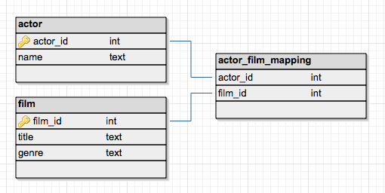
DP-900 Microsoft Azure Fundamentals
Microsoft Azure Data Fundamentals: Explore relational data in Azure
Date: 05/03/23
Extra: Junction Tables
This is not in the course notes, but I stumbled across it when assessing why “every table should contain a primary key, although SQL does not enforce this”. In my mind, often when doing data modelling in power bi, my dimension tables will each have a primary key, my fact table will often have many foreign keys but no primary key.
Many people on stackoverflow state that a unique identifier even in a fact table is often necessary when selecting, deleting and linking.
It also becomes important when dealing with many to many relationships. If we have two tables with a different primary key in each but that we want to link up, we can instead do this mapping in a junction table. For this we need primary keys in each table.
Two examples are shown below:

Slide 17
DP-900 Microsoft Azure Fundamentals
Microsoft Azure Data Fundamentals: Explore relational data in Azure
Date: 15/03/23
Database objects
Designed to optimize data organisation and encapsulate programmatic actions.
View
A view is a virtual table consisting of data which is viewed from one or more tables in the database. It is created using the SELECT statement just like any other query. It behaves just like another table and so can be directly queried itself.
Stored Procedure
This is defining functions. For example, you may want to define a function that relaces an entry given a certain input id.
Index
An index can help speed up querying on a large table. When you create an index in a database, you specify a column from the table, and the index contains a copy of this data in a sorted order, with pointers to the corresponding rows in the table.

Slide 18
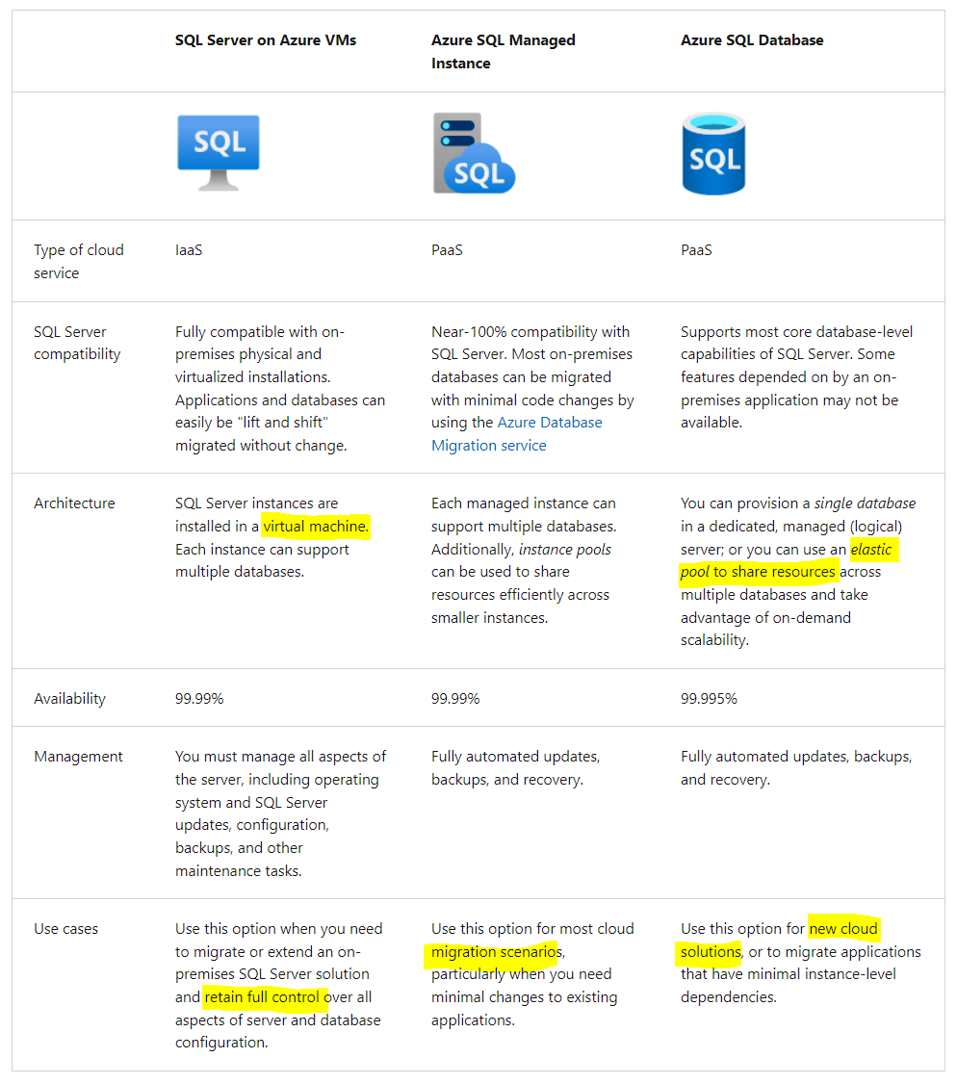
DP-900 Microsoft Azure Fundamentals
Microsoft Azure Data Fundamentals: Explore relational data in Azure
Date: 15/03/23
SQL Server on Azure Virtual Machines (VMs)
A virtual machine (IaaS) running in Azure with an installation of SQL Server. to optimize data organisation and encapsulate programmatic actions.
Azure SQL Managed Instance
A platform-as-a-service (PaaS) option that provides near-100% compatibility with on-premises SQL Server instances while abstracting the underlying hardware and operating system
Azure SQL Database
A fully managed, highly scalable PaaS database service that is designed for the cloud. This is a good option when you need to create a new application in the cloud.
Single pool – resources can be pre-allocated (only you use that server) or serveless (where multiple different databases are stored and not just for your company)
Elastic pool – only your company has access to the elastic pool but you can have multiple databases on that pool.

Slide 19
DP-900 Microsoft Azure Fundamentals
Microsoft Azure Data Fundamentals: Explore relational data in Azure
Date: 15/03/23
Azure Database for MySQL
MySQL started life as a simple-to-use open-source database management system. It's available in several editions; Community (free – popular with web apps), Standard, and Enterprise (additional tools and features). LAMP standard for Linux, Apache, MySQL, and PHP.
Azure Database for MariaDB
MariaDB is a newer database management system, created by the original developers of MySQL. The database engine has since been rewritten and optimized to improve performance. A table can hold several versions of data, enabling an application to query the data as it appeared at some point in the past.
Azure Database for PostgreSQL
Enables you to store custom data types, with their own non-relational properties. Another key feature is the ability to store and manipulate geometric data, such as lines, circles, and polygons. PostgreSQL has its own query language called pgsql. Some features of on-premises PostgreSQL databases aren't available in Azure Database for PostgreSQL. These features are mostly concerned with the extensions that users can add to a database to perform specialized tasks, such as writing stored procedures in various programming languages (other than pgsql, which is available)

Slide 20
DP-900 Microsoft Azure Fundamentals
https://learn.microsoft.com/en-us/training/paths/azure-data-fundamentals-explore-non-relational-data/
Section 3
Microsoft Azure Data Fundamentals: Explore non-relational data in Azure

Slide 21
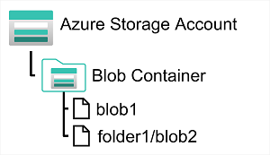
DP-900 Microsoft Azure Fundamentals
Microsoft Azure Data Fundamentals: Explore non-relational data in Azure
Date: 15/03/23
Azure Blob Storage
Azure Blob Storage is a service that enables you to store massive amounts of unstructured data as binary large objects, or blobs, in the cloud.
Applications can read and write them by using the Azure blob storage API.
However, by default, these folders are simply a way of using a "/" character in a blob name to organize the blobs into namespaces. The folders are purely virtual, and you can't perform folder-level operations to control access or perform bulk operations.
Azure Blob Storage supports three different types of blob:
Block blobs. A block blob can contain up to 50,000 blocks (each up to 100mb), giving a maximum size of over 4.7 TB. The block is the smallest amount of data that can be read or written as an individual unit. Block blobs are best used to store discrete, large, binary objects that change infrequently.
Page blobs. A page blob is organized as a collection of fixed size 512-byte pages. A page blob is optimized to support random read and write operations; you can fetch and store data for a single page if necessary. A page blob can hold up to 8 TB of data. Azure uses page blobs to implement virtual disk storage for virtual machines.
Append blobs. An append blob is a block blob optimized to support append operations. You can only add blocks to the end of an append blob; updating or deleting existing blocks isn't supported. Each block can vary in size, up to 4 MB. The maximum size of an append blob is just over 195 GB.
The Hot tier is the default. You use this tier for blobs that are accessed frequently.
The Cool tier has lower performance and incurs reduced storage charges compared to the Hot tier. Use the Cool tier for data that is accessed infrequently
The Archive tier provides the lowest storage cost, but with increased latency. The Archive tier is intended for historical data that mustn't be lost, but is required only rarely.

Slide 22
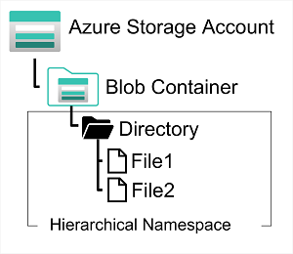
DP-900 Microsoft Azure Fundamentals
Microsoft Azure Data Fundamentals: Explore non-relational data in Azure
Date: 18/03/23
Azure Data Lake Gen 2
Built on blob storage so it has the hot cold access tier advantage.
It is spun up by creating a blob storage account and ticking ‘Enable Hierarchical Namespace (HNS)’. This means the folders are no longer virtual and can be used perform folder level operations. This means the location of the file is stored in metadata and so when we move a file for example, we simply change this metadata. In gen 1 there are no hierarchical namespace, the ‘folder’ is actually just in the name of the file. Therefore, if we want to ‘move’ the file what actually happens is a copy of the file is made with the new name and the old file is deleted.
With this ‘true’ file structure we can also use ACL (access control list) to control on a folder level who can read write and execute, something we couldn’t do before in non-HNS storage.
Systems like Hadoop in Azure HDInsight, Azure Databricks, and Azure Synapse Analytics can mount a distributed file system hosted in Azure Data Lake Store Gen2 and use it to process huge volumes of data.

Slide 23
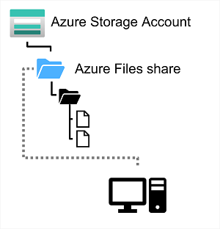
DP-900 Microsoft Azure Fundamentals
Microsoft Azure Data Fundamentals: Explore non-relational data in Azure
Date: 18/03/23
Azure File Share
Many on-premises systems comprising a network of in-house computers make use of file shares. A file share enables you to store a file on one computer, and grant access to that file to users and applications running on other computers.
Azure Files is essentially a way to create cloud-based network shares, such as you typically find in on-premises organizations to make documents and other files available to multiple users.
Azure File Storage offers two performance tiers. The Standard tier uses hard disk-based hardware in a datacenter, and the Premium tier uses solid-state disks.
Azure Files supports two common network file sharing protocols:
Server Message Block (SMB) file sharing is commonly used across multiple operating systems (Windows, Linux, macOS).
Network File System (NFS) shares are used by some Linux and macOS versions. To create an NFS share, you must use a premium tier storage account and create and configure a virtual network through which access to the share can be controlled.

Slide 24
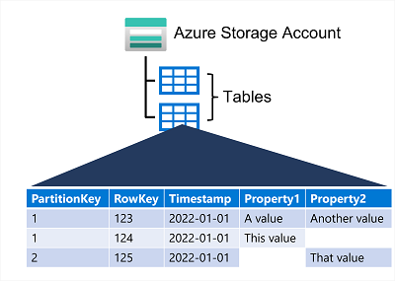
DP-900 Microsoft Azure Fundamentals
Microsoft Azure Data Fundamentals: Explore non-relational data in Azure
Date: 18/03/23
Azure Tables
Almost like Microsoft Excel. Azure Table Storage is a NoSQL storage solution that makes use of tables containing key/value data items. Each item is represented by a row that contains columns for the data fields that need to be stored.
An Azure Table enables you to store semi-structured data. All rows in a table must have a unique key (composed of a partition key and a row key), and when you modify data in a table, a timestamp column records the date and time the modification was made; but other than that, the columns in each row can vary.
To help ensure fast access, Azure Table Storage splits a table into partitions. Partitioning is a mechanism for grouping related rows, based on a common property or partition key. A table can contain any number of partitions. When you search for data, you can include the partition key in the search criteria. This helps to narrow down the volume of data to be examined and improves performance.

Slide 25
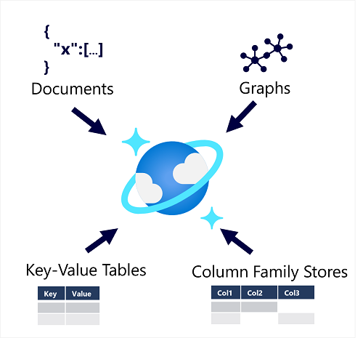
DP-900 Microsoft Azure Fundamentals
Microsoft Azure Data Fundamentals: Explore non-relational data in Azure
Date: 23/03/23
Azure Cosmos DB
Cosmos DB uses indexes and partitioning to provide fast read and write performance and can scale to massive volumes of data
Cosmos DB is a highly scalable database management system. Cosmos DB automatically allocates space in a container for your partitions, and each partition can grow up to 10 GB in size. Indexes are created and maintained automatically. There's virtually no administrative overhead.
Containers are schema-agnostic, which means that no schema is enforced when adding items.

Slide 26
DP-900 Microsoft Azure Fundamentals
Microsoft Azure Data Fundamentals: Explore non-relational data in Azure
Date: 23/03/23
Azure Cosmos DB APIs
This is a single managed service that’s effectively built out to handle both relational and non relational data. Within a single instance of Azure cosmos db we can now use:
Azure Cosmos DB for NoSQL is Microsoft’s native non-relational service for working with the document data model
Azure Cosmos DB for MongoDB is a popular open-source database in which data is stored in Binary JSON (BSON) format and queried using MongoDB Query Language (MQL).
Azure Cosmos DB for PostgreSQL is a native PostgreSQL for relational data.
Azure Cosmos DB for Table is used to work with data in key-value tables, similar to Azure Table Storage.
Azure Cosmos DB for Apache Cassandra is compatible with Apache Cassandra, which is a popular open-source database that uses a column-family storage structure, queried using SQL.
Azure Cosmos DB for Apache Gremlin is used with data in a graph structure.

Slide 27
DP-900 Microsoft Azure Fundamentals
https://learn.microsoft.com/en-us/training/paths/azure-data-fundamentals-explore-data-warehouse-analytics/
Section 4
Microsoft Azure Data Fundamentals: Explore data analytics in Azure

