Slide 1
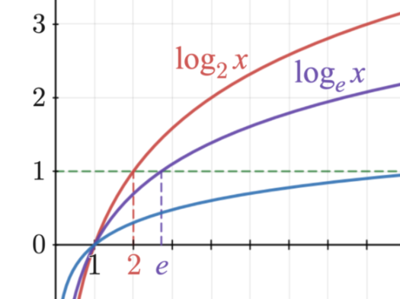
Graph Database
General Functions
Exponential

Slide 2
Graph Database
General Functions
Logarithmic

Slide 3
Graph Database
General Functions
Natural Logarithmic

Slide 4
Graph Database
General Functions
Composite Functions

Slide 5
Graph Database
Loss Functions
Cross-Entropy

Slide 6
Graph Database
Activation Functions
Sigmoid

