Slide 1

AZ-900 Microsoft Azure Fundamentals
Section 2
Benefits of Cloud Computing

Slide 2
AZ-900 Microsoft Azure Fundamentals
Benefits of Cloud Computing
Section: 2.5, 2.6, 2.7
Date: 24/02/22
Describe Cloud Concepts (20-25%)
Benefits of Cloud Computing
Cost Saving
Generally cloud companies can manage a server much cheaper than you can. More efficient air-conditioning, bulk buying hardware (economies of scale)
Don’t have to overprovision resources like you do in your own environment. This is auto scaled, you pay for what you use.
CapEx (capital expenditure) is money invested in assets like computers that return investment over time. OpEx (operational expenditure) is money spent on day to day operating expenditure. All of a sudden instead of having to invest loads of money in hardware in one go, we now don’t need any CapEx on servers, paying for the cloud is entirely OpEx and this is better for tax purposes, to have only a steady amount of money going out.
Agility (respond to marketplace, to demand etc.)
Agility is the ability to change rapidly based on changes to the market or environment (say you have a critical period of the day, for an hour then you can add more servers.)
Elasticity is the ability of a system to automatically grow and shrink based on application demand.
Availability (often have duplicate data on the cloud so if a storm hits one centre, the application can still function as normal)
Generally achievable to get four nines availability (99.99%). That equates to around 4 minutes a month of downtime. Importance of this depends on the use case of the application. Maybe its internal and only being used 9-5, that will have lower importance that say Facebook.
Disaster recover is the ability of a system to recover from failure within a period of time and how much data is lost. Can be done easily and automatically in the cloud.
Scalability
Scaling out = adding more resource e.g. more VMs.
Scaling up = adding more power to existing resource e.g. more CPU

Slide 3
AZ-900 Microsoft Azure Fundamentals
Benefits of Cloud Computing
Section: 2.5, 2.6, 2.7
Date: 24/02/22
Security
Global reach
It’s often not possible to setup datacentres in multiple countries (end users will gain the speed improvements from cloud datacentres positioned correctly for who is using them.)
Ready to go on-demand services
Such as pre-trained AI models, dashboards, analytics tools etc.
Range of tools
Many tools designed to help you manage the server are already built.

Slide 4
AZ-900 Microsoft Azure Fundamentals
Section 3
Cloud Models and Cloud Types

Slide 5
AZ-900 Microsoft Azure Fundamentals
Cloud Models and Cloud Types
Section: 3.8, 3.9
Date: 24/02/22
Cloud Models
All of these are ‘as a service’. The reason for this is that we don’t own the thing, we rent it and therefore it is a service. In IaaS we don’t own the virtual machine we provision we rent them. A great analogy is cooking at home versus going to a restaurant. Going to a restaurant could be described as CaaS (cooking as a service). We don’t have any CapEx (we don’t pay for the oven, the pots the pans etc.) we just pay the OpEx. We also have no control over the maintenance of the hardware (oven)
Infrastructure-as-a-Service (IaaS)
Most basic foundational type of cloud model.
This is where you’re receiving virtual machine. You basically take what you’re doing on your local machine and transfer that to the cloud.
We need to configure IaaS, we need to select the CPU’s, RAM etc. Examples include VMs, Azure Storage, Load Balancer etc.
Platform-as-a-Service (PaaS)
Next level of abstraction. Here you take you code, place it in a zip file, upload and the cloud will run it for you.
You may need to select a tier, but you don’t have to manage the CPU’s the RAM etc. like you do when running a IaaS.
An example is ‘App Services’, ‘Azure SQL Database’ or ‘Azure ML Studio’. Key here is that you need to build upon this platform with code for it to be useful.
Software-as-a-Service (SaaS)
This is the next level of abstraction. An example of this is dropbox, google drive, Microsoft docs etc. Here we’re accessing a piece of ready made software on the cloud.
Anything where you use a web browser to access a service is typically a SaaS service.
It should be useful as a standalone product.

Slide 6
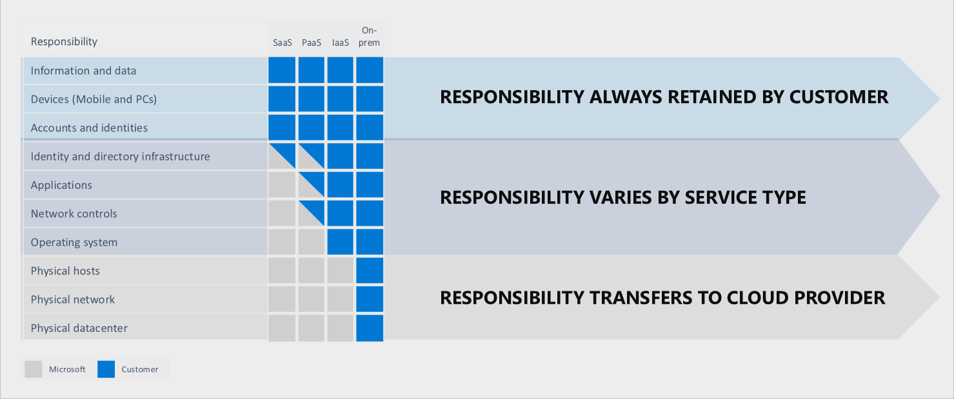
AZ-900 Microsoft Azure Fundamentals
Cloud Models and Cloud Types
Section: 3.8, 3.9
Date: 24/02/22
IaaS, PaaS and SaaS Shared Responsibility Model.

Slide 7
AZ-900 Microsoft Azure Fundamentals
Cloud Models and Cloud Types
Section: 3.10
Date: 24/02/22
Cloud Models
Serverless Model
The most prominent other cloud model available out there is called the serverless model. It’s a little confusing, there are still servers, its just the user will never have to deal with them.
Here we have even less control that PaaS. In PaaS we can at least select a performance tier and pay more for more or less. In serverless we do not even have access to this.
In a serverless model, you give them the code and they will take responsibility for scaling. If traffic increases, they will handle adding more CPU. In PaaS we have control over this scaling, we may need to up the tier to pay for more performance.
So with serverless we don’t even need to worry about choosing the right plan or tier.
Serverless also means you might actually pay nothing. If you host a website and no one visits, then you wont pay anything. In PaaS you will be.

Slide 8
AZ-900 Microsoft Azure Fundamentals
Cloud Models and Cloud Types
Section: 3.11
Date: 24/02/22
Cloud Types
Public Cloud
Basically if you have a credit card you can sign up for it.
AWS, Azure, Google Cloud are all examples of public cloud providers.
Private Cloud
Can setup a cloud environment with your own hardware. A large enterprise with their own data centre may want to do this. They may be running many applications all with varying demand from different parts of the business and a private cloud can offer much of the same benefits around scalability and elasticity that a public cloud offers.
Often have to work with a company like IBM to help set this up.
Hybrid
Microsoft is bigger on this than Google or Amazon.
It’s a combination of public and private clouds. You could have agents installed on a local machine that allows you to connect to the public cloud. If I understand correctly you don’t even need a full private cloud, the private part can simply be your own machine.
Usually useful if there are regulation around where some data needs to be stored and processed.

Slide 9
AZ-900 Microsoft Azure Fundamentals
Section 4
Core Azure Architectural Components

Slide 10
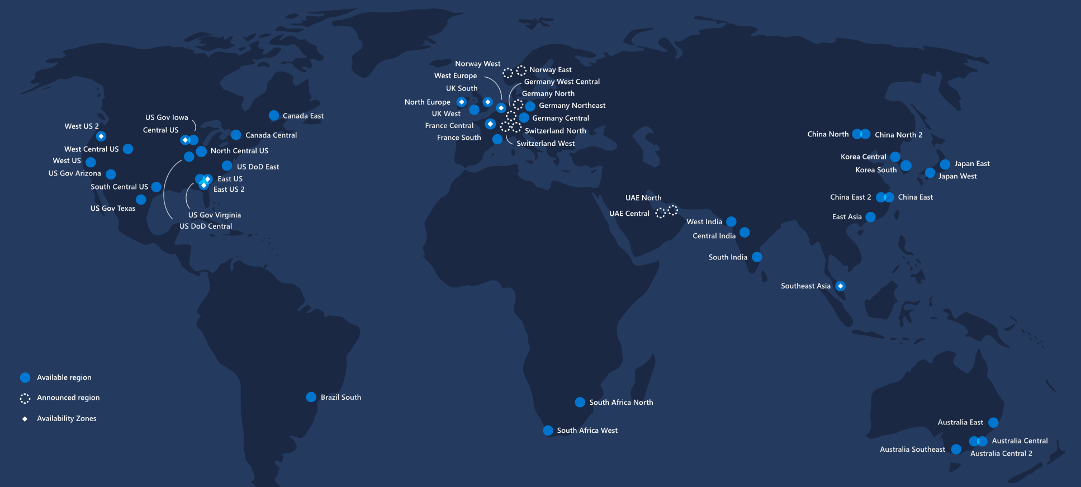
AZ-900 Microsoft Azure Fundamentals
Core Azure Architectural Components
Section: 4.12
Date: 25/02/22
Describe Core Azure Services (15-20%)
Regions
Broken up the map into 60+ regions. When choosing say a VM or most other products you need to specify a region.
Not every region is available to everyone and will not be visible when selecting. An example is Azure in China. This is organised by a different company and you will need a specific agreement with them.
2019

Slide 11
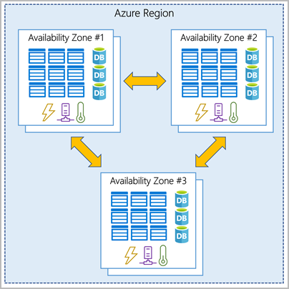
AZ-900 Microsoft Azure Fundamentals
Core Azure Architectural Components
Section: 4.12, 4.13
Date: 25/02/22
Region Pairs
Each region has on other region which is pre-defined and setup as a ‘pair’ by Azure.
This pair is the best place to provide a backup for the user selected region.
Its important that the pair is located where there are the same data laws and in a similar location so the latency is low (typically ~300 miles apart)
I believe the user has control over where their backup goes, but it makes sense to chose the pair.
If one region goes down the pair is on ‘high importance’.
Example of some pairs
Canada Central – Canada East
North Europe – West Europe
East US – West US
2019
Availability Zone
Within each region you will sometimes be able to deploy to individual availability zones.
Each availability zone is physically separated. They are separate buildings (but on the same property perhaps) but with their own network, power supply etc. So if there is a power outage, it will likely only effect one availability centre.

Slide 12
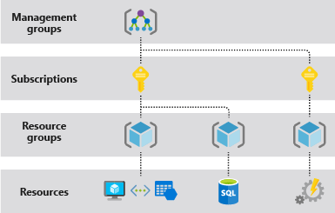
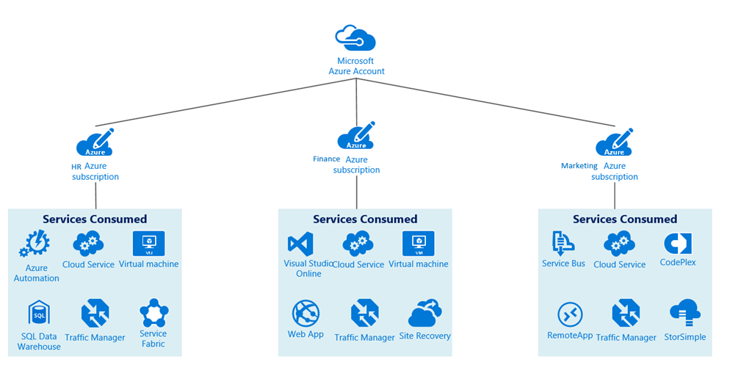
AZ-900 Microsoft Azure Fundamentals
Core Azure Architectural Components
Section: 4.13
Date: 25/02/22
Management Groups
- Top of the tree. Management groups can be nested. They’re used to set rules or policies to the subscriptions that are under that group (e.g. can only spend x amount).
Subscriptions
Subscription is a billing unit or credit card. All the resources under that subscription get charged to that credit card.
A user can have more than one or more subscriptions with different roles.
When selecting a resource (say a VM) you need to select which subscription gets charged.
2019
Common to have different subscriptions to bill things separately, even if it’s the same credit card (I could see this being done with different projects for billing purposes).
Resource Group
User defined bucket of resources available under a subscription.
This is almost like a Petrel bundle.
An example of how a company set this all up is on the right.

Slide 13
AZ-900 Microsoft Azure Fundamentals
Core Azure Architectural Components
Section: 4.14
Date: 25/02/22
Azure Resource Manager (ARM)
Allows you to use azure PowerShell and other tools to create, update and delete resource and resource groups.
ARM template can be used (these are JSON files that can be easily updated).
2019

Slide 14
AZ-900 Microsoft Azure Fundamentals
Section 5
Core Resources Available in Azure

Slide 15
AZ-900 Microsoft Azure Fundamentals
Core Resources Available in Azure
Section: 5.17
Date: 25/02/22
Azure Core Resources
This can be broken down into 5 main types which will be covered in more detail in the coming lectures.
Compute Services (like VMs etc.)
Networking Services (the way applications can communicate with each other and the security)
Storage Services (just like a file system on a local machine)
Database Services (similar to storage but structured)
Azure Marketplace (where you go to find these services)
Compute Services
Virtual Machine (VM) is IaaS and is a ‘slice’ of a physical machine shared with other customers. But you have full control over it, you can install what you like. Over 200 to chose from (CPU cores, CPU speed, RAM, disk size etc.)
App services is a PaaS, provide the code and configuration to Azure and they will run it, select the compute required based on your tier etc.
Containers contain everything the app needs to run in a ‘container or docker image’. Azure Container Instance runs on a single instance and is quick to deploy. Azure Kubernetes Service runs on a cluster of servers (orchestration tool that is used to control running of container instances). You can run a container in a virtual machine.
Windows Virtual Desktop – intended as a hosted way for company users to access Microsoft Office and other Windows desktop software over RDP that runs in Microsoft's datacentres (which may or may not be Azure). Azure VMs are IaaS. Azure VMs only come with a license to run their own pre-packaged version of Windows, not Office.
2019

Slide 16
AZ-900 Microsoft Azure Fundamentals
Core Resources Available in Azure
Section: 5.18
Date: 25/02/22
Networking Services
There are 4 different types of networking services, each will be broke down in more detail here
Connectivity Services
Virtual Network is effectively what connect you sitting at home or in the office to that resource you're trying to access (say a VM).
Virtual Private Network (VPN) connects two networks as if they were on the same and securely. This means that if you surf online with a VPN, the VPN server becomes the source of your data. This is often used when connecting to the office from home for example.
ExpressRoute – high speed private connection to Azure, but you have to pay for it and it doesn’t run on the public internet.
Protection or Security Services
DDoS Protection (Distributed Denial of Service) – directing too much traffic to a single destination (e.g. web app) to overwhelm it.
Azure Firewall (allow or block certain traffic)
Network Security Groups is a type of firewall with basic static rules or list (such as IP address).
Private Link
Delivery Services
All about delivering data to the end user efficiently
- Load Balancer (distributes traffic evenly between multiple backend servers
2019

Slide 17
AZ-900 Microsoft Azure Fundamentals
Core Resources Available in Azure
Section: 5.18
Date: 25/02/22
Delivery Services
All about delivering data to the end user efficiently
Load Balancer (distributes traffic evenly between multiple backend servers).
Content Delivery Network (CDN) – stores data files closer to the user so things load quicker.
Azure Front Door Service (combines the above for best user performance).
Monitoring Services
Important to be able to ‘watch’ traffic going over your virtual network and make adjustments where necessary.
Network Watcher
ExpressRoute Monitor
Azure Monitor

Slide 18
AZ-900 Microsoft Azure Fundamentals
Core Resources Available in Azure
Section: 5.21
Date: 25/02/22
Setting up a Virtual Machine
The first thing we need to do is create a virtual network. Virtual machines can be created in the same virtual network and they can connect to each other using private IP addresses. Virtual machines can connect if they're in different subnets. They connect without the need to configure a gateway or use public IP addresses. To put VMs into a virtual network, you create the virtual network. As you create each VM, you assign it to the virtual network and subnet. Virtual machines acquire their network settings during deployment or startup.
Virtual machines are assigned an IP address when they're deployed. When you deploy multiple VMs into a virtual network or subnet, they're assigned IP addresses as they boot up.
Note we can enable auto shutdown which will automatically shutdown the VM at a specified time in order to prevent unwanted costs. Note VM’s are charged hourly. Also note that we’re going to be paying even when the machine is ‘off’. This is because there is storage on the VM that needs to be there constantly in order to be able to log back in and start where we left off (only the CPU and RAM isn’t in use).

Slide 19
AZ-900 Microsoft Azure Fundamentals
Core Resources Available in Azure
Section: 5.22, 5.25
Date: 25/02/22
Storage Services
One of the three foundations of cloud computing: storage, compute and networking (we need data in storage, and compute to run things on that data, and networking to connect to that data and compute).
Most commonly use General Purpose v2 (gpv2) with blobs, tables, queues and files.
Typically charged at a few cents per Gb per month.
Many options to chose from: access tier (hot, cool, archive), performance tiers, location, replication (by default 3 copies in one region or you can do 6 copies in two regions) etc.
Azure Private endpoint is the fundamental building block for Private Link in Azure. It enables Azure resources, like virtual machines (VMs), to communicate with Private Link resources privately.
Azure Database Services
Cosmos DB (NoSQL – not only SQL, very fast sub-10ms response to queries).
Azure SQL Database
Azure Database for MySQL
Azure Database for PostgreSQL (opensource)
SQL Managed Instance
https://docs.microsoft.com/en-us/azure/private-link/tutorial-private-endpoint-storage-portal

Slide 20
AZ-900 Microsoft Azure Fundamentals
Core Resources Available in Azure
Section: 5.26
Date: 25/02/22
Azure Marketplace
User interface where Azure list the services available for use.
Note that its not only Microsoft products on here.
There are loads to chose from. For example we can get a VM with SQL already installed. Note can also setup our own VM with everything we want installed on it. This is called a virtual machine image. Say we want anaconda, PostgreSQL and office installed. We do this and then effectively set it as a template so other users can spin up a VM instance with the same setup.

Slide 21
AZ-900 Microsoft Azure Fundamentals
Section 6
Azure Core Solutions

Slide 22
AZ-900 Microsoft Azure Fundamentals
Azure Core Solutions
Section: 6.27, 6.28
Date: 25/02/22
Describe Core Solutions and Management Tools (10-15%)
Internet of Things (IoT)
IoT Hub (receiving small and limited pieces of data coming in from many sources - like a smart fridge for example)
IoT Central: connect monitor and manage IoT assets at scale.
Azure Sphere (platform to maintain security of a device like the one above – includes a silicone chip and ‘Sphere operating system’)
Big Data and Analytics
First lets discuss the concept of a data warehouse. Originally reports (analytics) were run on databases themselves. This slowed down the day to day operations required with that DB. So data is pulled out the data that is needed for reporting and placing it into its own database (could be done overnight). Can now modify or trim this new database (or data warehouse) without fear that it will upset operations.
Azure Synapse Analytics (formerly SQL Data Warehouse).
Open source big data solution is Apache Hadoop. Microsoft do offer Apache products as managed products whether they be PaaS or SaaS. All these managed Apache products fall under HDInsight.
Azure Databricks (also opensource) – data analytics platform. You can run different processes in a databricks environment, main functionality appears to be using a jupyter notebook. ML dependencies in here like tensorflow.

Slide 23
AZ-900 Microsoft Azure Fundamentals
Azure Core Solutions
Section: 6.30, 6.31, 6.32
Date: 25/02/22
Artificial Intelligence AI
Azure Machine Learning
Cognitive Services (pre-trained computer vision models, NLP models such as translators that understand the context of a sentence etc.)
Azure Bot Services (natural language chatbot service – front end that allows users to ask questions)
Azure Functions
Much smaller bits of code that are hosted directly within Azure. So you may want a small function to run when something happens. Ordinarily you’d need to spin up a VM and have it constantly running, looking for when to run the function. Azure functions removes this requirement making the process simpler. It’s serverless (we don’t pick the CPU, RAM etc.)
1 million executions per month is free.
Logic Apps
Workflow service, effectively chained functions.
Like Azure Functions its also serverless.
Lots of pre-defined ‘external connectors’ that are setup and ready to go like ‘copy file automatically to one drive when placed on dropbox’ or ‘email yourself new tweets about a certain keyword via twitter’.

Slide 24
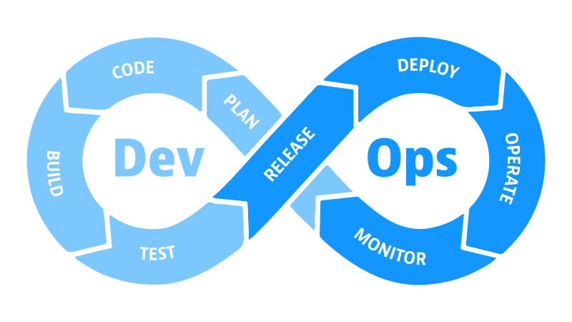
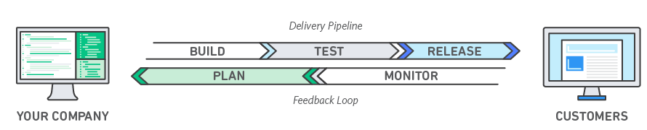
AZ-900 Microsoft Azure Fundamentals
Azure Core Solutions
Section: 6.33
Date: 25/02/22
DevOps Solutions
Often have two teams development team working on the software itself and the operations team (or IT team), handling the servers, the hardware, keeping everything running. DevOps is a hybrid role. We may want the developers to commit their code to GitHub and then it be automatically deployed into a development server, or a testing server, with no hands on operations. There’s a significant amount of programming needed to do that automation.
DevOps Solutions
Azure DevOps (Kanban boards, pipelines etc.)
GitHub
GitHub Actions (detects is source code has been changed, compiles it and pushes it into your development environment – called continuous integration. This might be in a test environment).
Azure DevTest Labs (create environments)
Note./ Microsoft purchased GitHub in 2018 and have been slowly integrating it into Azure behind the scenes.

Slide 25
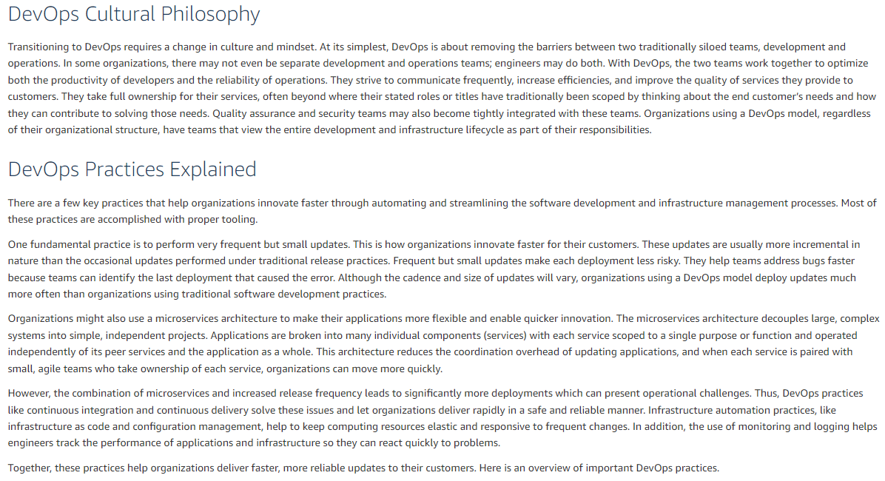
AZ-900 Microsoft Azure Fundamentals
Azure Core Solutions
Section: 6.33
Date: 25/02/22
https://aws.amazon.com/devops/what-is-devops/#:~:text=DevOps%20is%20the%20combination%20of,development%20and%20infrastructure%20management%20processes.

Slide 26
AZ-900 Microsoft Azure Fundamentals
Section 7
Azure Management Tools

Slide 27
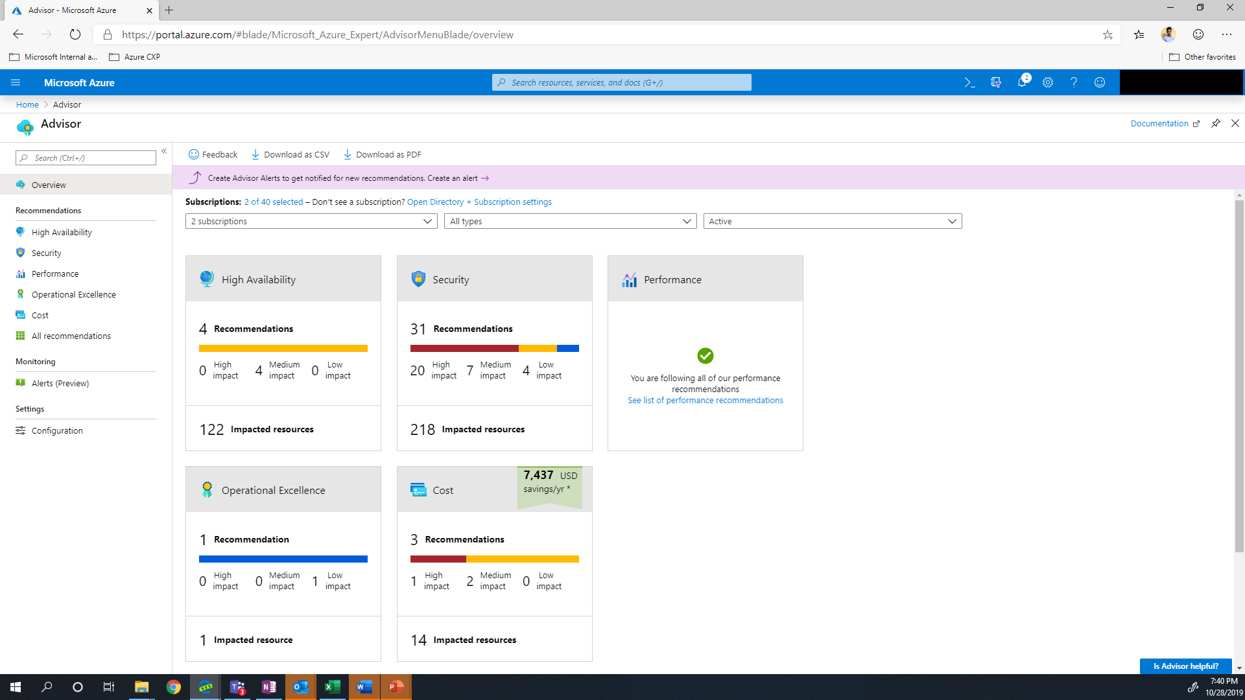
AZ-900 Microsoft Azure Fundamentals
Azure Management Tools
Section: 7.34, 7.35
Date: 28/02/22
Azure Tools
Azure Portal (this is the main tool used for interacting with Azure. It is effectively the login page and you can control all the resources from here).
PowerShell (it’s possible instead to manage all the resource without the need for the portal, can control VM’s and other resources directly from the PowerShell).
Azure Cloud Shell (scripting in the browser as opposed to having to install PowerShell onto you machine).
Azure Mobile App (use the app to monitor health and status of the resources from your phone - but you cant perform everything on your phone).
Azure Advisor
Analyse your usage of azure and make suggestions on how you can improve (e.g. under utilising a server).
The categories it recommends to you is based on: High availability, Security, Performance, Operational Excellence and Cost.
Recommendations are categorised as high, medium or low impact.

Slide 28
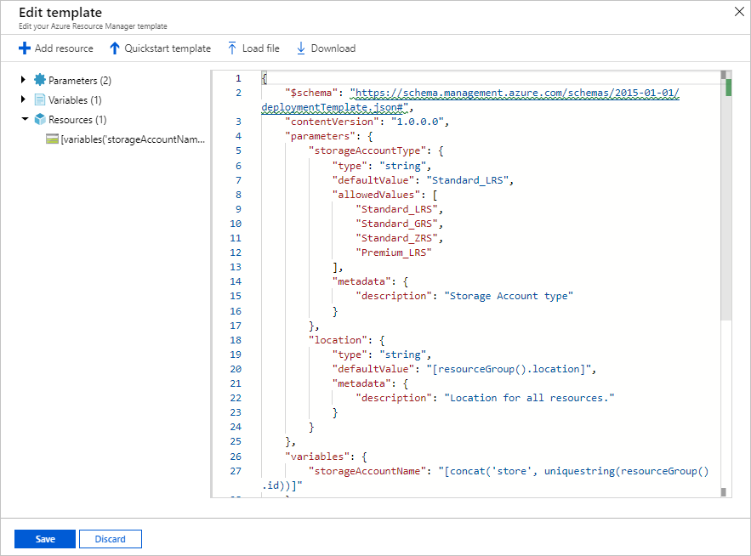
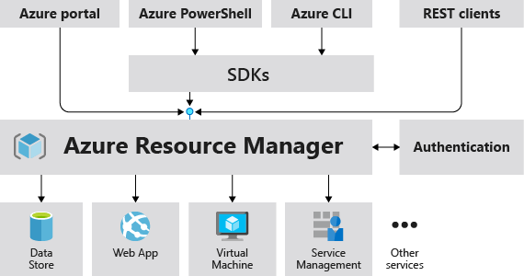
AZ-900 Microsoft Azure Fundamentals
Azure Management Tools
Section: 7.37
Date: 28/02/22
Azure Resource Manager (ARM) Templates
ARM is how Azure deploys resource to users under the hood.
All requests funnel through the same deployment process no matter how you’re asking Azure to do it for you. It’s like the kitchen in a restaurant, I may order food in the restaurant or via an app but all the orders go through the restaurant in the same way.
See the image below outlining this, we could request resources through the portal, or through the PowerShell, ultimately it will go through the ARM.
The actual thing that is written in ARM is a template, in JSON format, which we can actually edit directly. One way of documenting the infrastructure we have.

Slide 29
AZ-900 Microsoft Azure Fundamentals
Azure Management Tools
Section: 7.37
Date: 28/02/22
Azure Monitor
Like a centralised dashboard for monitoring the health of most resources in Azure.
Monitors your instances of resources.
Free but you need to pay for storage.
Azure Service Health
Like azure monitor for azure as a whole. Its like down detector for azure.
Can filter by region. If a datacentre is having issues with power in America it may not effect you if you’re region is set to Europe.
Can setup alerts to notify you when certain parts of azure are down. You may chose to only be notified about incidents that effect you.
https://docs.microsoft.com/en-us/azure/azure-monitor/overview

Slide 30
AZ-900 Microsoft Azure Fundamentals
Section 8
Azure Security Features

Slide 31
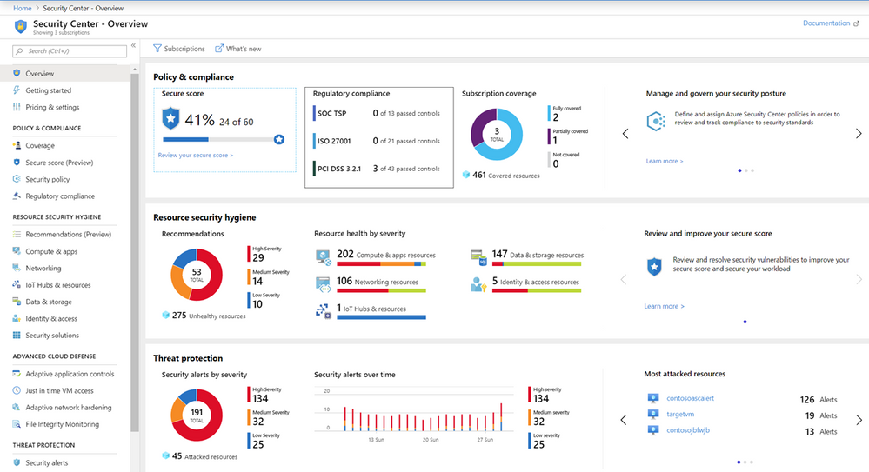
AZ-900 Microsoft Azure Fundamentals
Azure Security Features
Section: 8.39
Date: 28/02/22
Describe General and Network Security Features (10-15%)
Azure Security Centre
Centralised dashboard that monitors and protects your systems inside and outside of Azure (need to install software agents locally).
Ties in with Azure Advisor, which has security as one of the five categories. Completing the recommendations will improve your ‘secure score’

Slide 32
AZ-900 Microsoft Azure Fundamentals
Azure Security Features
Section: 8.40
Date: 28/02/22
Azure Key Vaults
Secure repository for storing secrets (user ID and password), certificates and keys.
Previously some people hard coded the user ID and password to access certain information. Later it was stored externally in a configuration file. But now this information can be stored in Azure Key Vaults such that even the developers don’t have access to those values.
Improves security as its no longer stored within the codebase.
You grant access to the applications to retrieve information from Azure Key Vault.
Azure Sentinel
Has access to the log files from various resources.
For example if someone keeps trying to log in and failing, it may trigger an alert on Azure Sentinel.
You can also implement the fix to an identified security problem in sentinel as well.
Azure Dedicated Hosts
You can ask Azure to dedicate hardware only to you, so no other customers can use it and you have access to exactly the same machine every time you work on it.
You can reserve a piece of hardware and even run multiple VM’s on it.
Useful for ‘hyper sensitive’ companies or for those that need the max security on a given project say.

Slide 33
AZ-900 Microsoft Azure Fundamentals
Section 9
Azure Network Security

Slide 34
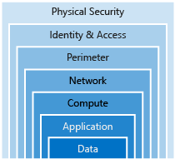
AZ-900 Microsoft Azure Fundamentals
Azure Network Security
Section: 9.41
Date: 28/02/22
Defence in Depth or Security Layers
This is the swiss cheese model for security. No single security is relied upon.
Physical (doors, locks, key cards etc. around the physical datacentres.)
Azure AD - Active Directory (provides single sign-on, multifactor authentication, and conditional access)
Perimeter (DDoS, firewalls)
Network Security Groups – NSGs (Azure network security group to filter network traffic to and from Azure resources in a VN. A network security group contains security rules that allow or deny inbound network traffic to, or outbound network traffic from, several types of Azure resources)
Compute (windows updates, limit VM access)
Application (API management)
Data (virtual network endpoint)
https://docs.microsoft.com/en-us/azure/virtual-network/network-security-groups-overview
https://azure.microsoft.com/en-gb/services/active-directory/

Slide 35
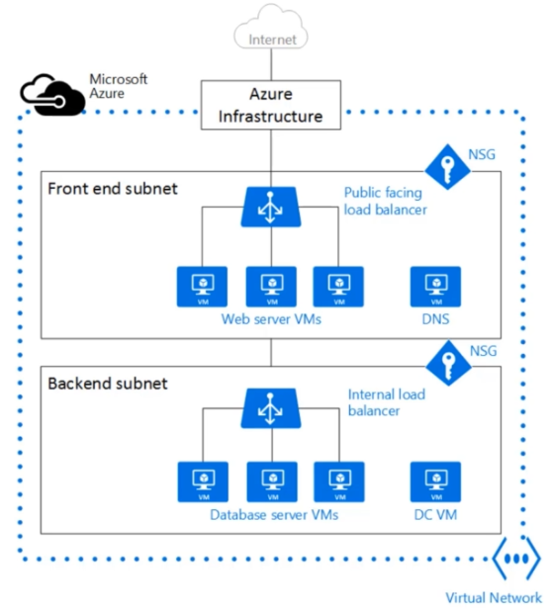
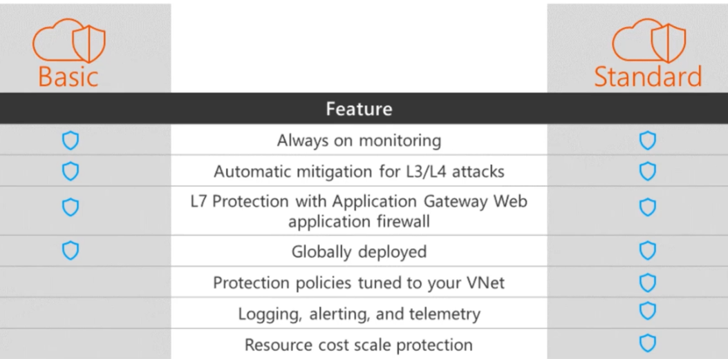
AZ-900 Microsoft Azure Fundamentals
Azure Network Security
Section: 9.42
Date: 01/03/22
Network Security Group
When setting up a virtual network we often split into multiple subnets designed for different purposes and with the aim of keeping things separate
NSG is a set of rules around a subnet. For example we may grant limited access to certain areas (e.g. VMs in that subnet may only access data from port x say.)
Azure Firewall
Analyses traffic trying to come in and see if it matches known bad patterns
Azure DDoD Protection
Main difference between basic and standard is instead of having general policies, the policies will be specifically tuned to you and your needs.

Slide 36
AZ-900 Microsoft Azure Fundamentals
Section 10
Managing Azure Costs

Slide 37
AZ-900 Microsoft Azure Fundamentals
Azure Managing Costs
Section: 10.39
Date: 21/06/22
Describe Azure Management and Governance (30-35%)
Free Services
Resource groups
Virtual networks (up to 50)
Load balancer (basic)
Azure Active Directory (basic)
Network security groups
Free-tier web apps (up to 10)
Pay Per Usage Services
Azure Functions. First 1 million executions free per month ($0.2 per million after than) – so far cheaper than spinning up a VM to host a basic function.
Storage (pay per Gb basis).
Outbound bandwidth. Inbound data is free, you can put as much as you want into storage and you’re being charged for storage but not uploading that data to the cloud. Downloading data from Azure however isn’t free and its roughly ~$0.05 per Gb. This is because they want you to keep your data in the cloud.
Logic Apps.
Cognitive Services API.

Slide 38
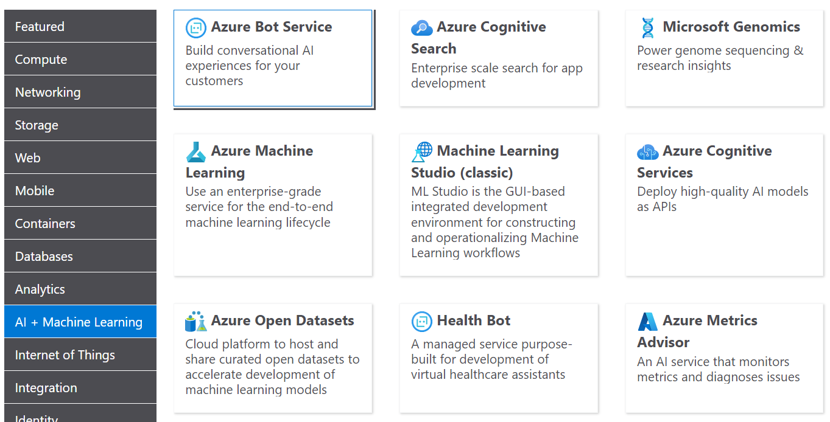
AZ-900 Microsoft Azure Fundamentals
Azure Managing Costs
Section: 10.39 & 10.40
Date: 21/06/22
Pay For Time Services
VMs (charged at second basis).
VMs (stable option committing to fixed time e.g. 1yr or 3yrs – know exactly what the bill is going to be).
Azure Pricing Calculator
https://azure.microsoft.com/en-gb/pricing/calculator/
They have tools so you can build a business case.
The calculator is purely an estimate, its not possible to be completely accurate.
You can price up VM’s, storage accounts, bandwidth etc.
See a screengrab of all the items you can ‘add to your cart’.
You effectively get analytics back from this that can be saved and shared or exported to a spreadsheet.

Slide 39
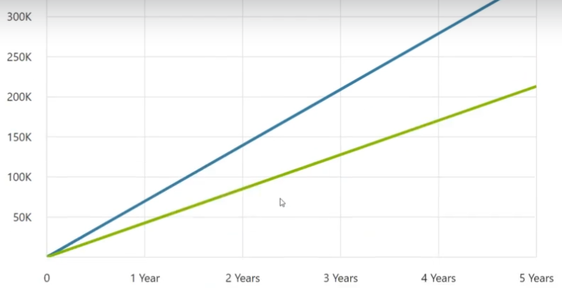
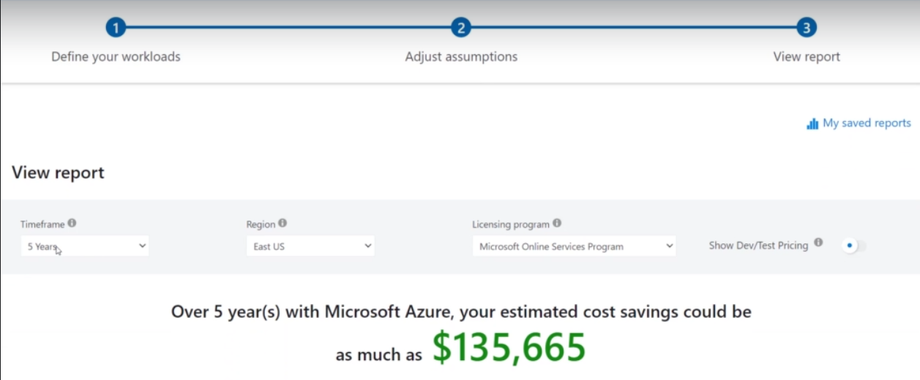
AZ-900 Microsoft Azure Fundamentals
Azure Managing Costs
Section: 10.41
Date: 21/06/22
Total Cost of Ownership Calculator
https://azure.microsoft.com/en-gb/pricing/tco/calculator/
The cost of a server isn’t just the hardware but everything around it (internet, cooling, real-estate or space, labour, security etc.)
This calculator is aimed to help you understand how much an on prem setup would cost you. Note that this is possibly going to be slightly bias and overestimate the cost because Microsoft want you to use their cloud instead of you setting up an on prem solution.
It then shows you how much it will cost for the server ownership vs the cost of the Azure over time.
It also breaks down where the savings are (e.g. is it in compute, networking, storage, labour etc.?)

Slide 40
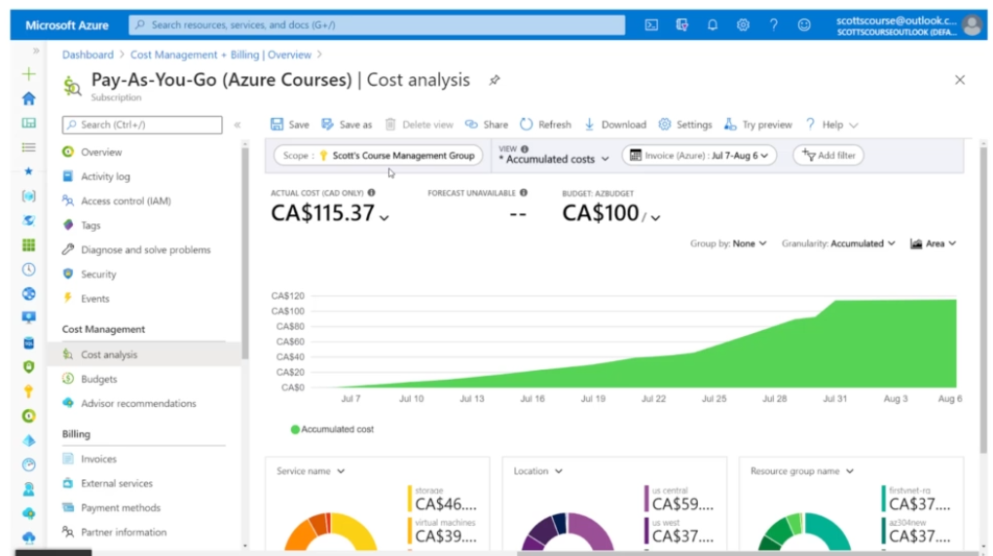
AZ-900 Microsoft Azure Fundamentals
Azure Managing Costs
Section: 10.42
Date: 21/06/22
Azure Cost Management
Another free tool that can be used to analyse spending.
The difference is this time its about tracking your actual spending rather than forecasting how much it will cost or how much it will save you.
Can track spending over time.
Also have a forecast function which estimates how much the remainder of the month will be based on past behaviour.
You can set a budget, this doesn’t mean you cant spend more than the budget but you can setup alerts when charges are reaching a certain number (e.g. SMS or email when you hit 75% or 80% of your budget say).
Can view all your past invoices.
Schedule reports that are emailed to you on usage.

Slide 41
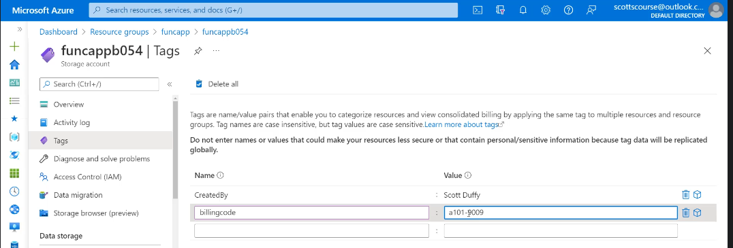
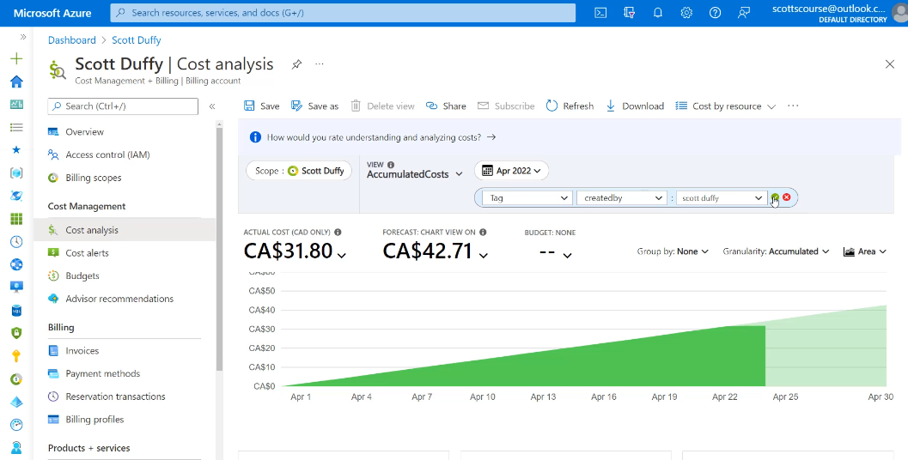
AZ-900 Microsoft Azure Fundamentals
Azure Managing Costs
Section: 10.43
Date: 21/06/22
Resource Tags
Way for you to add metadata to your resources for personal use.
If you setup a VM, 6 months later it may be difficult to know why that was setup.
So you add a resource tag to a resource so you know what project that resource is assigned to.
This allows you to keep track of all the costs for a specific project through looking at the billing by tag in the azure cost management area.
Figure to the right shows the creation of a resource tag and then bottom right shows filtering by tags in the Azure cost management app.

Slide 42
AZ-900 Microsoft Azure Fundamentals
Section 11
Azure Governance and Compliance

Slide 43
AZ-900 Microsoft Azure Fundamentals
Azure Identity Services
Section: 11.44
Date: 21/06/22
Azure Governance and Compliance
Likely that a company will have a set of rules that need to be followed.
An example of this is: always have a daily backup enabled on every server. This could be a rule or policy over the organisation.
How to Manage or Ensure Governance is being Followed?
One option is to simply send an email and assume that everyone reads it and follows it.
Another option is to use Azure tools to enforce the riles or audit compliance (for the previous example the former would be forcing people to have backups whereas the latter would be monitoring the number of servers with and without backups – this would then need to be followed up on). There are 4 topics we need to be aware of:
Service Trust Portal
Azure Blueprints
Azure Policy
Resource Locks
Service Trust Portal
https://servicetrust.microsoft.com/
Location of documents required for MS regulatory standards.
This is how MS Azure complies with different standards such as GDPR.

Slide 44
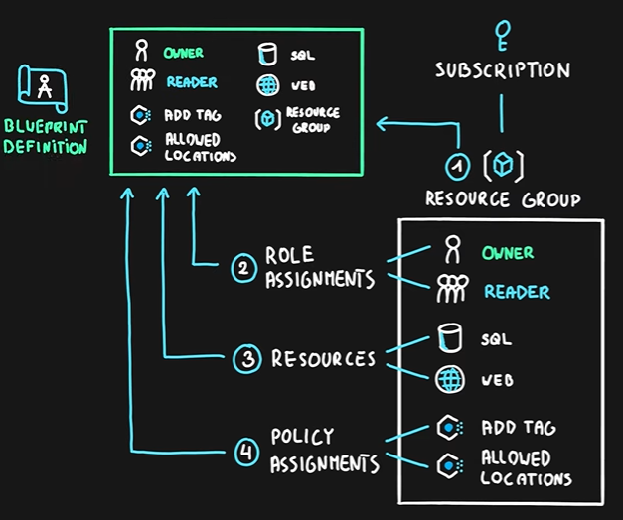
AZ-900 Microsoft Azure Fundamentals
Azure Identity Services
Section: 11.44
Date: 21/06/22
Azure Blueprints
https://docs.microsoft.com/en-us/azure/governance/blueprints/overview
Basically, a template for a subscription that will allow us to make the same resources repeatedly.
A blueprint definition is a collection of azure components role assignments resource groups resources and policy assignments allowing you to deploy those with a single press of a button.
When creating a blueprint, we can create one from scratch where we define our own assignments, or we can select commonly used premade templates.

Slide 45
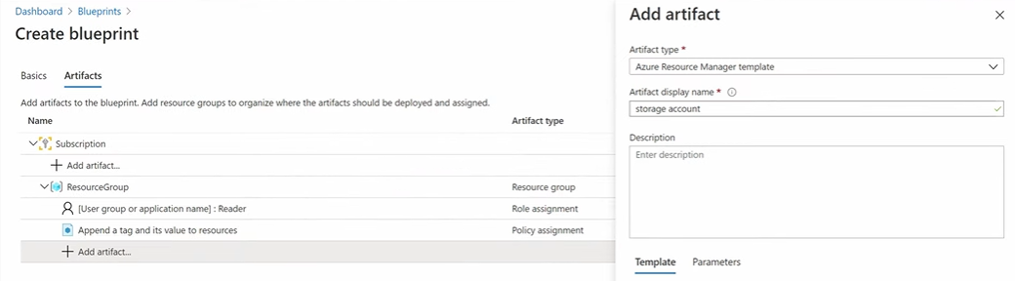
AZ-900 Microsoft Azure Fundamentals
Azure Identity Services
Section: 11.44
Date: 21/06/22
1. Create the Blueprint
Here we have created a blueprint from scratch.
We’ve added a set of fields that need to be filled in and specified that a storage account is to be created.

Slide 46
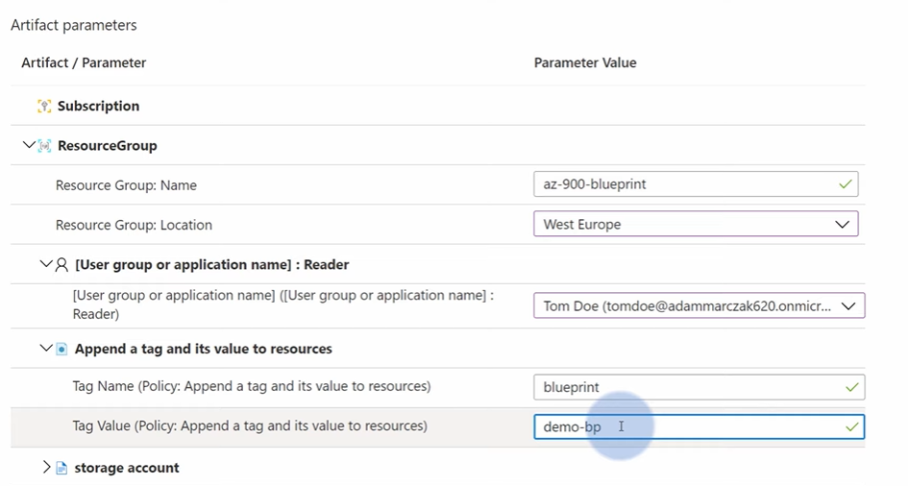
AZ-900 Microsoft Azure Fundamentals
Azure Identity Services
Section: 11.44
Date: 21/06/22
2. Applying the Blueprint
The blueprint can be used now to create a storage account, but note that we have to fill in a set of parameters before this is done.
This ensures that certain fields are always filled in when creating a resource.

Slide 47
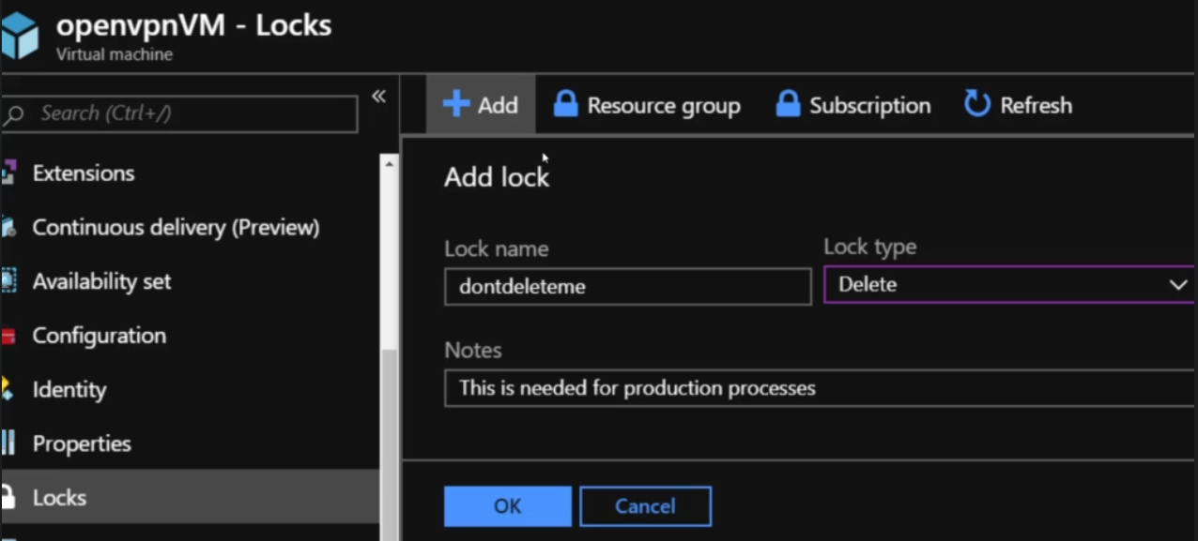
AZ-900 Microsoft Azure Fundamentals
Azure Identity Services
Section: 11.44
Date: 21/06/22
Azure Policy
Define rules across all of your Azure resources.
You can define your own policy (using JSON definition) or more commonly you can chose from a set of built in policies, for example:
Require SQL Server 12.0 or over.
Define allowed locations.
Define allowed storage accounts.
Virtual machine resources types (avoid people deploying expensive VMs).
Block certain resource types.
Can apply policy to entire subscription or down to specific resource groups. So you don’t have to block off the entire company from using certain resources.
Resource Locks
Read Only Lock - Lock a resource as being read only, so cant be modified. So you can lock a VM, and it will still function just fine but the properties of that VM can not be changed.
Can not Delete Lock - The resource can be altered and changed it just can be deleted.

Slide 48
AZ-900 Microsoft Azure Fundamentals
Section 12
Tools for Managing and Deploying Azure Resources

Slide 49
AZ-900 Microsoft Azure Fundamentals
Tools for Managing and Deploying Azure Resources
Section: 12.45, 12.46
Date: 21/06/22
Azure Portal
Web based app that allows you to manage and see resources that are running.
User friendly, you can see things in graphs.
Scripting Languages
Sometimes when we have thousands of deployed resources the portal may not be enough, or it may simply be too large and messy and instead we may wish to interact with azure using scripting languages.
PowerShell and bash (both CLI’s or command line interface) are supported and you can use these locally when connected to azure.
When going into cloud shell you do need to create or link a storage account.
Say you need to create a VM, you could write a script for that and run it in the CLI or PowerShell so you don’t need to interact with the portal; it can speed processes up.
All Azure specific commands start with the ‘az’ such as the following:
$ az group create –name newrg –location eastus
Typically though this would be inside a script which is then run in the CLI as often we need to specify many more variables.
Unix based OS are popular with servers due to their stability, security, flexibility and the fact the majority are open source (free)
Windows
Unix
1985
1969
PowerShell
Bash
https://www.quora.com/Why-is-Linux-commonly-used-on-servers
MacOS
Linux
1984
1991
+many more
Ubuntu
Red Hat Linux
2004
1994

Slide 50
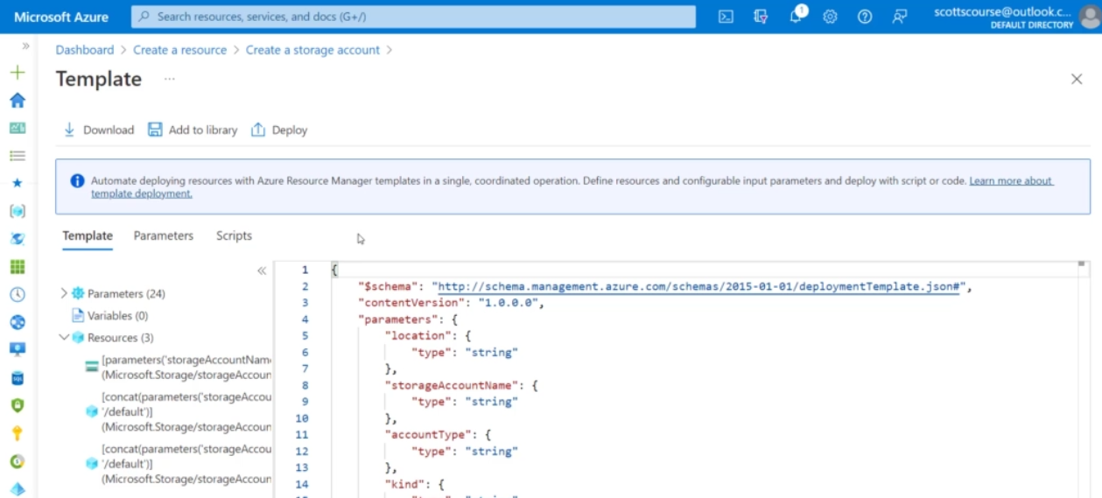
AZ-900 Microsoft Azure Fundamentals
Tools for Managing and Deploying Azure Resources
Section: 12.47, 12.48, 12.49
Date: 21/06/22
Azure Arc
Allows you to see your own infrastructure that you run on prem or with other clouds such as AWS. I also believe you can manage these resources as well but I’m not 100% sure.
There’s no charge to see this, just add the infrastructure and see the views.
Also offer a sandbox to play with this without having to have resource deployed in other locations.
ARM (Azure Resource Manager) Templates
Service running in the background that’s effectively the middle man between the actual resource and tools available to us like the portal.
When you create a resource in the portal it gets created in an ARM template and it’s the template that gets deployed. The template is in JSON format and is effectively a set of variables.
We can download a template when creating a resource in the portal. This is useful if we want to create resources repeatedly.
We can save and store our templates in the ‘template specs’ for future use.
N.B./ An Azure Blueprint often consists of a set of resource groups, policies, role assignments, and Resource Manager (ARM) template deployments. So, blueprints are almost one level up from ARM templates

Slide 51
AZ-900 Microsoft Azure Fundamentals
Section 13
Monitoring Tools

