Slide 1
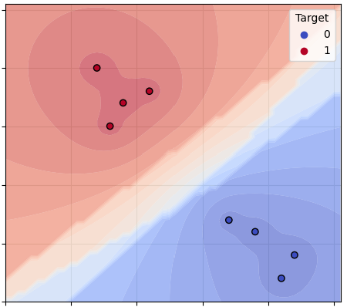
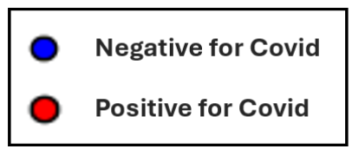
102
Day 1
8 Samples
101
100
Temperature (F)
99
98
97
0
2
4
6
8
10
Sense of Smell & Taste
(0 = no sense, 1 = normal)

Slide 2
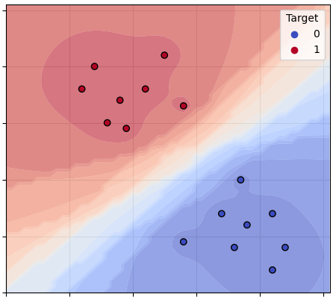
102
Day 2
16 Samples
101
100
Temperature (F)
99
98
97
0
2
4
6
8
10
Sense of Smell & Taste
(0 = no sense, 1 = normal)

Slide 3
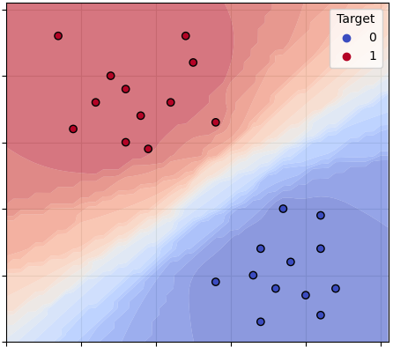
102
Day 3
24 Samples
101
100
Temperature (F)
99
98
97
0
2
4
6
8
10
Sense of Smell & Taste
(0 = no sense, 1 = normal)

Slide 4
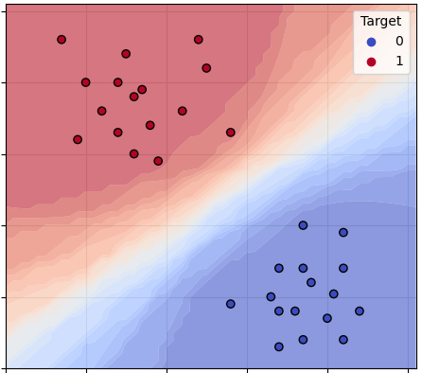
102
Day 4
32 Samples
101
100
Temperature (F)
99
98
97
0
2
4
6
8
10
Sense of Smell & Taste
(0 = no sense, 1 = normal)

Slide 5
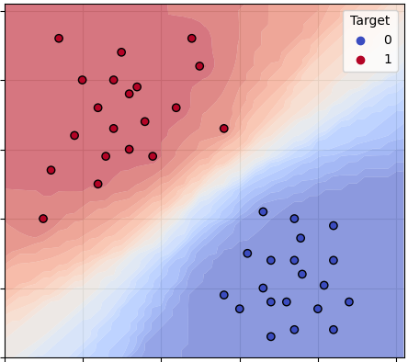
102
Day 5
40 Samples
101
100
Temperature (F)
99
98
97
0
2
4
6
8
10
Sense of Smell & Taste
(0 = no sense, 1 = normal)

Slide 6
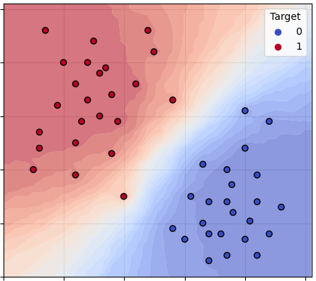
102
Day 6
48 Samples
101
100
Temperature (F)
99
98
97
0
2
4
6
8
10
Sense of Smell & Taste
(0 = no sense, 1 = normal)

Slide 7
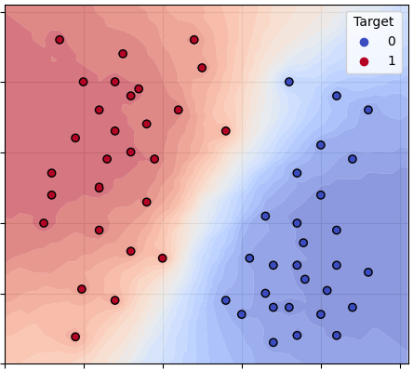
102
Day 7
56 Samples
101
100
Temperature (F)
99
98
97
0
2
4
6
8
10
Sense of Smell & Taste
(0 = no sense, 1 = normal)

Slide 8
Negative for Covid
Positive for Covid

