Slide 1

DP-100 Microsoft Azure Data Science
https://learn.microsoft.com/en-us/credentials/certifications/azure-data-scientist/?practice-assessment-type=certification
Title Page
DP-100 Azure Data Scientist Associate

Slide 2
DP-100 Microsoft Azure Data Science
https://learn.microsoft.com/en-us/training/paths/design-machine-learning-solution/
Section 1
Design a machine learning solution

Slide 3
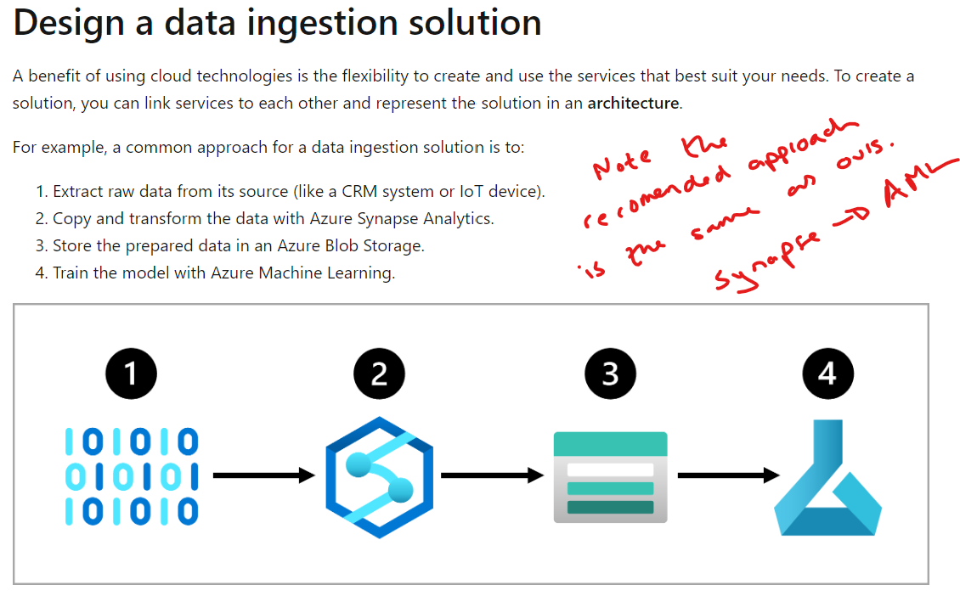
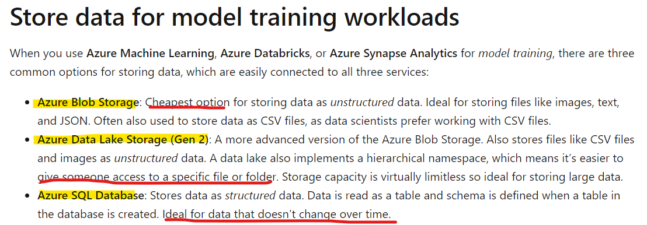
DP-100 Microsoft Azure Data Science
Microsoft Azure Data Science: Design a machine learning solution
Date: 18/10/24
Data Storage & Ingestion Approaches
Data Ingestion Pipelines
Azure Synapse: With Azure Synapse Pipelines you can create and schedule data ingestion pipelines
Azure Databricks: More of a managed service than synapse but very similar.
Azure Machine Learning: Though Azure Machine Learning pipelines are commonly used to train machine learning models, you could also use it to extract, transform, and store the data in preparation for training a machine learning model.
https://learn.microsoft.com/en-us/data-engineering/playbook/articles/databricks-vs-synapse

Slide 4
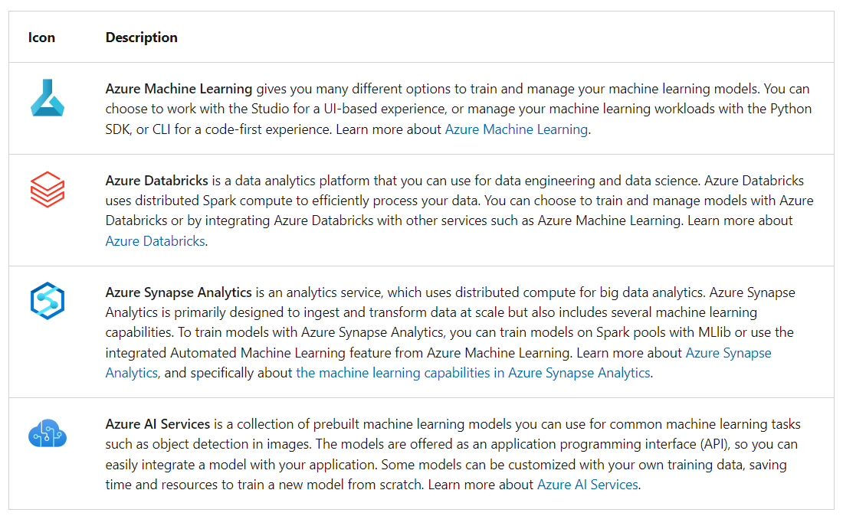
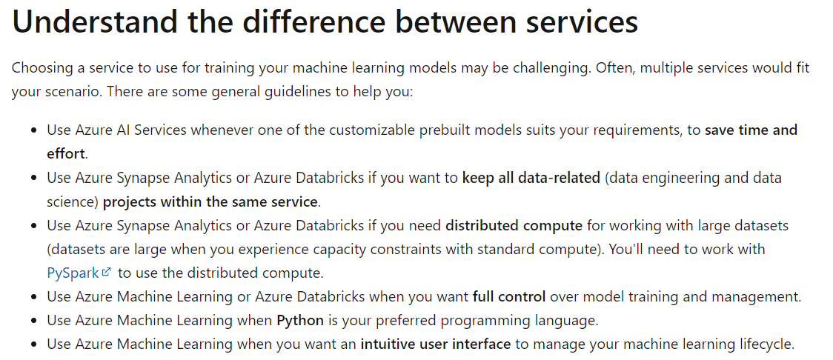
DP-100 Microsoft Azure Data Science
Microsoft Azure Data Science: Design a machine learning solution
Date: 18/10/24
Services for Training Models

Slide 5
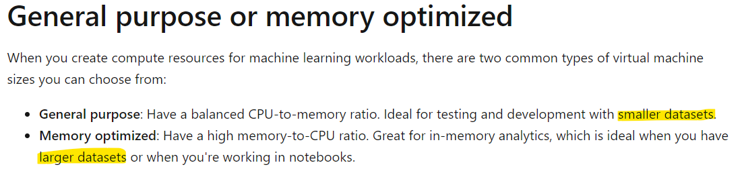
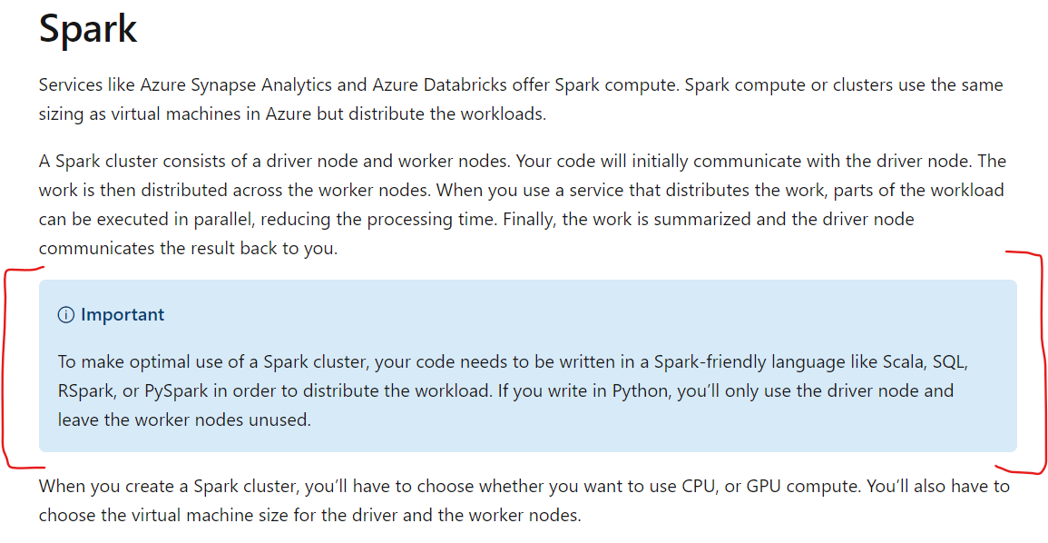
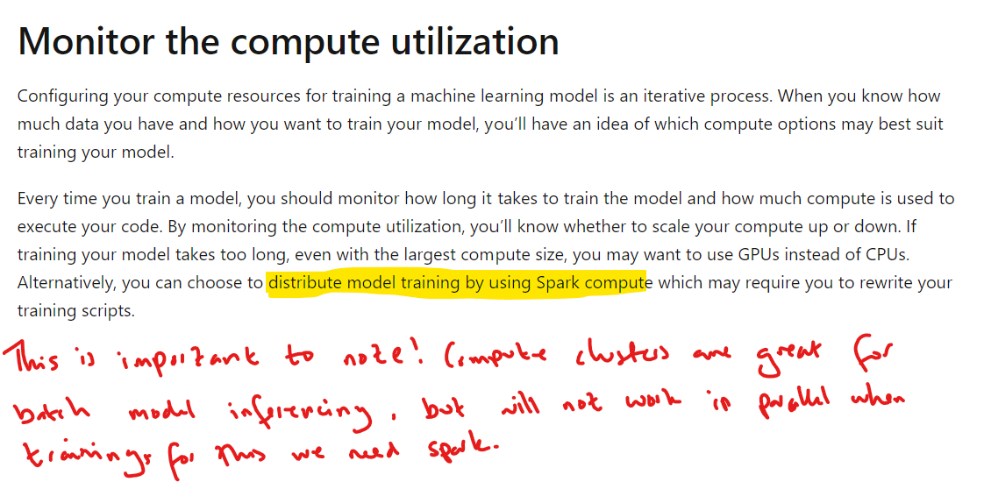
DP-100 Microsoft Azure Data Science
Microsoft Azure Data Science: Design a machine learning solution
Date: 18/10/24
Compute for Model Training

Slide 6
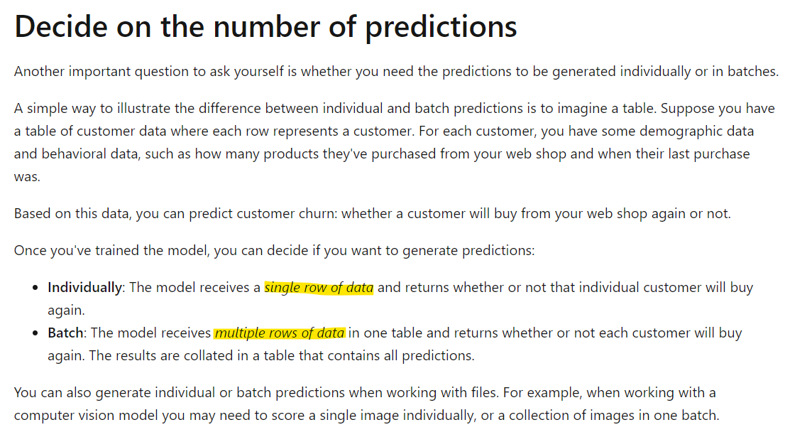
DP-100 Microsoft Azure Data Science
Microsoft Azure Data Science: Design a machine learning solution
Date: 18/10/24
Model Deployment

Slide 7
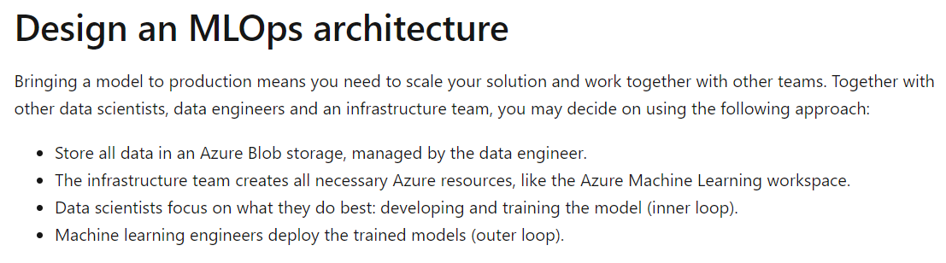
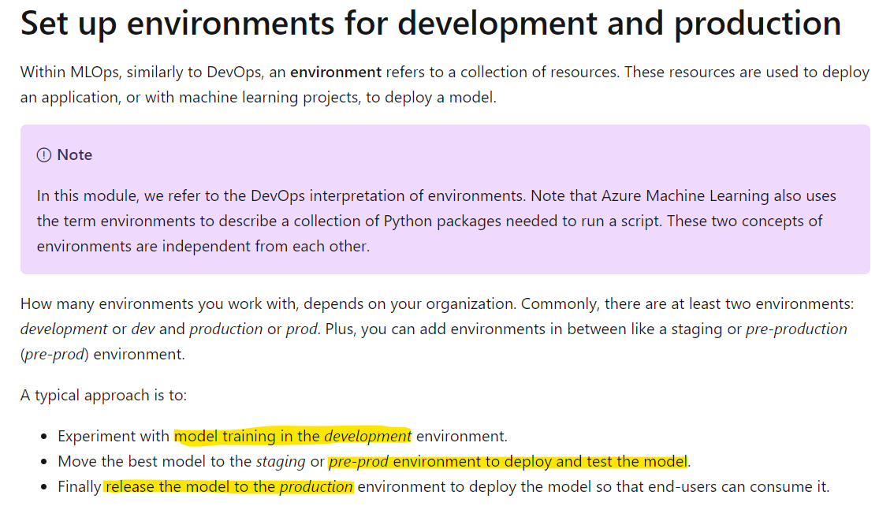
DP-100 Microsoft Azure Data Science
Microsoft Azure Data Science: Design a machine learning solution
Date: 18/10/24
MLOps Architecture Deployment

Slide 8
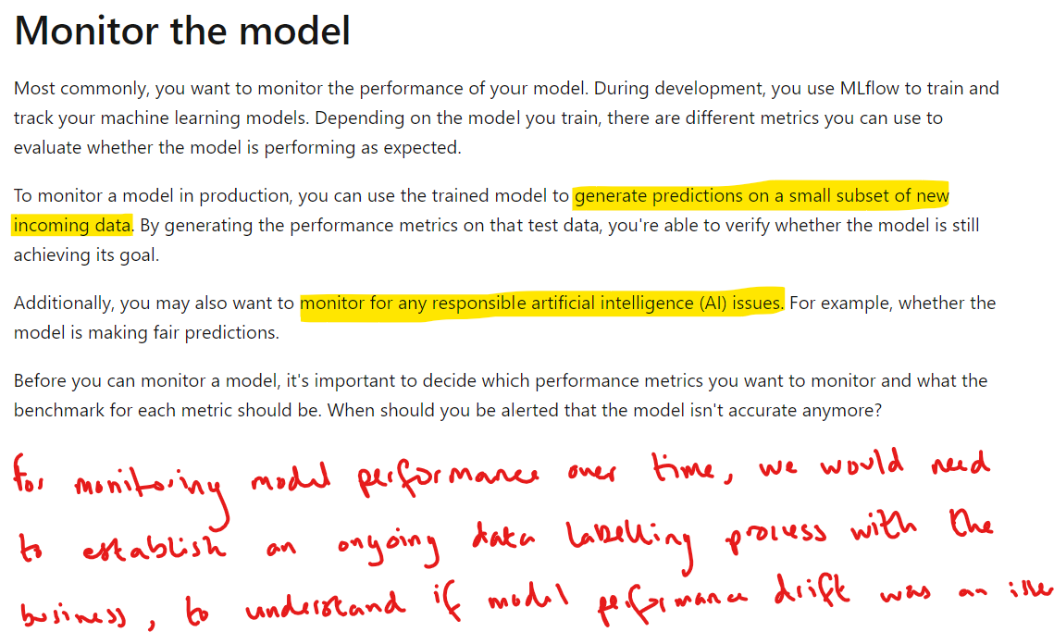
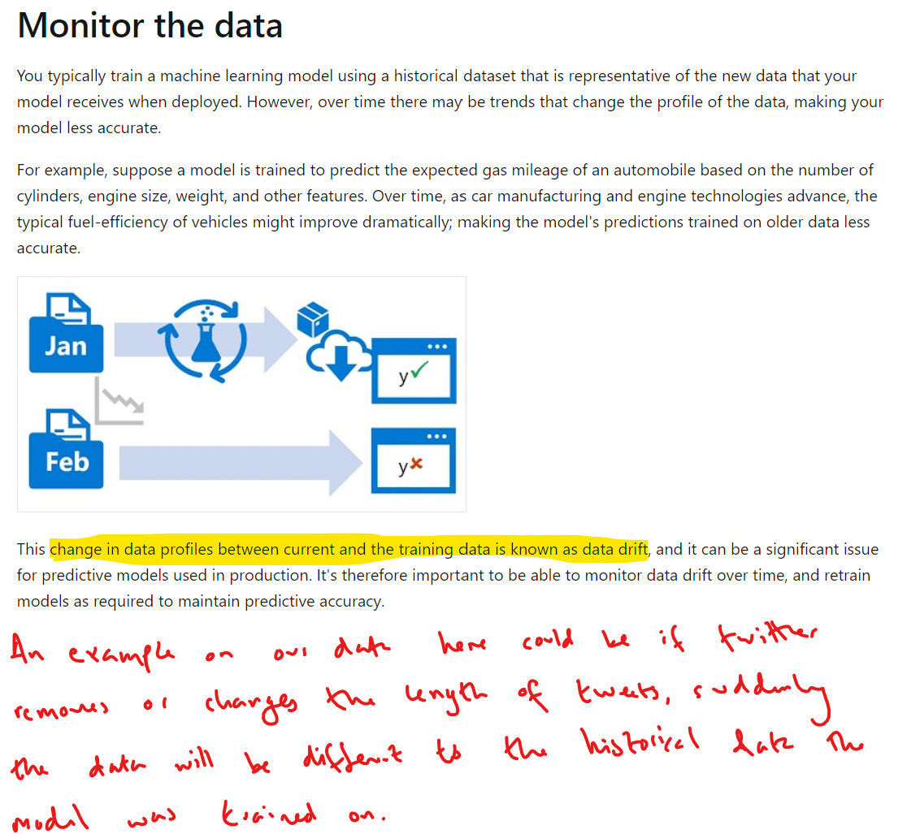
DP-100 Microsoft Azure Data Science
Microsoft Azure Data Science: Design a machine learning solution
Date: 18/10/24
Monitoring the Model
“In essence, monitoring data drift can give you insights into potential issues before they affect model performance, while monitoring model performance drift helps you catch issues that might have already impacted the model.”
“Model performance drift, on the other hand, refers to changes in the model's performance over time. This can be due to data drift, but also other factors like changes in the model's environment or the relationships between input features and the target variable”

Slide 9
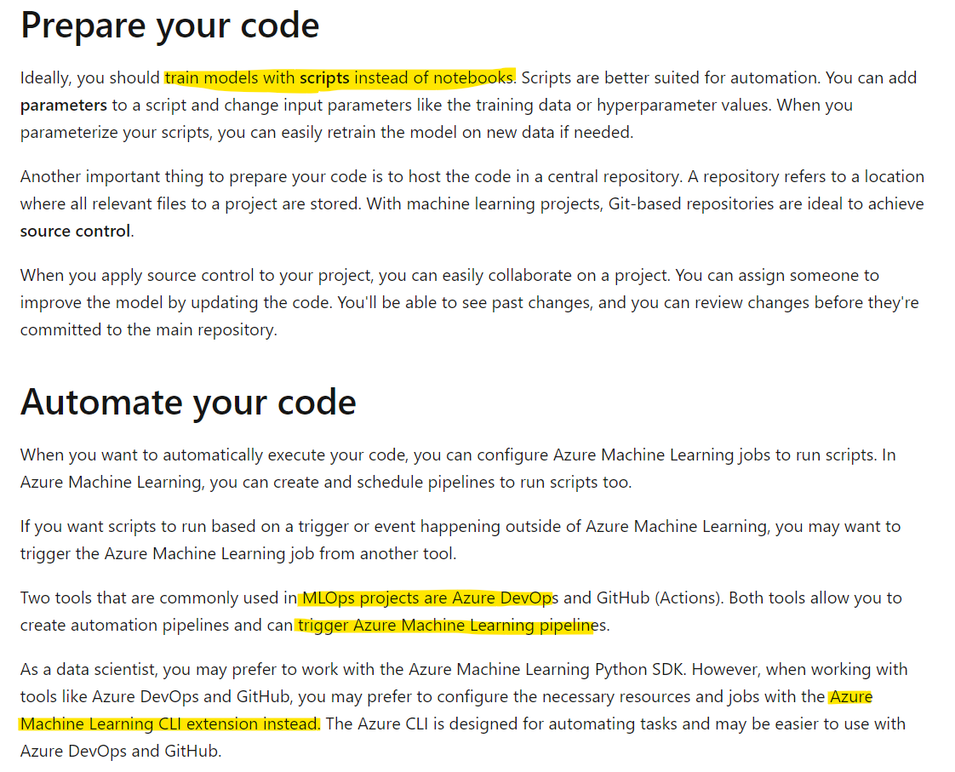
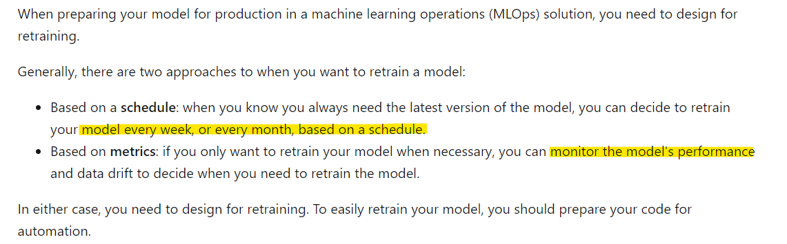
DP-100 Microsoft Azure Data Science
Microsoft Azure Data Science: Design a machine learning solution
Date: 18/10/24
Model Retraining Approaches

Slide 10
DP-100 Microsoft Azure Data Science
Microsoft Azure Data Science: Design a machine learning solution
Date: 18/10/24
Bonus Section on Containerisation & VMs
The key difference between containers and VMs is containers share the underlying hardware via a shared OS kernel, whereas VMs split up the hardware on a single machine or server, such that the allocated resource to a single VM cannot share with another VM.
Container 1
OS A
Container 2
OS B
Container 3
OS A
VM 1
OS A
VM 2
OS B
VM 3
OS C
Kernel
(Sometimes referred to as OS kernel)
Single machine or server with hardware split between VMs
Hardware
(CPU, GPU, RAM)
Hardware
(CPU, GPU, RAM)
Hardware
(CPU, GPU, RAM)
Hardware
(CPU, GPU, RAM)
https://www.ibm.com/topics/containerization

Slide 11
DP-100 Microsoft Azure Data Science
https://learn.microsoft.com/en-us/training/paths/explore-azure-machine-learning-workspace/
Section 2
Explore the Azure Machine Learning Workspace

Slide 12
DP-100 Microsoft Azure Data Science
Microsoft Azure Data Science: Explore the Azure Machine Learning Workspace
Date: 18/10/24
Text

Slide 13
DP-100 Microsoft Azure Data Science
https://learn.microsoft.com/en-us/training/paths/automate-machine-learning-model-selection-azure-machine-learning/
Section 3
Experiment with Azure Machine Learning

Slide 14
DP-100 Microsoft Azure Data Science
Microsoft Azure Data Science: Experiment with Azure Machine Learning
Date: 18/10/24
Text

Slide 15
DP-100 Microsoft Azure Data Science
https://learn.microsoft.com/en-us/training/paths/use-azure-machine-learning-pipelines-for-automation/
Section 4
Optimize model training with Azure Machine Learning

Slide 16
DP-100 Microsoft Azure Data Science
Microsoft Azure Data Science: Optimize model training with Azure Machine Learning
Date: 18/10/24
Text

Slide 17
DP-100 Microsoft Azure Data Science
https://learn.microsoft.com/en-us/training/paths/manage-review-models-azure-machine-learning/
Section 5
Manage and review models in Azure Machine Learning

Slide 18
DP-100 Microsoft Azure Data Science
Microsoft Azure Data Science: Manage and review models in Azure Machine Learning
Date: 18/10/24
Text

Slide 19
DP-100 Microsoft Azure Data Science
https://learn.microsoft.com/en-us/training/paths/deploy-consume-models-azure-machine-learning/
Section 6
Deploy and consume models with Azure Machine Learning

Slide 20
DP-100 Microsoft Azure Data Science
Microsoft Azure Data Science: Deploy and consume models with Azure Machine Learning
Date: 18/10/24
Text

