Slide 1
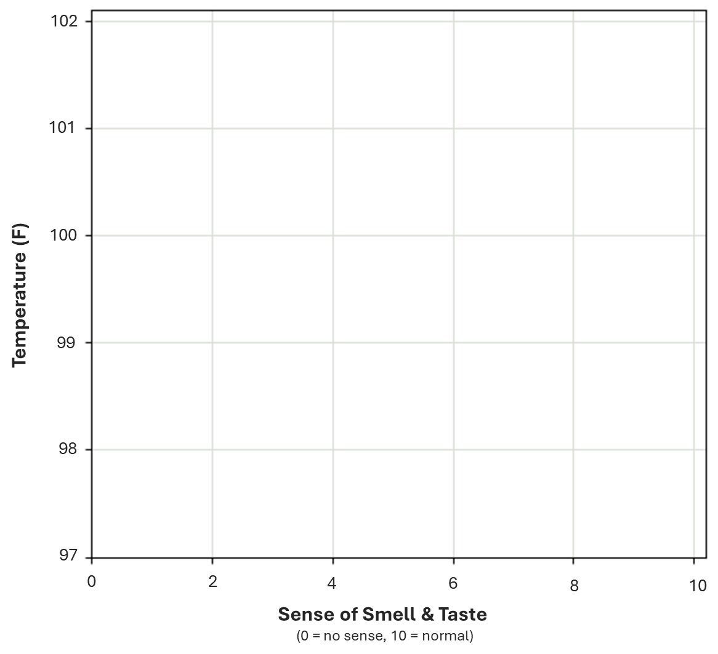
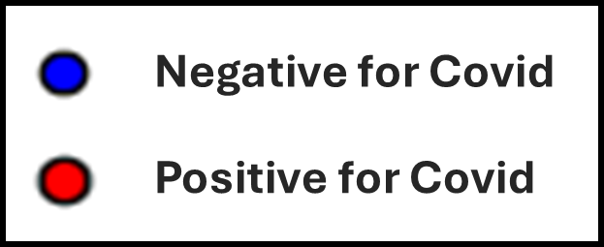
Prediction 1
Temperature = 101
Sense of smell = 4
Input
Hidden Layer
Output Layer
4
w1 = -0.8
0.85
0.8
w3 = 4
101
w2 = 0.05
b1 = -1
b2 = -2

Slide 2
Prediction 2
Temperature = 98.5
Sense of smell = 7
Input
Hidden Layer
Output Layer
7
w1 = -0.8
-1.68
0
w3 = 4
98.5
w2 = 0.05
b1 = -1
b2 = -2

Slide 3
Prediction 3
Temperature = 100
Sense of smell = 8
Input
Hidden Layer
Output Layer
6
w1 = -0.8
-0.8
0.01
w3 = 4
100
w2 = 0.05
b1 = -1
b2 = -2

Slide 4
Prediction 4
Temperature = 100
Sense of smell = 3
Input
Hidden Layer
Output Layer
3
w1 = -0.8
1.6
0.98
w3 = 4
100
w2 = 0.05
b1 = -1
b2 = -2

Slide 5
Prediction 5
Temperature = 99
Sense of smell = 2.5
Input
Hidden Layer
Output Layer
2.5
w1 = -0.8
1.95
1
w3 = 4
99
w2 = 0.05
b1 = -1
b2 = -2

Slide 6
Prediction 6
Temperature = 99.5
Sense of smell = 8.5
Input
Hidden Layer
Output Layer
8.5
w1 = -0.8
-2.83
0
w3 = 4
99.5
w2 = 0.05
b1 = -1
b2 = -2

Slide 7
Prediction 7
Temperature = 98
Sense of smell = 8
Input
Hidden Layer
Output Layer
8
w1 = -0.8
-2.5
0
w3 = 4
98
w2 = 0.05
b1 = -1
b2 = -2

Slide 8
Prediction 8
Temperature = 101
Sense of smell = 2
Input
Hidden Layer
Output Layer
101
w1 = -0.8
2.45
1
w3 = 4
2
w2 = 0.05
b1 = -1
b2 = -2

Slide 9
Prediction 9
Temperature = 99.5
Sense of smell = 1
Input
Hidden Layer
Output Layer
99.5
w1 = -0.8
3.18
1
w3 = 4
1
w2 = 0.05
b1 = -1
b2 = -2

Slide 10
Prediction 10
Temperature = 99.5
Sense of smell = 7
Input
Hidden Layer
Output Layer
99.5
w1 = -0.8
-1.63
0
w3 = 4
7
w2 = 0.05
b1 = -1
b2 = -2

Slide 11

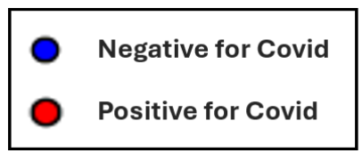
102
101
100
Temperature (F)
99
98
97
0
2
4
6
8
10
Sense of Smell & Taste
(0 = no sense, 10 = normal)

Slide 12
Negative for Covid
Positive for Covid

