Slide 1
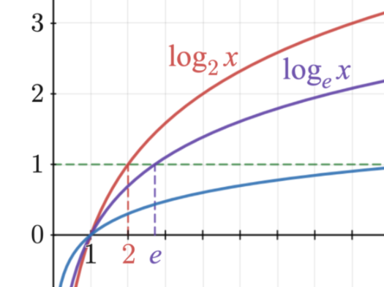
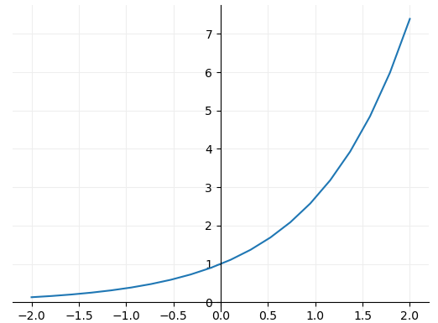

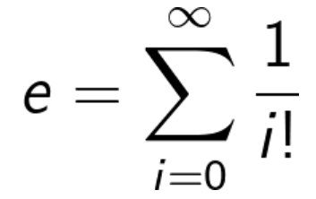
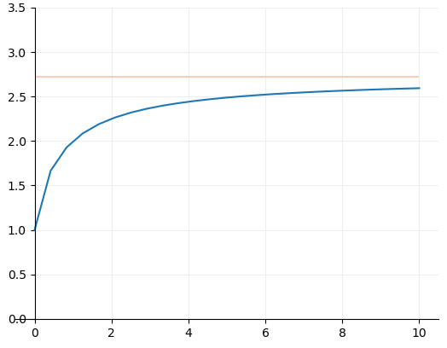

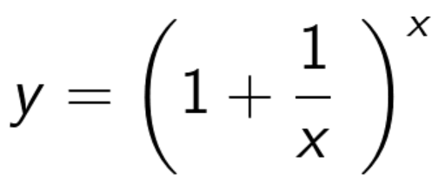
Graph Database
General Functions
Exponential
What's so special about Euler's Number?
Euler originally defined e through calculating the first 15 components of the following summation:
In fact, there are many ways of calculating the value of e, but none of them ever give a totally exact answer, because e is irrational, and its digits go on forever without repeating. It can be defined to 10 significant figures as the following:
e = 2.7 1828 1828
https://www.mathsisfun.com/numbers/e-eulers-number.html#:~:text=It%20is%20often%20called%20Euler's,so%20is%20worth%20learning%20about.

Slide 2
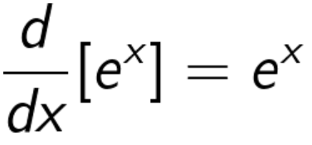
Graph Database
General Functions
Exponential
What's so special about Euler's Number?
e has many very interesting properties. The most remarkable is that the differential of e^x is e^x. That’s to say when:
If that value of e was any larger the derivative would be larger than e^x and if it were any smaller the derivative would be smaller.

Slide 3
Graph Database
General Functions
Logarithmic

Slide 4
Graph Database
General Functions
Natural Logarithmic

Slide 5
Graph Database
General Functions
Composite Functions

Slide 6
Graph Database
Loss Functions
Cross-Entropy

Slide 7
Graph Database
Activation Functions
Sigmoid

